Slide 1
Scrubbing progress - 09/12/2012
G. Arduini, H. Bartosik, G. Iadarola, G. Rumolo, Cryogenics, Operation Vacuum teams
Machine Coordinators: J. Uythoven J. Wenninger

Slide 2
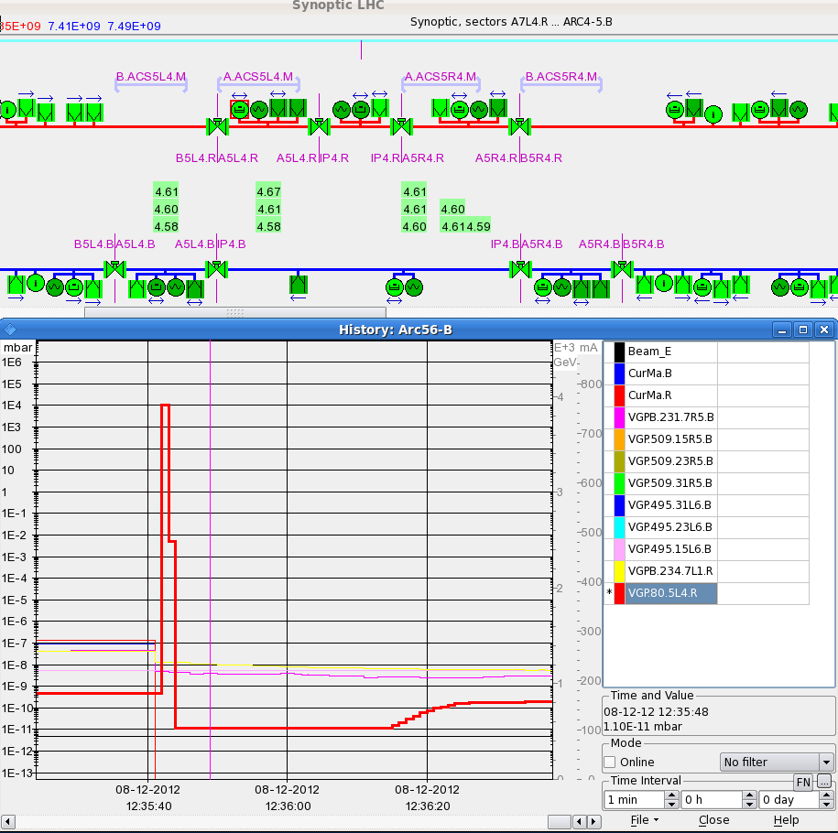
09:18 Start pre-cycle after loss of cryo conditions in matching section R8.
New regulation of the 120 A DFB cryo-cooling and investigations on the issue of the sudden loss on the cryo maintain (bug suspected)
10:36-12:34 Filling. Got to 1452 bunches/beam.
12:35 RF trip (M2B2) beam dump. Spurious interlock
VGP.80.5L4.R had an electrical glitch. Reading jumped from 10⁻¹⁰ mbar to 1000 mbar in 1 sec then switch on again.
More redundancy?
No loss of cryo maintain likely due to the lower intensity/heat load

Slide 3
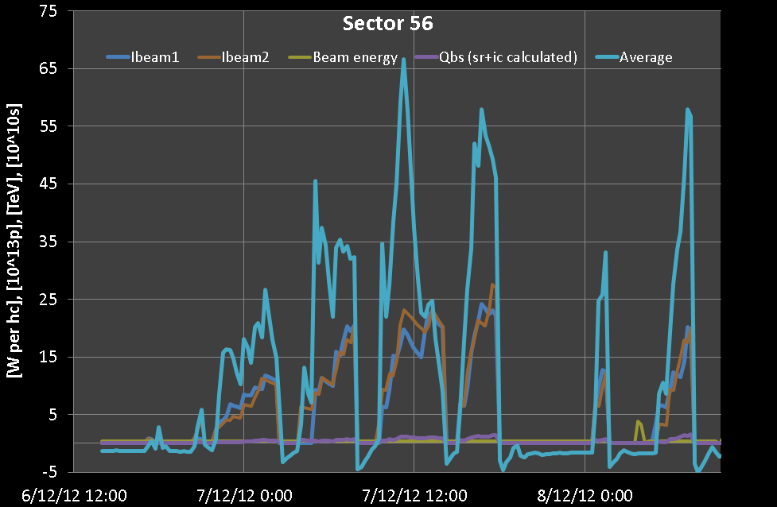
Heat load evolution: still no significant reduction
L. Tavian, G. Iadarola

Slide 4
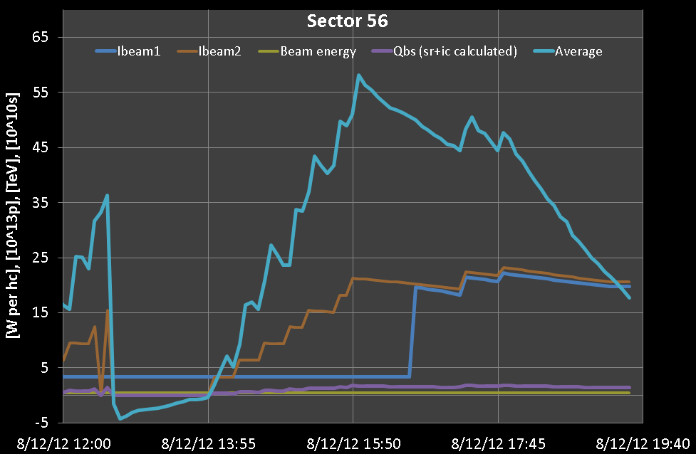
13:43 Start fill again
15:49 2028 Bunches/beam. Stop here for a while.
17:20 Restart filling up to 2460 bunches/beam
Reduction of the heat load below 20 W/half-cell corresponding to <200 mW/m/aperture by 19:30 ➔ dumped beams at 19:50
L. Tavian, G. Iadarola

Slide 5
During injection of current fill TDI vacuum could be kept at a reasonable pressure level moving the TDI out after each injection. It was not done in the morning. This led to the dump in the morning yesterday. Monitoring of the vacuum at TDI and TCTV BLM R8 on long running sums.
A. Lechner

Slide 6
Another fill over night until 3 AM:
Up to 2740 bunches.
Loss of cryo maintain after the dump. Temporary fix to be tested for next dump (forcing one of the temperature data 120 A Q6.R8 at the moment of dump)

Slide 7
Unexplained (likely not due to electron cloud) blow-up at the end of first train and beginning of the following ones. Some measurements taken with shorter trains with large spacing. To be investigated today.
B1V
B2H
B2V

Slide 8
B1V
B2H
B2V

Slide 9
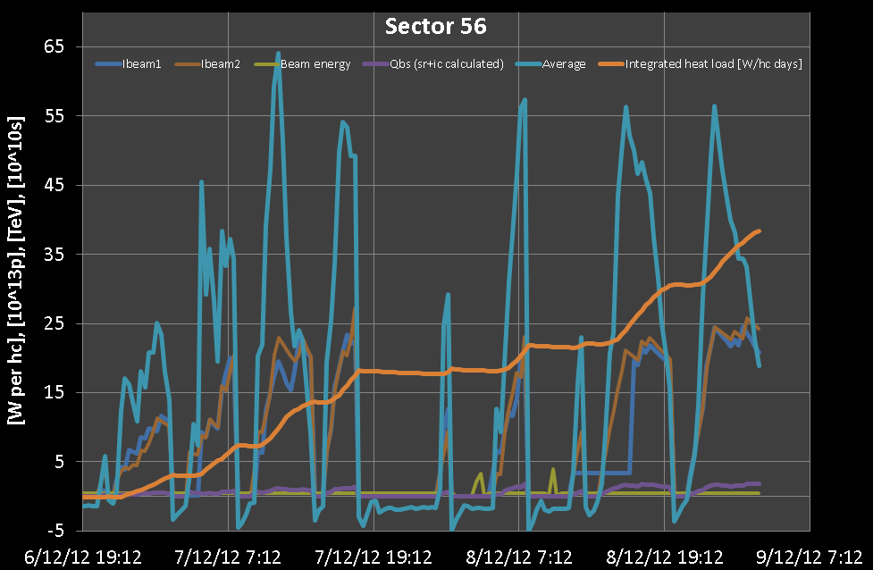
05:45 – new fill (lost 1 hour for POPS problem).
H. Bartosik, L. Tavian

Slide 10
Lifetime evolution

Slide 11
Plan
Keep on scrubbing at 450 GeV
Request of access:
ATLAS (water leak)
lost the communication with QPS DQAMC of B19L5
➔ tomorrow morning

