Slide 1
Scrubbing progress - 08/12/2012
G. Arduini, H. Bartosik, G. Iadarola, G. Rumolo, Cryogenics, EN-STI, Operation, Vacuum teams
Machine Coordinators: J. Uythoven J. Wenninger

Slide 2
07:52 2748 bunches (B1) – 2316 (B2)
Beam dump due to BPM LSS6 (low intensity on some of the bunches due to losses

Slide 3
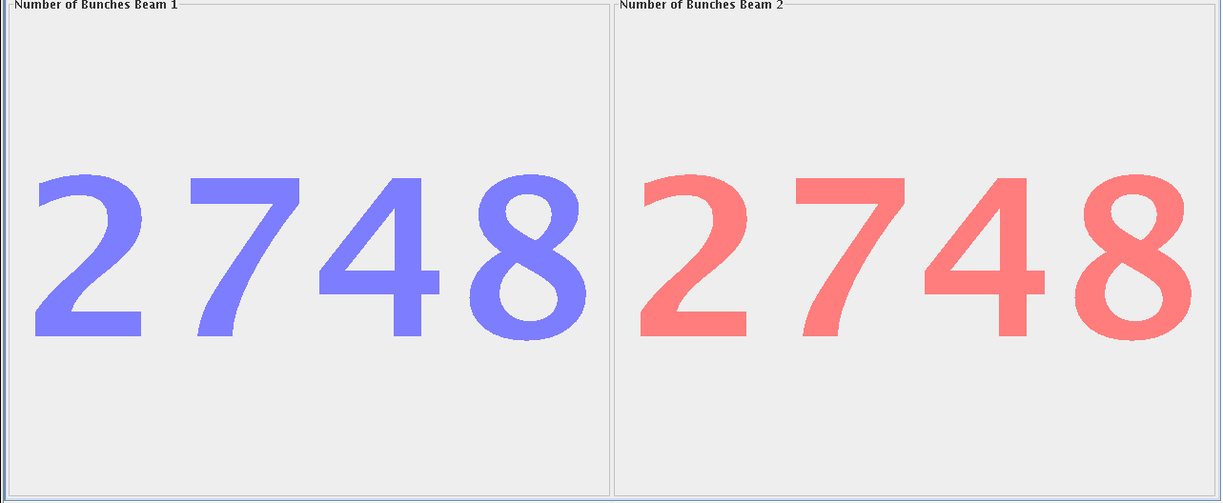
13:01: Machine full!

Slide 4
Very good progress but still emittance blow-up and losses. BSRT B1 now working (acquisition problem fixed – before averaged emittance instead of bunch by bunch emittance)
16.5 μm
3.3 μm

Slide 5
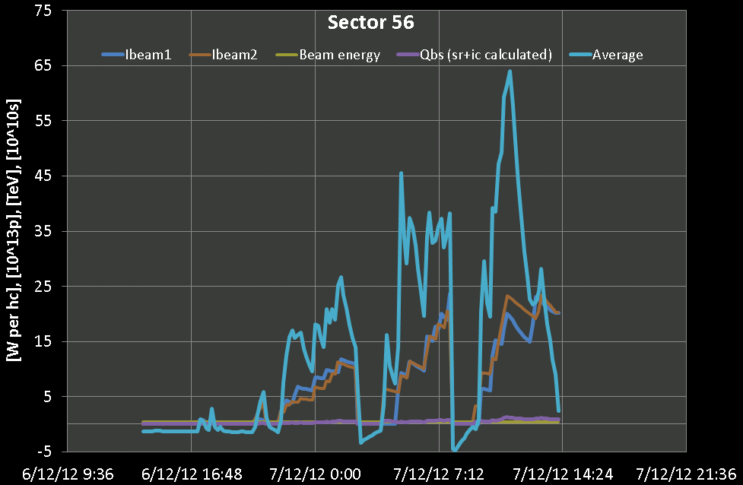
14:06 OP dump to refill as heat load decreasing as no more efficient scrubbing after peak of ~650 mW/m/aperture!!
L. Tavian, G. Iadarola

Slide 6
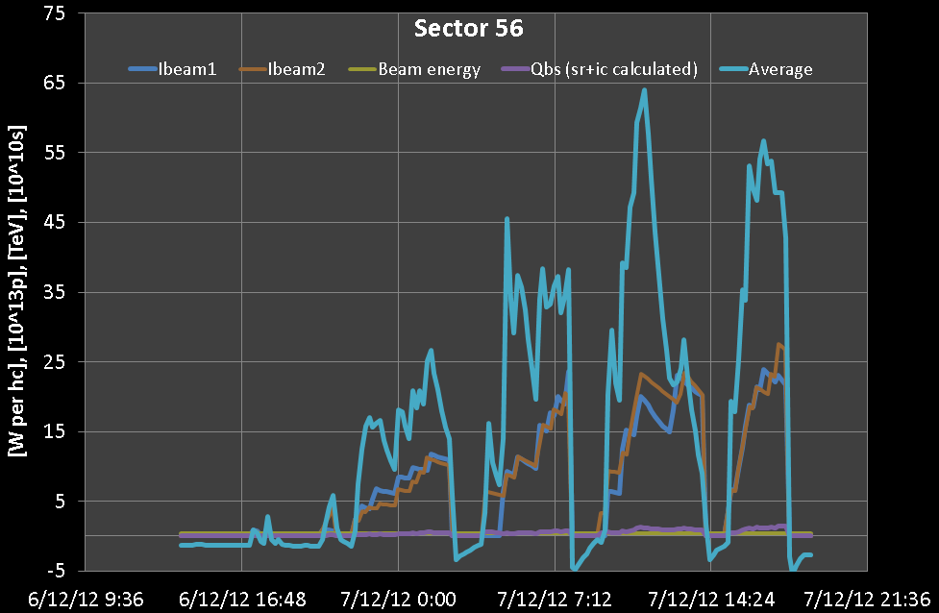
14:30-17:53: Filling again with trains of 288 bunches up to 2460-2748 bunches. Beam dump due to ALICE trigger (UFO like event on the left side of ALICE).
Pressure rise above 10⁻⁷ mbar on TDI even if retracted after every injection. More than 2.7x10¹⁴ p on B2, 2.3×10¹⁴ p on B1 (new record)
Slight reduction in arc heat load. Sign of scrubbing?
L. Tavian, G. Iadarola

Slide 7
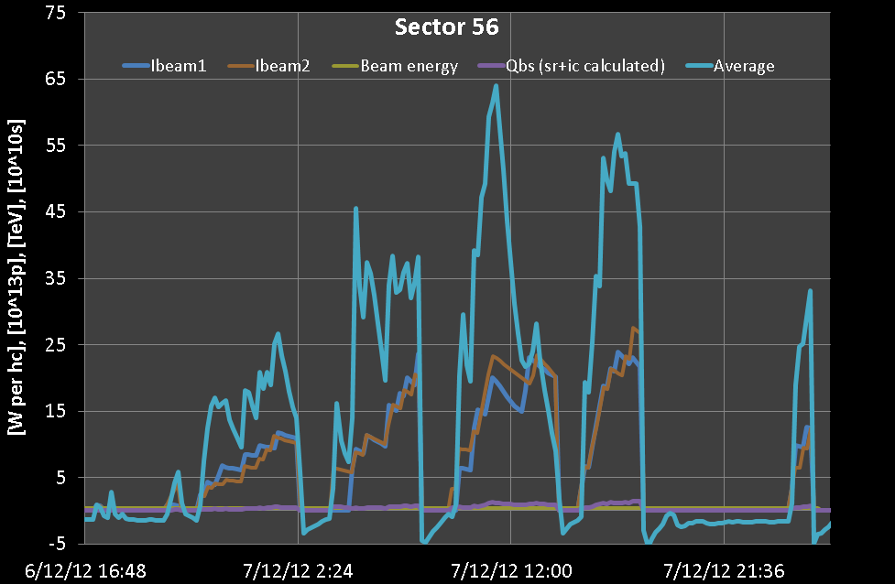
18:00 Few mins after ALICE dump lost cryo conditions in Sector 81 matching section (fluctuations on 120 A current lead temperature – current lead “overcooling”)
22:45 Finally found regulation allowing to keep 120 A current lead temperature under control. Pre-cycle.
01:31 Injected up to 1164 bunches lost cryo conditions in the matching section R8. Still quite some activity visible
04:30 Start all over again…

Slide 8
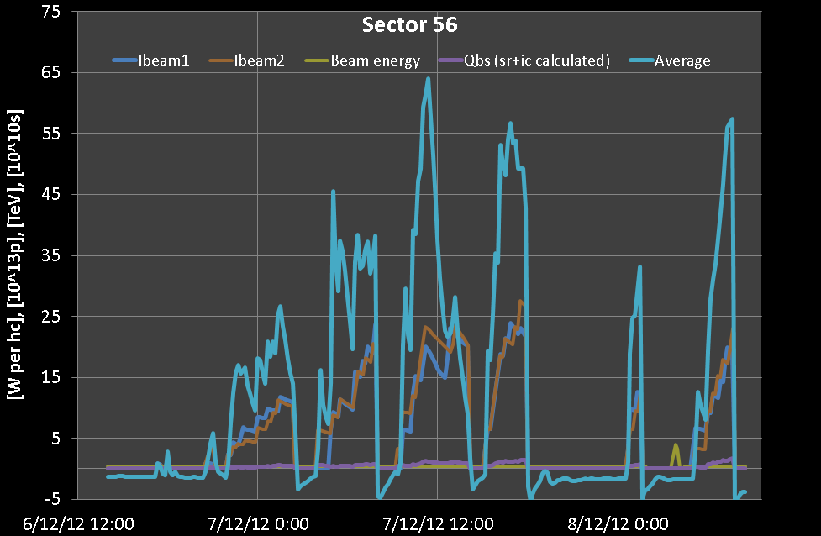
Got to 2028/2460 bunches dumped by losses on TCTVB.R8 (likely vacuum at TDI which is close to it)
Few mins after lost the cryogenics conditions in point 8 MSR8. Cryo team checking

Slide 9
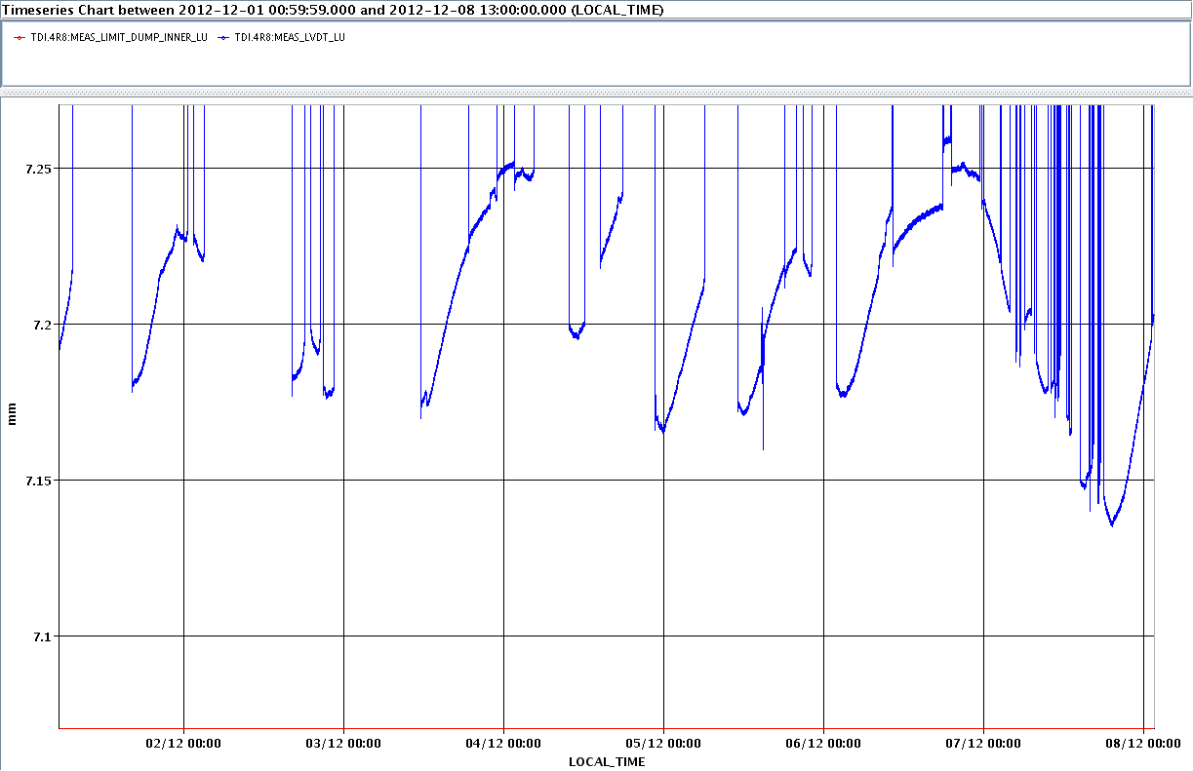
Potential limitations: TDI
TDI 4R8: There is a visible drift of some LVDT position readings (particularly left upstream - LU) since the first higher intensity 25 ns fill yesterday (06/12/12, 22:00). Peak yesterday evening at ~18:00. Indication of heating and deformation of the jaws.
TDIs is moved out after every injection.
A. Lechner

Slide 10
Limitations: TDI
TDI outgassing likely due to heating producing higher loss rates at TCTVB (close or above threshold – e.g. last dump) ➔ limit total intensity in order to keep fill longer

Slide 11
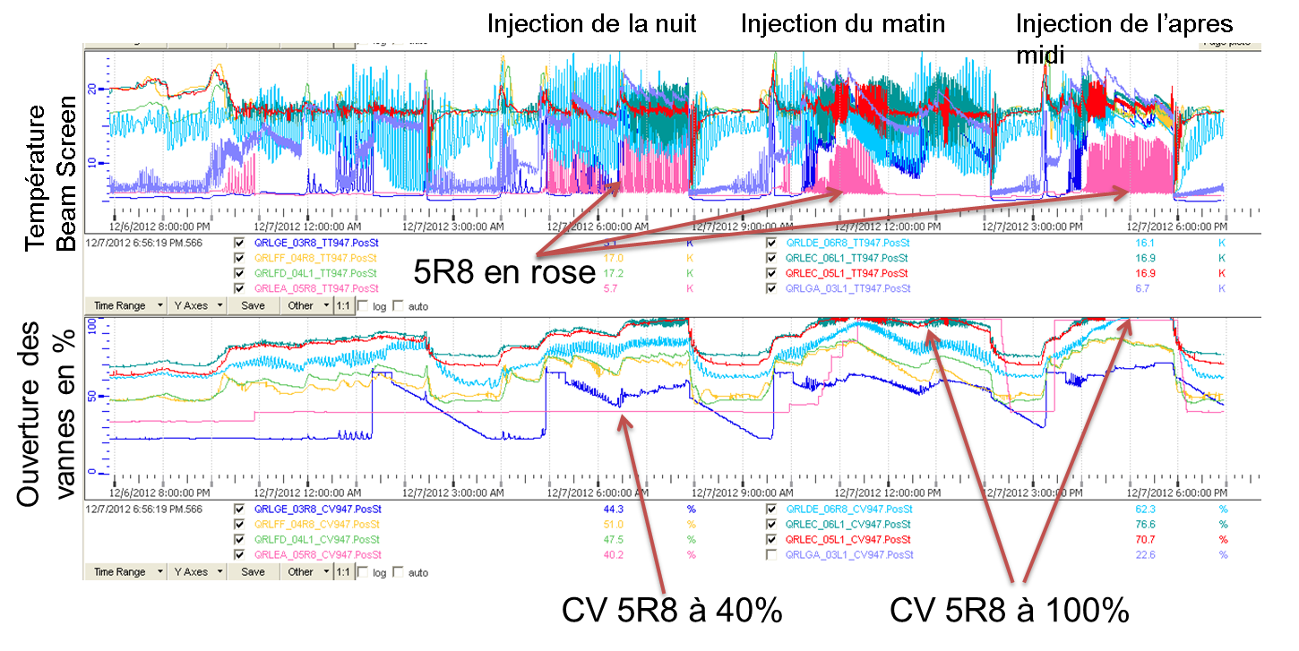
Limitations: cryogenics
Limitation on the cooling of the beam screens of the stand-alone magnets and of some areas in point 6 and 8 where limited cooling power. This is presently limiting the pace of the filling process.
Cryo team

Slide 12
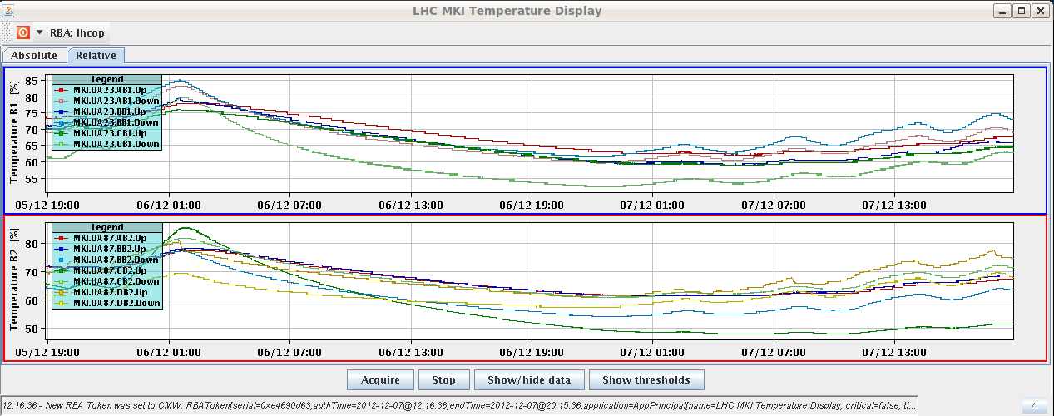
Limitations: MKI
MKI has limited the scrubbing rate at the beginning. Not a limit now after increase of the pressure interlocks at the interconnects between MKID and Q5 from 1.5x10⁻⁸ to 4x10⁻⁸ mbar (M. Barnes). Extended soft starts during long stops due to cryogenics. Some activity on the temperature front during the afternoon evening.

Slide 13
Plan
Keep on scrubbing at 450 GeV
Considering option of ramps at 4 TeV for tomorrow according to evolution of the heat load which is still high (profiting of the BCMS 25 ns beam which is now available from PS)

Slide 15
New record intensity at 450 GeV

Slide 16
UFO observations (preliminary)
121 MKI UFOs so far (all below 1% of BLM dump threshold). About 70 of these at MKI.B5R8. With 50ns, below <30 MKI UFOs would have been expected.
ARC UFOs: Beam 1: 3 arc UFOs in 9h15m with >1E14p. -> about 0.32 UFOs/hour Beam 2: 3 arc UFOs in 9h36m with >1E14p. -> about 0.31 UFOs/hour
throughout 2012 with 50ns at 450GeV: Beam 1: 2 arc UFOs in 50h with >1000b -> about 0.04 UFOs/hour Beam 2: 4 arc UFOs in 36.5h with >1000b -> about 0.11 UFOs/hour Conclusion: Increased activity of MKI UFOs, particularly at MKI.B5R8, but amplitudes are far below BLM dump thresholds. For arc UFOs the statistics is extremely low, but could indicate an increased UFO activity with 25ns.
T. Baer

