Slide 1
Thursday - setup
10:00 Starting pre-cycle.
RCBH18.L7B1 has FCGC problem – removed from active set.
11:30 Injection.
A few issues with the OFB that seems to use a strange set of correctors – problem of masks – refresh had to be enforced
ADT setup starting.
15:00 ADT setup finished with single bunches. Starting setup for 25 ns with 12b injections.
Injection lines and ADT.
17:00 72b injections. Beam unstable with Q’ ~ 2. Increased Q’ by 10 units.
17:30 First injections of 144b – dumped after few turns.

Slide 2
Thursday - setup
17:30 First injections of 144b – dumped after few turns. Increase Q’ to ~15.
18:00 ADT setup for 25 ns:
Transfer functions checked. Only minor changes.
ADT to remain in wide-band mode.
18:30 Injection of 216b becoming unstable at injection.
19:30 Injection of 288b becoming unstable just after injection.
20:00 Injections up to 288b are ‘clean’, but the beams do not stay in…

Slide 3
Thursday - scrubbing
20:30 Scrubbing with 72b per beam.
21:20 SIS injection interlock on Wire Positioning System (WPS) L5. Problem on the FEC (power supply).
22:00 Hitting vacuum limit on MKI interconnects (1E-8) for B2.
23:30 Interlock on interconnects vacuum increased to 1.5E-8.
TDI LVDT out of tolerance (~20 um only!). Back ok after a cycle.
02:20 Injection of 288b.
02:30 Dump – TDI vacuum reaching 1E-7 – heating.

Slide 4
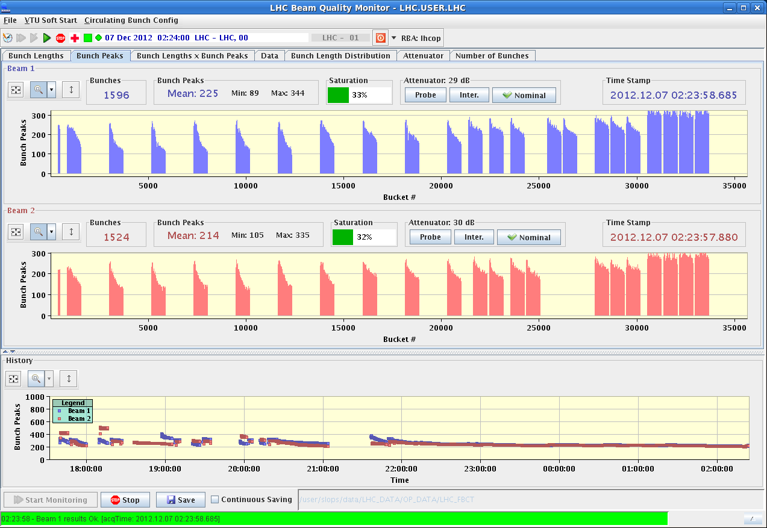
LHC scrubbing run (day 1)
Beam lifetime improvement observed after injection of ~7 trains (both Beam 1 and 2), it then got better and better during the fill
Decision to inject trains closer to each other (925ns spacing), then move gradually to injections of trains of 144, 216 and finally 288 bunches
1596
1524
Pattern of bunch lengths follows that of bunch-by-bunch intensity

Slide 5
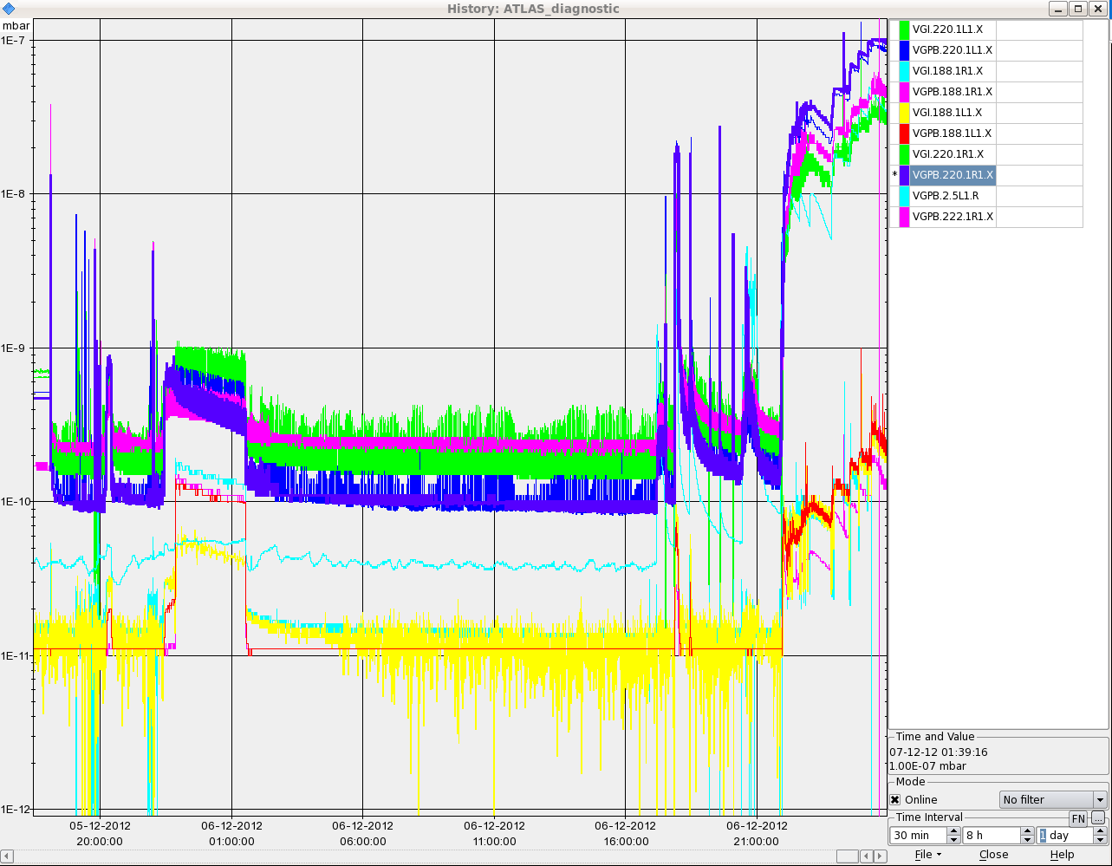
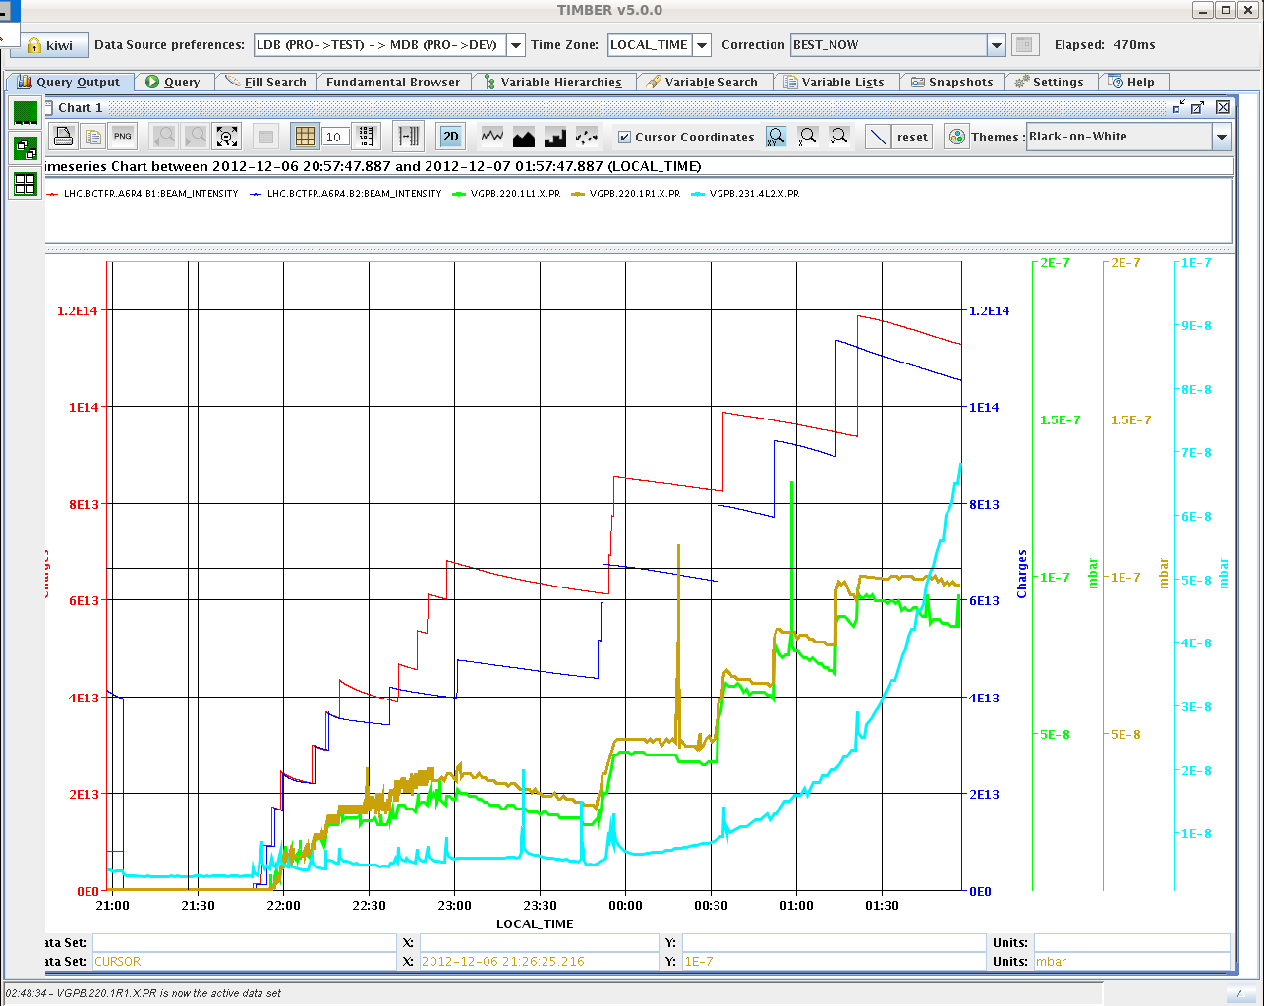
LHC scrubbing run (day 1)
Limiting factors encountered during the fill 3389:
Pressure in the MKI interconnects, M. Barnes raised the thresholds a few times
After moving TDI jaws out, some secondary LVDTs are beyond limits for both TDIs (this happened twice, but due to bad configuration of the tool – not a problem because due to heating)
Pressure rise in ATLAS (interlock value 4e-7mbar, 1e-7mbar reached!). CMS does not exhibit any pressure rise, but they have the experimental solenoid on.
Vacuum at TDI.4L2 rising (VGPB.231.4L2.X.PR), caused manual dump of fill 3389 ➔ decision for next fill to keep TDI in IR2 open when filling Beam 2 and TDI in IR8 open when filling Beam 1 + move both out whenever possible

Slide 6
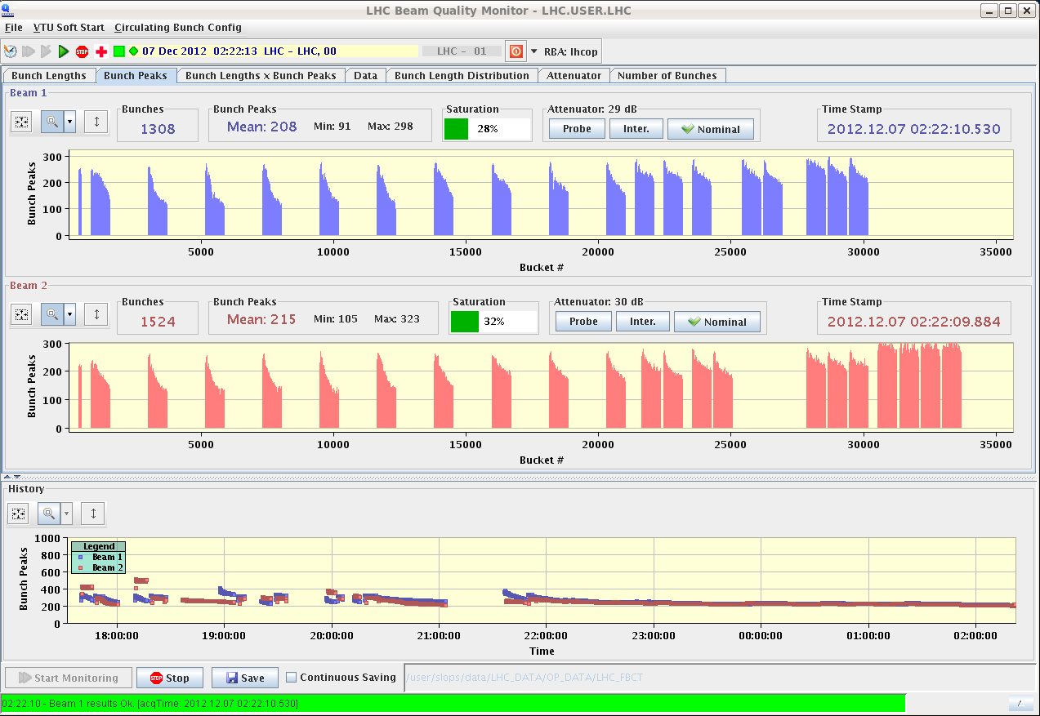
First injection of 288b
Losses improving a lot…

Slide 7
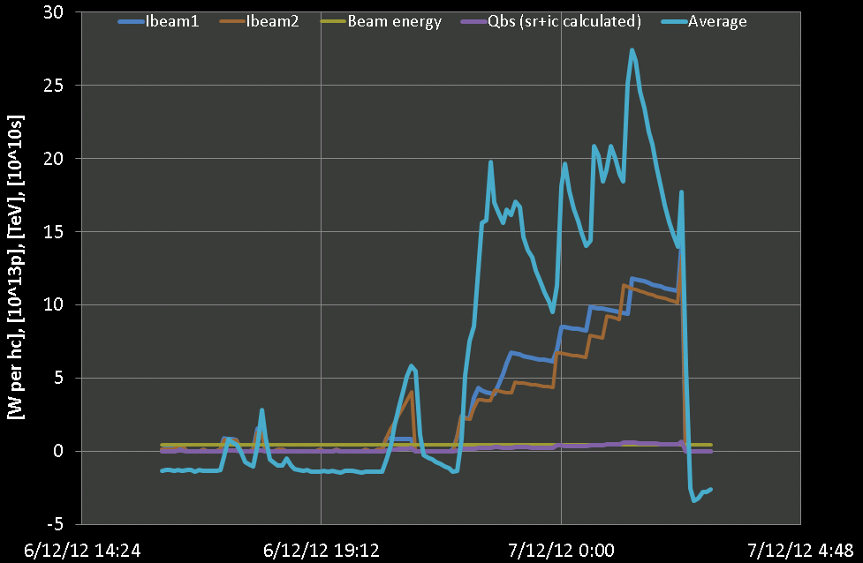
LHC scrubbing run (day 1)
Heat load in Sector 56 during fill 3389:
Peak value ~28 W/hc to be compared with ~40 W/hc, maximum value reached during 25ns scrubbing in 2011

Slide 8
LHC scrubbing run (day 1)
Summary of lifetimes of Fill 3389
Clear improvement for last trains injected
Low and slow losses on trains of 288 bunches injected!!
Beam1
Beam2

Slide 9
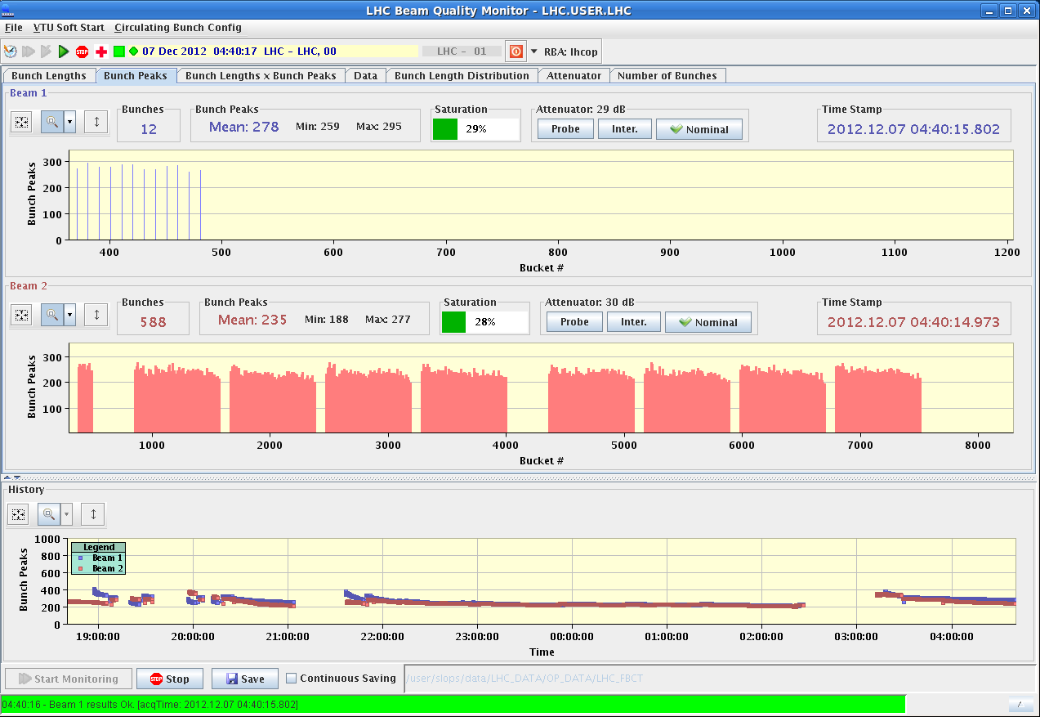
LHC scrubbing run (day 1)
Fill 3390 → Train of 288 bunches for both Beam 1 and Beam 2, started at about 3:45 after ~1h vacuum recovery
Chroma set to 6-7 from the beginning, remeasured with pilots in
Injected first two trains for Beam 2, then stop for ~45’ due to MKI interconnect vacuum interlock + RF problem in Ring 4 of the PSB. Good lifetime!

Slide 10
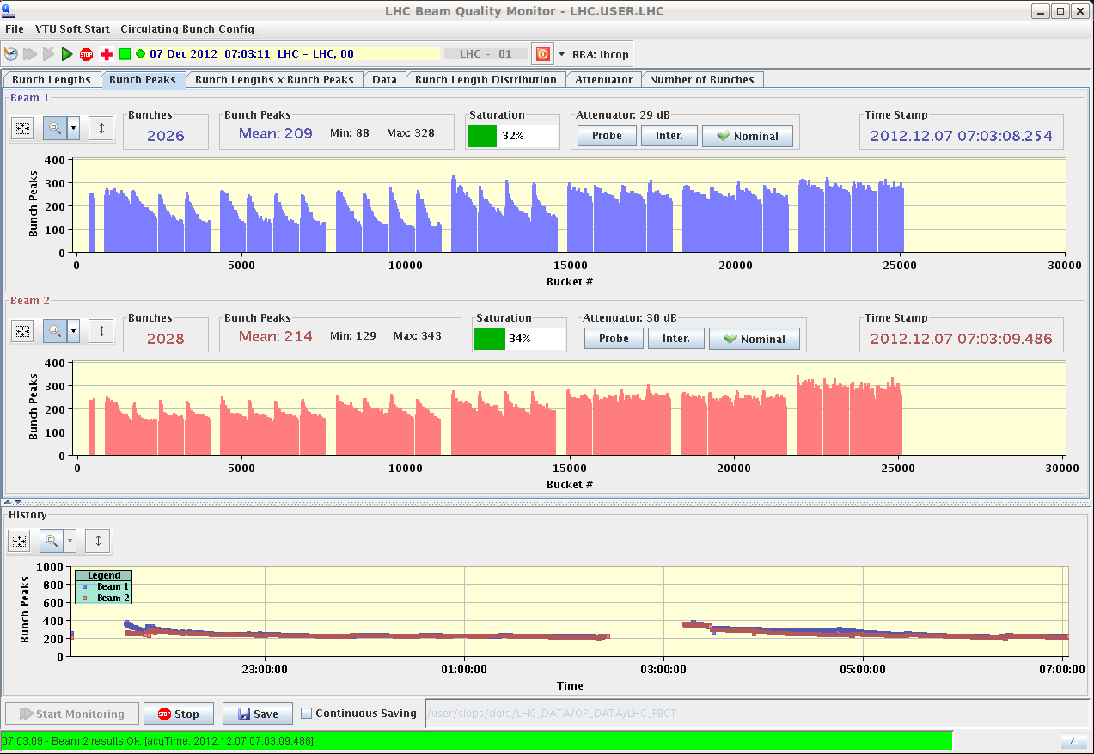
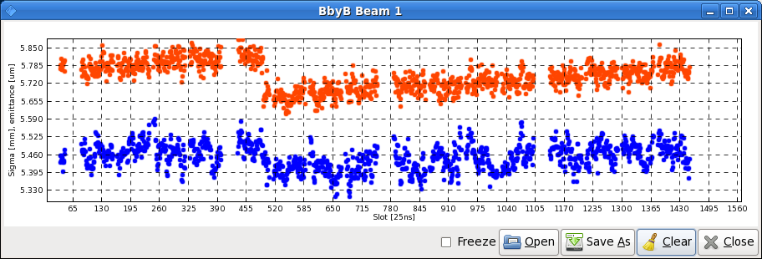
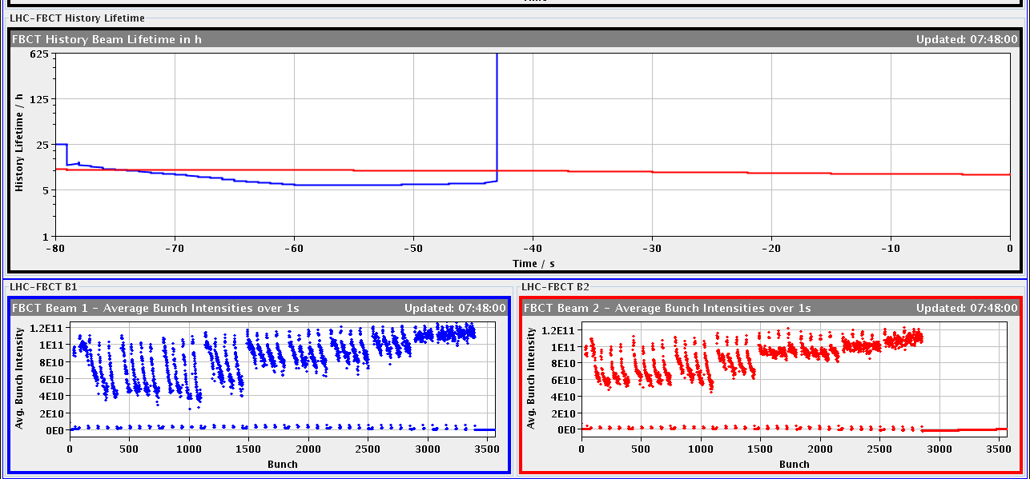
LHC scrubbing run (day 1)
Filled with 4 trains per beam, then stopped for a long while due to the high vacuum in ATLAS (above 2e-7mbar!). Possible to inject more after slightly increasing the threshold
Also strong heating in Sectors 45 and 78
Machine finally full (beam 1)!
2316
2740

Slide 11
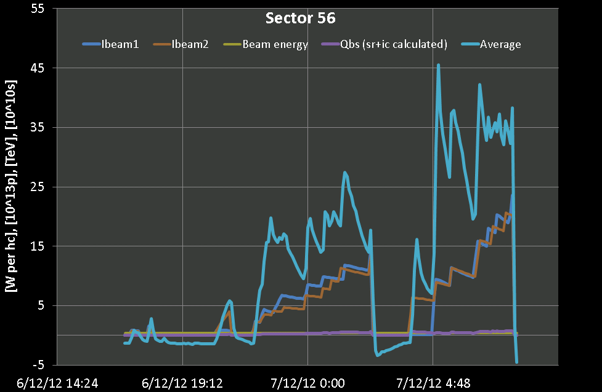
LHC scrubbing run (day 1)
Heat load in sector 56
Higher values than ever last year
Kept high throughout the fill, ensuring scrubbing efficiency
Dumped because of BPMs in IR6, i.e. bunches at the end of trains below detection threshold

Slide 12
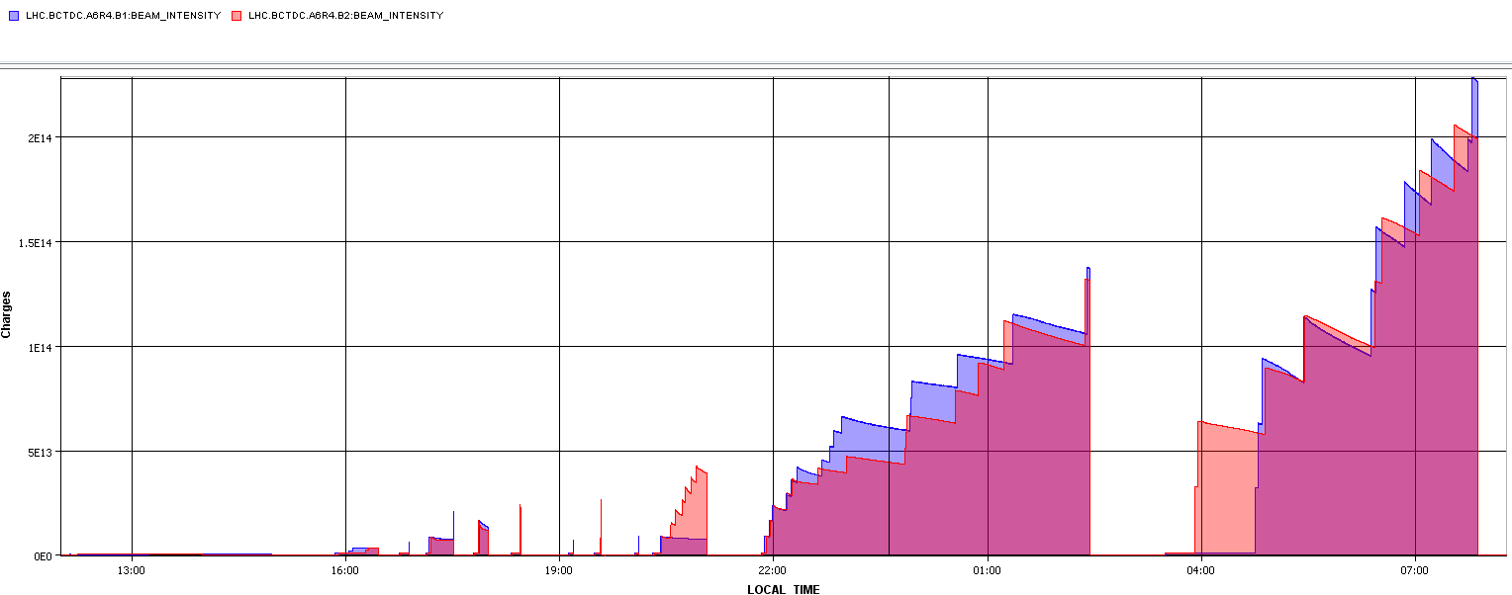
Intensity evolution

