Slide 1
LHC – Progress with Beam
Coordination:
Week 48: G. Arduini, E.B. Holzer
MD Coordination: F. Zimmermann, G. Papotti

Slide 2
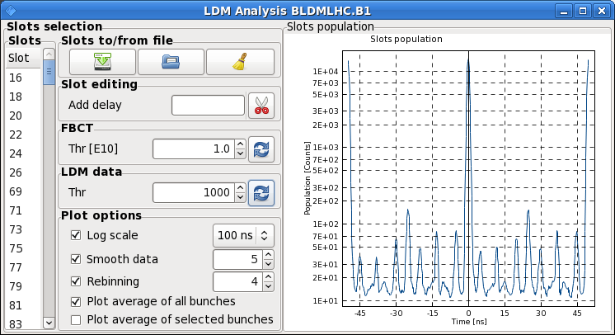
Sunday 2.12.
3:55 – 16:05 stable beams fill 3360 (OP dump)
Increasing satellites for ALICE
Injection losses at LHCb mostly around 30-40% of dump threshold
Losses at start of ramp up to 41%
B1: 1 %

Slide 3
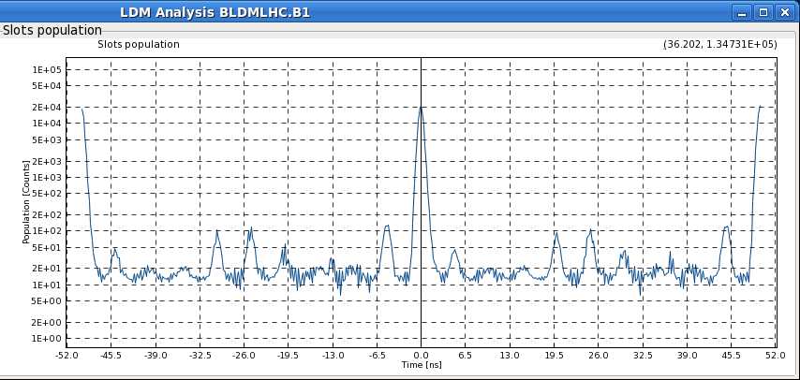
Satellites B1: Comparison to previous Fills
Fill 3345-3346: 0.25 %
Fill 3350 - 3360: 0.5 %

Slide 4
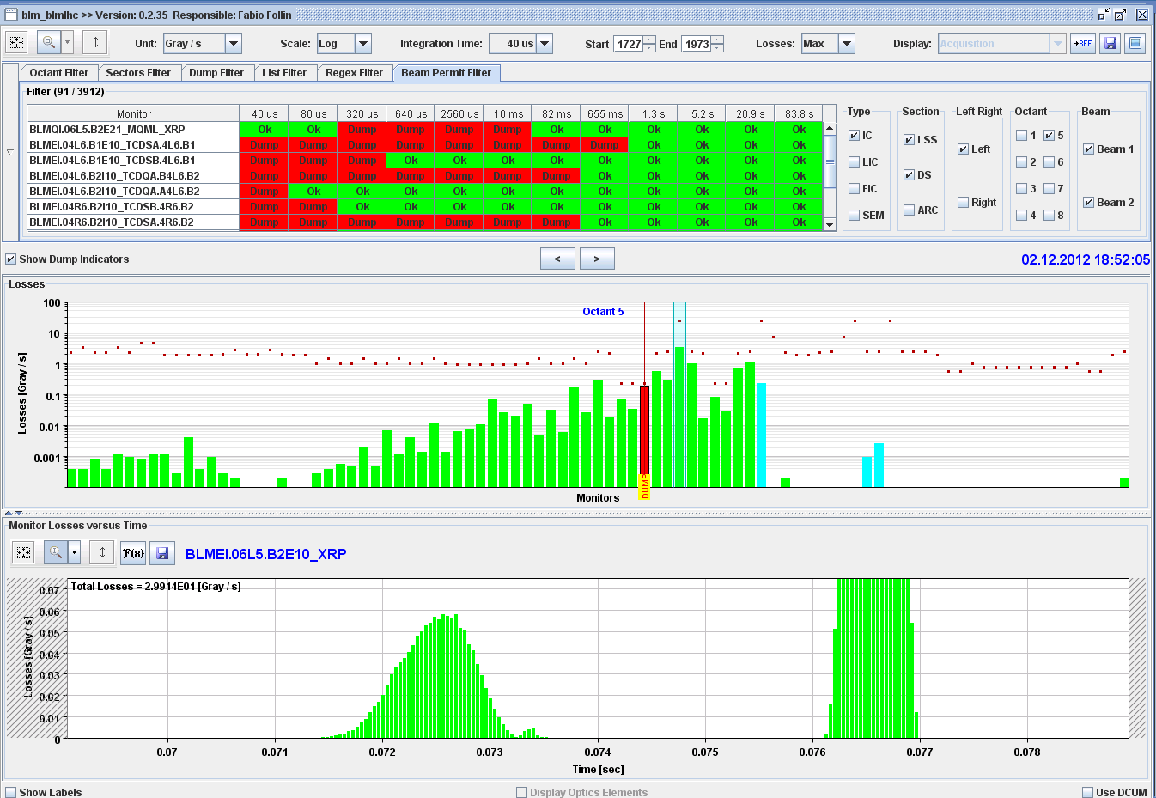
Two dumps by Losses – Dump 1
Sun 18:52 beam dump in Adjust: UFO like loss (~0.6ms long) at BLMQI.06L5.B2E21_MQML_XRP
Precursor losses: 5.5ms earlier; ~2% of loss rate; ~1.5ms long

Slide 5
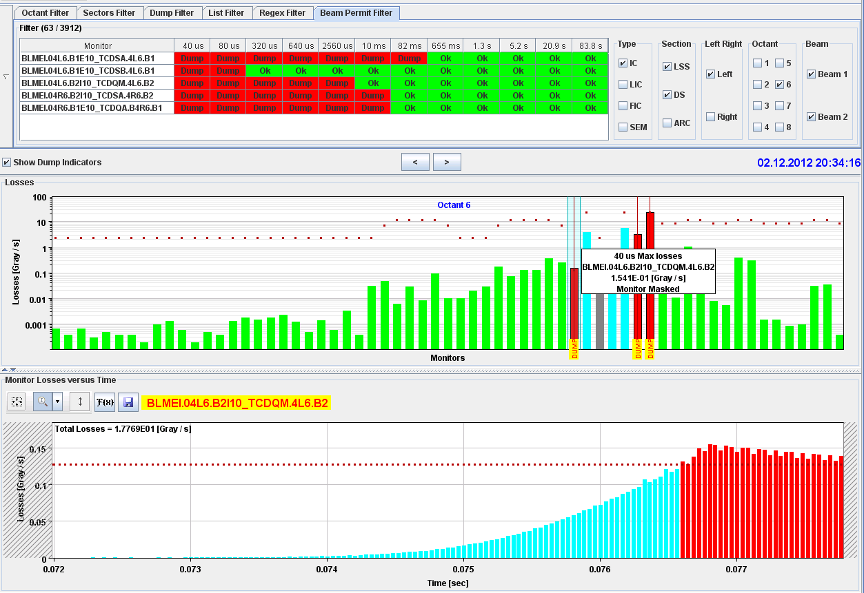
Two dumps by Losses – Dump 2
Sun 20:34 beam dump during Ramp
Loss B2 (possibly a long UFO, rising for 3ms) starting in cell 4L6 triggering BLM on TCDQM.4L6
Satellite enhancement reversed again and re-filling
23:27 stable beam fill 3363

Slide 6
Fills with stable beams week 48
0.7 fb-1 produced in 4 days
~35% of time in stable beams excluding the MD times
Fill | Day | Peak lumi ATLAS/CMS [10³³ cm⁻²s⁻¹] | Peak lumi ALICE [10³⁰ cm⁻²s⁻¹] | Stable beam [h] | Int L [pb⁻¹] | Dump
3363 | Sun 2/12 | 7.1 | 8.3 | 8:30 + | 140+
3360 | Sun 2/12 | 7.2 | 8.4 | 12:05 | 172 | OP dump
3351 | Sat 1/12 | 6.8 | 10.1 | 07:48 | 120 | OP dump
3350 | Fri 30/11 | 6.7 | 9.2 | 07:46 | 120 | OP dump: abort gap filling because of RF problem
3347 | Thu 29/11 | 7.3 | 5.6 | 09:50 | 156 | OP dump
 | Total |  |  | 46 | 708
Notes:
133 hours total
Till 8: 46h stable beams

Slide 7
Non-physics time
Thursday:
3.5h test ramp and asynch. dump test in collision
3h IR8 aperture measurement MD
5h access: start of TED problem required strap of the corresponding interlock authorized by the DSO
3h heating studies with shorter bunches
2.5h SPS, access for RCBXH2.L5 power converter
Friday
3h Attempt of injecting high brightness beam (see extra slides)
2h access for RF problem (see extra slide)
Saturday
3.5h access attempt to temporarily disable TED in OUT position (see extra slide)
3h transfer line steering and 3 dumps by LHCb during filling due to problems with the RF and kicker settings in the PS (see extra slide)

Slide 8
Dumps due to beam losses
Sunday
Dump in adjust: Slow losses close to roman pots (MQML 6R5) during collapse of IP1/5 separation bumps (vacuum spikes)
Two dumps by UFO like losses, one in Adjust and one during the ramp

Slide 9
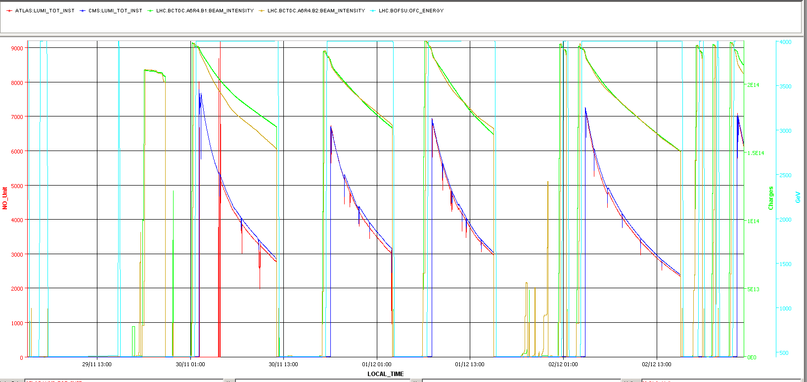
Luminosities and Intensities week 48
Integrated Luminosity:
ALICE: 9.4 pb⁻¹ ATLAS: 23.4 fb⁻¹ CMS: 23.4 fb⁻¹ LHCb: 2.15 fb⁻¹
Starting Thursday 4:00

Slide 10
High brightness beams – injection attempt
Beam dump due to ALICE trigger when injecting B1 with high brightness beam (24 bunches):
Requested B1
Extracted B1 from SPS
MKI8 (B2) kicker fired but not MKI2 (B1)
Beam not kicked and dumped on TDI in point 2
Vacuum spike around TDI leading to vacuum valve closure
Timing team looking at options to make the timing system more robust against these situations
S. Gilardoni and H. Damerau have already prepared another cycle with extraction timing advanced by 25 ms

Slide 11
15 ms can make the difference…
Extraction time from PS (w.r.t. start of PS magnetic cycle) delayed by 390 ms to allow time for RF gymnastics for the h=9/batch compression/bunch merging
Injection time in the SPS (w.r.t. start of SPS magnetic cycle) delayed accordingly. I.e. injection occurring 1015 ms after start cycle
The injection warning event (Inj. -1s) and the bit defining the ring need to be present on the same cycle to update the destination in the telegram
Inj. -1s
Inj.
Next LHC Injection =
R2
R1
MKI8
MKI2
Thanks to J.C. Bau, J. Kozsar, N. Magnin,G. Hagman

Slide 12
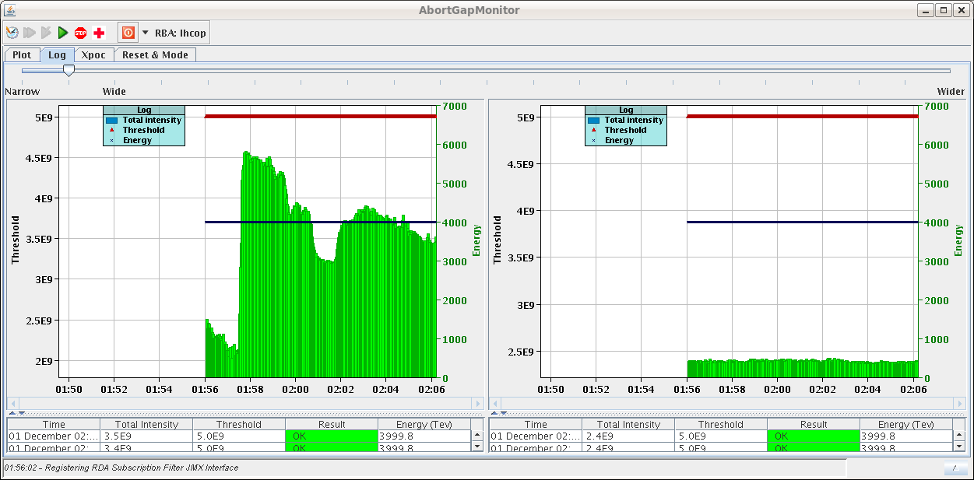
RF Problem on Friday
01:54 Warning from Big Sister about abort gap cleaning required for beam 1. Lost communication with RF FGCs. Switch ON Abort Gap Cleaning.
02:57 Not possible to restore communication. Dump and give access.
Power supply of control crate for feedback line 5B1 replaced. Still problems with the movement of the TED in TI2

Slide 13
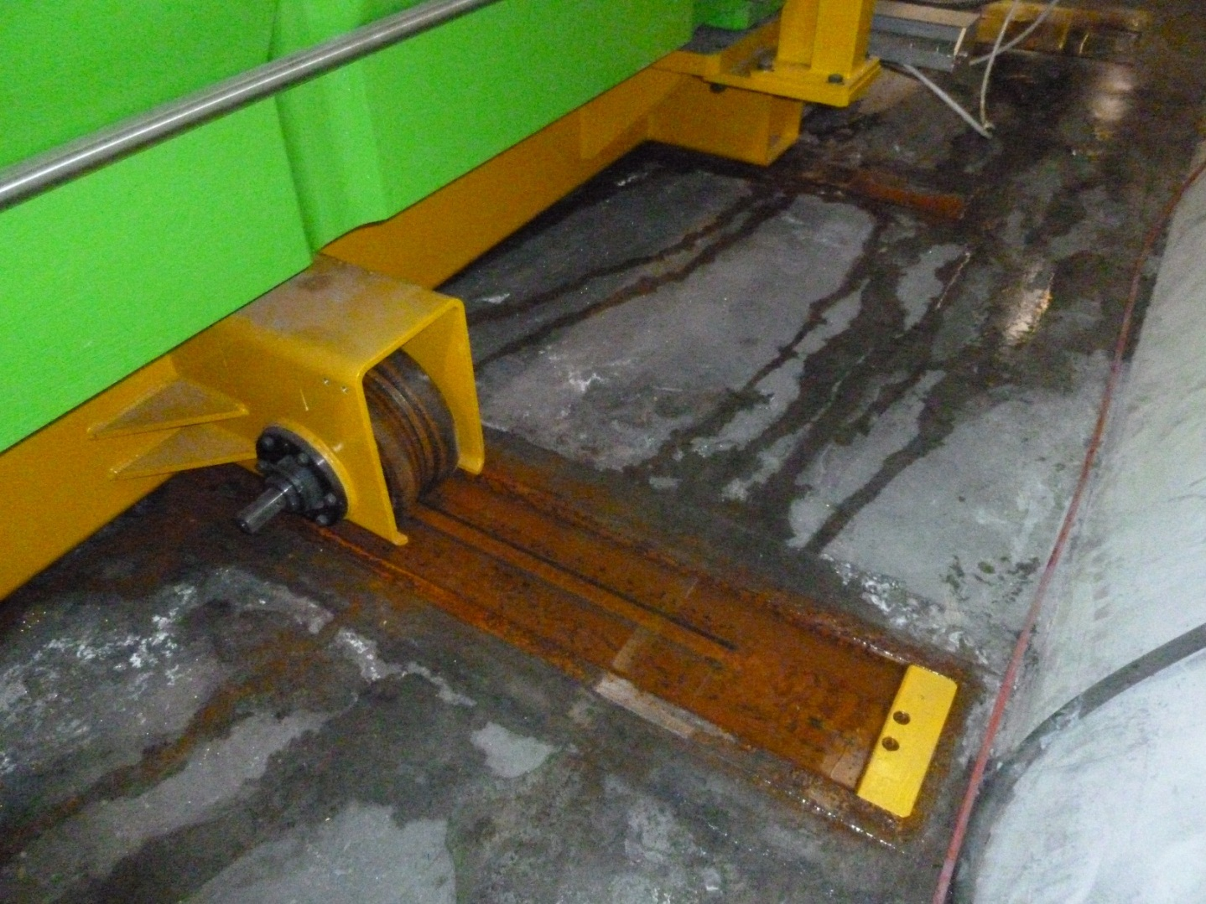
TED TI2 Rails
TI2 TED movement could block anytime → don’t move anymore before repair

Slide 14
TED TI2 Procedure for Access
LHC Access Safety System (LASS)
EIS – Elements Importants pour la Sûreté (f-faisceau, m-machine)
EDMS 1255294 2.0
In TI2 the three EIS elements are the beam stopper TED 29132, MBIBH29314 and MSIB29529. Currently a mechanical fault prevents the TED moving
→ ensure that SPS chain 4 is in access mode whenever access is needed in the LHC; this chain includes TED6103 thus providing a mechanical block to any potential beam
Putting any LHC EIS out of chain makes it impossible to re-arm that chain for beam, so for each period of LHC access the TED must be removed and then replaced in chain in order to take beam
This temporary procedure replaces the automatic positioning of a beam block with a manual check that another block is in place → repair estimated less than one week

Slide 15
From PS (Simone and Massimo) - Saturday
New configuration for PS extraction bump (extraction conditions at the extraction septum in the PS are same as before)
The problems encountered with the new cycle are not related to the new set of correctors used for the extraction but to a non conform copy of the RF settings and of the extraction kicker timing for the new cycle. This has resulted in larger satellite population and in particular of those in front and behind the main trains. These bunches are partly intercepted by the upper jaw of the TED and result in losses in LHCb
As a result of that we have reverted back to the standard cycle with the same satellite population as in the last two fills.

Slide 16
Heating study - bunch length variation at injection
Summary slides from Benoit Salvant
Beam 1 and 2 stayed at injection for 1h between 1 ns and 1.1 ns (1.5e11 p/b and 1374 bunches) thanks to increase of RF voltage from 6 MV to 14 MV
→ No damage was observed
→ No other showstopper unveiled (at this point of the analysis)
→ However the beam spectrum was very different than during and after a ramp (higher frequencies were much lower during the test)
Performed a comparison with a fill with ramp after a stop of 20 min in prepare ramp (fill 3318 with 1.6e11 p/b Sat 24.11.)

Slide 17
Summary table (to be updated)
B. Salvant
equipment | Changes with bunch length? | Difference with fill 3318?
BSRT | Yes (slightly ) | Similar
TCTVB temperature | Yes | Heated more
TCP.B6L7 temperature | No | Heated less
MKI temperatures (other than MKI8C) | No | Similar
MKI8C temperatures | Difficult to see | Heated more
ALFA | Yes | Heated more
TDI pressure and deformation | Difficult to see | Seemed to be larger for Pt 2
Arcs temperature | Yes | Similar
Q6R5 | No | Heated less
Very different patterns with bunch length, that will help to understand the origin of the heating
The items that heated more are planned to be upgraded (ALFA, MKI8C, TDI) or removed (TCTVB)

Slide 18
Bunch length test preliminary summary (analysis ongoing)
→ MKI:
similar heating observed on MKIs magnet temperatures except MKI8C (much larger temperature increase with lower bunch length on MKI8C tube and magnet temperatures than for fill 3318)
→ Collimators:
TCP: temperature increased less than for fill 3318 and looked insensitive to bunch length changes
TCTVB: temperature increased more than for fill 3318 and were very sensitive to bunch length changes
TDI: difficult to conclude, to be checked with vacuum, ABT and STI experts.
→ ALFA:
Temperature increased more than for fill 3318 and were very sensitive to bunch length changes
→ TOTEM:
Pressure excursion observed when bunch length increased, to be followed up
→ BSRT:
Similar temperature increase than for fill 3318, small temperature slope changes with bunch length
→ CRYO:
Similar temperature increase than for fill 3318, Arcs temperature was very sensitive to bunch length
B. Salvant

Slide 19
Week 49
Coordinators: Jan Uythoven and Joerg Wenninger
Issues:
TI2 TED
ODH sensor in UP62. In case of access fire brigade to intervene first. Intervention required.
MKI8_C_Up temperature increase
To come:
Access for ATLAS TRT detector leak (late morning)
LHCb polarity change (Monday)
Reactivation ATLAS BCM (Monday)
PS extraction bump new configuration
High brightness beam test
Low pile-up run (LHCb)

Slide 21
Explanation (J.C. Bau, I. Kozsar)
The delay in production of H9 in the PS caused the SPS to set the injection moment at C1015 (on SPS user LHC3). This means that the event SIX.F1KFO-CT came in the present cycle, while the NLHCINJ bit in the LHCSSEQE group is present only in the previous cycle. The two need present at the same time in order to trigger the sending of HX.RNGI-CT on the LHC timing cable. Because this latter event was missing, the RNGI group in the LHC telegram remained at the value present before delaying the SPS injection (RING 2). Nevertheless, the LHC requests were still being executed, sending the LHC injection events (HIX.xxx), prepulses generated, etc. but for the wrong ring in case the requested one was R1.

