Slide 1
MKDV switch faults November 2012
25. 11. 2012
V. Mertens
L. Ducimetière
with
H. Bartosik, G. Bellotto, C. Boucly, P. Burkel, E. Carlier, D. Comte,
S. Huon, M. Laville, V. Senaj, L. Sermeus, J. Uythoven, F. Velotti, …

Slide 2
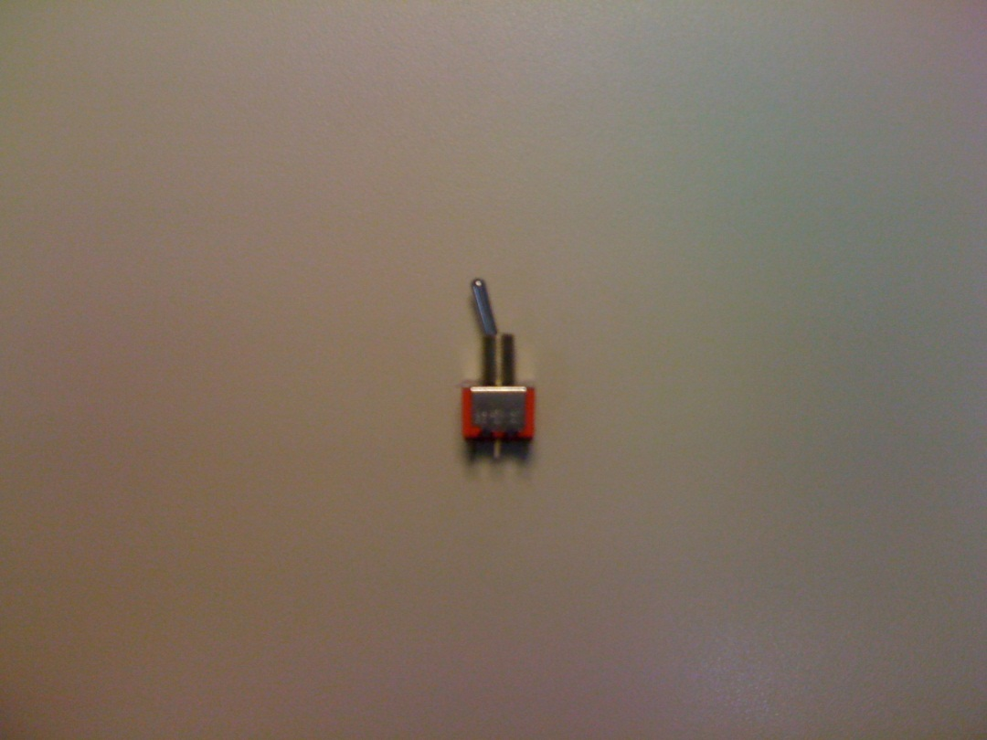
Why is it so complicated/time consuming to replace a “switch” ?
And why does the need for it arise so frequently ?
(an attempt to answer that at the end …)

Slide 3
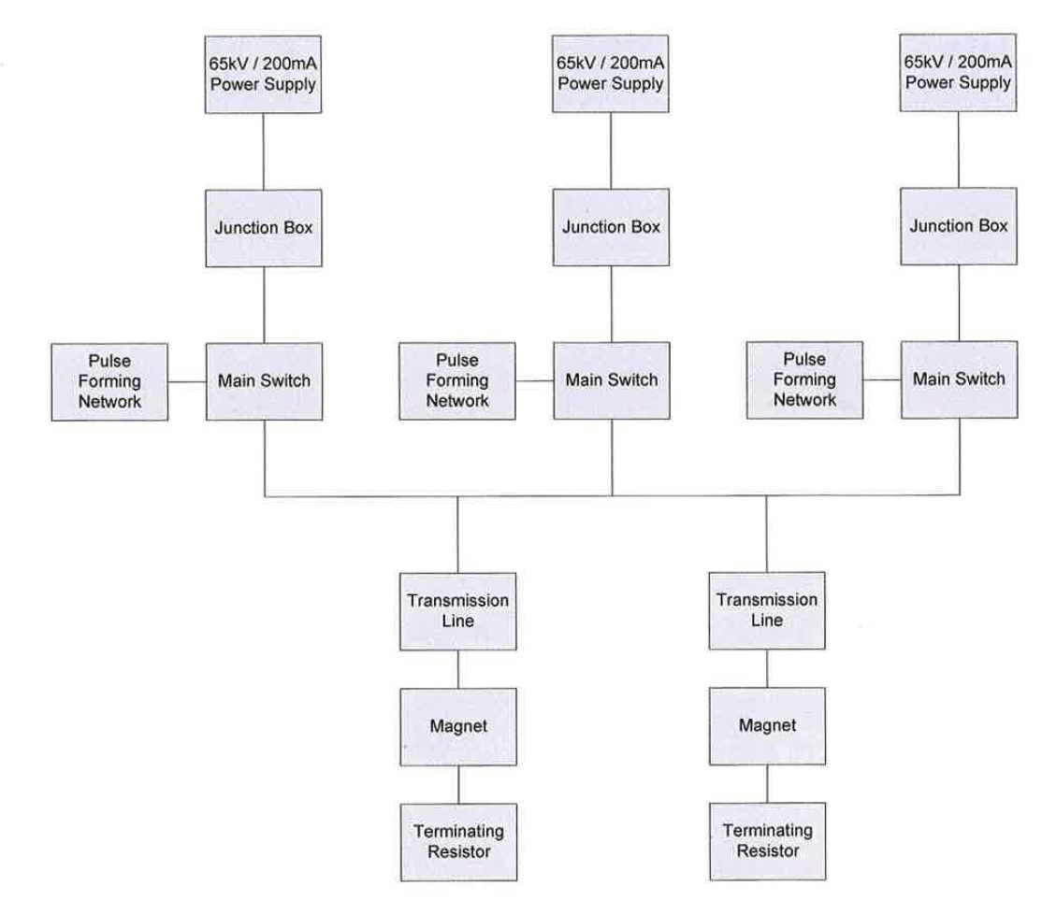
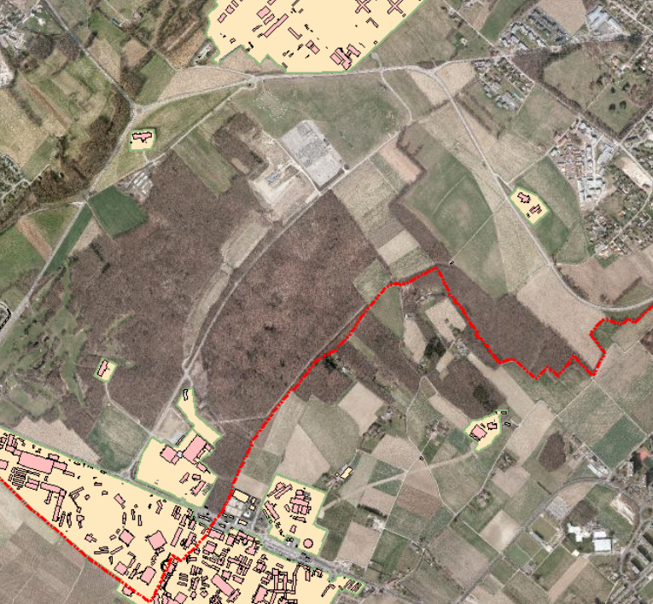
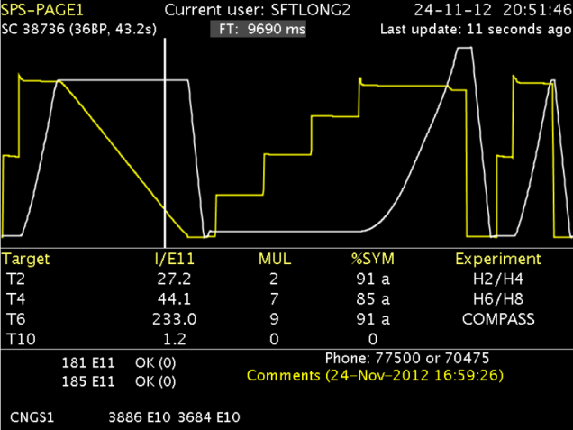
SPS MKDV system (vertical beam dump kickers in SPS Pt 1)
MKDH not shown
BA1
3 pulse generators
feeding 2 magnets
Firing at every cycle
surface building
machine tunnel
Beam
beam dump
TIDVG
U_{nom} = 52 kV, I_{/switch} = 9 kA, I_{/magnet} = 13 kA, T_{rise} = 1 µs

Slide 4
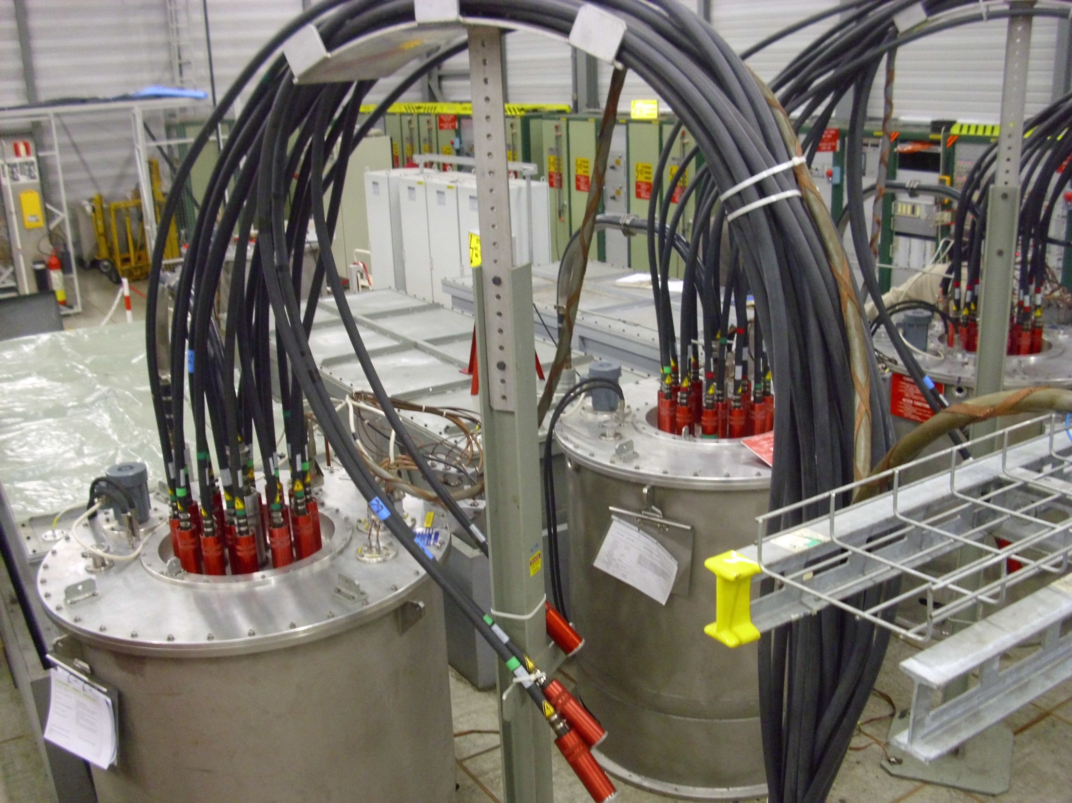
MKDV pulse generator installation in BA1
electronics racks
charging PS
PFN 1
PFN 2
PFN 3
HV switch 1
HV switch 2
HV cables to magnet
HV switch 3

Slide 5
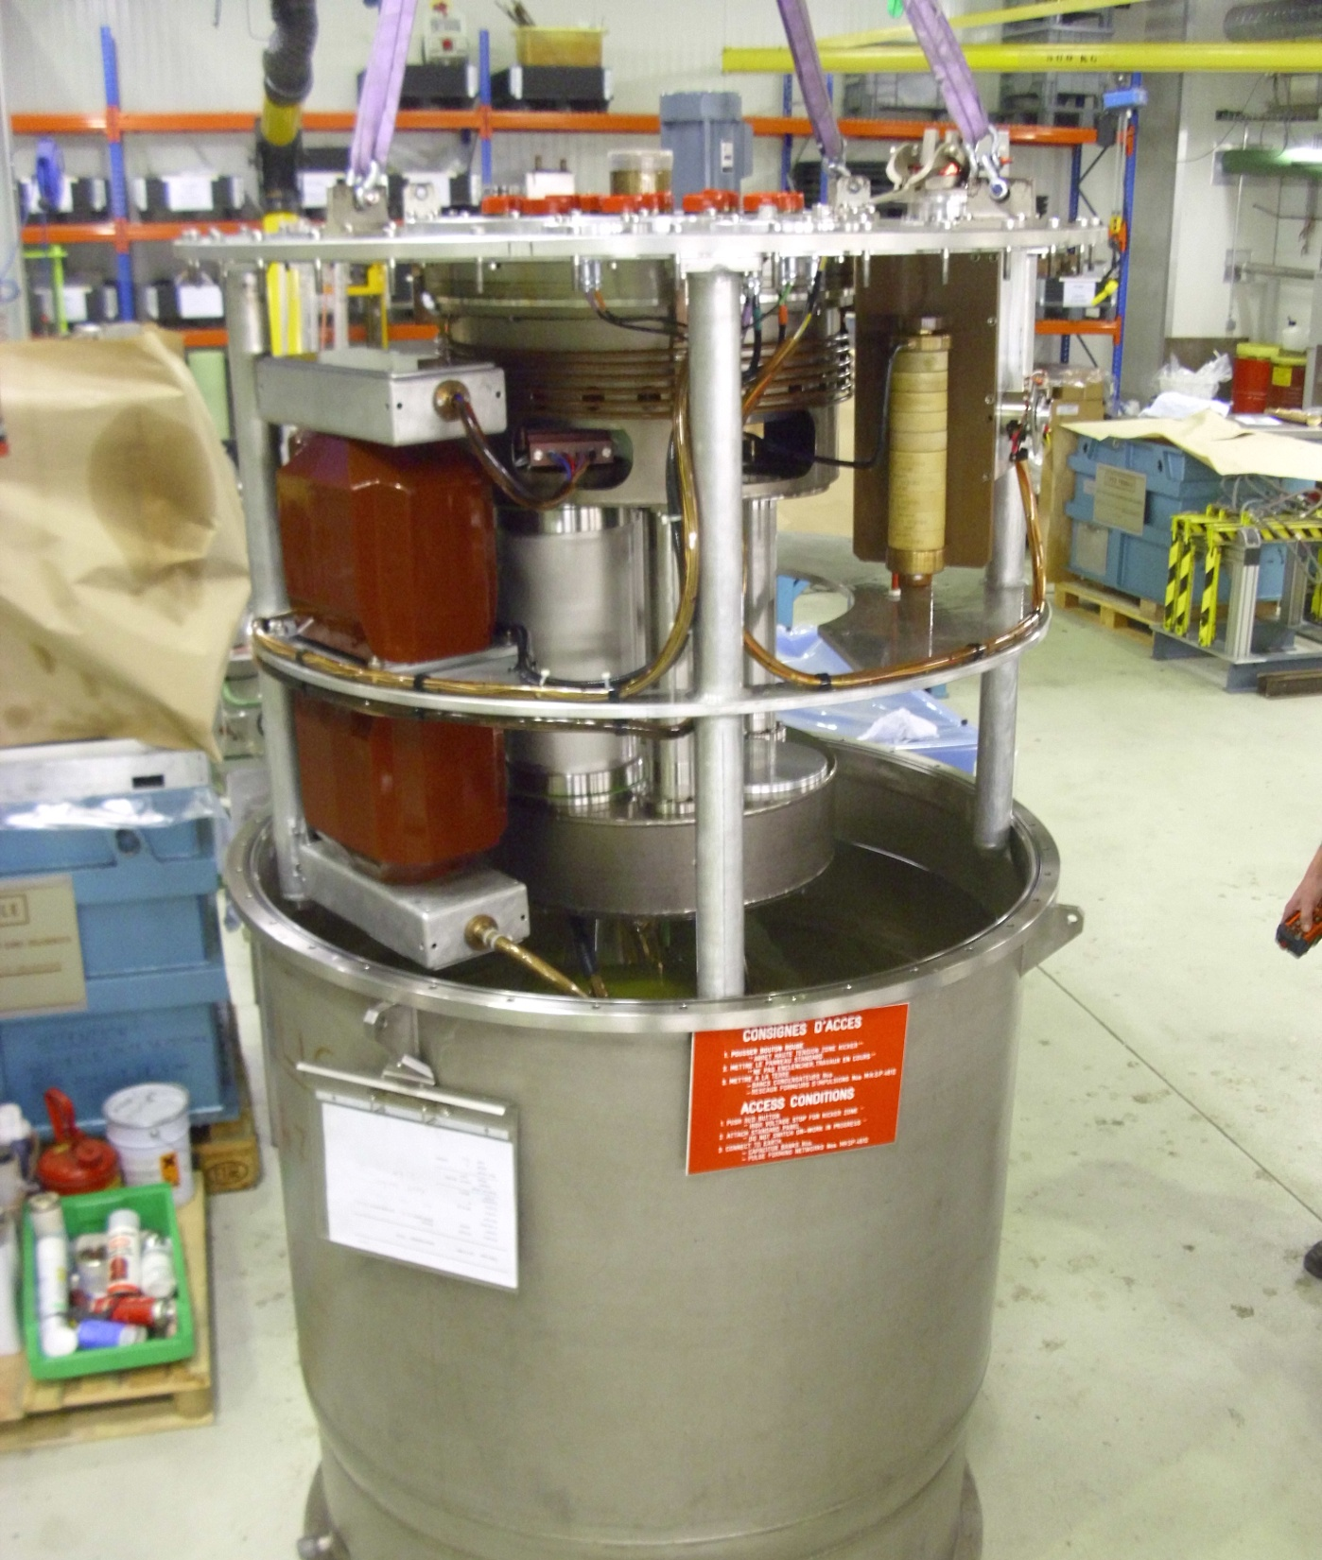
HV switch
fluid pump
PFN
HV sockets
cooling circuit
ANODE
grounding
circuit
THYRATRON
Ignitron
charging
resistor
insulating
transformer
Ignitron stack
housing
Ignitron
CATHODE
Thyratron
housing
Ignitron
bias
circuit
tank filled with silicone dielectric fluid
magnet
faster
rise time
higher current
more reliable

Slide 6
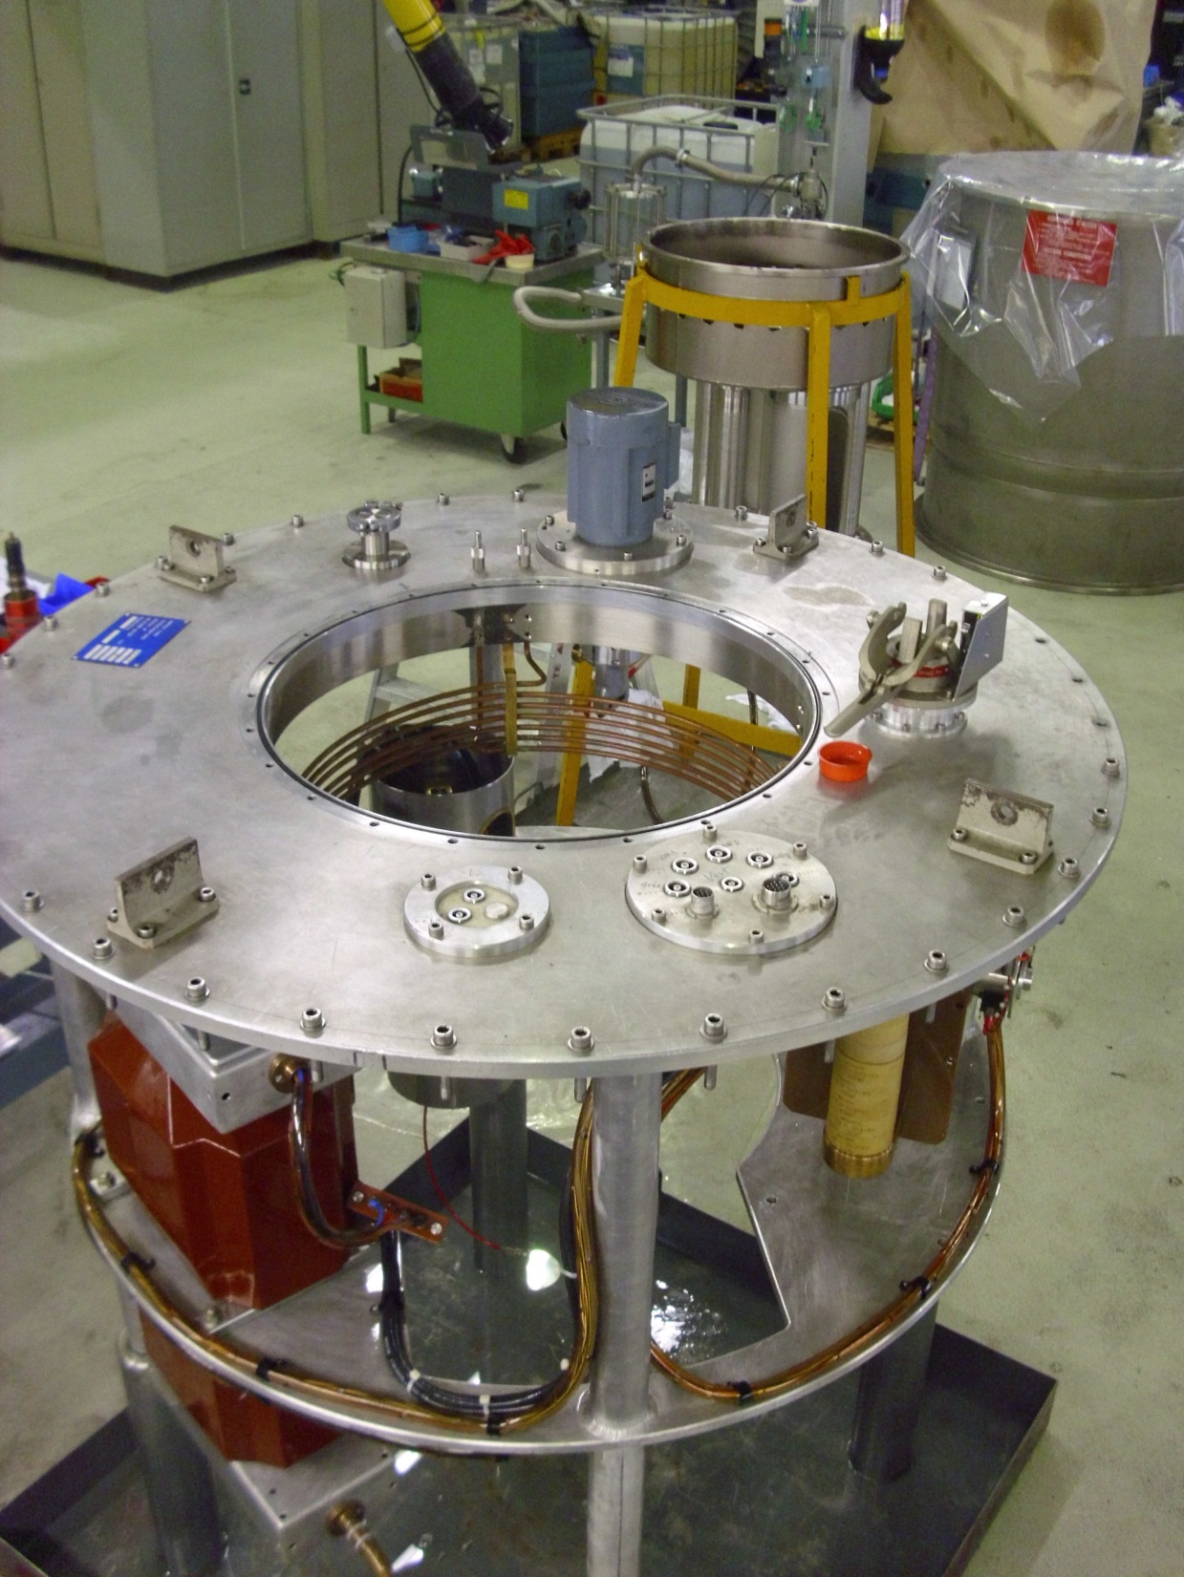
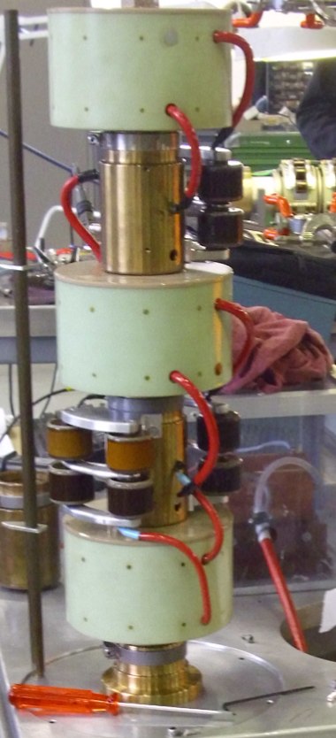
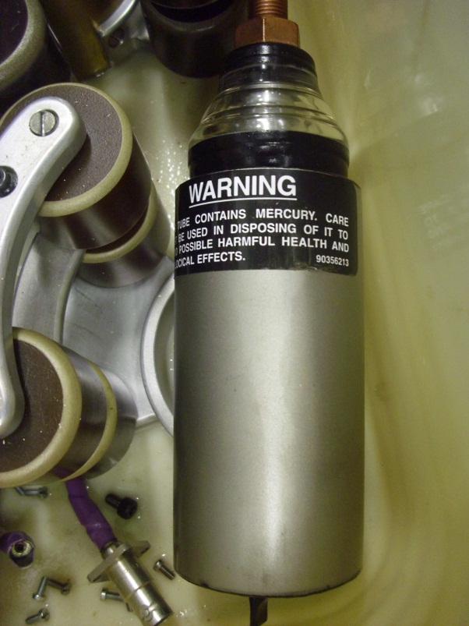
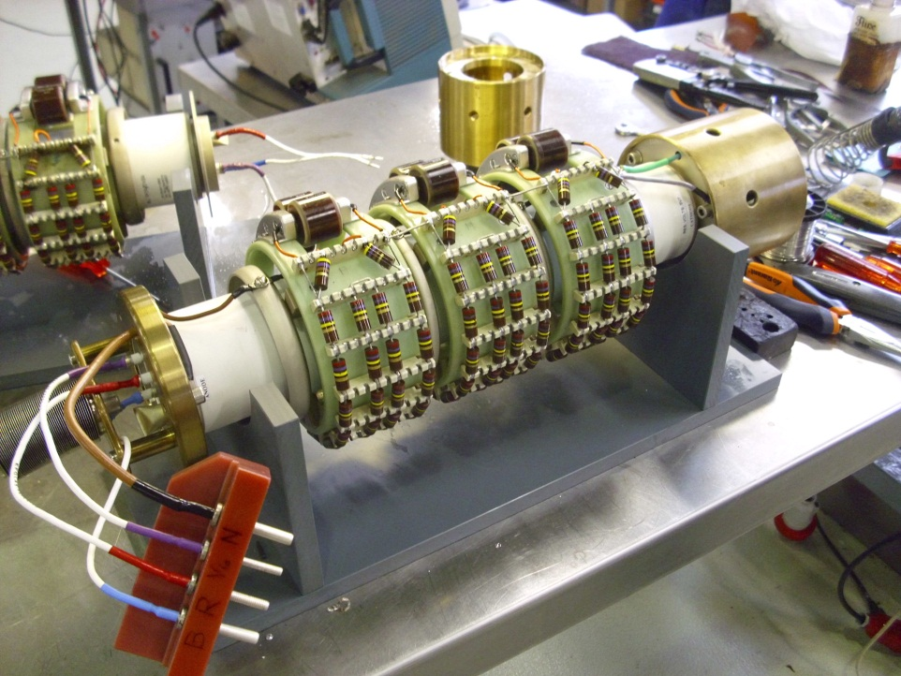
Switch details
Ignitron stack
tubes enclosure
tank
single Ignitron
frame structure
Thyratron

Slide 7
Overview of faults
Situation before series of faults: 3 HV switches in operation, 3 spares (1 to 6).
No major failures on system since 2010 (only basic checks and maintenance).
< Nov 1 Nov 10 Nov 17 Nov 21 Nov 24 Nov
POS
3
2
1
Spare storage (in BA1 and 867):
Workshop
2
2
2
2
1
1
6
6
5
3
3
3
5
4
4
4
4
4
5
1
3
5
2
1 Nov: “6” ignitrons “missing” → erosion of high current contact, failed after 8 years of operation, repair time about 1 month – awaiting parts; replaced with “5” (in spare since > 2 years).
10 Nov: “5” ignitrons “missing” → contact lost on ign. trigger, failed after 10 days, repair within 1 - 2 weeks possible (including proper, i.e. slow, conditioning); replaced with “3” (spare since > 2 years).
17 Nov: “2” thyratron “erratic” → thyratron failure, after > 4 years, repaired with parts from failed switches – by 24 Nov yet untested; replaced by “1” which was known as a weaker spare (old tube).
21 Nov: “4” ignitrons “missing” → ignitron failure, after > 4 years; repaired with all new tubes within 1 day, being conditioning in lab (serves as next spare, readily tested as from end of this weekend).
24 Nov: “1” thyratron “erratic” → thyratron failure, weak spare failed after 7 days, to be shipped to lab for repair (waiting for imminent delivery of 1 new thyratron); replaced by untested “2”.

Slide 8
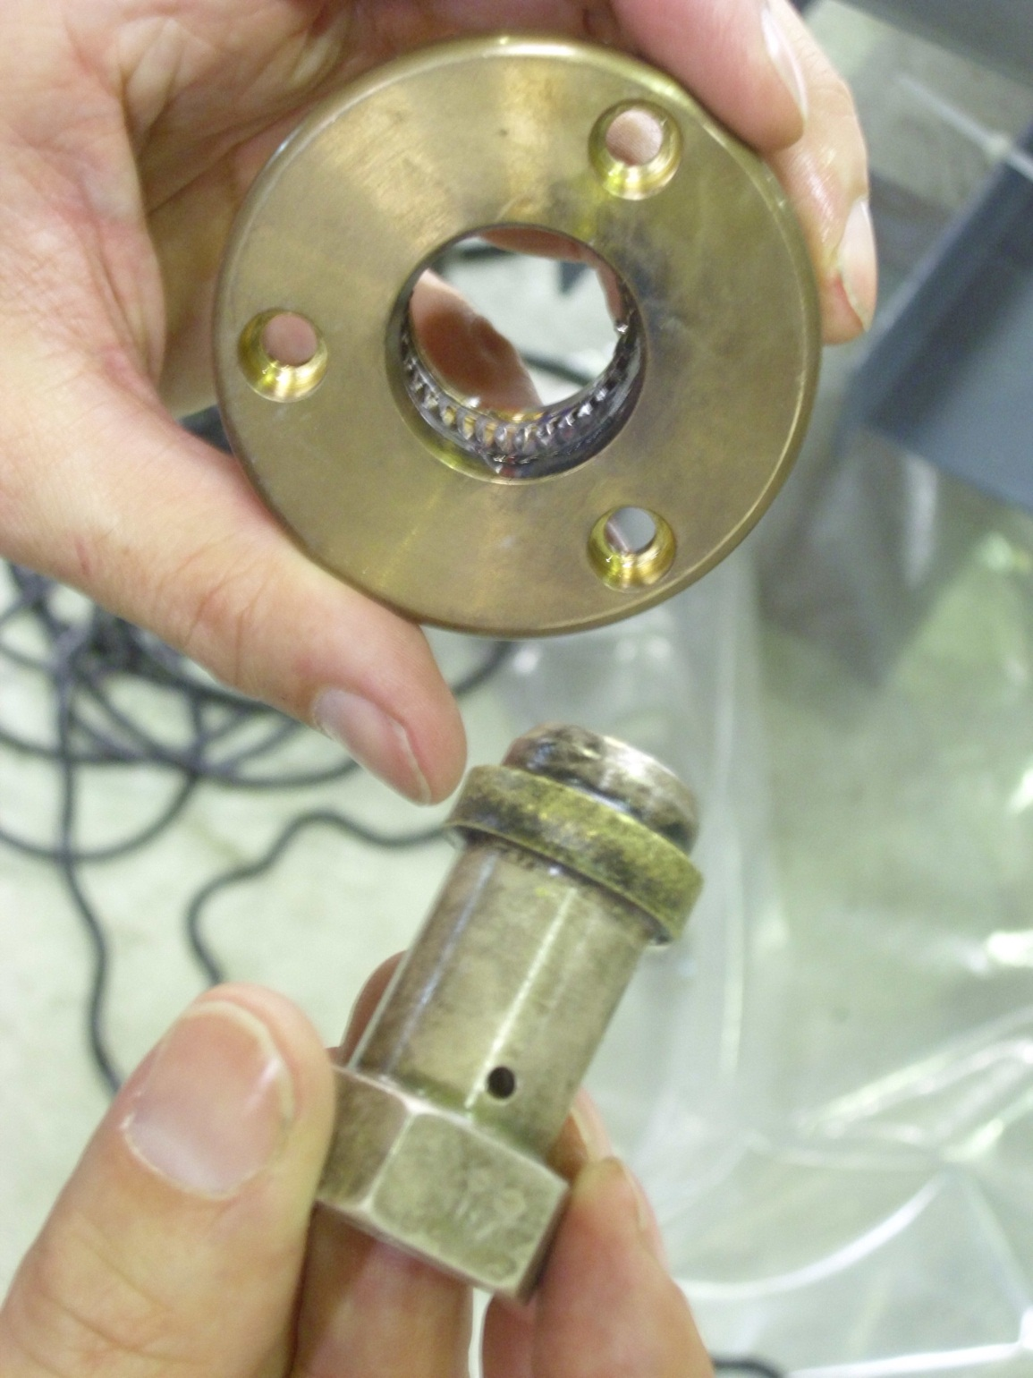
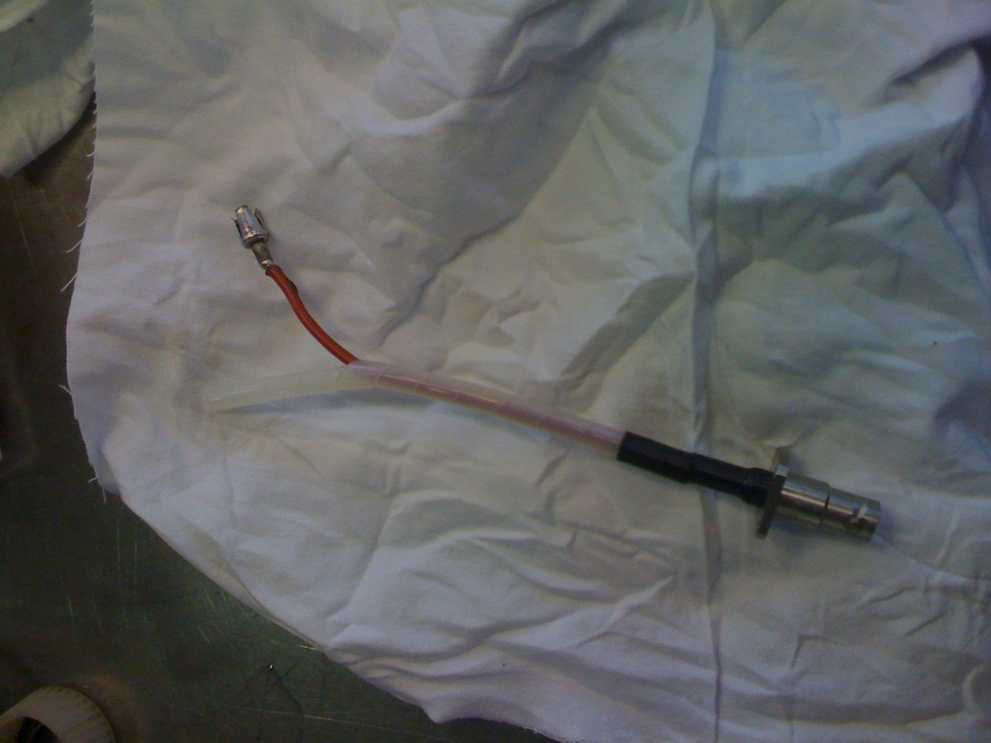
Failed parts (besides the tubes)
bad soldering of contact part
(taken from the new parts shelf),
hidden under heat shrink tubing (switch 5, 10 Nov)
erosion of high current contact (switch "6, 1 Nov)

Slide 9
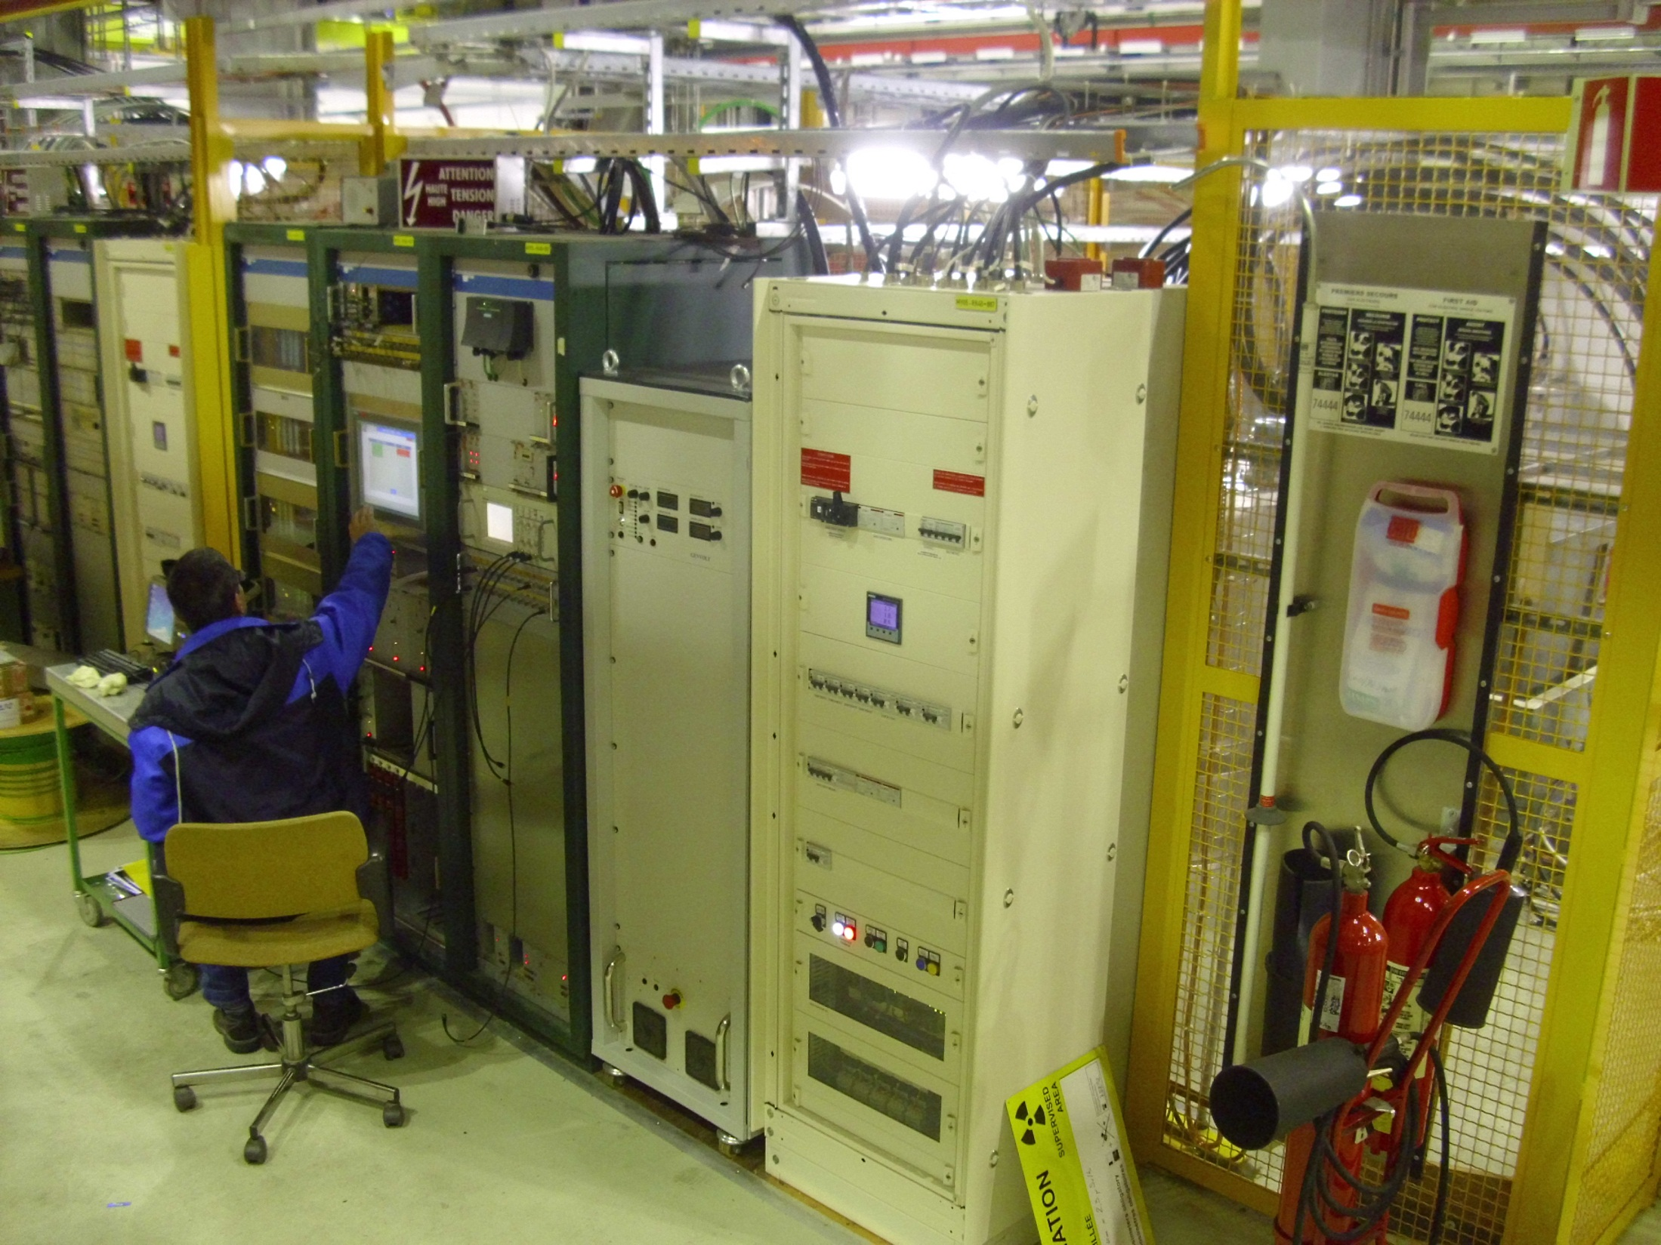
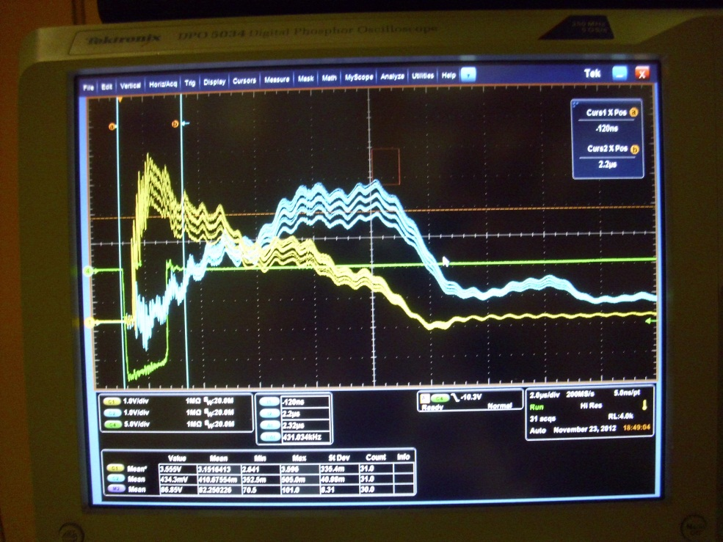
HV conditioning in lab
B867
ramping up of voltage
yellow traces: thyratron current
blue: ignitrons
Switch (oil should contain no air bubbles) and tubes (mercury in ignitron) need settling time before starting the HV conditioning.
Conditioning should ideally go rather slowly (recommended ca. 1 week, if hand-controlled), otherwise risk of immedidate damage or strong reduction of tube lifetime.

Slide 10
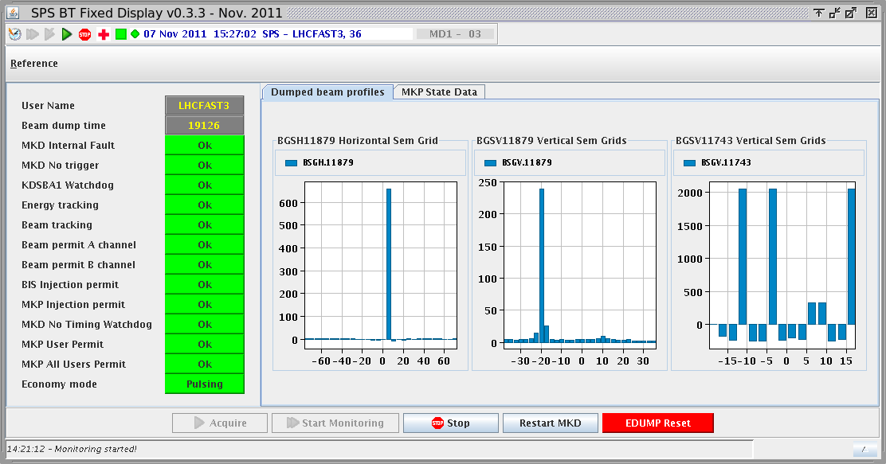
Actions on 23 November
Weak spare “1” giving “erratics” on the thyratron, during the night. Untested spare “2” was immediately transported to BA1 (to note: with a certain risk of failures which would be found during normal testing, and requiring more time for conditioning).
The faults could be temporarily overcome by increasing the tube pressure (increasing the voltage to the filament heating the D₂ reservoir). In the afternoon, following one more “erratic”. the operational MKDV voltage was lowered to 41.4 kV (from 44 kV).
Thorough checks with beam sampling the kicker pulse at different energies confirmed the simulations, that the TIDVG is still properly hit (with properly working MKDV).
These measures allowed operation to move on until 24 Nov morning (production fill in during 24 Nov intervention).
41.4 kV maintained after 24 Nov, in order not to overstress the already used thyratrons.
450 Gev, Q20 optics, 12 bunches
Restarted operation in 2011,
after magnet problems,
with 39 kV (Q20 optics, MD).

Slide 11
Summary and Assessment
5 MKDV HV switch problems since 1 November, affecting all 3 generators.
Reasons
3 x tube end-of-life or sudden failure
erosion of high-current contact
component not good (rapidly developing defect).
Faults apparently unrelated (as unrelated a system with connected outputs can be …).
Will there be another such problem in the coming days ? Hard to say …
MKDV highly stressed system, and delicate – one failure and the subsequent interven-tion trigger with some likelihood another one (from experience).
Nevertheless, the last “fault storm” was long ago, > 15 years ?
No MKDV switches intervention needed since September 2010 … (1 in 2009, 1 in 2010).
Despite failure rate machine protection was never affected due to redundant architecture in the switches.
Machine protection also justifies time taken for revalidation before going back to opera-tion with high intensity beams.

Slide 12
Outlook
Spend more money (~ 30 kCHF/thyratron) and manpower on preventive maintenance ?
Refurbishment doesn't guarantee a fault-free operation afterwards (see above) – some hesitation to touch a working system, in particular in short stops.
Will add the overhaul of the MKDV switches to the (already long) work list for LS1.
Have ongoing consolidation programme to
replace ignitrons with GTOs
split the powering of the magnets.
For this R&D still continuing (ring-gate GTOs, fast trigger transformers, …)
Work slowed down by need to re-organise the laboratory space in 867.
LIU-SPS project ventilating idea of completely new dump system in other SPS point (should take the new requirements into account) – time horizon LS2.

