Slide 1
LHC Summary – week 47
Coordination: Mike Lamont & Bernhard Holzer

Slide 2
W47 – interesting week

Slide 3
W47 Faults
System | Problem | Time [hours]
LBDS | TSU survey | 2.5
QPS | Controller reset | 0.6
LBDS | Generator B2 | 1.18
SPS magnet | Vacuum leak | 25.75
Power converter | RB.A23 - active filter | 3
SPS MKD | Switch | 5.07
RF | SPS BQM | 2.1
Post mortem | Reset problem | 1
Power converter | RQ10.L8 | 2.4
RF | SPS BQM | 0.75
SPS vacuum | conditioning | 2.1
SPS MKD | Switch | 1.05
SPS MKD | Switch | 4.4
SPS MKD | Switch | 0.92
SPS MKD | Switch | 1.45
BLM | Coms. US15.L1 | 0.63

Slide 4
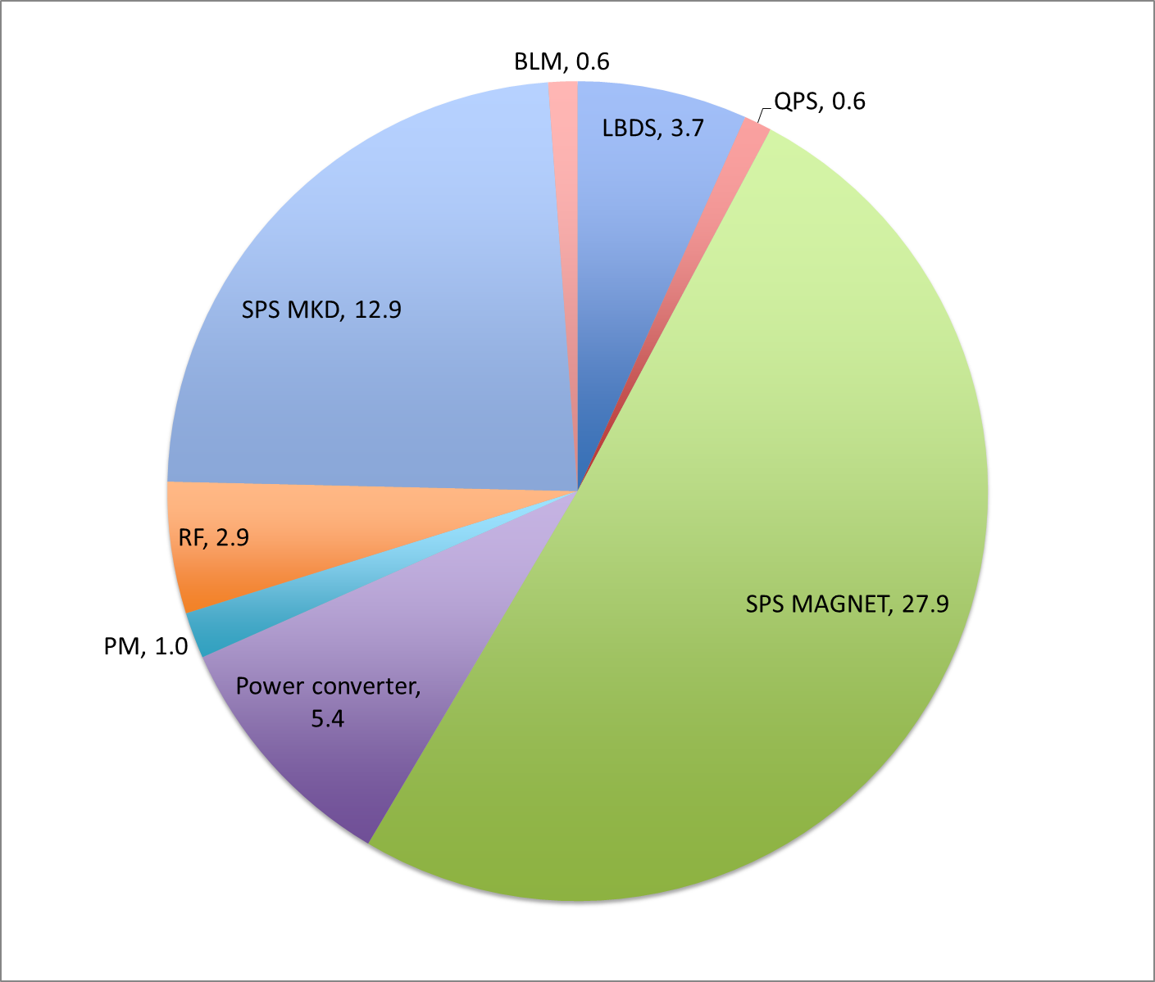
Faults by system
LBDS | 3.7
QPS | 0.6
SPS MAGNET | 27.9
Power converter | 5.4
PM | 1.0
RF | 2.9
SPS MKD | 12.9
BLM | 0.6
TOTAL | 54.9

Slide 5
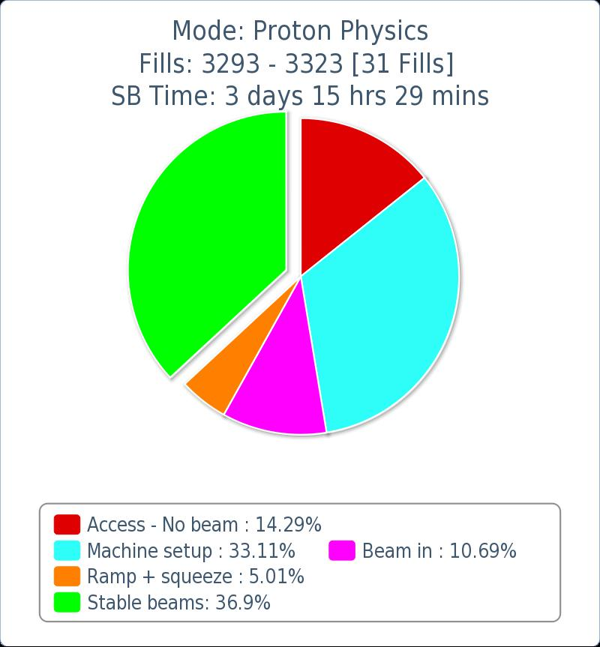
Last 7 days
TRANSFER LINE SET-UP | 13
SPS MAGNET | 27.9
OTHER FAULTS | 27
VdM SET-UP | 10
VdM RUN | 24

Slide 6
SELECTED ISSUES

Slide 7
Transfer line collimator settings
Monday PM: realized that the positions of the transfer line collimators had not followed the Q20 change in optics
  wrong transfer line collimator openings, worst case 1.3 sigma
Trimmed manually in Q20 optics values into settings and from this TCDI openings were automatically calculated
Thresholds updated and checked
Recalculated trajectory oscillation knobs for Q20
Validated the new TCDI openings for both lines with oscillations of different phases to check phase space coverage
VALIDATION OK
Many thanks to Chiara Bracco and Wolfgang Bartmann for pulling an all-nighter to sort this out.

Slide 8
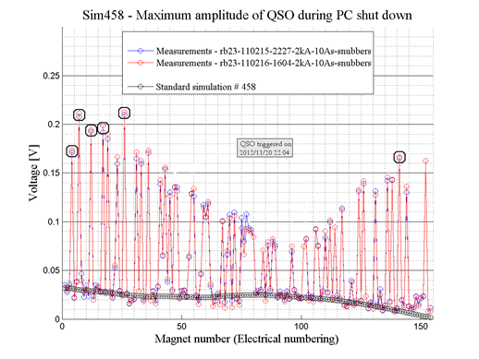
RB.A23
Perturbations clearly visible in V_MEAS, the thresholds of some QPS detectors were exceeded. As a result 6 dipole magnets have fired heaters (A18;B11;A17;B26;B20;C13) R2.
From previous studies in 2011 we know what magnets in the chain are most sensitive to such oscillations. For these magnets are the signal was above threshold and they quenched (see in figure) (Rudiger)
Wednesday: RB.A23 active filter exchanged
Tested the RB.A23 over ten cycles of going to standby and back to injection level. No fault observed. The exchange of the active filter is validated. (HuguesThiesen)

Slide 9
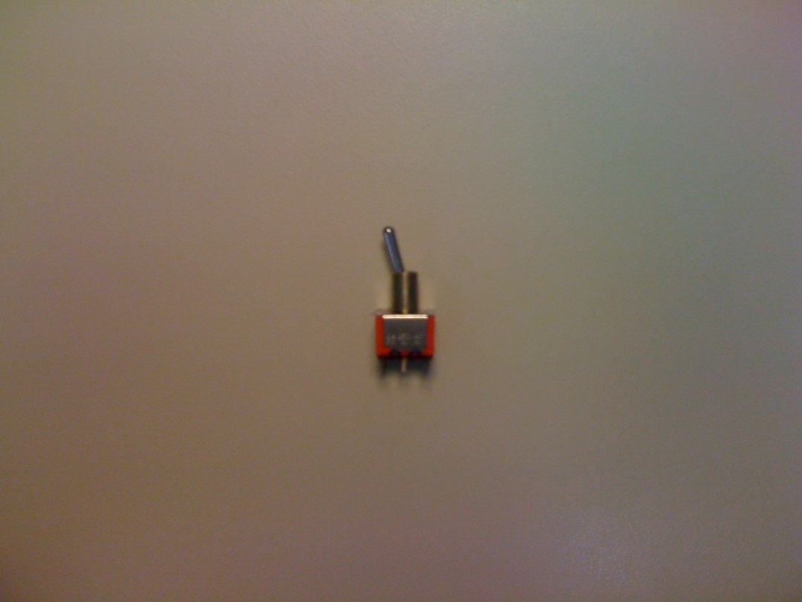
Why is it so complicated/time consuming to replace a “switch” ?
And why does the need for it arise so frequently ?
(an attempt to answer that at the end …)
Volker Mertens

Slide 10
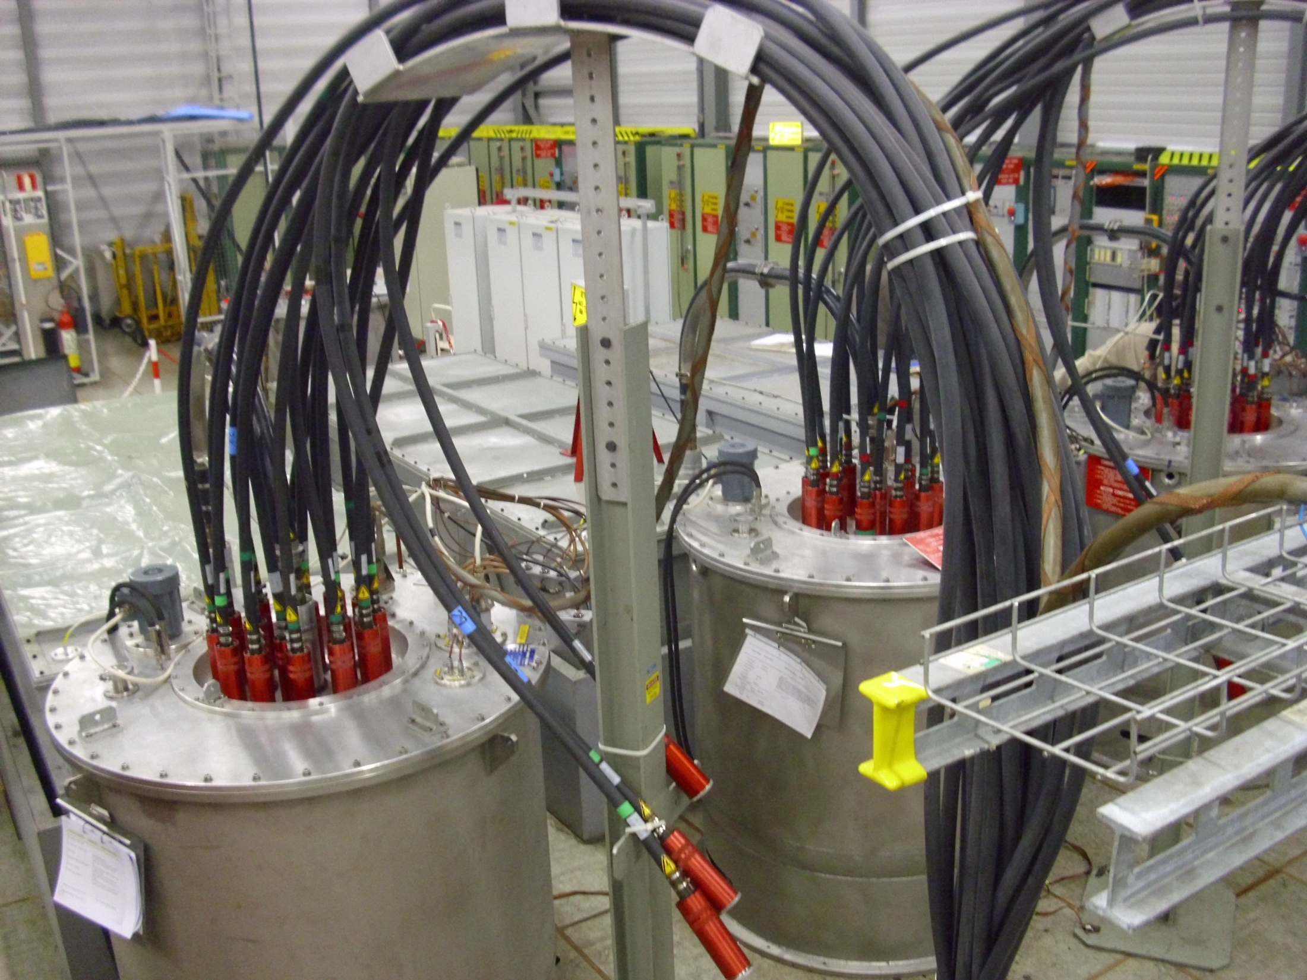
MKDV pulse generator installation in BA1
electronics racks
charging PS
PFN 1
PFN 2
PFN 3
HV switch 1
HV switch 2
HV cables to magnet
HV switch 3
Volker Mertens

Slide 11
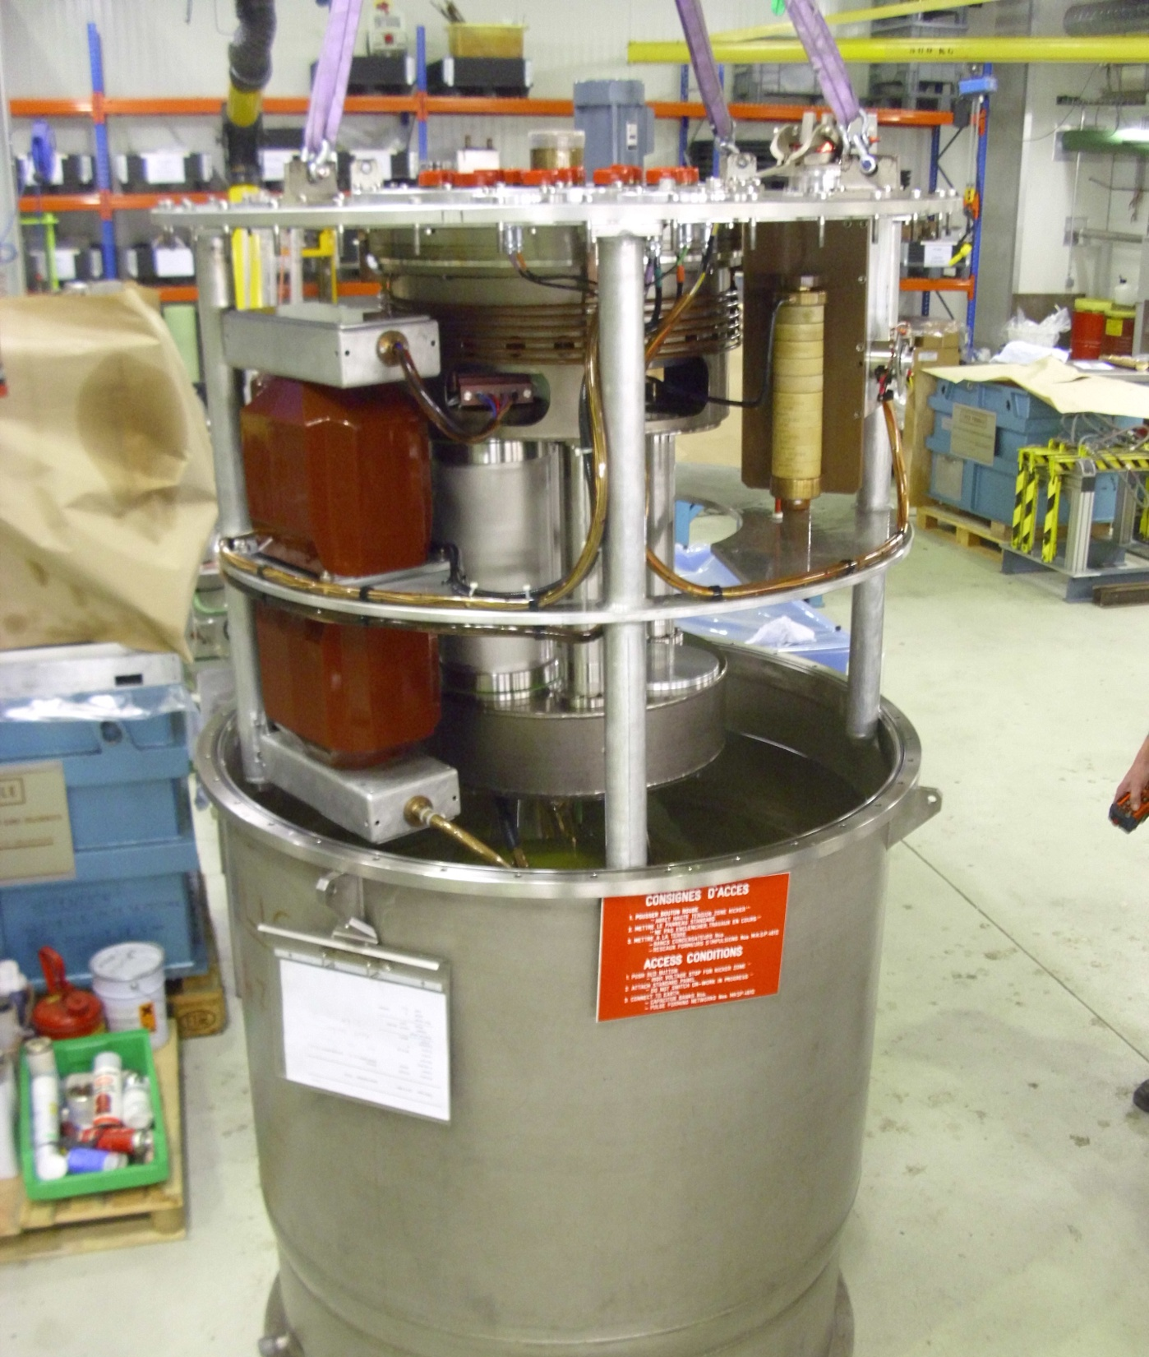
HV switch
fluid pump
PFN
HV sockets
cooling circuit
ANODE
grounding
circuit
THYRATRON
Ignitron
charging
resistor
insulating
transformer
Ignitron stack
housing
Ignitron
CATHODE
Thyratron
housing
Ignitron
bias
circuit
tank filled with silicone dielectric fluid
magnet
faster
rise time
higher current
more reliable
Volker Mertens

Slide 12
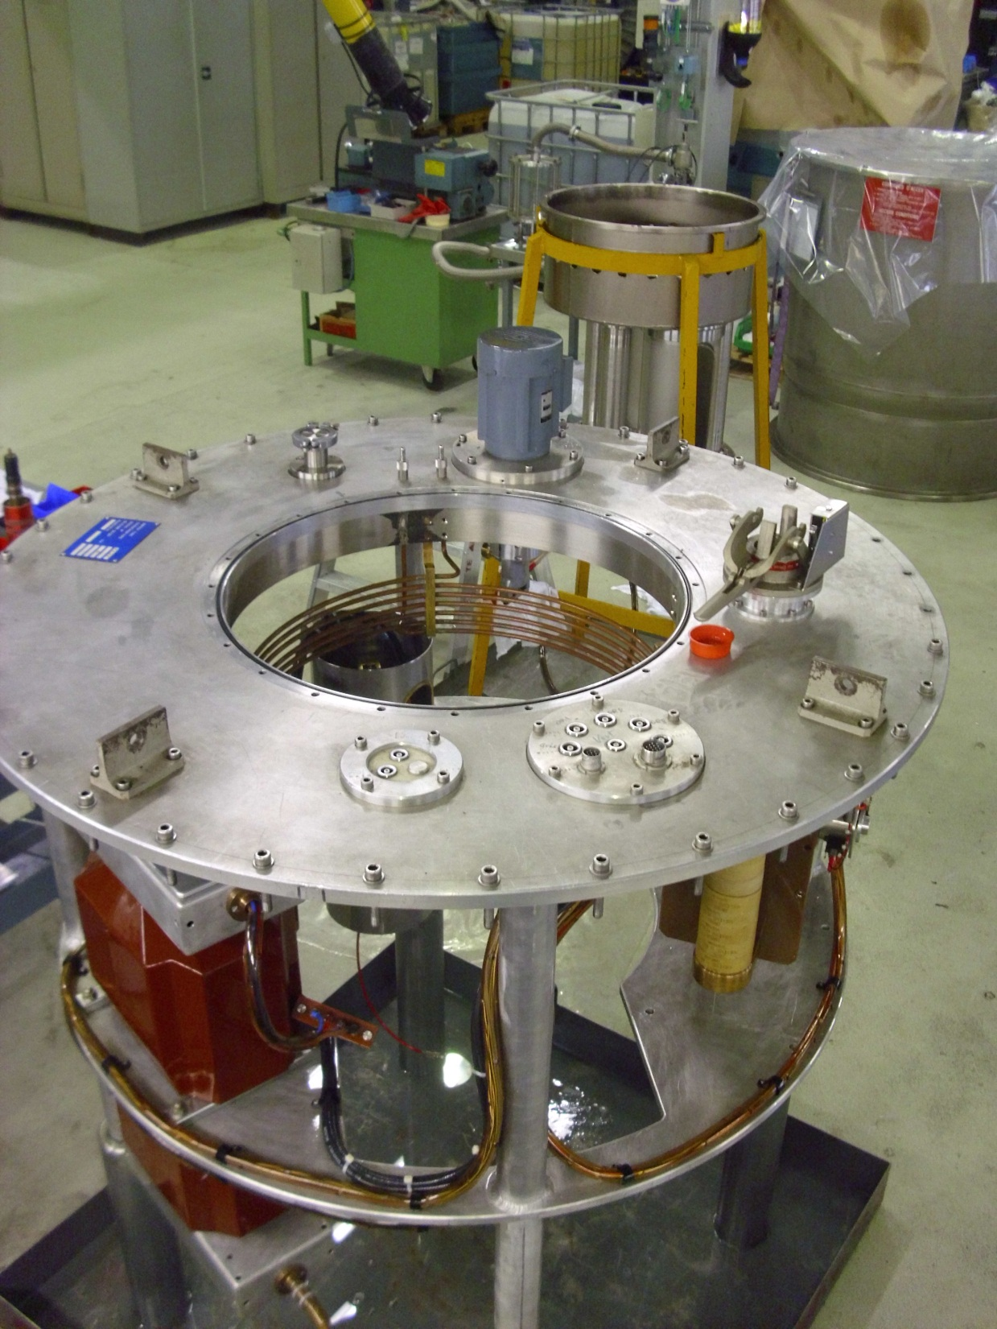
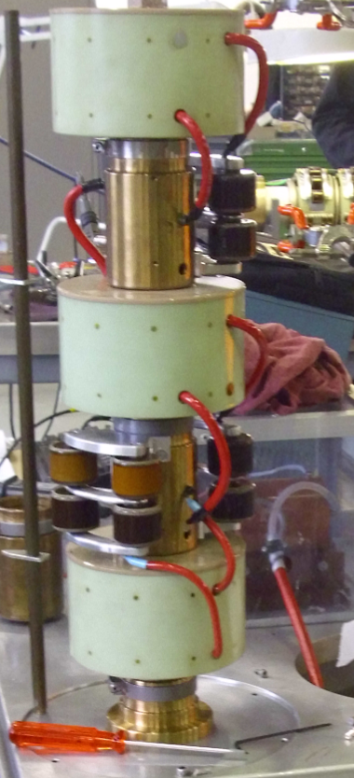
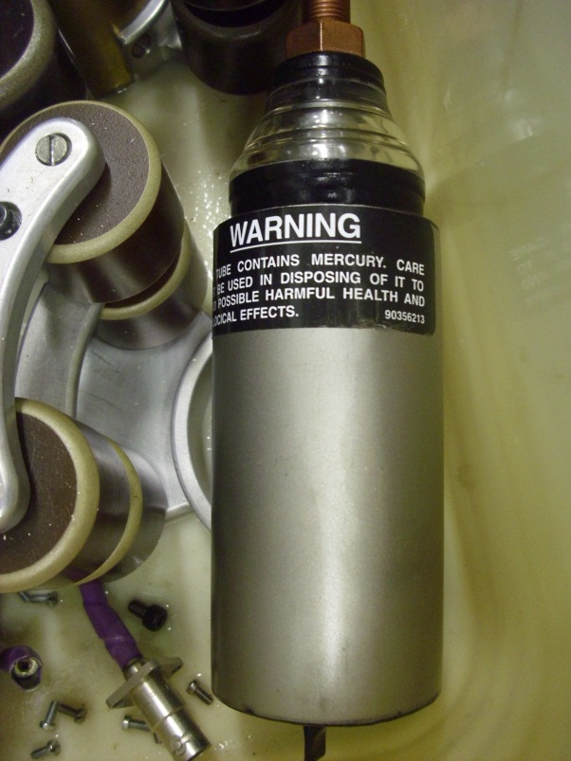
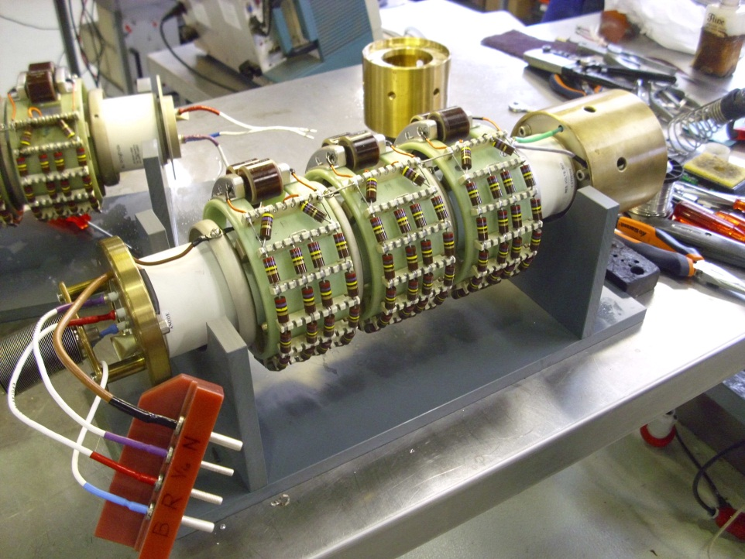
Switch details
Ignitron stack
tubes enclosure
tank
single Ignitron
frame structure
Thyratron
Volker Mertens

Slide 13
Overview of faults
Volker Mertens
Situation before series of faults: 3 HV switches in operation, 3 spares (1 to 6).
No major failures on system since 2010 (only basic checks and maintenance).
< Nov 1 Nov 10 Nov 17 Nov 21 Nov 24 Nov
POS
3
2
1
Spare storage (in BA1 and 867):
Workshop
2
2
2
2
1
1
6
6
5
3
3
3
5
4
4
4
4
4
5
1
3
5
2
1 Nov: “6” ignitrons “missing” → erosion of high current contact, failed after 8 years of operation, repair time about 1 month – awaiting parts; replaced with “5” (in spare since > 2 years).
10 Nov: “5” ignitrons “missing” → contact lost on ign. trigger, failed after 10 days, repair within 1 - 2 weeks possible (including proper, i.e. slow, conditioning); replaced with “3” (spare since > 2 years).
17 Nov: “2” thyratron “erratic” → thyratron failure, after > 4 years, repaired with parts from failed switches – by 24 Nov yet untested; replaced by “1” which was known as a weaker spare (old tube).
21 Nov: “4” ignitrons “missing” → ignitron failure, after > 4 years; repaired with all new tubes within 1 day, being conditioning in lab (serves as next spare, readily tested as from end of this weekend).
24 Nov: “1” thyratron “erratic” → thyratron failure, weak spare failed after 7 days, to be shipped to lab for repair (waiting for imminent delivery of 1 new thyratron); replaced by untested “2”.

Slide 14
RF noise over the weekend
Increased abort gap population beam 1
Cavity voltage noise solved.
The noise spikes in Cavities 7B1, 3B1 and 1B2 were traced to acquisition errors on the cavity voltage and generator current signals in the setpoint module of the Low Level cavity controller.
The cause was the 20 MHz sampling clock alignment which was out of tolerance, probably a side-effect of the new firmware introduce earlier in November. The clock delay (PDC20) was recalibrated for these 3 cavities and they are now stable.
A similar check should be made on all cavities when is available next week.
A. Butterworth, Ph. Baudrenghien

Slide 15
Miscellaneous
Wire Scanner Situation:
  LHC.BWS.5R4.B1V1
  LHC.BWS.5L4.B2H2 (~8000 scans – use with caution)
  No Scanner for B1H available
  LHC.BWS.5L4.B2V1
Switching position of first 6 bunches B1/B2 – done
  With apologies to Ralph Steinhagen
BPMSA.A4L6.B1 – investigations – Eva Calvo
  A small reflection was found where the CMC50 cables arrive to the rack, where the attenuators are mounted. The levels should still be further analysed.

Slide 16
PERFORMANCE

Slide 17
VdM set-up
Overnight Wednesday to Thursday
  Unfolded smoothly
  Jorg, Laurette, Guy for OP with Belen Salvachua, Gianluca Valentino, Stefano Redaelli for the collimation team
Setup and validation of TCTs (and TCPs) – top of the ramp unsqueezed
  All TCTs aligned in 1 hr 10 minutes, set at 26 sigmas around new centers.
  IR7 TCPs set at 5.3 sigmas, position limits set at 0.3 mm around the jaw positions of TCTs. TCP position limits loaded from beam process.
  Loss maps performed (tune resonance crossing, B1 & B2, H & V) + negative off-momentum loss map (+500 Hz).
Plus validation run and async dump
Frustrating loss of first attempt at VdM run...

Slide 18
Overview of scan program
W. Kozanecki
25 Nov12
ATLAS & CMS: very similar program, 6-7 x/y scan pairs each
  β* = 11m to maximize luminous size (←→ vertex resolution)
  centered scans (→ baseline vdM technique, assumes factorization)
    at least 2 in short succession → reproducibility
  off-axis scans → constrain non-factorization effects
    x scan with beams offset (= partially separated) in y & vice-versa
    2 values of the offset, (3-4 σ_{b} & 1.5 -2 σ_{b)} → probe ≠ regions of the tails
  interleave centered & off-axis scans → reproducibility
  extra ATLAS scan pair right after last CMS scan → β* comparison
  no distance-scale calibration (done in July)
ALICE
  centered scans only (baseline vdM technique) + background measurement at large beam separation
    multiple pairs → reproducibility
  x & y distance-scale calibration
LHCb: no scan, but SMOG on (thanks!)

Slide 19
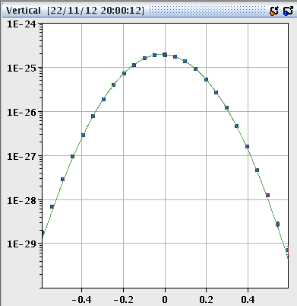
vdM scans: highlights & problems
Highlights
  preparation of single-gaussian beams by 3-d beam shaving in injectors: beautiful WS profiles, ghosts & satellites very small. Thanks, Hannes & colleagues!
  L-scan curves nicely gaussian, much more so than in July scans
    injected beam quality
    also bec. lower LHC octupoles ?
  vdM-scan widths Σ _{x,y} barely sensitive to out-of-plane separation → non-factorization effects significantly better. A big THANKS from ATLAS & CMS!
Problems
  DIP & FBCT problems (some scans had to be repeated)
  WS in LHC dumped ATLAS fill in spite of B1 intensity below threshold
ATLAS scan 10
(LUCID_EventAND)
Fit function: g + p0
All scans show similarly good single-gaussian shapes!

Slide 20
Fills
Fill | Day | Peak | Stable | Int | Dump
3300 | Mon | 7.4e33 | 8:27 | (148) | OP
3318 | Sat | 6.4e33 | 10:30 | 147 | OP
3319 | Sat | 6.2e33 | 2:10 | 44 | BLM comms.
3322 | Sun | 7.1e33 | 11:13 | 168 | OP
3323 | Sun | 7.1e33 | 10:40 | 164 | OP
Total lumi 0.52 fb⁻¹

Slide 21
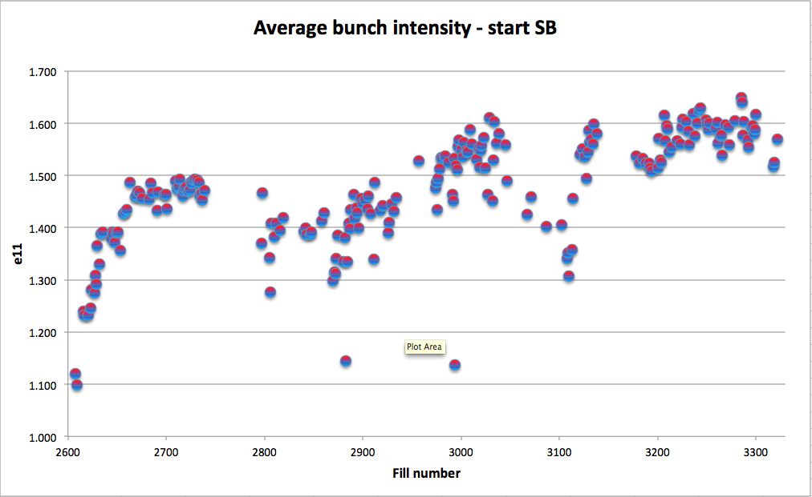
Bunch intensity

Slide 22
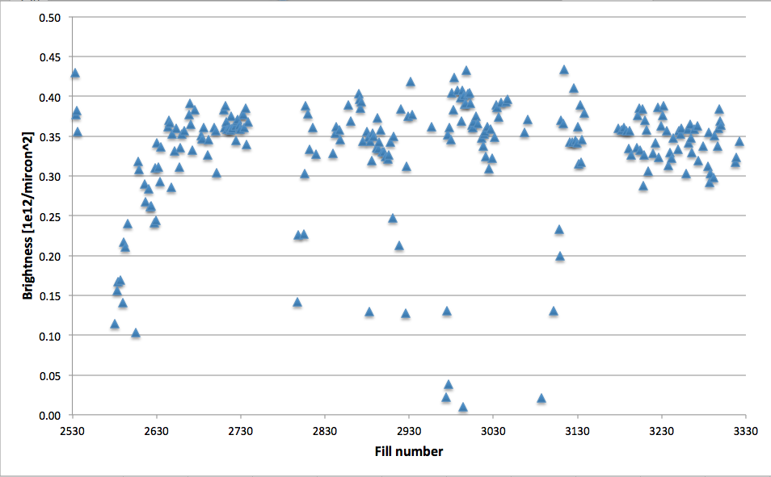
Brightness

Slide 23
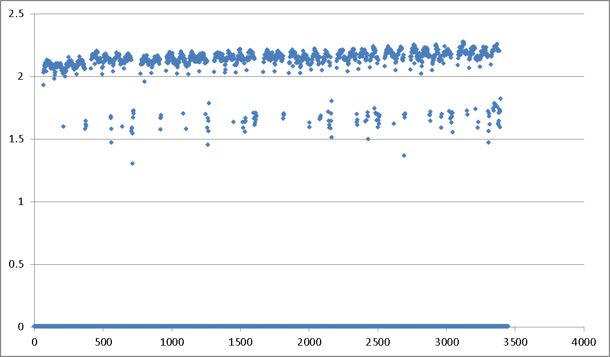
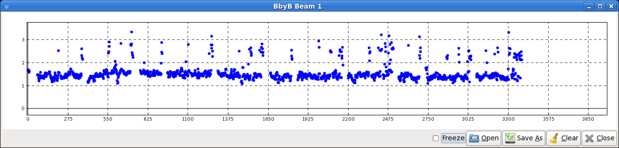
Fill 3300
Instabilities (B1V) at end squeeze blowing certain bunches up
Been adjusting ADT gain and tune split
3300 from last Sunday – see Gianluigi’s 8:30 talk a week ago
Specific lumi
BSRT beam size
Normalized gain B1V: 0.08 to 0.04 in ramp

Slide 24
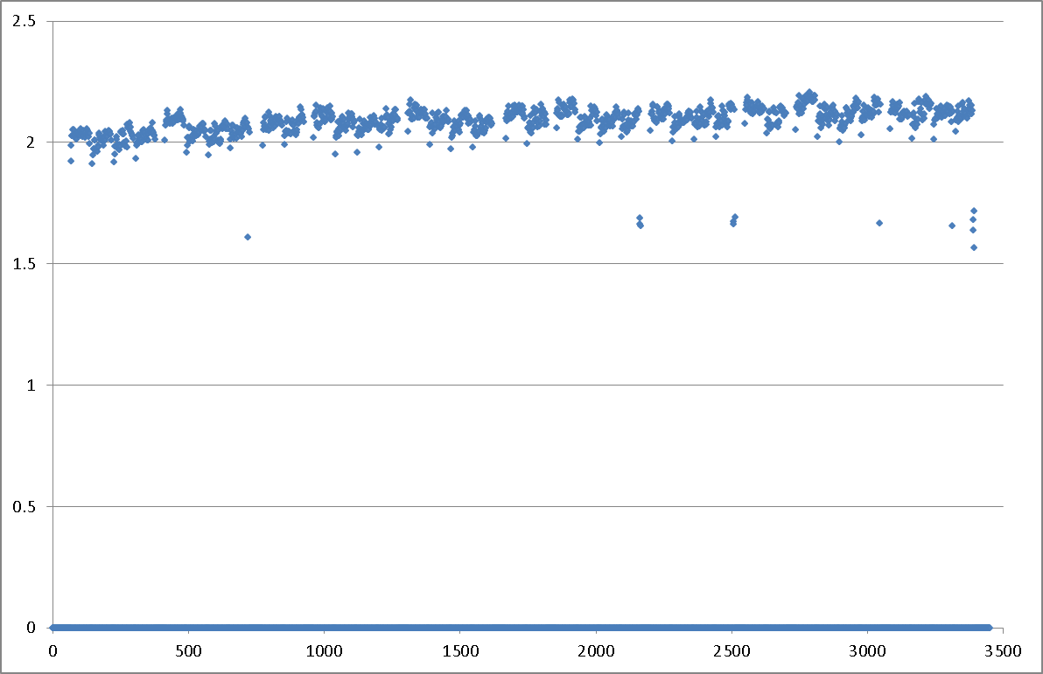
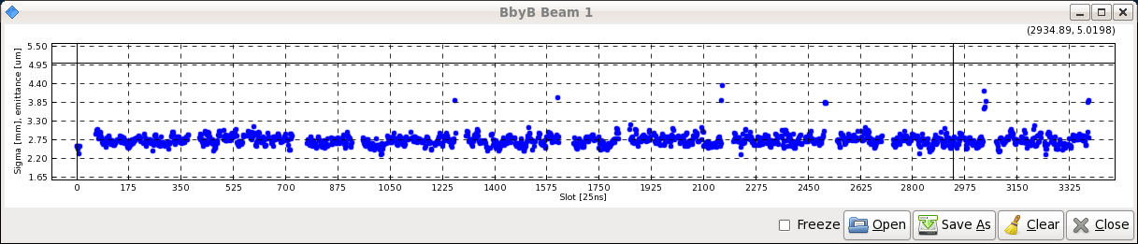
Fill 3322 – this Saturday
Premise: high brightness in B1V exacerbated by further emittance reduction via ADT
Normalized gain B1V: 0.04 to 0.02 in ramp

Slide 25
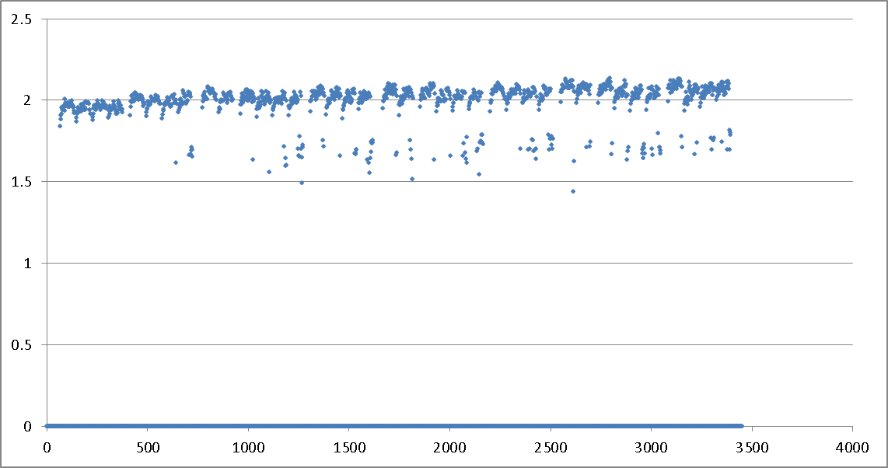
3323 - Sunday
Normalized gain B1V: 0.04 to 0.04 in ramp
Low statistics…

Slide 26
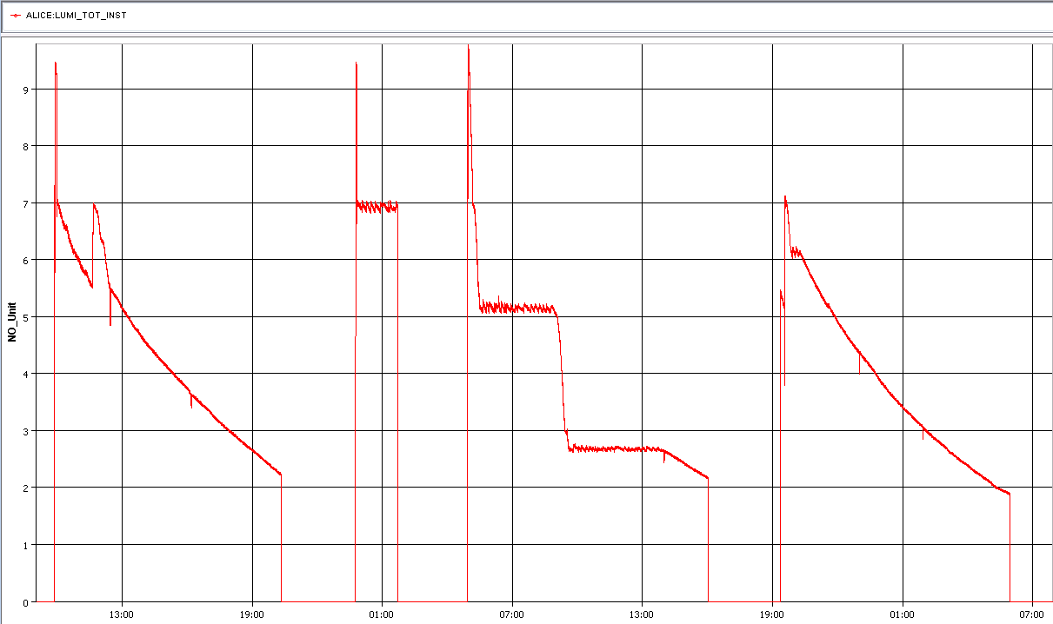
ALICE’s luminosity over the weekend
Decision taken with ALICE to hold satellite re-enhancement until after MD

Slide 27
INCOMING

Slide 28
MD4 Mon – Thu (26 – 29.11.)
Frank Zimmermann
Mon | 06:00 | Ramp down if needed
 | 08:00 | 450 GeV: IR8 aperture
 | 10:00 | 450 GeV: Beam instrumentation
 | 16:00 | 450 GeV→ 4 TeV: p-Pb test
Tue | 00:00 | Ramp down
 | 02:00 | 450 GeV→ 4 TeV: MQY transfer function
 | 06:00 | Ramp down
 | 08:00 | 450 GeV: RF study (longit. stability for batch or RF voltage modulation)
 | 16:00 | 450 GeV: beam-beam (noise or impedance)
 | 22:00 | 450 GeV→ 4 TeV: Collimation impedance & follow up from last MD
Wed | 04:00 | Ramp down
 | 06:00 | 450 GeV→ 4 TeV: two –beam impedance
 | 14:00 | Ramp down
 | 16:00 | 450 GeV: transverse impedance localization at injection
 | 18:00 | 450 GeV: TCDI automatic setup
 | 22:00 | 450 GeV→ 4 TeV: bunch flattening with RF phase modulation
Thu | 02:00 | Ramp down
 | 04:00 | End of MD#4

Slide 29
Operational development
CMS are going to regenerate their helium during the MD period – this could take a little longer than scheduled time – it is thus proposed to slot in the following operational development at the end of the MD block
Beam induced heating (Benoit Salvant et al)
  Test 1: bunch length reduction at injection energy (~2 to 3 h operational development).
  Test 2: applying RF noise to enhance beam frequencies beyond 1 GHz (~2 to 3 h ) at injection. To MD4.
  Test 3: applying RF noise to enhance beam frequencies beyond 1 GHz (end of fill study) at top energy [provided test 2 was successful] MD4
H=9 (bunch merging) low emittance beam (Steve Hancock, Simone Gilardoni, Heiko Damerau)
  1 shift – low number of bunches through cycle

Slide 30
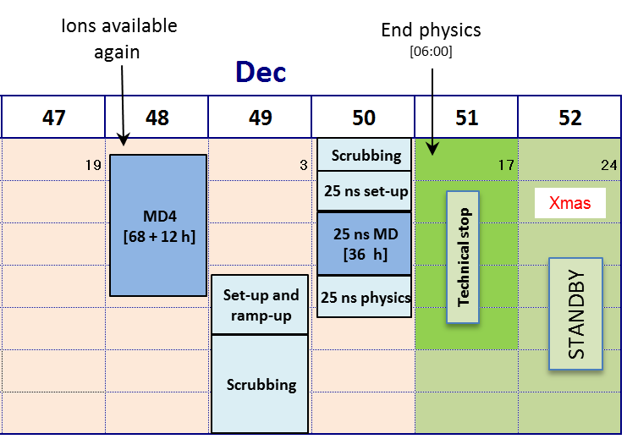
The end is nigh

