Slide 1
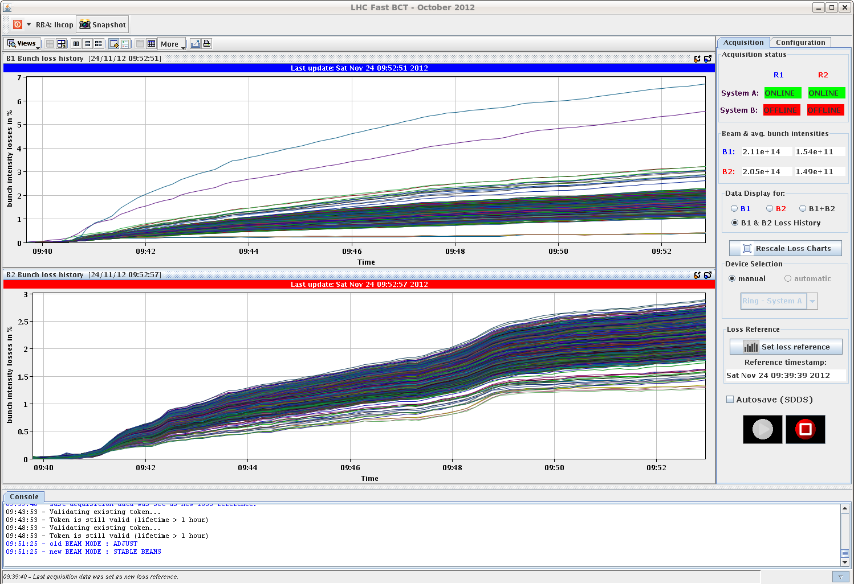
LHC Status Sunday Morning 25-Nov
Bernhard Holzer, Mike Lamont
Saturday Morning
... since 05:30h end of vdm scans,
preparing the machine for standard physics fill
08:11h injection physics beams
problem with BBQ, no tune signal
wrong gating
09:04h ramp
09:40h squeeze
09:51h stable beams
L0=6.4*10³³
10:00h Decision to change SPS MKDV3 switch
emittances beam 1 after squeeze

Slide 2
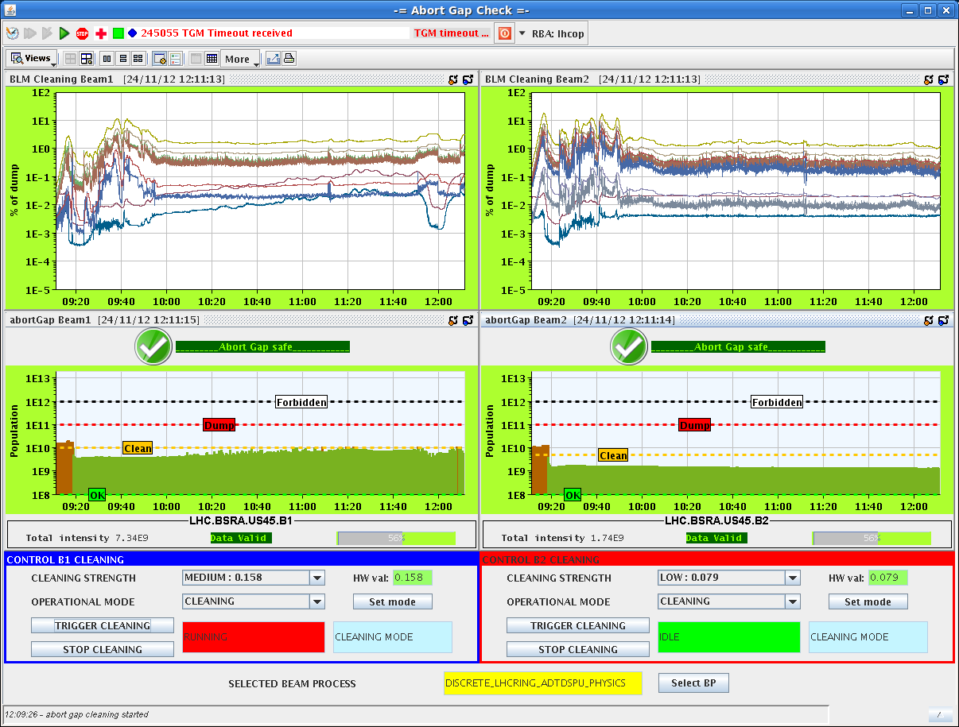
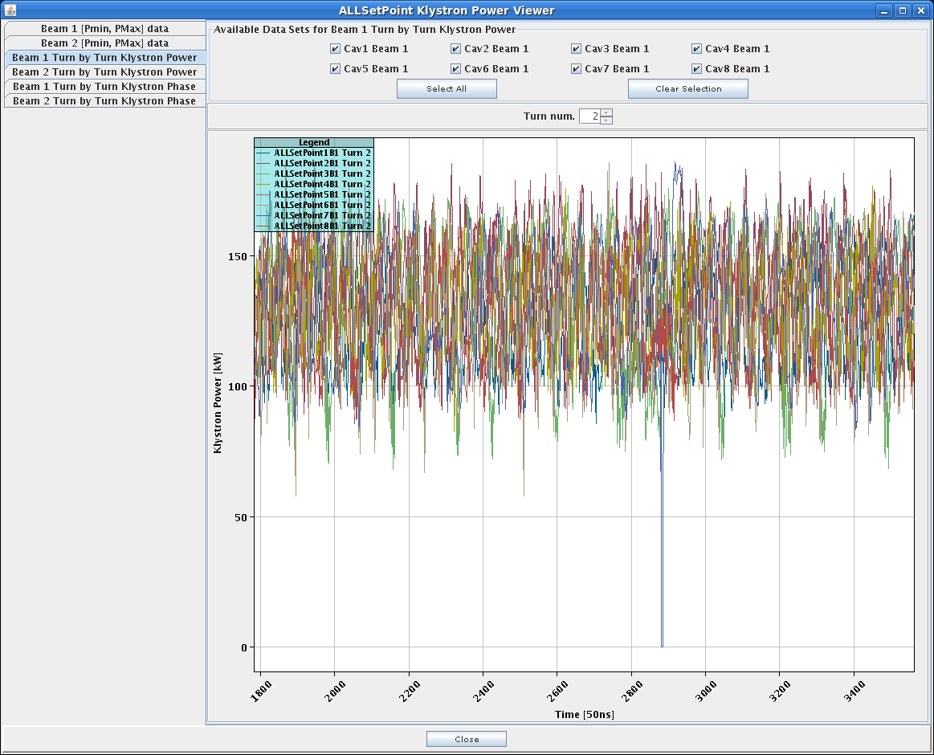
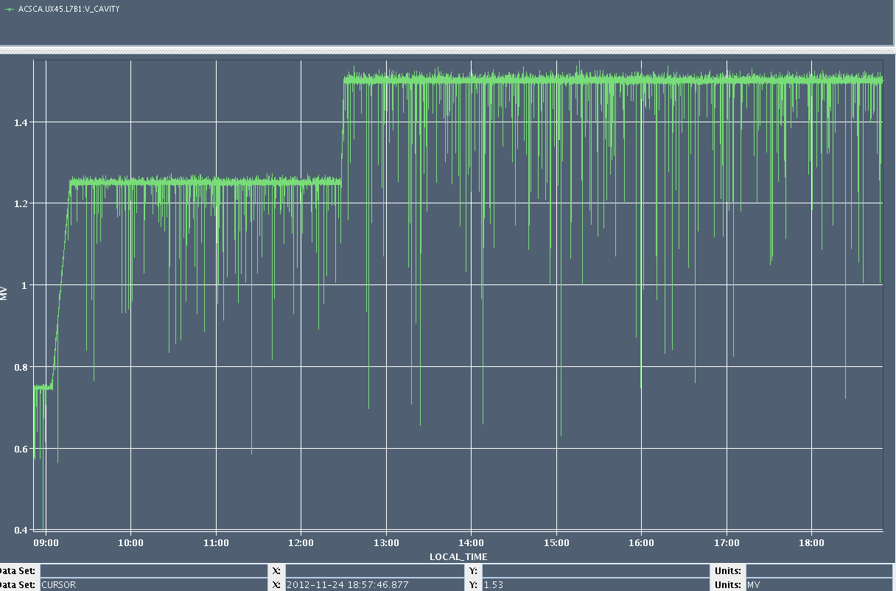
Saturday Morning
12:10h some “?” at the abort gab population
all looks fine but ...
klystron 7b1 power seems to drop
to zero from time to time
further investigation during fill ...
noise on cavity 7 beam 1

Slide 3
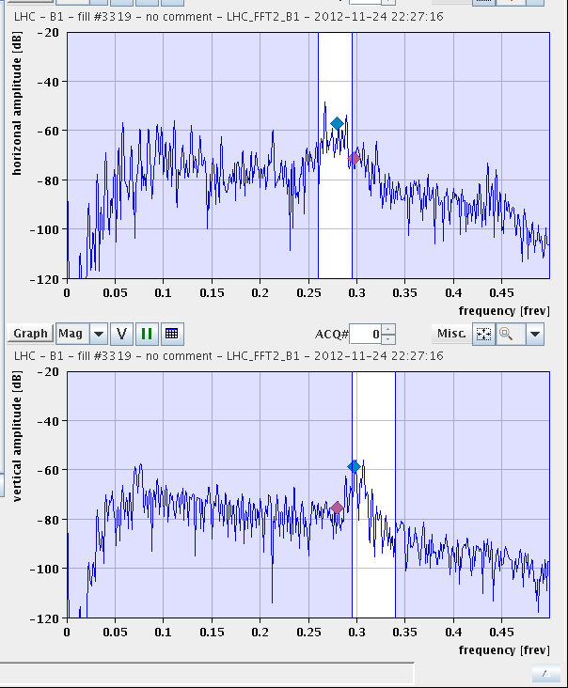
Saturday Late
baby sitting
20:20h beam dump (OP)
SPS MKDV3 switch has been changed
21:11h injection ... fill pattern with swapped 6 bunches
again: problems with BBQ, no tune signal
-> piquet
22:16 works again ... but ...
trying to chirp for the ramp ...
switch off gating
22:40 ramp ... basically without BBQ

Slide 4
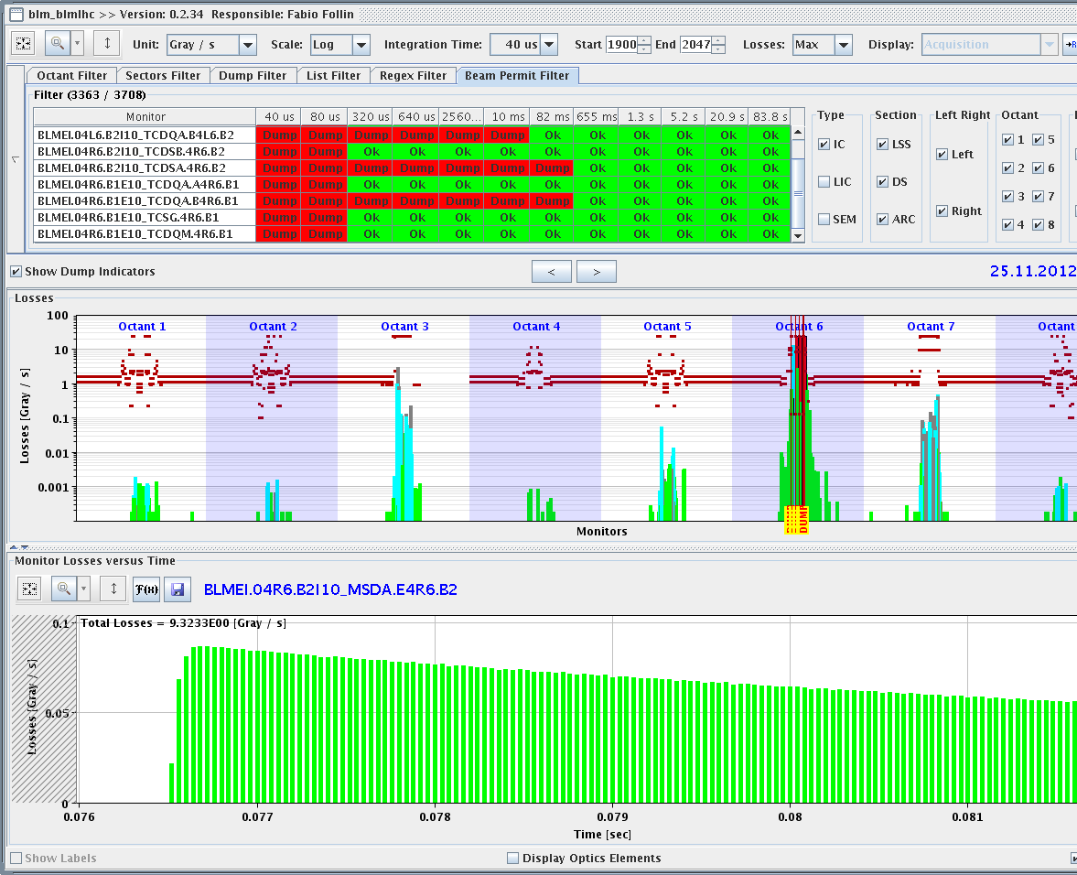
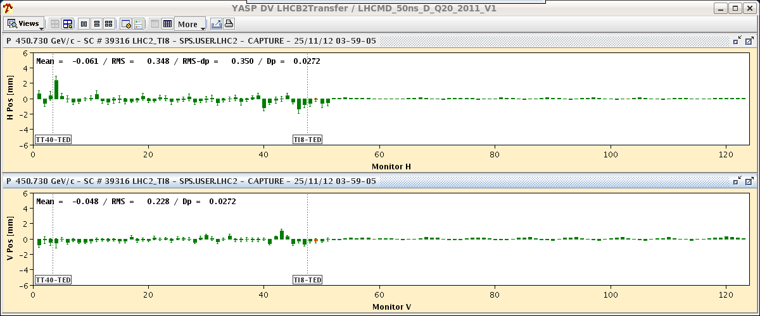
Saturday Night
22:35h ramp
22:40h flat top
23:30 stable beams
01:40h beam dump,
Spurious BLM trigger at L1, both beams
“(lost packet in communication)”
02:50h new injection, beam 1 ok
03:15h beam 2 not so good: beam dump,
losses during injecting in TI8
03:30h once again: new injection
Transfer-line trajectory corrected
04:07h ramp / flat top / squeeze
04:50h stable beams
L₀=7.0*10³³

Slide 5
Sunday Morning
end vdm scnas
spurious BLM trigger
TI8 losses
Plan:
next fill with enhanced satellites
Monday 06:00 dump for MD#4

