Slide 1
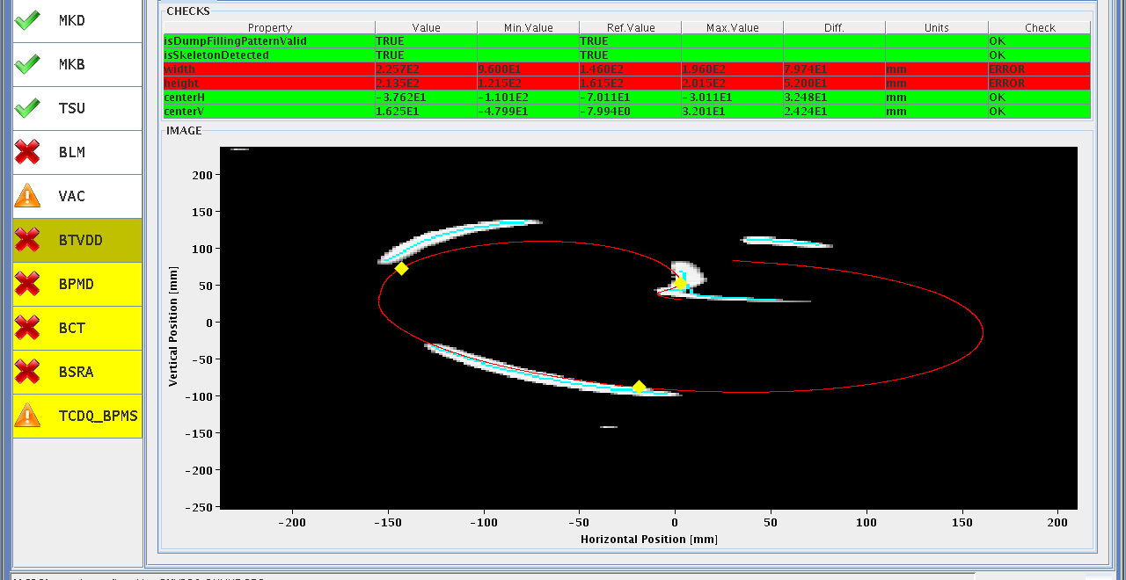
LHC Status Friday Morning 23-Nov
Bernhard Holzer, Mike Lamont
Thursday Morning
... since 02:30h TCT optimised for vdM scans
loss maps for validation done
07:00h set up new injection for vdM fill #2 to finish machine preparation
08:00h stable beams, optimising all IPs
beam mode adjust: scanning the separation bumps for check
09:00h asynch. dump test: ok
09:30h trip of RQ10.L8 tripped during ramp-down...
Access needed for repair of PC
... and for ATLAS (gas leak)

Slide 2
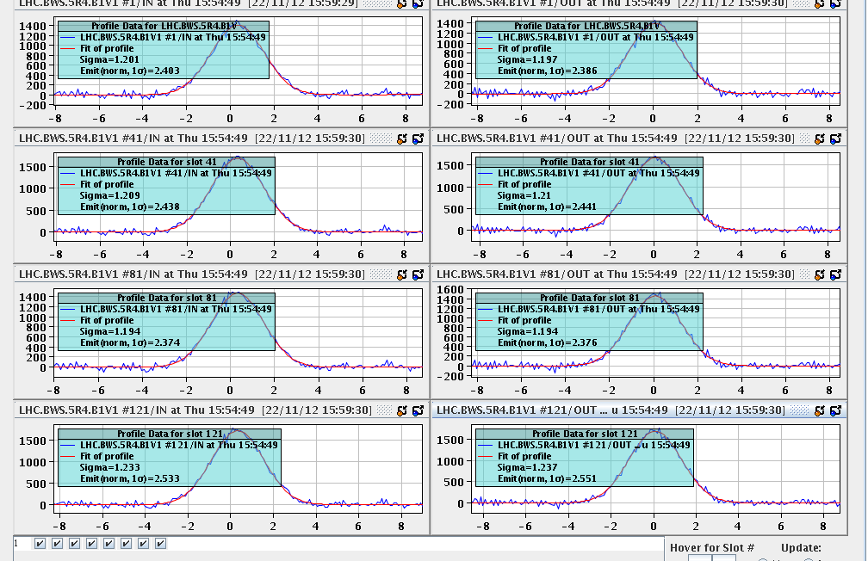
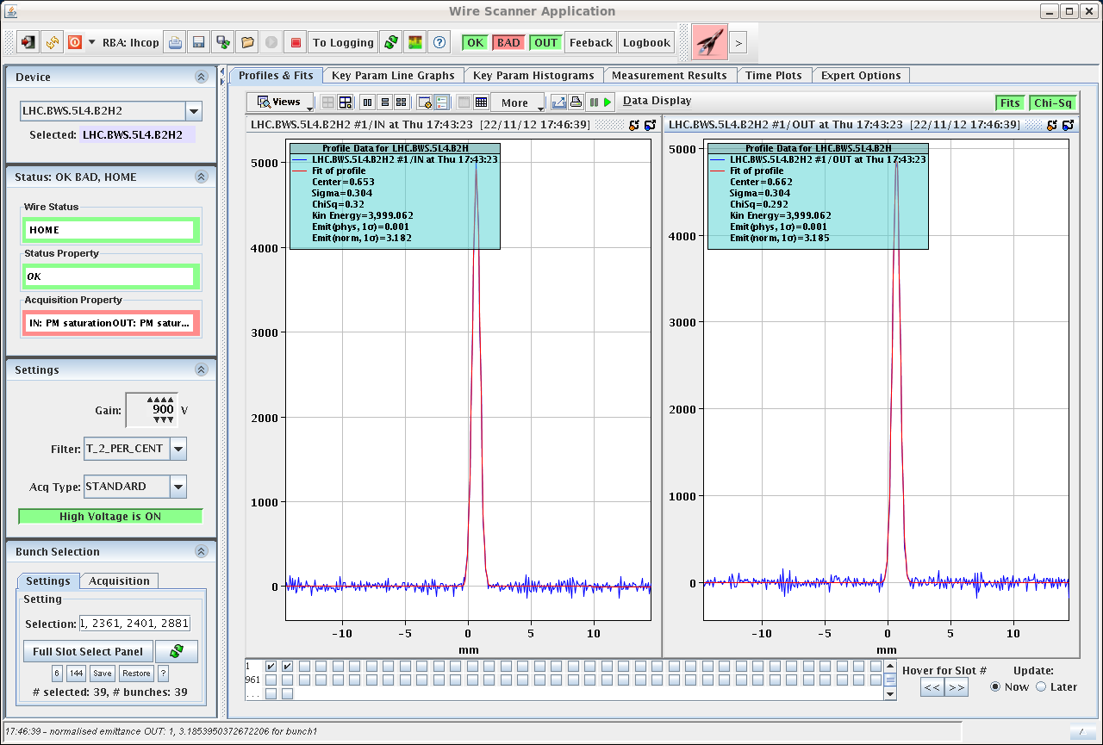
Thursday Morning
11:50h precycle
14:15h injection for vdm scan fill FINALLY
emittance measurement at injection
16:15h ramp
17:00h adjust & optimisation in all IPs.
17:45h wire scanner measurment at 4 TeV:
warnings at ≈ 77%

Slide 3
Thursday Late
17:50h Scan X plane ATLAS: -6 sigma to 6 sigma,
step of 0.5 sigma
18:20h Scan Y plane ATLAS: -6 sigma to 6 sigma,
step of 0.5 sigma
... to be repeated twice ☹
19:15h CMS cryoplant went down, CMS magnet running on Dewar.
23:40h Beam Dump:
loss over threshold at BLM Alarm due to wirescan measurement
??? quoi ???
00:00h Back to Physics Fill:
SPS vacuum problems -> conditioning efect for 50ns patterns at
exchanged magnet ? !

Slide 4
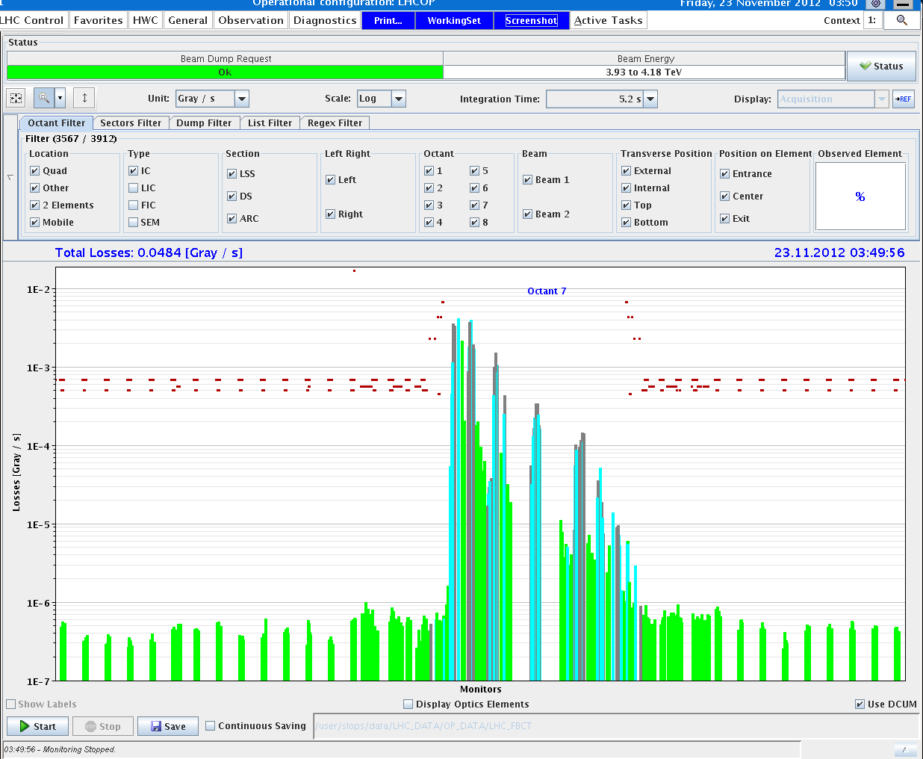
Thursday Night
-> go for Loss maps
02:41h injection physics beam
02:52h ramp
03:20h squeeze
03:40h adjust, loss maps
04:30h beam dump & preparation for new fill
see Wed 8:30 meeting

Slide 5
Thursday Night
05:20h trip of RB.A12 at standby
07:15h SPS problem with MKDV3 switch (since ≈ midnight)
i.e. another dump Kicker switch which is degrading
exchange being prepared, time estimate: 6h
Latest Status & PLAN:
07:30h * prepare for finishing the vdm scans for ALICE & CMS
* hoping CMS will be ready around 11:00h
* hoping that the SPS switch will do it for a couple of injections
* during the LHC vdms switch exchange in SPS
* Afternoon:
finally back home for good and simple physics runs

