Slide 1
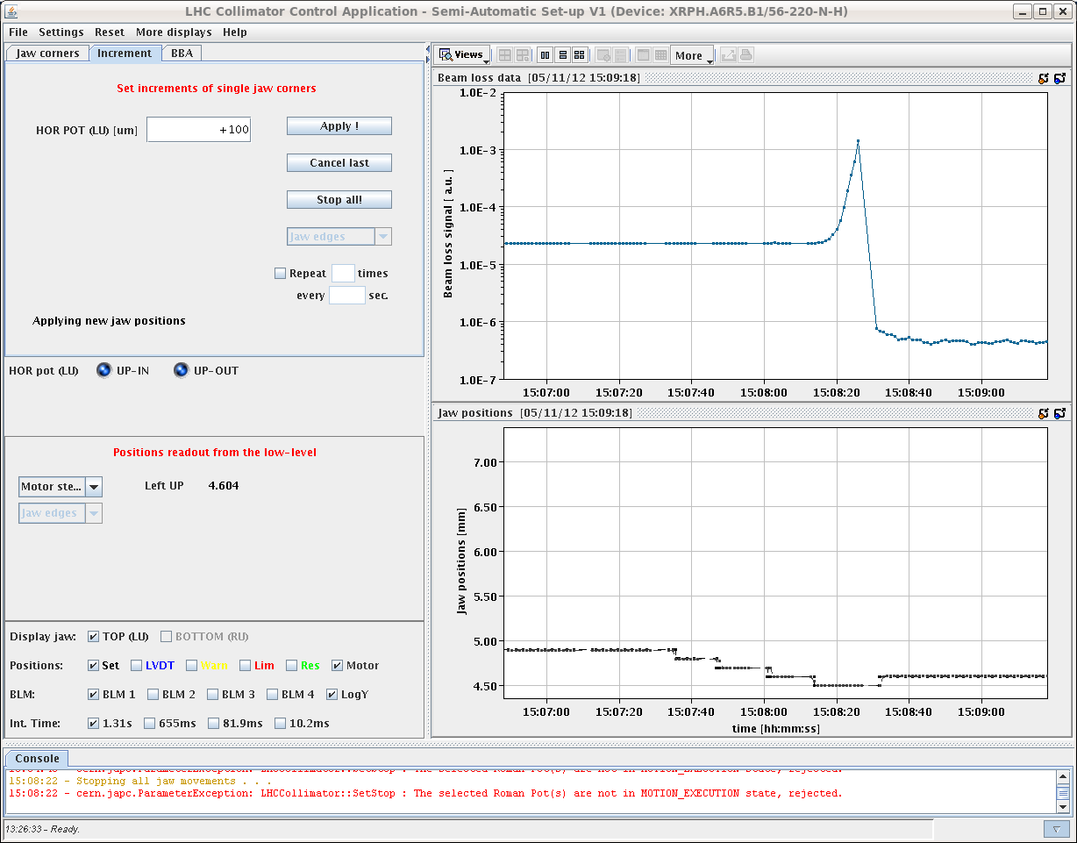
Monday 5.11. – Morning
Fill 3265 stable beams since 1:31
13:10 injectors ready to deliver beams
13:30 End of fill study for roman pots
TCLs in IP1 and IP5 opened to >60σ
Roman pots moved in
14:45 all ALFA pots at final position
15:08 beam dump because of losses when XRPH.A6R5.B1 at 32σ:
Losses rising during several seconds after the movement of the RP
Dump by RS7, RS8 and RS9 BLMEI.06R5.B1E10_XRP (same one which dumped last time at similar sigma)
No scraping at the time of movement; no instability seen

Slide 2
Afternoon
Integrated luminosity fill 3265 in 13h36’:
ATLAS/CMS: 183 pb-1, LHCb 19 pb-1, ALICE 174 nb-1
15:39 – 17:57 RF line 1B1 LL problem during ramp down
Access in UX451 to change a CPU
Pre-cycling
19:10 injecting again
transfer line steering
19:43 trip of RF line4B1, pre-driver faulty (dump during injection) -> re-injecting
20:27 – 20:39 SPS no extraction B1 (MST and MSE over temperature)
21:00 re-start injection

Slide 3
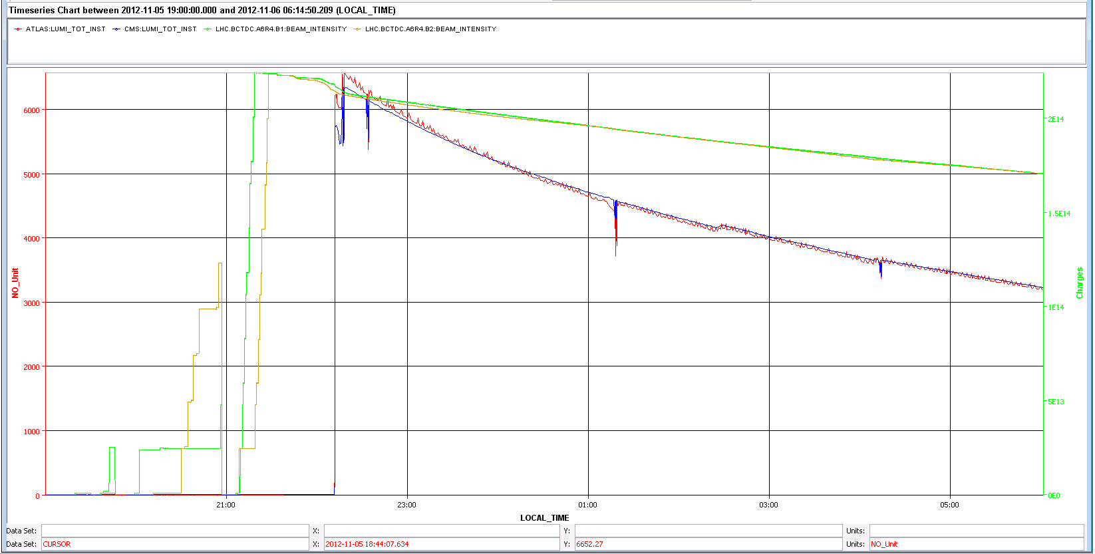
Night
22:16 stable beams fill 3266
1.55E11 ppb at the start of stable beams
Peak luminosity ~6.4 10³³ cm⁻²s⁻¹
Transverse emittance ~2.54 um
2:24 increasing the RF voltage to nominal

Slide 4
Pending
No beam from SPS after 5am Tuesday 6.11., technical stop:
Magnet repair: estimated Tuesday 19:00 or Wednesday morning
Wire scanner repair: estimated Tuesday midnight – Wednesday morning
Accesses
BLM IP2 installation of 1 Little-IC and 1 Flat-IC (3 hours without beam for DB update)
ALICE 4 hours
?

