Slide 1
Summary of Week 44
Coordination:
Mike Lamont & Jan Uythoven

Slide 2
The weekend: Friday
08:45 Stable beams Fill #3253 Initial luminosity ~7.3e33 cm-2s-1
09:45 Increase RF voltage from 10 MV to 12 MV
12:00 ADT to wideband settings
12:38 Beams dumped, lost BLM crate L8. 79 pb-1 in 3h53m
BLM card change and BLM CPU change. Access BBQ and ATLAS.
17:48 Start pre-cycle
19:30 Transfer line steering
20:29 Beams dumped on last injection B2, LHCb BCM
22:09 Filling for physics
23:39 Fill #3259. Stable Beams. Initial lumi 6.5e33 cm-2s-1

Slide 3
The weekend: Saturday
09:04 Beams dumped: Sector 67 trip, RB.A67 ST_ABORT_PIC. Integrated lumi 143 pb-1 in 9h25m.
10:00 Access for ALICE and P6 for MPE piquet and QPS: RB 67 trip was about the sixth time: micro-switch changed.
13:45 Pre-cycle
14:30 Cryogenics problem IP2
16:10 Cryo OK
16:40 Injecting physics beam
16:42 Successful start-up of daughter number 2 of ML
19:15 Stable beams fill 3261, initial lumi 7.3e33 cm-2s-1

Slide 4
The weekend: Sunday
00:55 Beams lost due to possible spurious BLM trigger point 7. Fill 3262 delivered 105 pb-1 in 4h42m
03:59 Stable beams fill 3262, initial lumi 7.0e33 cm-2s-1
04:27 Beams lost due to instability B1. Delivered 11 pb-1 in 0h27m
05:25 Injecting, problems B2 stability, suspect ADT.
04:54 No beam from SPS
07:14 SPS back again, checking ADT at injection.
09:30 Intervention on ADT, set-up of ADT with 6 indivs.
11:30 Ready to inject for physics.
12:54 Stable beams fill 3264, initial lumi 7.1e33 cm-2s-1.
14:25 Beams lost due to spurious BLM trigger L1. 33 pb-1 in 1h31m.
15:27 PS Booster problem: initially RF but then serious problem on injection, stray field compensation. Understood, to be fixed during day.
00:02 Start filling
01:31 Stable Beams fill 3265. Initial lumi 7.0e33 cm-2s-1.

Slide 5
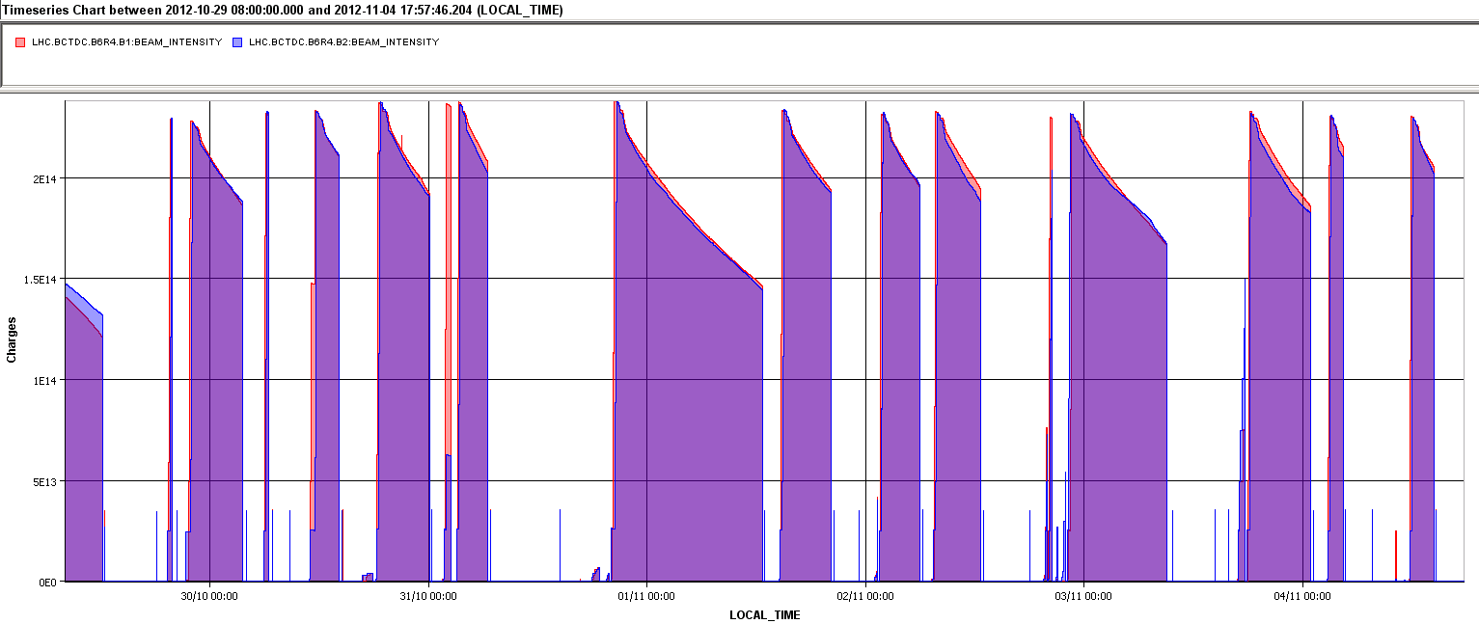
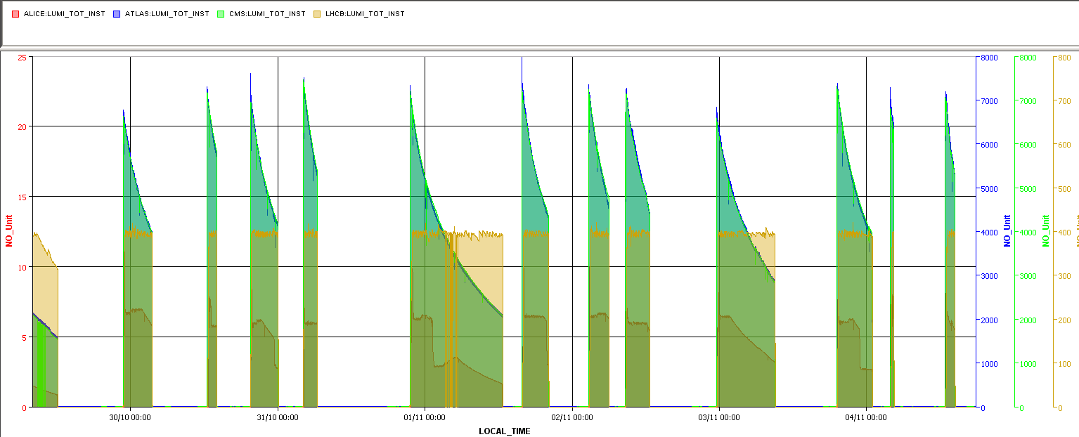
The week: many short fills
Beam Currents
ALICE
Fibre & 18 kV
BLM
ADT
PSB
ATLAS & CMS
Lumi’s
LHCb
ALICE

Slide 6
The week – fills summary
Fill | Day | Peak lumi | Stable beam [h] | Int L [pb⁻¹] | Dump
3236 | Sun 28/10 | 7.40E+33 | 4:00 | 50 | Operator dump (inherited fill)
3238 | Mon 29/10 | 6.70E+33 | 4:36 | 81 | QPS trigger, two correctors IP 5
3240 | Tue 30/10 | 7.20E+33 | 1:27 | 32 | QPS RQ5.L1 trigger
3242 | Tue 30/10 | 7.00E+33 | 4:27 | 85 | RF trip Line4 B1
3244 | Wed 31/10 | 7.34E+33 | 2:14 | 50 | QPS heaters powered RQ4.L1, – SEU?
3249 | Wed 31/10 | 7.20E+33 | 14:59 | 199 | Operator dump
3250 | Thur 1/11 | 7.20E+33 | 4:17 | 83 | QPS trigger RQX.L1
3252 | Fri 1/11 | 7.10E+33 | 3:13 | 65 | QPS on RCB.XV1.R1
3253 | Fri 1/11 | 7.30E+33 | 3:53 | 79 | BLM crate L8
3259 | Fri 1/11 | 6.50E+33 | 9:52 | 143 | QPS trip of RB.A67
3261 | Sat 2/11 | 7.30E+33 | 4:42 | 105 | BLM false trigger point 7
3262 | Sun 3/11 | 7.00E+33 | 0:27 | 11 | Instability B1
3264 | Sun 3/11 | 7.10E+33 | 1:31 | 33 | BLM false trigger L1
3265 | Mon 4/11 | 7.00E+33 | 07:00 | 115 | Still in
 | Total |  | 2d18h | 1131
> 1.1 fb-1, 40 % in physics

Slide 7
Major down time
Optical fibres and SPS 18 kV, planned intervention
Wednesday, planned: Footprint of 6 hours
No knock-on effects, many thanks to Pierre Charrue & team
SPS 18 kV short found
BLM replacement of cards and CPU
Friday: 4 hours, 15 min
ALICE emergency intervention, QPS in shadow profited to replace micro-switch
Saturday: 4 hours
RF- ADT replacement of DSPU board
Sunday: 4 hours
PS Booster, RF and injection problems
Sunday: 8 hours 35 min
Total with smaller events, 1day and 18 hours : 25 % downtime of which about 1/3 due to injectors

Slide 8
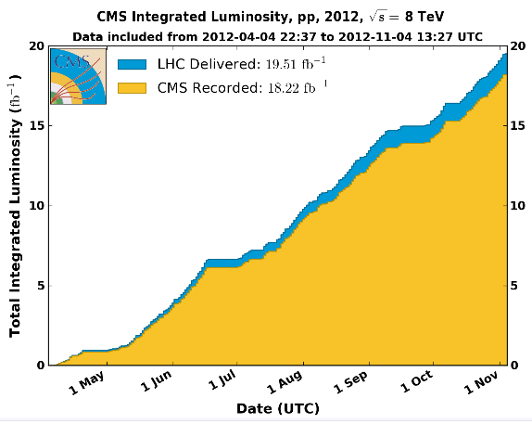
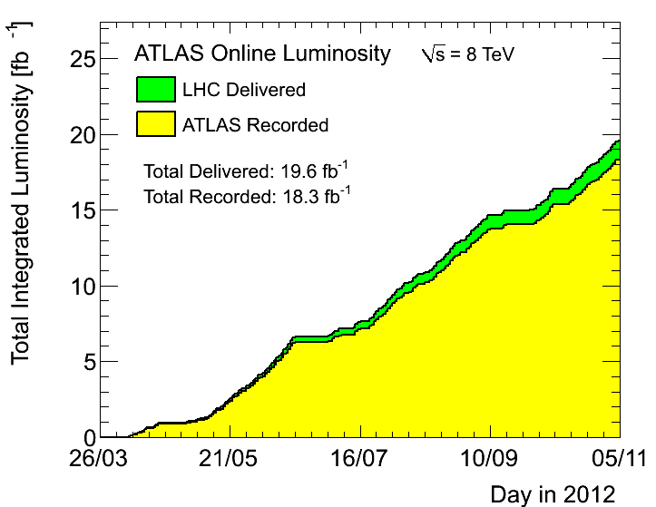
Total lumi’s (yesterday evening)

Slide 9
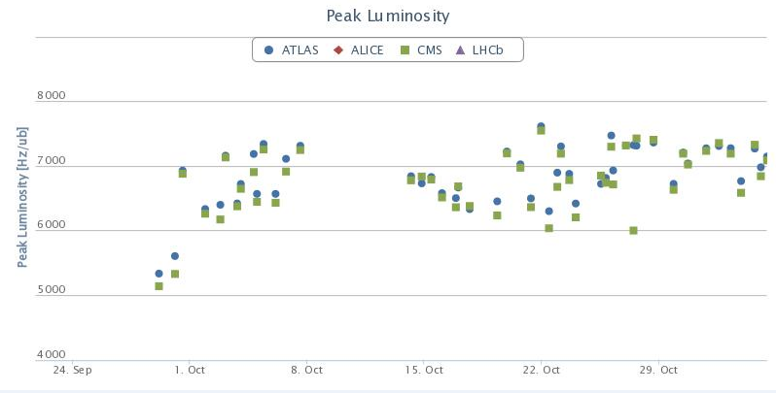
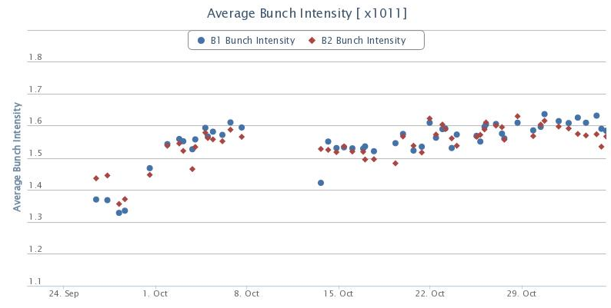
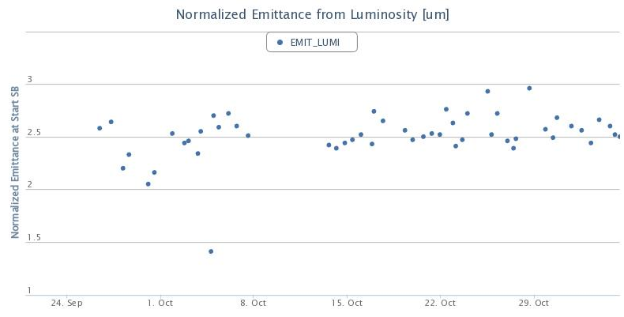
Plots from statistics pages, since TS3
Peak lumi steady above 7e33 cm-2s-1
7000
Bunch intensity taken down a bit, emittance start of sb rather constant

Slide 10
RF voltage and heating: Voltage down
Monday morning reduced RF voltage as end of fill test
Counteract heating BSRT, ALFA and MKI
New operational procedure for RF
Batch by batch blow up with new target value of 1.5ns (instead of 1.4ns)
Decrease voltage during ramp with correspondingly increased bunch length target during blow-up (10 MV and 1.36 ns) to keep the same longitudinal emittance.
Later in the week brought back up voltage during physics to gain back some lumi

Slide 11
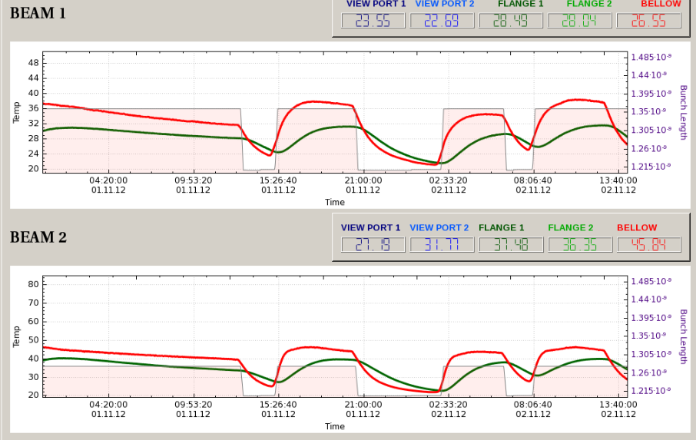
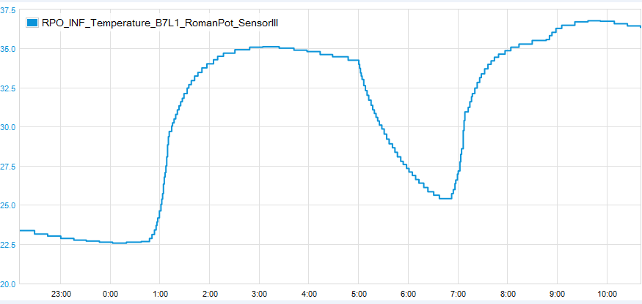
Voltage UP, after 1 hour in stable beams
BSRT, no significant effect
ALFA, sees an effect
No significant effect on MKI

Slide 12
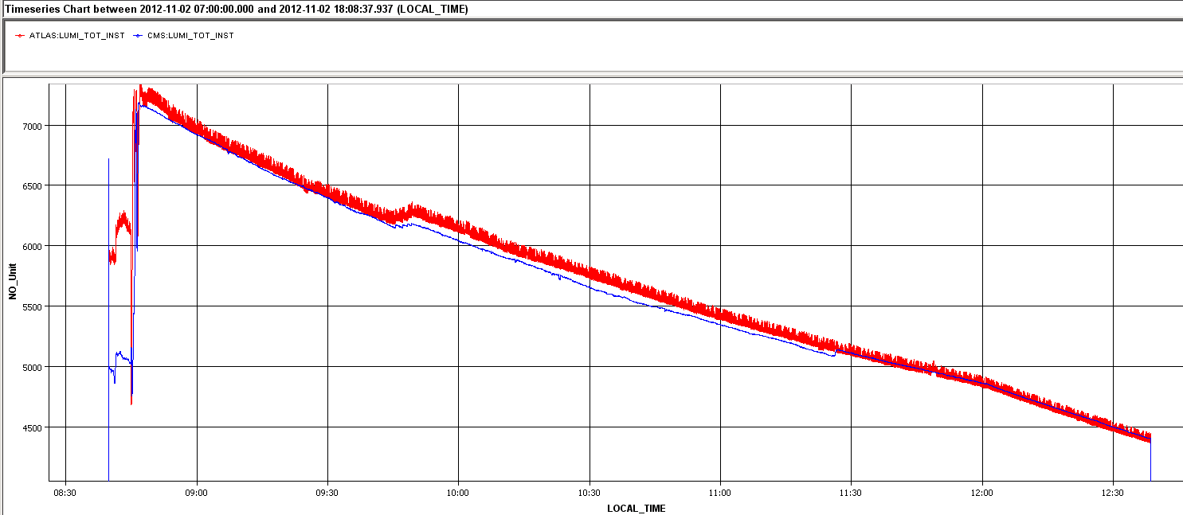
Effect RF on lumi
Good for the lumi to increase to RF voltage
ADT wideband settings, after optimisation, still a (small) negative effect on lumi lifetime

Slide 13
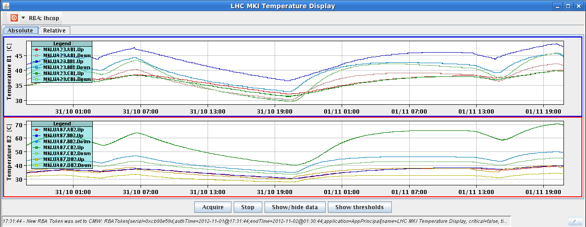
MKI temperature
One outlier: MKI.8C.
Not understood why this one hotter. Different layout with damping ferrites and resistor
This magnet also has higher ‘tube temperature’
Increased SIS interlock limit in few steps after rise time measurements when kicker is hot
SIS limit now at 66 °C
Did not significantly delay injection during this week. Keep an eye on it
MKI.8C
40

Slide 14
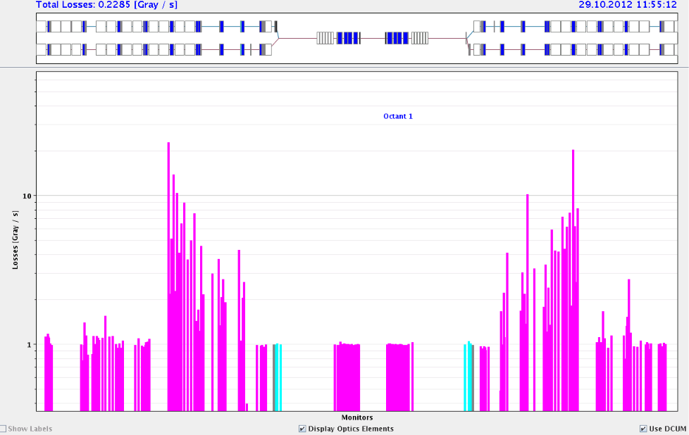
Taking out TCLs and Roman Pots
Debris collimators at the IP
Effect on cryogenics load tested OK
Effect on cryo load – first order ok
More detailed analysis to come (?)
TCLs can be taken out when Roman Pots to be moved in
Planned to take Roman Pots out this week as end-of-fill
End-of-fill never happened
Ratio of losses TCL-out/TCL-in in IR1

Slide 15
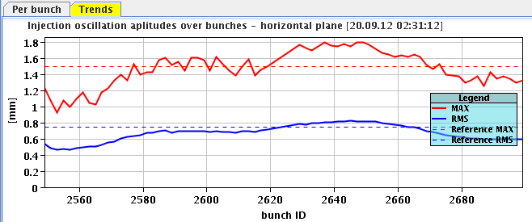
Injection
Steering for oscillations regularly needed.
Steered on 144 bunches (with intermediate 6 bunch ‘safety’ shot)
B2 horizontal oscillations
Injection fill 3256 on Friday evening:
Last injection: Dump triggered by LHCb BCM upon injection of 144 bunches
In the past this was related to large satellite population...

Slide 16
Effect of batch-by-batch blow-up on inj. losses
Friday, fill 3256, blow-up 1.5 ns, dumped on LHCb BCM last inj
Saturday, fill 3261, stop blow (up to 1.1 ns), losses not worse at the end
Sunday fill 3262, with 1.5 ns blow-up
Sunday fill 3264, with 1.1 ns blow-up: ok again
Lene has been asked to check loss statistics for the different injections, also depending on bbb blow-up

Slide 17
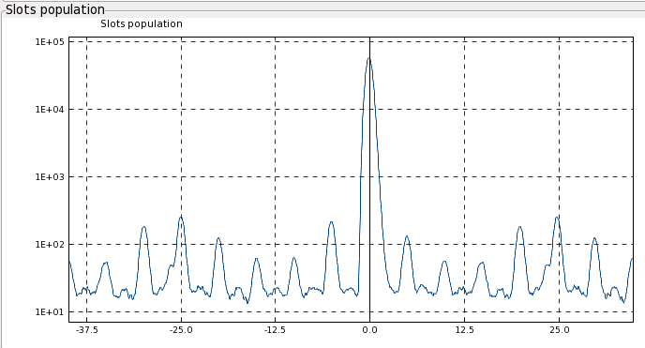
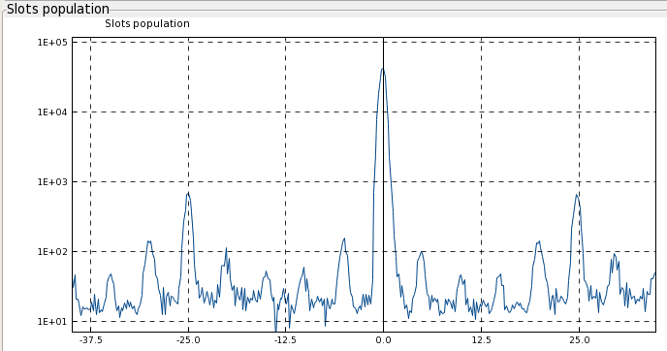
Satellites and ghosts
LDM in physics – satellites at +/- 25 ns.
ALICE lumi max about 8 – not that large. B1 B2
They can effect injection losses as they are extracted from the SPS, wider extraction pulse, but lost by LHC injection kicker which has a tighter pulse
Satellites at 25 ns (from PS)
Ghosts at 5 ns (from SPS capture)

Slide 18
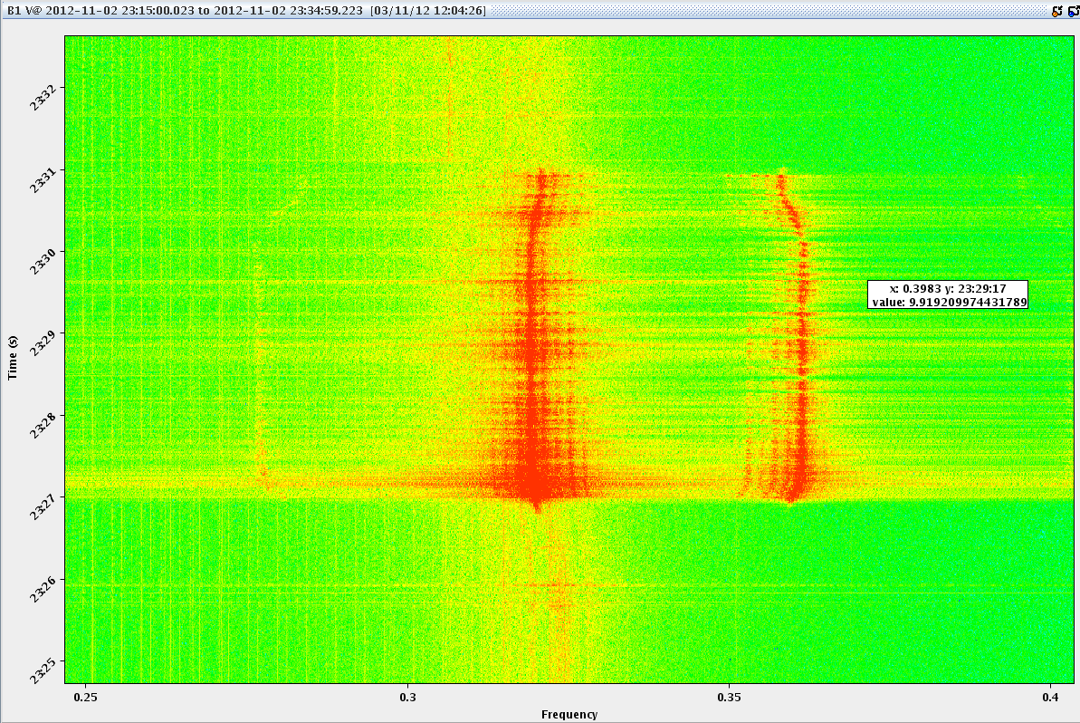
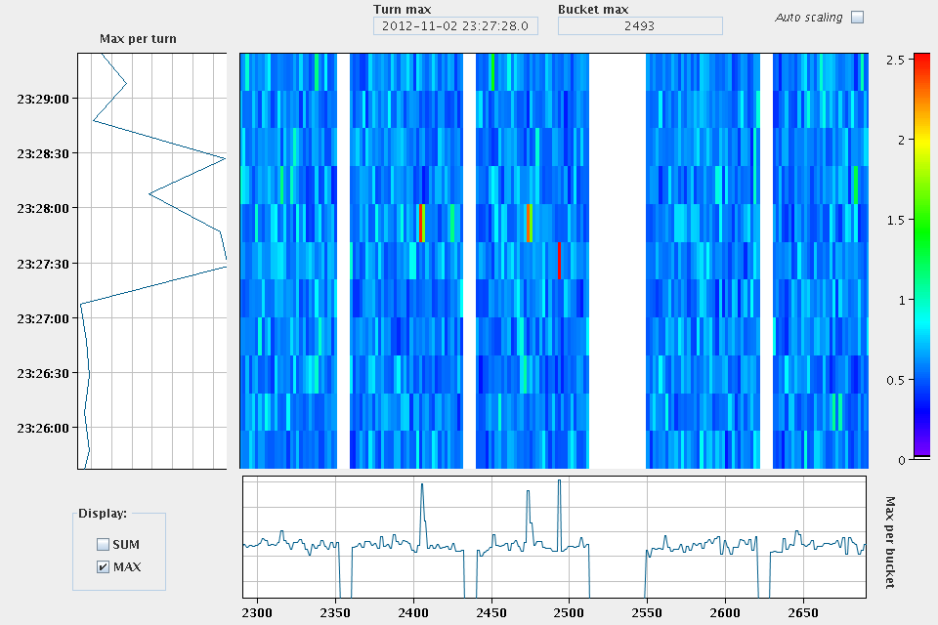
Instability end of squeeze
Beam OFTEN going unstable end of squeeze
At present not a problem for losses, but can blow-up the beam which will reduce luminosity
Introduced tune split between the two beams
Vertical tune B1 trimmed down by 0.003
Did not seem to help

Slide 19
Outstanding
SPS availability
SPS presently without timing system…
Tuesday starting at 8:00:
12 hours technical stop if leaks can be fixed
24 hours if magnet needs to be replaced
Injection still ropey – to be re-visited
Check ghost and satellite production in SPS
Related to batch-by-batch blow-up?
Also transverse quality of the beam from the injector chain
Better with smaller bunch intensities?
ALFA & TOTEM
Move in Roman Pots end of fill
ALFA with TCLs in or out
TOTEM only with TCLs out
This week Joerg and Barbara coordinating

