Slide 1
Monday 29 October
08:48 V/dM scan CMS end of fill #3236. Check of “fast scan”.
10:06 V/dM scan finished, start of RF studies, reducing RF voltage.
11:10 RF voltage reduced from 12 MV to 9 MV.
11:51 Opened TCLs to test for future retraction tests: OK
12:00 TCL tests finished.
12:08 Beams dumped by operator. Integrated lumi 216/0.20/211/25.1 pb-1.
13:10 Access for experiments, EPC and CV.
There is nothing like ‘A Quick Access’
15:26 QPS trip of matching section R8, related to EPC intervention on RD2.R8 earlier.
18:00 Bad contact found, start pre-cycle.
18:54 Injecting probes.
19:50 Ramp started fill #3237.
19:50 Beam dumped by LBDS at start of ramp, energy tracking MKD B2, generator L.
21:12 Injecting physics beam fill #3238.
22:55 Stable beams, initial lumi’s 6.5e33 cm-2s-1.
03:32 Beam dumps two correctors tripped in 5
Problems refilling: RF crowbar (solved, not understood), PC faults IT.R5: access

Slide 2
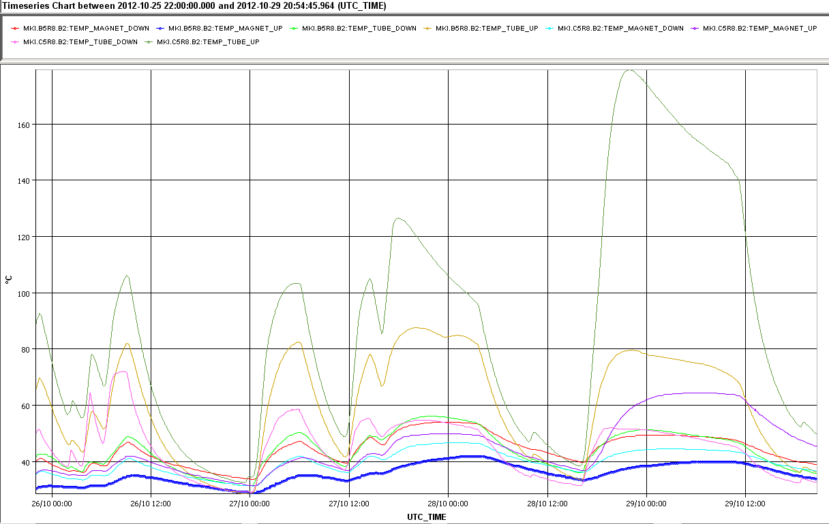
Kept beam in because injection kicker temp.
MKI.8C still hot
But prepared to temporarily increase temperature interlock after analysis of SoftStart data with ‘hot’ magnet.
Temporarily because temperature increase on this magnet not ‘normal’, likely due to HOMs. Tube damping ferrite getting very hot, about 180 °C.
Temperature interlock on this magnet increased from 58.3 degrees to 60.5 degrees.
Tube temperature
160
Yoke ferrite
40

Slide 3
End of fill – LHC RF Team
Reduction of RF voltage on both beams in steps from 12 MV to 9 MV lead to bunch length increase by 100 ps. Then bunch length was decreasing slowly as before (5-6 ps/ hour). Small reduction of luminosity at the moment of changes was observed and then lifetime was restored to the previous value.
Beneficial effects was observed on the ALFA pots.
Next fill:
Batch by batch blow up with new target value of 1.5ns (instead of 1.4ns)
We decrease voltage during ramp with correspondingly increased bunch length target during blow-up (10 MV and 1.36 ns) to keep the same longitudinal emittance. We will monitor...
Future: Voltage can be increased again during physics (slowly) to recover the luminosity geometrical factor if necessary.
Longer bunches can be beneficial not only for beam induced heating but for transverse stability.

Slide 4
The end of an 18 h fill
Not a record – longest is 22.8 h
ATLAS and CMS integrated lumi’s well over 200 pb-1

Slide 5
Access & Problems
Access for all experiments
EPC (2,4,6) and CV (water pump)
Vacuum pumps at P6 were switched on, but an intervention is needed to fix VRPA.25.4R6.B
EPC RD2.R8 intervention followed by QPS problems of the complete matching section
Another access needed, bad contact found.
First ramp beam lost at start of ramp due to LBDS tracking error on MKD generator L
PLC problem – will need two hour access with specialists
Temporarily reduced redundancy from 1oo4 to 1oo3

Slide 6
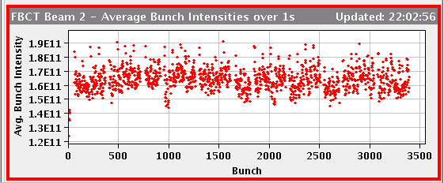
Fill #3238
Not the best beams from the injectors, large spread in bunch intensity
Stronger batch by batch longitudinal blow-up resulting in losses at warning level (32 %) on IP3 momentum collimators.
Reduced RF voltages at flat-top
Losses of 10 % on the 6 non-colliding bunches.
Initial lumi’s rather low, 6.7e33 cm-2s-1
While in physics, observed smaller temperature rise in BSRT beam2, as well as MKI beam2. B. Salvant also reports less heating on Alfa.
03:32 Beam dumps two correctors tripped in 5. Int lumi 81 pb-1.

Slide 7
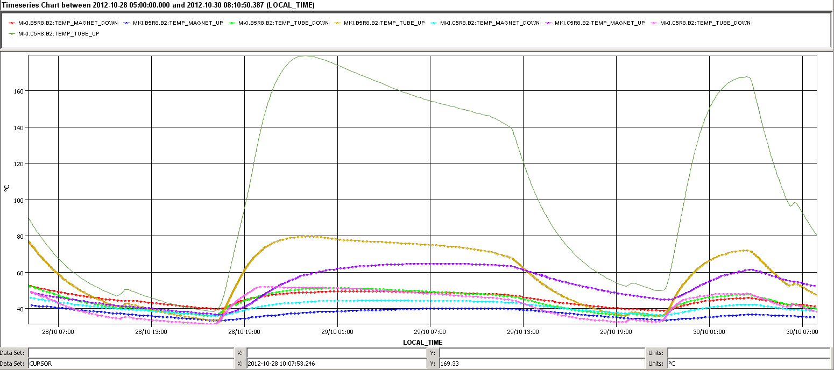
MKI heating
MKI.8C heating less
But (peak) lumi was lower as well
tube
tube
yoke

Slide 8
Refill for fill #3239
RF crowbar ACSLine1B2 ACSLine4B2 ACSLine3B2 ACSLine2B2
Lost RQX.R5, RTQX1.R5 and RTQX2.R5; PC fault
Access for EPC - ongoing

Slide 9
On the list
Access
Vacuum
VRPA.25.4R6.B
Recurring problem: “Had to restart the SIS monitoring for VAC_VGPB.137.5L2.B_ACQ. “
LBDS energy tracking MKD B2, 2 hours.
Operational development
ADT tests at injection, 1-2 hours
Intervention on fiber optics Wednesday morning
Most likely no beam, may be access

