Slide 1
Summary Week 43
Coordination: G. Arduini, E.B. Holzer
High beta* run: H. Burkhardt

Slide 2
Sunday 28.10.2012

Slide 3
Sunday 28/10
4:30 – 6:34 several power glitches (EDF) and several trips: RDs, LHCb dipole, RBs;
PS and SPS set-up to increase satellites for ALICE
9:00 pre-cycle
11:11 dump during ramp (fill 3233): Noise on MKD B2 generator L
12:00 – 13:40 SPS no beam due to RF problem
12:30 – 14:20 access for ATLAS muon detector
Access for MKD to fix MKD noise problem
14:20 – 15:30 SPS no beam due to RF problem
16:00 injecting, atempt to set-up B2 BBQ gating by R. Steinhagen, M.Gasior (with new BOBR FESA class from L.Jensen) → needs another iteration
18:09 stable beams fill 3236
initial luminosity ATLAS/CMS: 7.3E33 cm-2s-1, Alice 7.7E30 cm-2s-1
Arrived close to head-on in IP1,2 and 5 – declared stable beams before optimizing these points

Slide 4
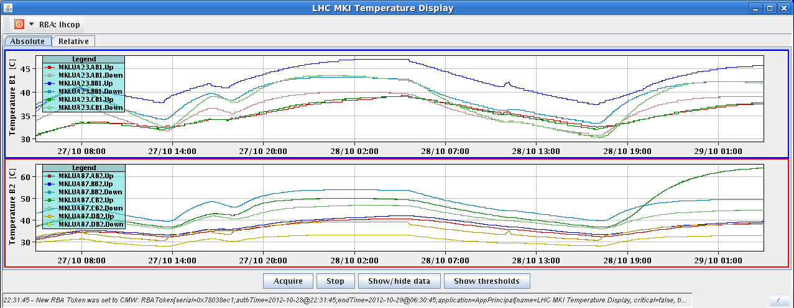
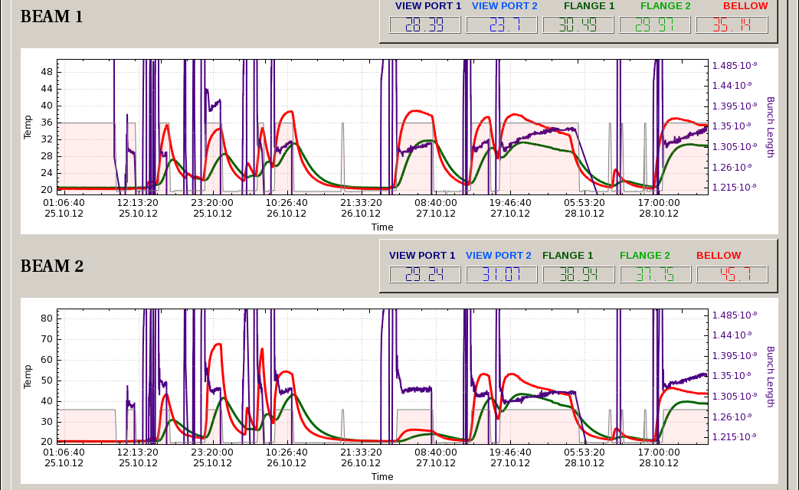
Fill 3236
MKI8_C_UP B2 temperature rising much more than previous fills >60 deg, 111%
~ 6 hours of cool-down without beam
BSRT B2 temperature lower again

Slide 5
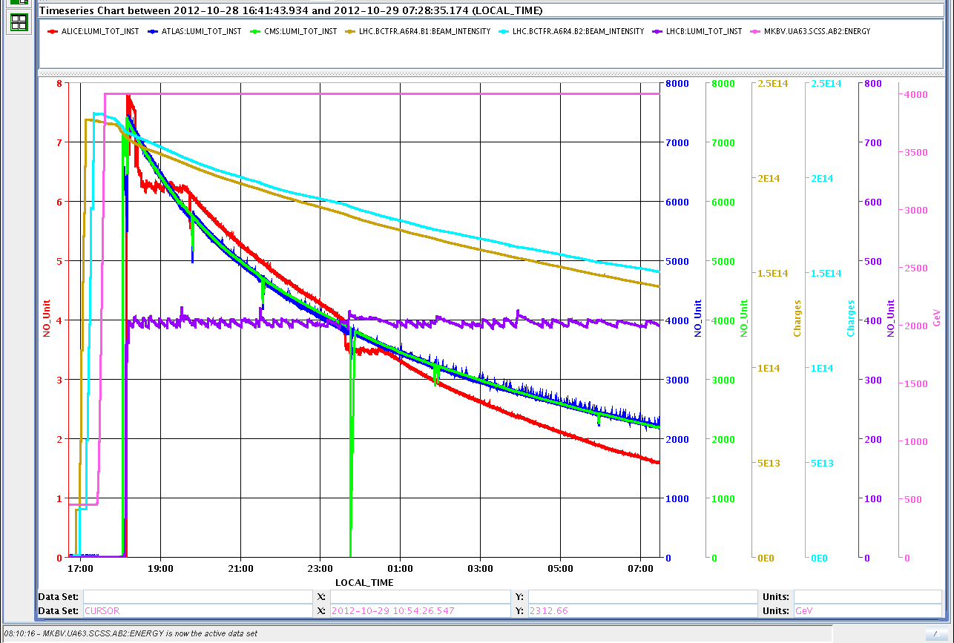

Slide 6
Overview Week 43
Luminosity production
24 hours of high beta* physics

Slide 7
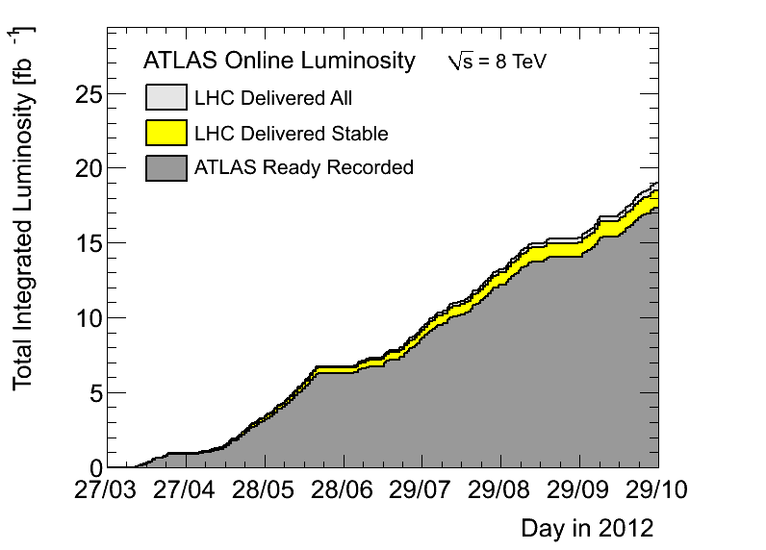
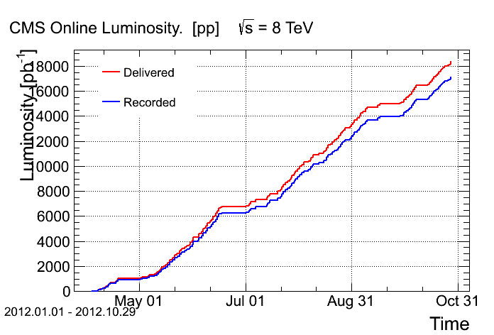
Summary
ATLAS: 18.37 fb⁻¹ CMS: 18.34 fb⁻¹ ALICE: 5.48 pb⁻¹ LHCb: 1.75 fb⁻¹
Week 43: Total: 933+ pb-1 produced
37% of time spent in stable beams or “quiet beams”

Slide 8
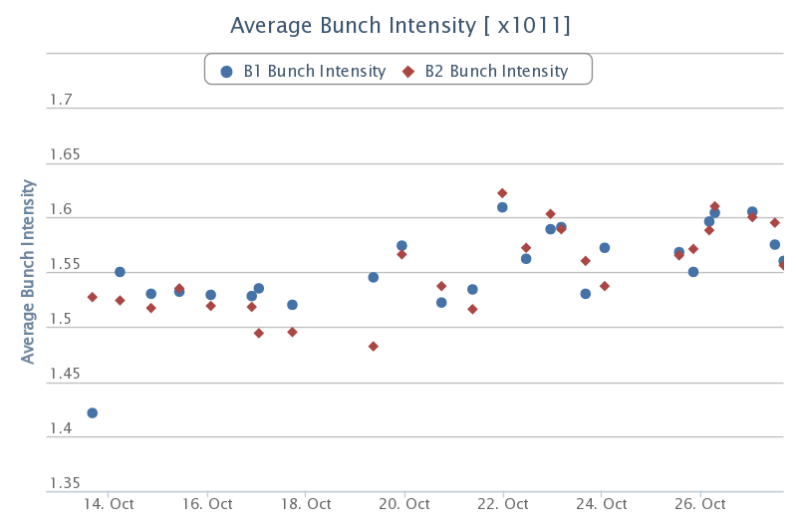
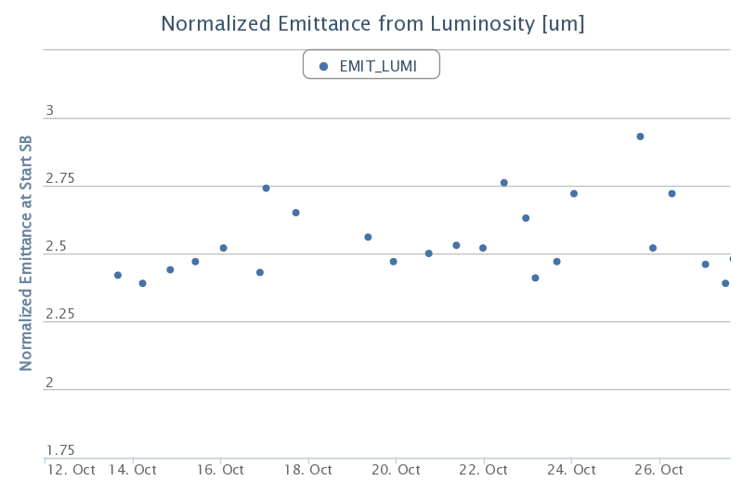
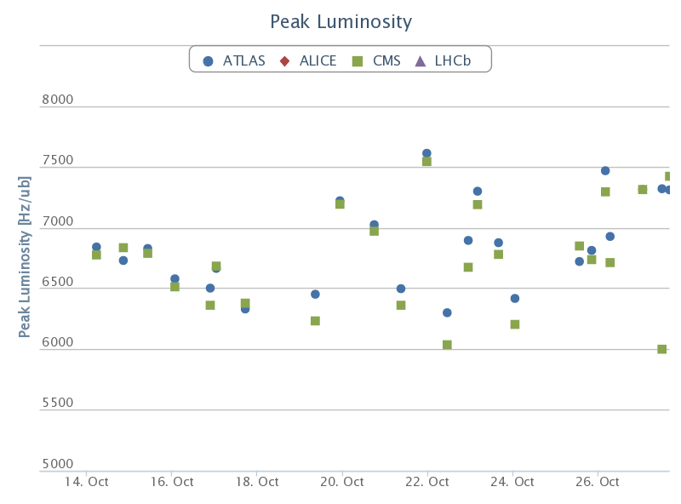
Bunch intensity, emittance, luminosity

Slide 9
Fills with stable beams
Fill | Day | Stable beam [h] | Int L [pb⁻¹] | Dump
3207 | Mon 22/10 | 4:12 | 88 | WorldFIP repeater: loss of communication PC in 78
3208 | Mon 22/10 | 4:11 | 73 | trip of RD2.L5 (QPS)
3209 | Mon 22/10 | 2:32 | 53 | EDF glitch – FMCM triggered
3210 | Tue 23/10 | 3:08 | 66 | MKB_B2 ion pump tripped - vacuum spike - dump system internal fault
3212 | Tue 23/10 | 0:56 | 21 | Trip of power converter RQT12.R1B2 (probably SEU)
3214 | Wed 24/10 | 5:26 | 95 | OP, for high beta* run
3220 | Thu 25/10 | 0:23 | 9 | PIC_PVSS to PIC_PLC communication lost – orbit correctors S56 switched off – dump by BLM system (80um orbit change in arcs)
3223 | Thu 25/10 | 1:33 | 34 | Trip of RCBXV3.R5 (probably SEU)
3225 | Fri 26/10 | 0:01 | 0.4 | Beam losses (800ms) B2, BSRT region
3226 | Fri 26/10 | 1:46 | 38 | OP, for power grid intervention EDF-SIG
3229 | Sat 27/10 | 4:21 | 88 | LBDS B2 ASIBUS card (safety bus)
3231 | Sat 27/10 | 1:56 | 32 | Trip of RCBWV5.L7B1
3232 | Sat 27/10 | 10:39 | 161 | Electrical glitch (EDF) – FMCM triggered
3236 | Sun 28/10 | 12+ | 174+

Slide 10
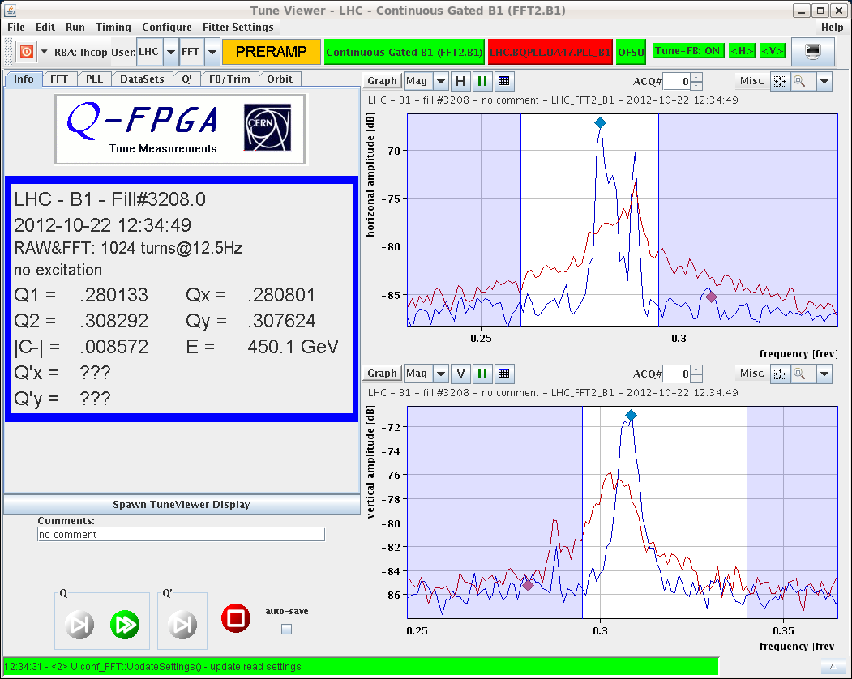
System Tuning in Week 43
Batch-by-batch longitudinal blow-up at injection - operational
Gated tune measurement and feedback on B1 – operational, but still under optimization
Tune measurement gated on the last of the first 6 bunches
ADT gain on the first 6 bunches reduced several times to improve tune signal
BBQ Hardware changed to improve sensitivity
BBQ spectra comparison before (red) and after (blue) changing ADT gains, gated on sixth bunch of the first batch of six bunches

Slide 11
System Tuning in Week 43
High bandwidth damper during the squeeze up to collision than back to lower bandwidth – unchanged since fill 3212
Satellites from the injectors
Normal ADT | High BW ADT (ramp till physics) | High BW ADT (ramp till collision process) | High BW ADT (squeeze till collision process
3203, 3207 | 3200, 3201, 3204 | 3208, 3209 | Since 3210
High BW ADT during stable beams

Slide 12
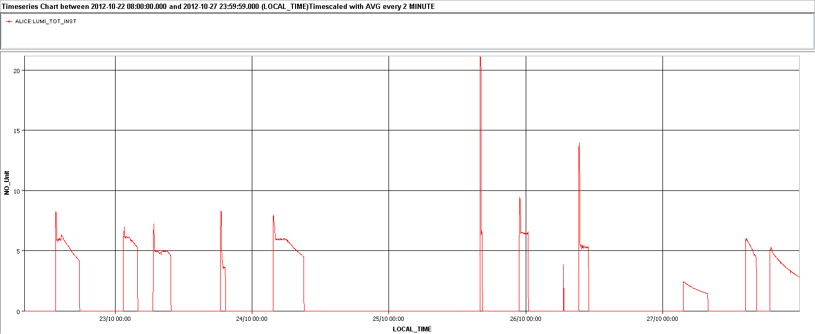
Satellites for ALICE
25/10 12:27 Enhancement of satellite population
25/10 20:40 Reverted back due to LHCb triggers at injection
26/10 17:24 Longitudinal set-up (adjustment of re-bucketing on h=84). But no more satellite (LHC not informed)
27/10 10:36 Increased PS longitudinal blow-up to generate satellites. Not enough
28/10 increase satellites again: >7.7E30 cm-2s-1

Slide 13
Monday 22/10
Injection line TI8 (L. Drosdal): IQC threshold for BPM.87604.H from 2mm to 2.5mm to avoid unnecessary latches due to variations coming from the MKE. Losses and injection oscillations still fine
18:11 PC trips in S23 (CS/CM lost for AML3)
The temperature sensors of one 600A current lead went in fault
→ Access: cryogenics access to tunnel UA27 for verification of a temperature sensor on DFBA DLCM chimney 15 → electronics card replaced
Also access for ATLAS
22:07 RQ8.L1 tripped
22:25 all accesses finished

Slide 14
Tuesday 23/10
10:19 – 14:46 Faulty sensor on a turbine of a warm compressor in point 8 tripping twice and leading to loss of cryo start/maintain of the matching section R8 (Sector 81). Sensor disabled (SW-wise and HW-wise). Had to pre-cycle twice.
15:00 – 16:30 Commissioning of batch by batch longitudinal blow-up
19:19 Trip of power converter RQT12.R1B2 - End of fill 3212
Access required for power converter replacement
Problem with PAD UJ16, Intervention of access piquet, patrol required
23:29 Machine closed
1:00 ready for injection

Slide 15
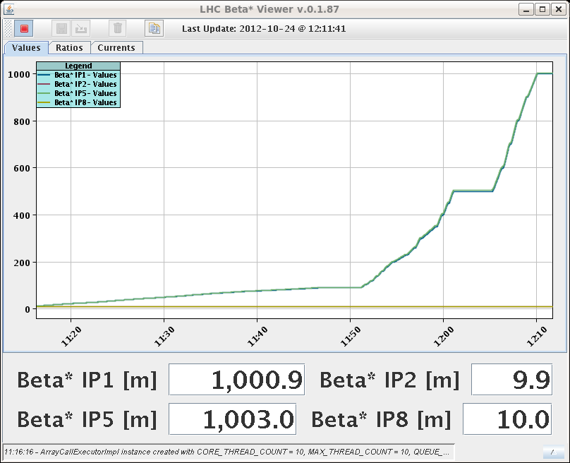
Wednesday 24/10 High beta* run
Wednesday 10:30 – Thursday 8:30 very successful β*=1 km physics run (H. Burkhardt et al.)
De-squeeze went very smoothly
Technique to reduce background
Scraping with TCP to 2(3) nominal (!) sigma in V(H)
Retracting TCPs to 2.5(5) sigma
Measuring with vertical RPs at 3 sigma
Massive beam losses during scraping especially B2 due to emittance blow up especially in H
B2H emittance ~ doubled during de-squeeze to 90m
Also strong losses especially B1 due to instabilities
Fill | Day | Dump
3215 | Wed 24/10 | Spurious opening of QPS switch on RB.A67
3216 | Wed 24/10 | OP, end of high beta* run

Slide 16
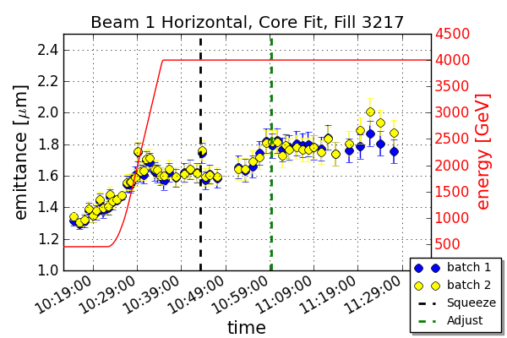
Thursday 25/10
LHCb changed to negative polarity
New version of OFSU deployed after dry tests on Wednesday and Thursday
Pilot ramp with 2x6 bunches/beam for check; In parallel wire scan measurements all along the cycle for emittance preservation studies → first results from Maria Kuhn
Batch-by-batch longitudinal blow-up at injection (target 1.4ns). At the start of the ramp the usual "common mode" blow-up is applied
Notes:
I attached the emittance plots from yesterday’s fill with 2 x 6 nominal 50 ns bunches. The whole cycle and a zoom into the ramp is plotted. I averaged the emittances over 6 bunches in one batch. The error bars include errors from averaging, fitting error and beta function error. The beam size is obtain through a core fit of the transverse profiles from the wire scanners. Beta functions are from k-modulation. Unfortunately not beta functions through the ramp yet, the beta beating team is still working on that. Therefore I used a linear interpolation between injection and flattop beta values.
I will also compare the wire scanner data to emittance from luminosity if I have time. Note also that B1V is missing. Had a problem with the data that I couldn’t figure out yet.

Slide 17
Friday 26/10 EDF-SIG transformer
11:05 Programmed dump for power grid intervention EDF-SIG
~11:50 EDF-SIG Transformer reconnection
ATLAS toroid tripped
Compensator harmonic filters tripped (as expected)
When the filters were switched back on, lost cryo in pt 2 (as expected)
Both undulators tripped several times (power converter repaired Sat morning)
Vacuum intervention during recovery:
Warm up of the beam screen in Q5R8
Sublimation for the MKI8 C and D
Long list of accesses, i.a.:
BBQ tune measurement (now higher sensitivity, gate-able tune measurement available on both beams)
QPS: RB.A67 energy extraction switch
More accesses needed to recover (fuse blown, undulators)
Recovered by 23:30

Slide 18
Friday 26.10. dump on losses fill 3225
Dump by BLM 655ms RS on BLMEI.05L4.B2E10_MBRB (which is downstream of BSRT B2)
The losses increased during ~10ms, ~800ms before the dump and stayed constant till the dump.
The BSRT B2 shows stronger heating fill 3223 and 3225
ALFA roman pots see stronger heating for fills 3223 and 3225 compared to fill 3220
Nothing abvious seen on the BSRT vacuum, the average bunch length, the maximum bunch length, the bunch population, beam intensity
Maybe a correlation with the minimum bunch length?
BLM long PM data (Christos Zamanztas)

Slide 19
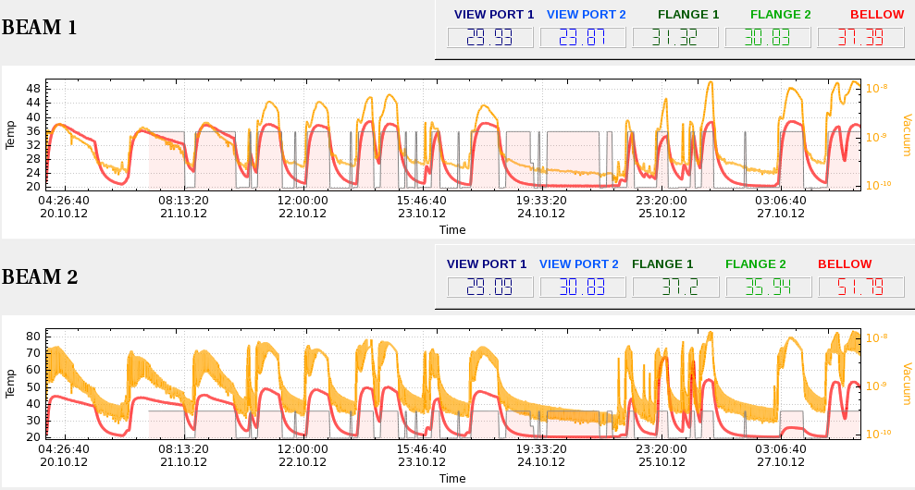
ALFA and BSRT temperature
BSRT temperature evolution
F. Roncarolo
Long. Blow-up@inj
Long. Blow-up@inj
3207
3220
3229
3223
3225
3226
BSRT B2 out

Slide 20
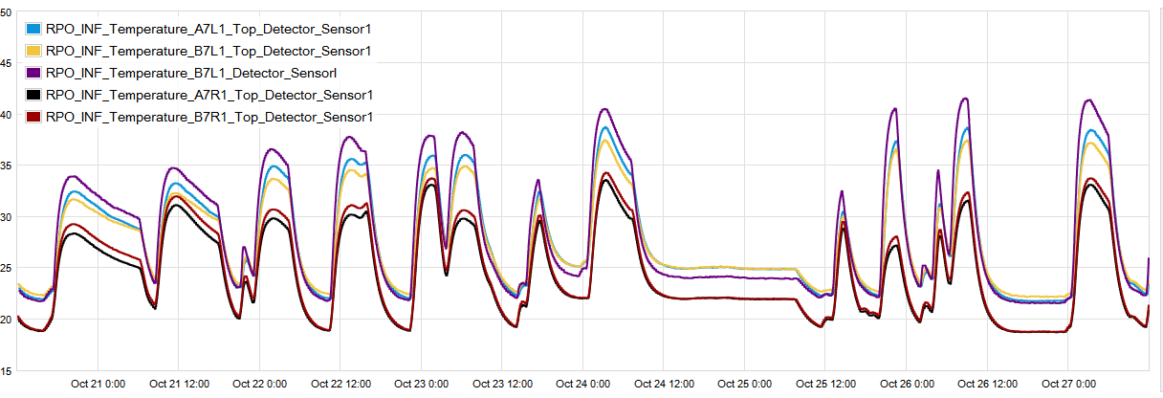
ALFA and BSRT temperature
ALFA temperature evolution
B. Salvant
Long. Blow-up@inj
Long. Blow-up@inj
3207
3220
3223
3225
3226
3229

Slide 21
Bunch length distribution
Flat top

Slide 22
B1 vs B2
Beam longitudinal spectra at flat-top
B. Salvant

Slide 23
Longitudinal blow-up
Specific luminosity @ beginning of fill
Evolution for few fills with comparable luminosity. Normalization with respect to injection time. No evident improvement seen yet.
Next step:
Further increase the longitudinal blow-up at injection. Target bunch length from 1.4 to 1.5 ns
Notes:
I had a look to the effect of the longitudinal blow-up on the emittance blow-up at injection. The mittance blow-up is larger for the trains that are injected first and translates into a reduction of the specific luminosity for the bunches that are injected first in the machine
The perfect is not evident for the moment we should likely increae the longitudinal blow-up further. This might help for the heating as well

Slide 24
Issues and accesses
Access:
QPS problem on C9R5 of old QPS in RB.56 (access?)
Diode exchange on RQ10.R6
TI: UW65 pump for rejected water (30 minutes, working hours)
RSS.A81B1 (QPS OK)
8kHz interference lines on Head-Tail and BBQ front-ends much stronger since Friday night – interfering with tune measurement (UPSs?)
Heating problems (BSRT, ALFA roman pots) under investigation
MKI C B2 heating

Slide 25
Pending
VdM scan CMS at the end of a fill during daytime
ADT tuning of high bandwidth ~ 1 hour at injection
Gating of B2 tune measurement and feedback
Wednesday morning: cable re-location
Longitudinal:
Increase longitudinal blow-up at injection to ~1.5ns (now 1.4ns)
One fill without bunch-by-bunch blow-up for reference measurements
Could also test with longer bunches: blow-up during ramp to ~1.4ns (currently 1.3ns)

