Slide 1
Friday 26.10.
6:39 beam dump by BLM 655ms RS on BLMEI.05L4.B2E10_MBRB (which is downstream of BSRT B2).
The losses increased during ~10ms, ~800ms before the dump and stayed constant till the dump.
See next slides from Federico Roncarolo
The BSRT B2 shows stronger heating Thursday night till Friday early morning - fill 3223 and 3225 (not any more during the fill Friday 3226)
ALFA roman pots see stronger heating for fills 3223 and 3225 compared to fill 3220
Nothing abvious seen on the BSRT vacuum, the average bunch length, the maximum bunch length, the bunch population, beam intensity
Maybe a correlation with the minimum binch length?
BLM long PM data (Christos Zamanztas)

Slide 2
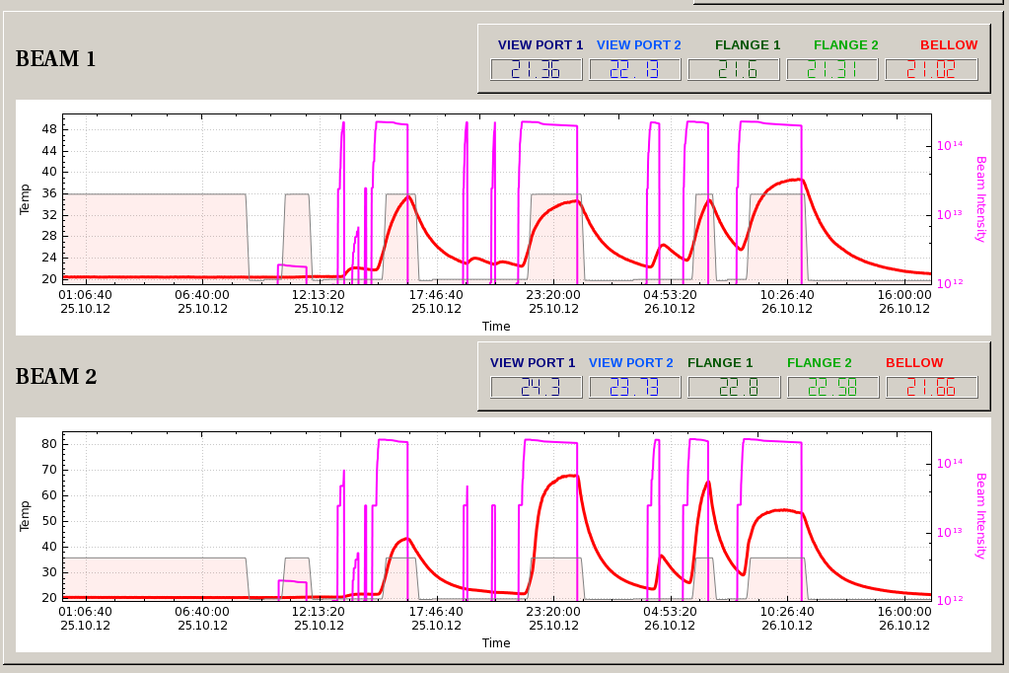
Federico Roncarolo
Bellow Temperature, Beam Intensity
Fill dumped by BLM at BSRT

Slide 3
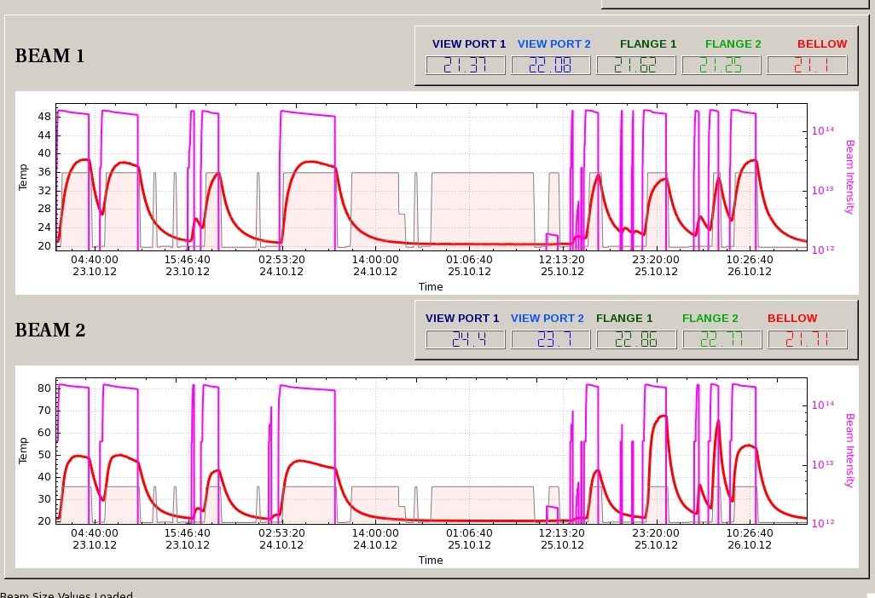
Federico Roncarolo
Bellow Temperature, Beam Intensity
1km beta* run
Fill dumped by BLM at BSRT
1km beta* run

Slide 4
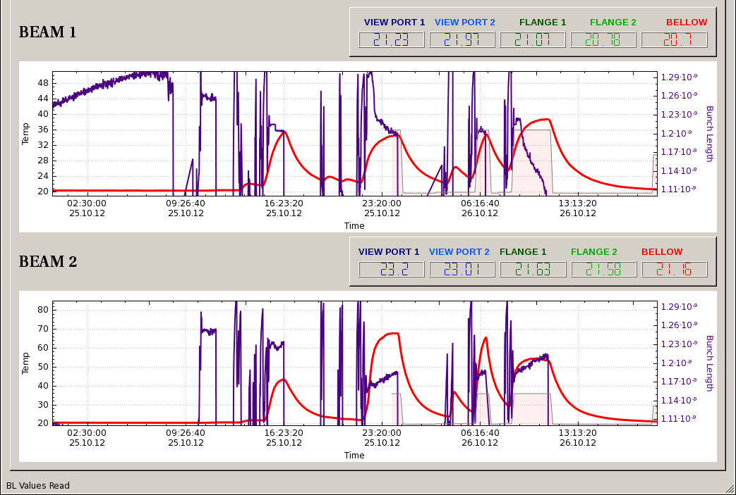
BSRT Bellow temperature and minimum bunch length
Federico Roncarolo

Slide 5
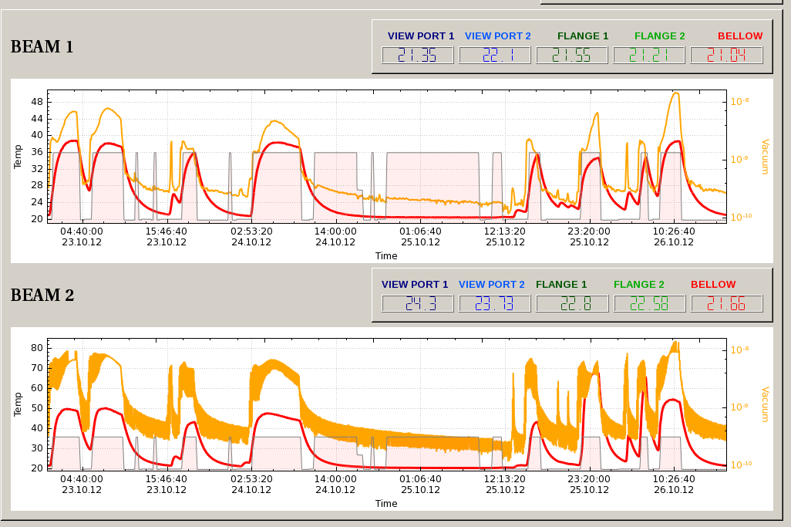
Federico Roncarolo
Bellow Temperature,Vacuum

Slide 6
Morning cont.
9:18 stable beams fill 3226:
~1.71e11 ppb
“UFO buster” application detected several events in the location where previous fill was dumped by losses (BSRT beam 2, 5L4)
Peak luminosity ATLAS/CMS: 7E33 cm-2s-1
Integrated lumi in 1h46’: ATLAS/CMS: ~38 pb-1
11:05 Programmed dump for power grid intervention EDF-SIG
~11:50 EDF-SIG Transformer reconnection
ATLAS toroid tripped, ALICE magnets tripped (?) being nearly completely ramped down anyway
Compensator harmonic filters tripped (as expected)
When the filters were switched back on, lost cryo in pt 2 (as expected) and the undulators tripped
Vacuum intervention during recovery:
Warm up of the beam screen in Q5R8
Sublimation for the MKI8 C and D

Slide 7
Accesses during recovery
ATLAS, CMS, LHCb and Alice
pt 1: CV; EPC; Oxygen Deficiency monitor; Radmon installation between Q5 and Q6
pt 2: cryo; LVDT TDI; RP; EPC
pt 3: EPC
pt 4: BGI, BBQ tune measurement (now higher sensitivity, gate-able tune measurement available on both beams), schottky monitor
pt 6: LBDS MKD; QPS: RB.A67 energy extraction switch
pt 8: vacuum for MKI
Exchange of four 60A correctors for preventive maintenance (internal Auxiliary Power Supplies are not working correctly)
Sector 34: RCBV24.R3B1 & RCBV33.L4B2
Sector 23: RCBH17.R2B2 & RCBV24.R2B2
Varia:
Biometry had to be bypassed to allow access in UJ16
Biometry DB needed to be reloaded on the PAD in PM85 and later in PM45
Problem with lights in UJ43, to be followed up by TI

Slide 8
Afternoon – recovery ongoing
16:00 access needed for undulator RU.R4 (change power module)
16:44 access in Pt8 for RB.A78 (disjoncteur need to be replaced)
18:10 machine closed, start precycle
But it takes a bit longer:
Communication lost with 4 correctors R4 → access → One electrical phase missing on some racks due to a blown fuse
RU.R4 tripped (power supply card for its DCCT in fault, spare is in Meyrin, leave it for the moment) → CS and CM lost → Q5, Q6, D3, D4 right of 4 tripped
Lost CS and CM on MSR2
21:30 ready to inject
But then:
RU.L4 tripped (probably a blown fuse in the PC – left off for the time being) → CS and CM lost MSL4 → Q5, Q6, D3, D4 and four correctors left of 4 tripped

Slide 9
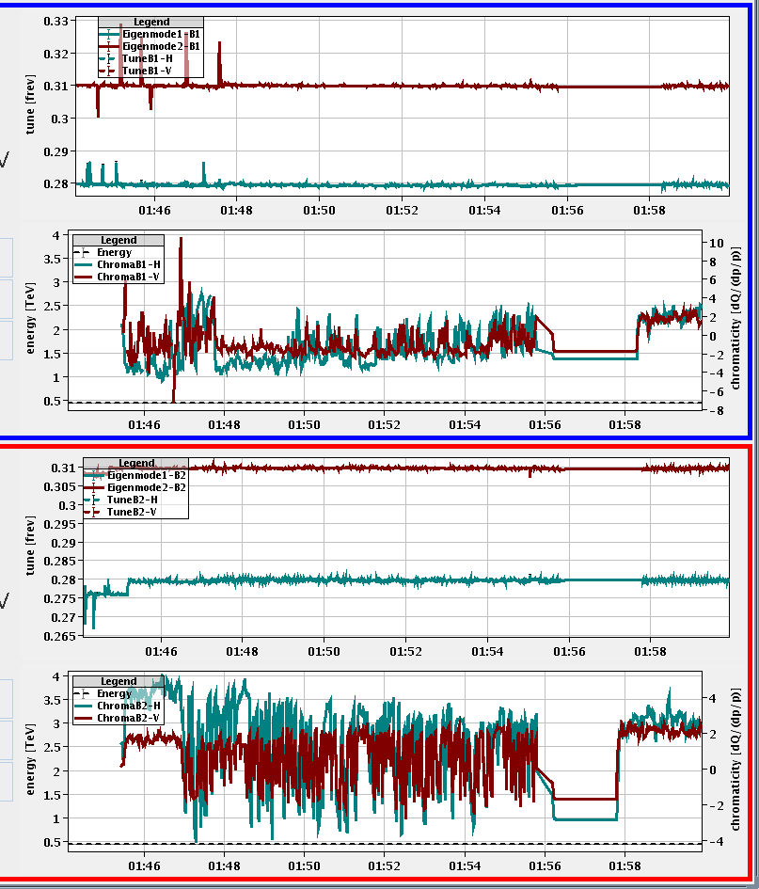
Night – beam back
23:00 cannot rearm LBDS B2 (no data received) – reset by piquet and dry dump
23:30 pilot injection
Till 1:30 Steering of both injection lines necessary – high losses on the 6 bunches
Chroma measurement: seems that data rate too high, and in bursts – rebooting 3 front-ends
3:37 stable beams fill 3229
Initial luminosities
ATLAS/CMS: ~7.6 E33 cm-2s-1
ALICE very low (~3E30 cm-2s-1)
Integrated lumi in 4h23’:
ATLAS/CMS: 87 pb-1
7:58 beam dump by LBDS B2 – access needed for card exchange
MKI2 soft-start required (vacuum spike of 4E-8 caused it to go in fault during the previous fill)

Slide 10
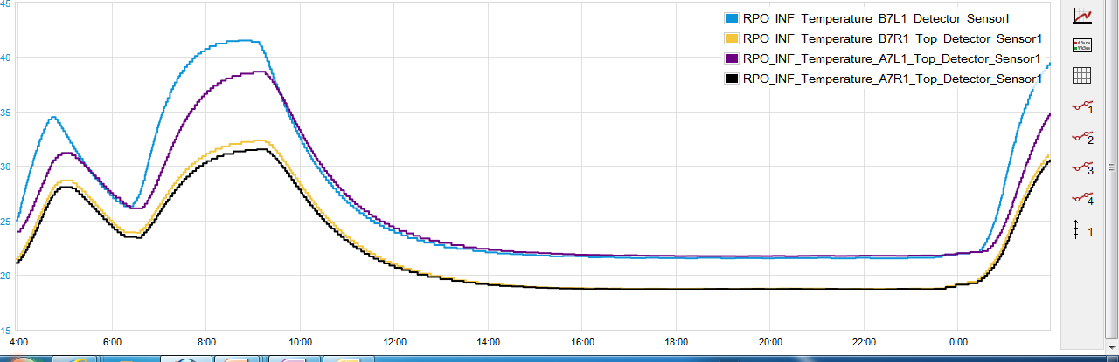
ALFA RPs
Fill dumped by BLM at BSRT
Difference between these two fills correlated to BSRT B2 temperatures
Beam2
Beam1
Friday Night reaching 40 degrees again

Slide 11
Issues and accesses
Access:
RU.L4 repair
RU.R4 repair
Diode exchange on RQ10.R6
8kHz interference lines on Head-Tail and BBQ front-ends much stronger than before the access – interfering with tune measurement (UPSs?)
While BSRT B2 mirror moved out (heating problems) abort gap cleaning to be switched on every ~30 minutes while in physics and before a programmed dump
B2 gating not active (FESA issue)
Heating problems (BSRT, ALFA roman pots) under investigation

Slide 12
Planning
Currently: Access for LBDS and in parallel for both of the undulators
Physics
VdM scan CMS at the end of a fill
ADT testing

