Slide 1
Tue 23/10
09:44 MKBV-B2 ion pump tripped. Vacuum spike leading to beam dump system internal fault and beam dump. Happened already few times. Follow-up by ABT+VSC. End of physics #3210. 66 pb⁻¹ in 3.1 h.
10:19 – 14:46 – Faulty sensor on a turbine of a warm compressor in point 8 tripping twice and leading to loss of cryo start/maintain of the matching section R8 (Sector 81). Sensor disabled (SW-wise and HW-wise). Had to pre-cycle twice.
15:00 – 16:30 Commissioning of batch by batch longitudinal blow-up

Slide 2
Batch by batch longitudinal blow-up (Ph. Baudrenghien et al.)
We first optimized the strength of excitation: 0.07 rad rms , leading to a two minutes time constant (length blown to 1.4 ns). We then refilled for physics. No unusual losses on momentum collimator, good lifetime. Plans: We found an issue with the treatment of the gaps between PS batches. The software will be upgraded on Wednesday. Then we will install it for normal operation on Thursday.

Slide 3
Tue 23/10
17:00 Fill for physics #3212
Batch by batch longitudinal blow-up
Gated tune measurement and feedback on B1
High bandwidth damper during the squeeze up to collision than back to lower bandwidth
Emittances at injection: B1H/V = 1.43/1.38, B2H/V=1.49/1.57

Slide 4
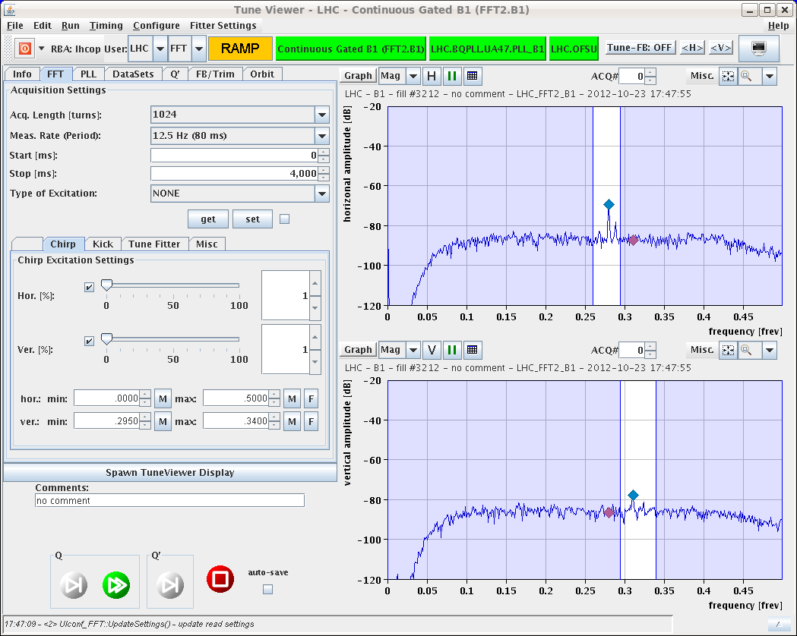
Tue 23/10
Reasonable losses at the beginning of ramp
No chirp: lost QV-B1 signal on gated BBQ above 2 TeV in spite of the reduction of the gain of the feedback on first 6 bunches done yesterday ➔ further reduction required

Slide 5
Tue 23/10
Batch by batch blow-up
Initial luminosity ~7x10³³ cm⁻²s⁻¹
18:23 Stable beams #3212
19:19 Trip of power converter RQT12.R1B2. End of fill 3212. 22 pb⁻¹ in ~1 h
Access required for power converter replacement.
Problem with PAD UJ16 (pending?). Intervention of access piquet
22:49 Intervention on RQT12.R1B2 and on PAD completed. Patrol.
23:29 Machine closed.

Slide 6
Tue 23/10 – Wed 24/10
Ready for injection at 01:00
Steering TI8
01:35 Injection Fill #3214:
Gated tune measurement and feedback on B1 (after further reduction of the gain on first 6 bunches by 6 dB)
High bandwidth damper during the squeeze up to collision than back to lower bandwidth
Still problems for tune feedback to lock on B1 from ~2 TeV
03:40 Stable beams #3214. Initial luminosity 6.5x10³³ cm⁻²s⁻¹

Slide 7
Plan
09:00 Beam dump
10:00 Beta*=1 km until tomorrow morning
PS intervention required on kicker (4 hours – during beta*=1 km fill)
Tomorrow:
LHCb polarity switch and low intensity ramp (2x6 bunches/beam)
Physics fill (with controlled longitudinal blow-up at injection)
During the day PS/SPS increasing satellite population for ALICE

Slide 8
Pending
Pending Accesses:
LVDT TDI Pt2. Tunnel, 2 hours
LBDS MKD-F-B1: check PC and generator. UA63
Radmon installation between Q5 and Q6 at IP1. 1 hour access, few hours pre-warning. Impact 21253 / D. Macina
Gated BBQ installation for B2 (2 hours) in point 4

