Slide 1
Not the most productive 24 hours on record

Slide 2
Thursday 19th October - morning
08:15 OP dump of fill 3194
164 pb⁻¹ in 12h36m
RB.A23 QPS controller communication problem solved with a "soft" reset.
RQ8.L1B1 and 2 tripped during ramp-down
Access required – decide to clear list
10:00 Start access...

Slide 3
Access for:
Power Converter S81 for Q8.
B2 BGI by Mariuz
BSRT by Aurelie
ATLAS & CMS
Roman Pots - TOTEM
Serge di Luca called to repair UJ43 pad but was not possible today, on the contrary he took care of other problems.
PAD UJ14 & problem with the biometry

Slide 4
Thursday 19th October - afternoon
12:15 start cycling (twice)
Redeployed the PcInterlock server with improving the stability of the Lsa-Monitoring. (Kajetan)
Also a new version of PcInterlock GUI was released, which more clearly displays the sources of the settings.
14:15 Ready to inject
Some delay – SPS in MD – coasting beam
15:00 Start RF tuner adjustment
We have fine-adjusted the tuners for 11 out of 16 cavities. We have also increased the QL from 60k to 70k on 5 cavities. That should reduce the demanded klystron power in physics, well below the saturation limit (taking place between 180 and 200 kW, klystron dependent). (Philippe & Themis)

Slide 5
Thursday 18th October - evening
16:20 RF beams dumped - injecting for physics
Some delay, SPS still in MD, beam quality checks needed
SPS transmitter fault – partial fill dumped at 19:20
With beam 1 in, we compared the tune signal in prepare ramp configuration with the BBQ bunch gating ON and OFF.
clear improvement of the signal with the gating ON. Switch off for the next fill.
20:30 start ramp
Ratty squeeze – both beams
Usual instability B1V at end of squeeze
Few bunches end batch – high bandwidth ADT requierd!
Beams lost towards end of adjust
Loss spike on collimators (B2)

Slide 6
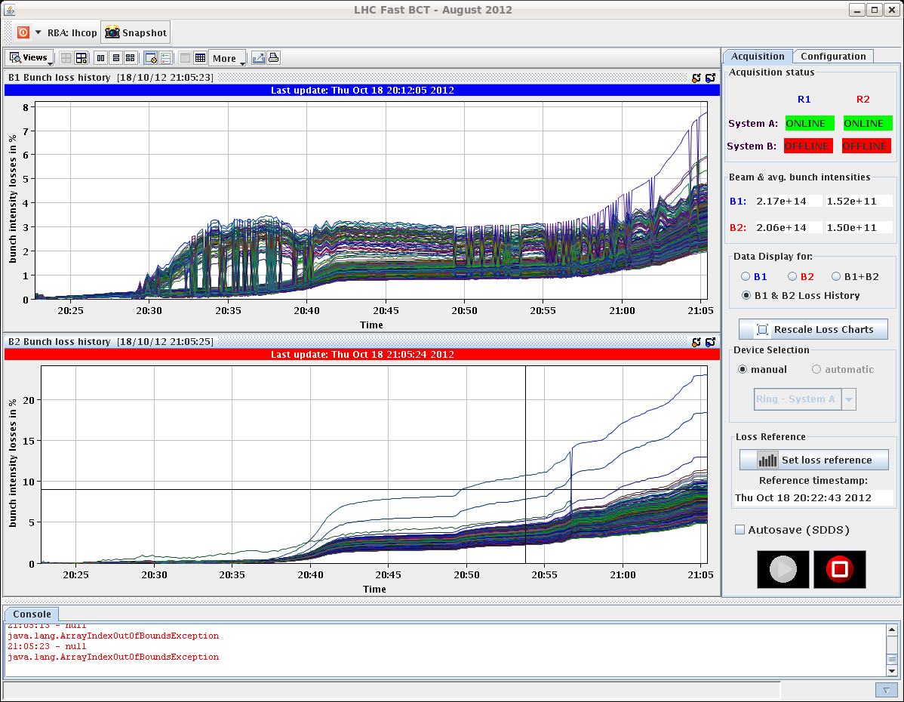
3198 squeeze

Slide 7
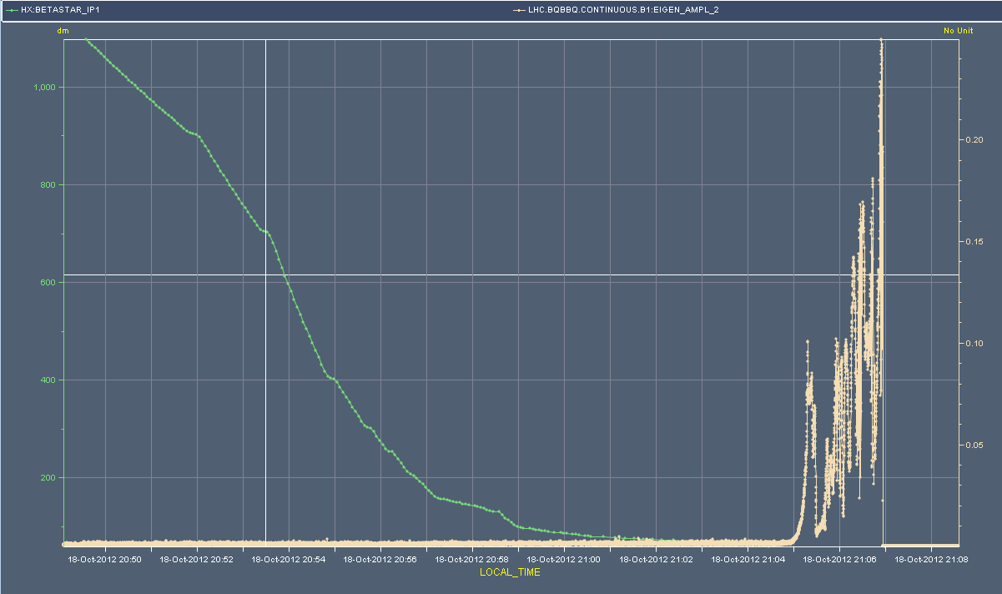
3198 – squeeze and adjust
B1V – BBQ amplitude - systematic

Slide 8
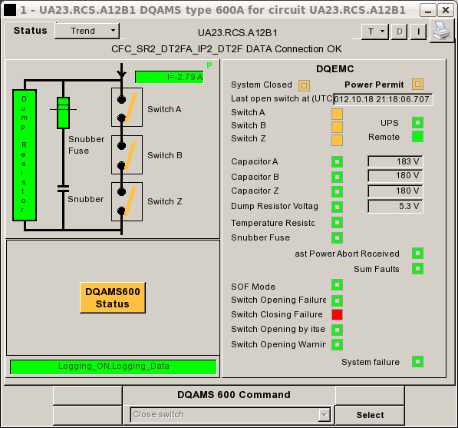
Late Thursday evening
23:10 back at flat top
Beams lost to QPS trigger - RCS.A12B1 switch problem
Needed to reset energy extraction on QPS synoptic, before we could reset the converter. Tried to close switches, did not work, went into fault. Second time around with more resets... no luck. Calling MPE piquet.
VINCENT, FROIDBISE In - changed the switch and the card that goes with it but there is still something wrong. Go back to the lab and get spares and then try again.

Slide 9
Mama told me there’ll be nights like this
04:25 RCS.A12B1, switches are closed.
According to Vincent, it was a DQAMS600 card that had a problem. It is the card that handles the communication, probably one input is broken.
04:30 PSB has a problem with the 16 MHz cavities, PS and SPS have no beam.
05:30 Cryo Start lost / flickering on 78 - could be a WorldFIP problem.
Cryo operator will call the best effort service, we take pilots in the meanwhile but will wait for his ok to get the physics beam.
06:15 WorldFIP repeater needs to be exchanged.
Pt 8 RE82, best effort support is here. Contact fire brigade for RP piquet.
07:15 Access to PM85

Slide 10
Friday October 19th - morning
07:30 CS status ok now for S78 after WorldFIP intervention in UJ83.
07:45 Cycling
Will fill for physics
With high bandwidth ADT

