Slide 1
Summary of week 40
Machine Coordinators: G. Arduini, M. Lamont
Main aims: Luminosity production, 25 ns test to verify feasibility of scrubbing run after change of MKI8D
Many thanks to the injectors for the quick setting-up of the 25 ns beam on Q20: H. Bartosik, S. Cettour-Cave, Y. Papaphilippou
Damper team: W. Höfle, G. Kozian, D. Valuch
Injection team: W. Bartmann, C. Bracco, G. Vanbavinckhove

Slide 2
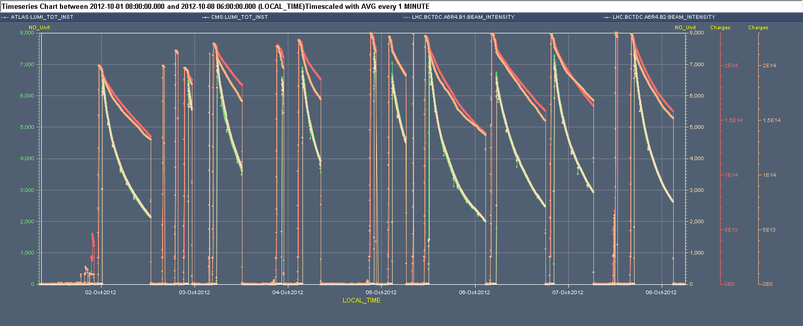
Week 40
7x10³³ cm⁻²s⁻¹
25 ns test – CMS solenoid
Access
Cryo-Pt4
L_{ATLAS} L_{CMS} I_{B2} I_{B1}

Slide 3
Last 24 hours
06:30 ALICE DIPOLE power converter trip. End of fill #3135. 158 pb⁻¹ in 10h3m.
07:41 OK from power piquet to restart the ALICE dipole power converter but reason of the fault not understood
09:00 ATLAS have a gas leak in TRT detector - urgent access of ~1h required (LHC is anyway waiting for the injection kickers to cool down)
10:32 ATLAS access finished
PS RF expert (H. Damerau) increasing longitudinal blow-up to enhance satellite population
11:04 MKI kicker temperature below threshold
11:00-11:40 Steering TI2/TI8. Some more losses at injection (satellites?)

Slide 4
Last 24 hours
12:41 Loss of communication of vacuum valve status in point 7 (Beam 2). Beam dump during the squeeze. Access required.
15:23 Injecting after vacuum intervention.
17:03 STABLE BEAMS #3138. Initial luminosity ~7.3x10³³ cm⁻²s⁻¹
ALICE head-on luminosity reaching 10³¹ cm⁻²s⁻¹ with enhanced satellites after further adjustment in the PS in the morning. No need to change filling scheme.
Several trips of damper H1B2. No more able to reset it.
00:57 MKI2 faulty ➔ heater module to be replaced
02:58 Dump trigger from BLM L1 (spurious?)
Start preparation of MD (problem with line 3B1) and call piquets (MKI, RF)
Access ongoing for RF in point 4

Slide 5
Main faults
Date | Duration [h] | Description
Mon 01/10 | 2.5 (6.3) 13 | MKI8 power supply and sublimation CMS solenoid (shared with 25 ns test)
Tue 02/10 | 2 | MKD-B1 ASI safety bus corruption (access required)
Wed 03/10 | 2.2 6.7 | MKB-B2 PLC Access (Miscellaneous)
Thu 4/10 | 9.4 1 | Cryo point 4 (PLC) OP (QPS reset with Q6 at high current)
Fri 5/10 | 2.5 1.7 | Vacuum valve control rack power supply (B1) – TZ76 RQ8.L1 trip (QPS-noise)
Sun 7/10 | 2.6 2.7 | MKI heating Vacuum valve control rack power supply (B2) – TZ76
Mon 08/10 | 1 1 | MKI2 heater power supply RF (damper+RF cavity)
Total | 48.3 (29%)

Slide 6
Main faults by system
System | Time [h] | Comments
Experiments | 13 | CMS solenoid (shared with 25 ns test)
Kickers | 10.3 | MKI temperature, MKI8 power supply and sublimation, MKD-B1 safety bus, MKB-B2 PLC, MKI2 heater power supply
Cryogenics | 9.4 | Point 4 – PLC Cold-box
Miscellaneous | 6.7 | Access for (cryogenics, beam instrumentation, power converters, vacuum, ATLAS, TOTEM, QPS, ventilation door in UJ33)
Vacuum | 5.2 | Vacuum valve control rack power supply (B1&B2) – TZ76
QPS | 1.7 | RQ8.L1 trip (QPS-noise)
RF | 1 | Damper+RF cavity
OP | 1 | QPS reset with Q6 at high current
Total | 48.3 (29 %)

Slide 7
Fills from 01/10 – 08:00
Fill | N_{b@SB start} [10¹¹] | # bunches | Duration [h] | L_{int} [pb⁻¹] | Dump reason
3121 | 1.54 | 1230 | 11.3 | 150 | OP dump
3124 | 1.55 | 1230 | 0.9 | 19 | Wrong reading current lead temp. RCBVX2.R2
3126 | 1.54 | 1374 | 6.4 | 114 | RQF.A45 (QPS – noise)
3128 | 1.49 | 1374 | 0.2 | 5 | SIS – orbit distortion trip RCBH29.R6B2
3129 | 1.54 | 1374 | 4.6 | 83 | Cryo – Pt 4 (PLC)
3130 | 1.59 | 1374 | 0.3 | 7 | Vacuum control rack power supply (B1) – TZ76
3131 | 1.56 | 1374 | 3.5 | 66 | UFO (29.L3)
3133 | 1.57 | 1374 | 14.5 | 187 | OP dump
3134 | 1.56 | 1374 | 12.5 | 178 | OP dump
3135 | 1.60 | 1374 | 10.0 | 157 | ALICE dipole power converter
3138 | 1.58 | 1374 | 9.9 | 150 | BLM (spurious?)
Total |  |  | 74 | 1116
STABLE BEAMS 74 h (44.6 %)

Slide 8
Lost fills before stable beams (>450 GeV)
c/o Post-Mortem DB
Event Timestamp | Phase | Beam Energy [TeV] | Fill Number | Comment
02-OCT-12 16:17 | RAMP | 3.3 | 3122 | LBDS internal trigger
02-OCT-12 19:41 | FLAT TOP | 4 | 3123 | BBQ front-end frozen. Dump after reboot.
07-OCT-12 12:41 | SQUEEZE | 4 | 3137 | Vacuum control rack power supply (B2) – TZ76

Slide 9
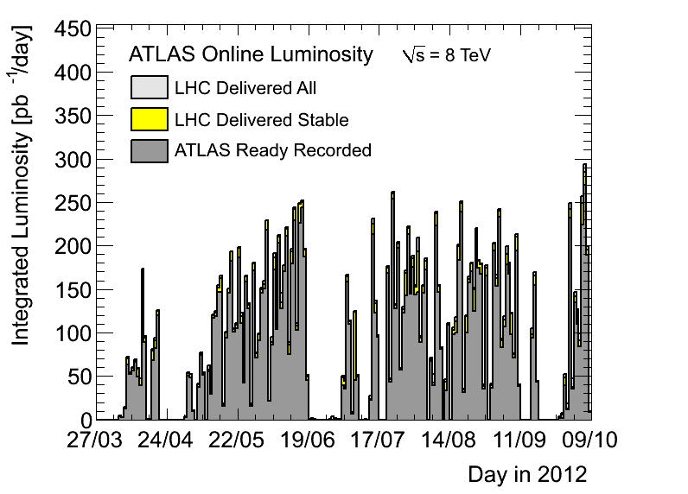
At least one record
286 pb⁻¹ delivered on Sat 6/10 from 00:00 to 24:00 UTC

Slide 10
Performance
~16.4 fb⁻¹
~1.6 fb⁻¹

Slide 11
Performance
Q20

Slide 12
Performance

Slide 13
Performance

Slide 14
25 ns test: MKI8
Hit (new) interlock on interconnect pressure after 1 or 2 72 bunch trains. No significant decrease unless losses. No effect of solenoid.
Hit interlock on MKID pressure when injecting B1 (444 bunches)
I_{B1} I_{B2} VGPB.192.5R8.R (interconn. to Q5) MKID (tank) Solenoid curr. [A]
12
12+72
12
12+2x72
12+72+144+216
12+72

Slide 15
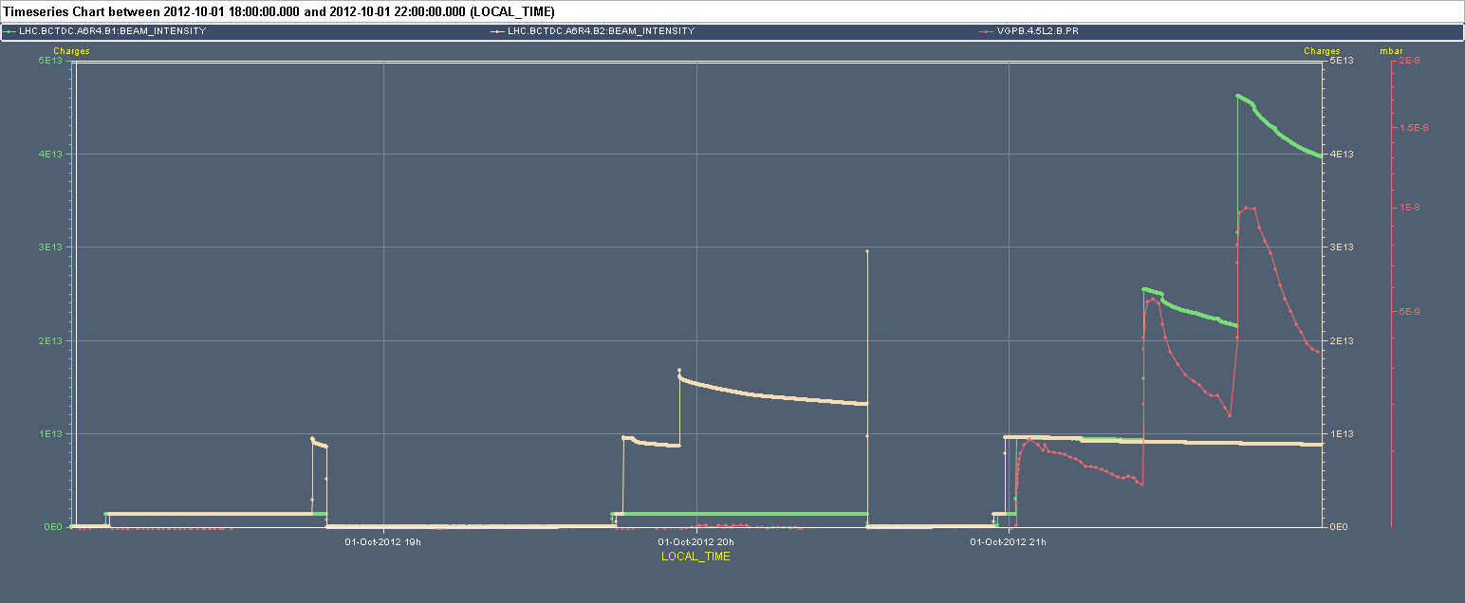
25 ns test: MKI2
Hit interlock on interconnect pressure after with 444 bunches on B1. Interlock added after TS3
I_{B1} I_{B2} VGPB.4.5L2.B (interconnect)
In the present conditions the scrubbing run cannot be performed efficiently without an increase of the vacuum thresholds in particular at the interconnects (new)
Considered too risky for the operation of the injection kickers
LMC decision to postpone the scrubbing run
12
12+72
12
12+2x72
12+72+144+216
12+72

Slide 16
2012 after technical stop
Sublimation &
25 ns test
High intensity 50 ns

Slide 17
Damper bandwidth
New filter coefficients for enhanced frequency response (flat up to 20MHz) as part of the 25 ns set-up
Almost ideal bunch-by-bunch damper. Signal edges are fast and bunches should not see each other through the impulse response.
W. Höfle, G. Kotzian, D. Valuch
50 ns beam could profit of that ➔ some more tests with 50 ns beams required at injection and during the ramp.

Slide 18
Q20
Q20 optics in operation in the SPS since 2 weeks (H. Bartosik, Y. Papaphilippou with support from RF and BT teams)
Emittances at injection in the LHC are smaller by approximately 5-10% and good reproducibility. Not yet profited by that reduction in collision
Q20 vs. Q26 ➔ smaller longitudinal emittance from SPS ➔ IBS likely to induce larger blow-up importance of batch by batch longitudinal blow-up ➔ to be put in operation

Slide 19
Kicker heating
Clear eduction of the temperature on MKI8D
Thresholds on the other magnets increased (M. Barnes) after analysis of pulse waveforms taken during soft-start above threshold temperature.
Unexplained increase in termperature

Slide 20
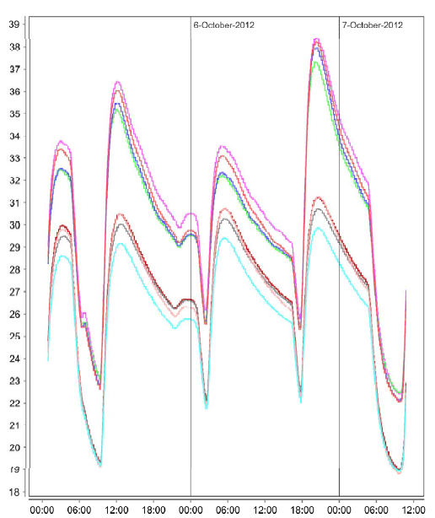
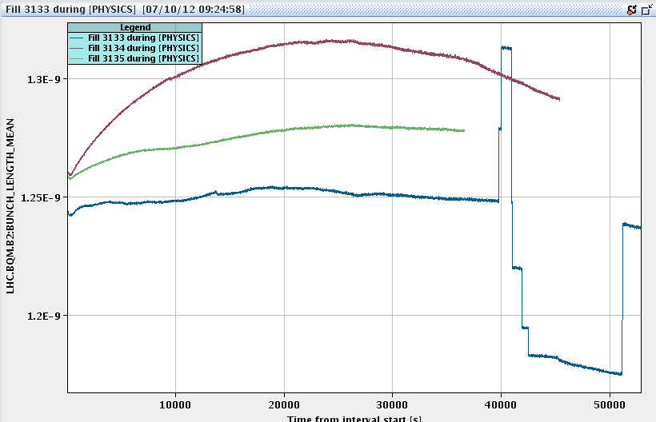
To be followed up
BSRT B2 not available. B1 doubtful.
ALFA roman pot temperature
Vacuum control equipment in point 7 (various faults in the last period. Radiation?)
S. Jakobsen

Slide 21
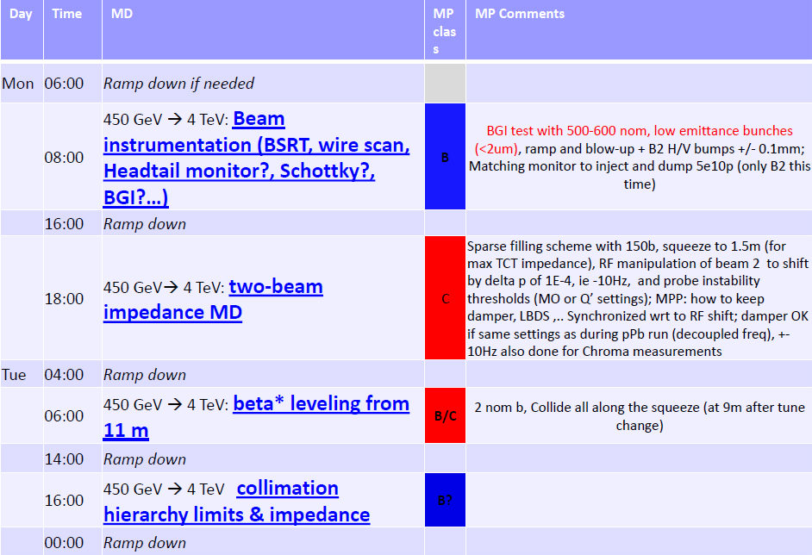
MD3 starting…

Slide 22
Pending
LHCb polarity switch after MD3
Operational Development
Gated tune measurement with reduced damper gain on first 6 bunches (ongoing)
Damper test at injection of the increased bandwidth with 50 ns beam ➔ can be tested during pilot run for LHCb polarity switch
Longitudinal Batch by batch blow-up
Next coordination team: J. Uythoven, J. Wenninger

