Slide 1
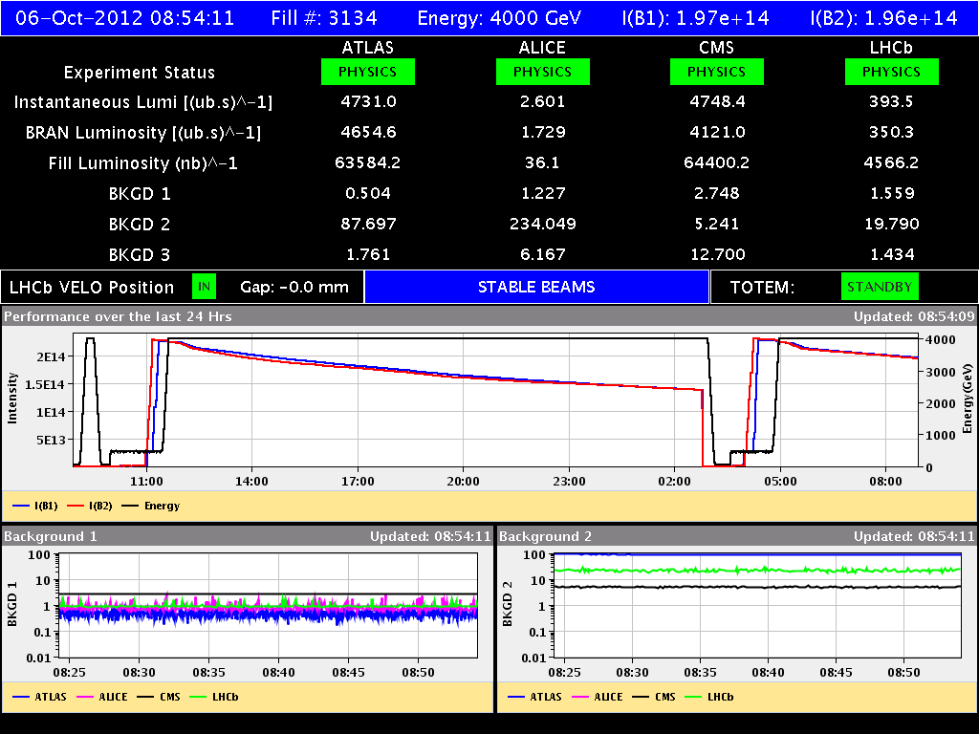
Friday 5/10 – Saturday 6/10

Slide 2
Friday 5/10 – Saturday 6/10
08:16 Sector 81 trip RQ8.L1 (QPS noise) - Pre-cycle
10:00 Injecting. Setting up of the damper gain modulation and BBQ gated measurement on beam 1. Successful ramp with gated gain modulation (lower gain on first 6 bunches). Gated BBQ (on first 6 bunches) running in parallel to “standard” BBQ.
12:10 Colliding in IP1/5. Peak luminosity >7.5x10³³ cm⁻²s⁻¹.
12:18 STABLE BEAMS #3133. Initial luminosity 7.3x10³³ cm⁻²s⁻¹.
23:00 – 02:20 Test with bunch length variation
02:47 OP dump: ~187 pb-1 in 14.5 h. ~250 pb-1 in 24 h.
03:38 injecting
Struggling: trip of ROD.A45.B1 before starting the ramp (restarted), tune feedback not locking.
05:38 STABLE BEAMS #3134. Initial luminosities: 6.77x10³³ cm⁻²s⁻¹.

Slide 3
ALICE
Scan for determining peak lumi (~5x10³⁰ cm⁻²s⁻¹). Sufficient?

Slide 4
Bunch length variation (B. Salvant, Ph. Baudrenghien et al.)
Aim: end of fill test with gentle variation of the bunch length (~+/-5%) to measure beam induced heating effects and bunch spectra on machine components with moderate bunch intensities. Preparation for possible additional machine studies (to be approved)
B1: 12 ⬅➔ 15 MV
B2: 10 ⬅➔ 14.5 MV

Slide 5
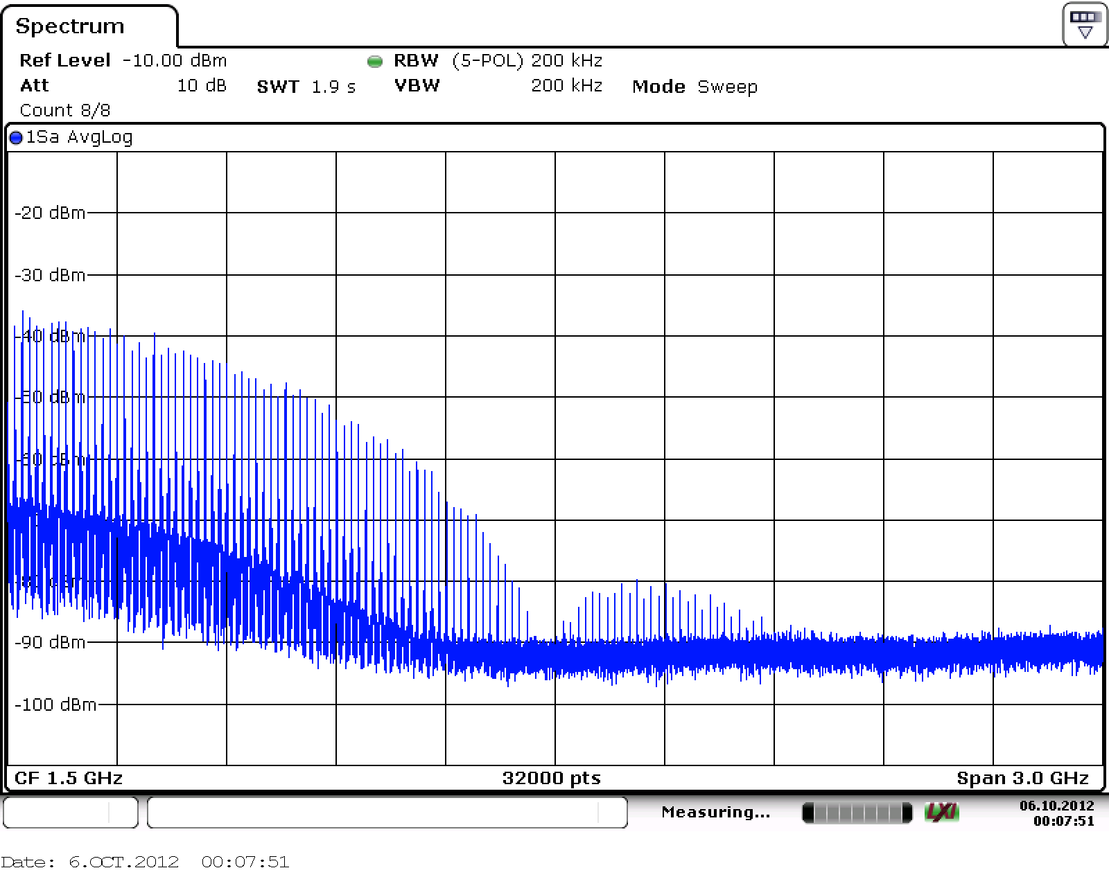
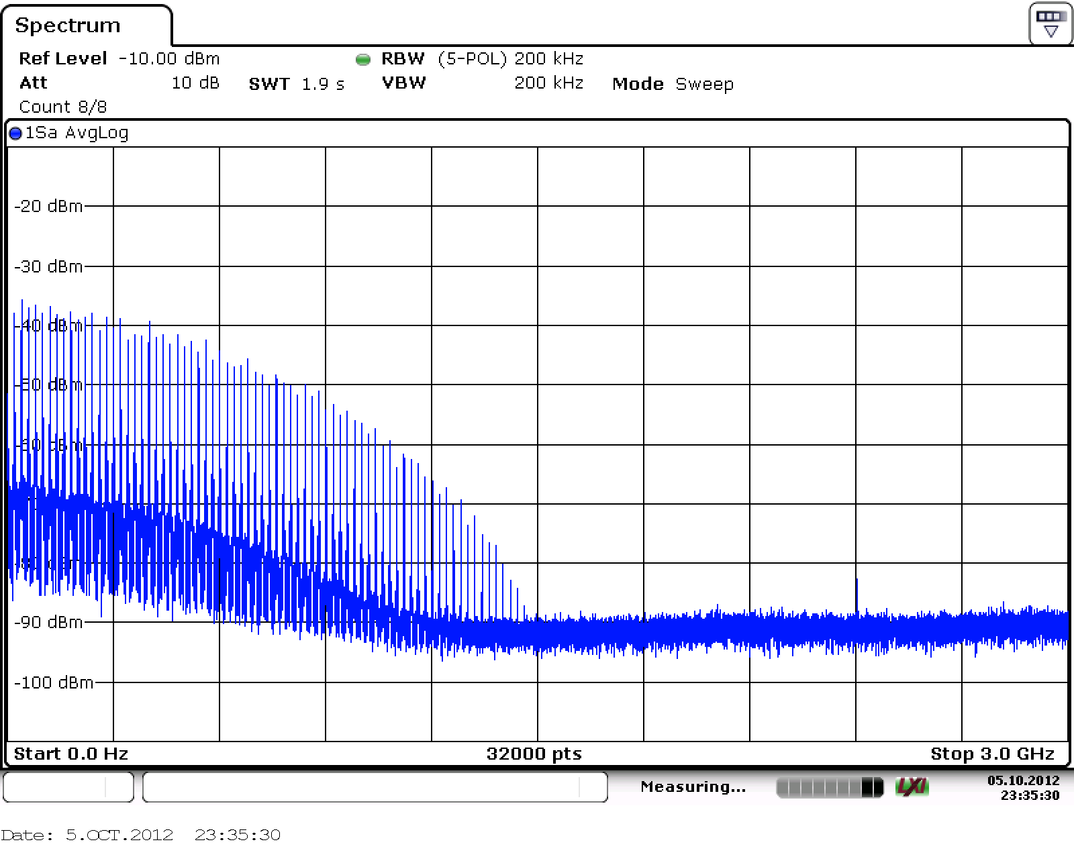
Bunch length variation (B. Salvant, Ph. Baudrenghien et al.)
Bunch profiles and beam spectra measured while varying the RF voltage at flat top. At each voltage level observed:
Beam spectrum, from a 3 GHz PU, short cable to UX45 platform, then fiber optics link (3 GHz BW) to SR4 and spectrum analyzer. Must be corrected for cable attenuation.
Profile of a "reference" bunch measured with same PU, short cable and 2.5 GHz BW scope in UX45. We have noted FWHM. Trailing edge of pulse is modified by cable. To be corrected. Rising edge is not affected much.
The spectrum of B1 was more gaussian (no side-lobe) then B2 from end-ramp (This fill has been continuously monitored).
14.5 MV B2
15 MV B19

Slide 6
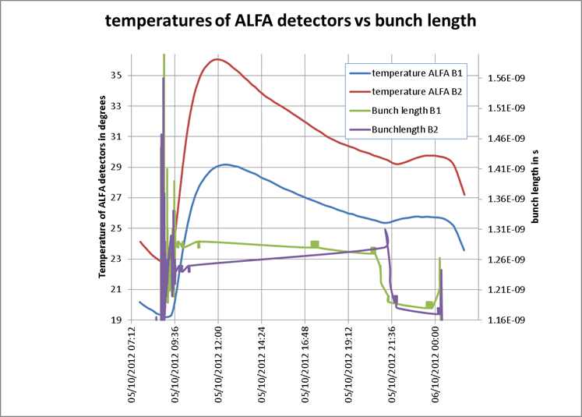
Bunch length variation (B. Salvant, Ph. Baudrenghien et al.)
Observations on temperatures following RF voltage increase on both beams:
Collimators: TCP.B6L7.B1: not much seen. TCTVB:with imagination, a small increase can be seen on temperatures of TCTVB.4R8 (B2) and TCTVB.4L8 (B1) at around 23:30
ALFA: clear change of slope on ALFA detector temperatures for B1 first and then B2, consistent with the reduction of bunch length (plot in UTC time from ATLAS logging). The 4 curves for the B2 detectors are all well above the 4 curves for the B1 detectors).
Beam screens: LSS very quiet, activity observed on arc beam screens when bunch length was changed (sector 34 and 56)
BSRT: some temperature probes (but not all) show changes of slope consistent with bunch shortening on B1 and lengthening and shortening on B2
MKI: nothing special seen on real time temperatures
TDI: nothing special seen on pressure in 4L2 and 4R8
Off-line analysis to be performed

Slide 7
Pending
Operational Development
Gated tune measurement with reduced damper gain on first 6 bunches ➔ ongoing
Damper test at injection of the increased bandwidth with 50 ns beam (after MD3)
Batch by batch blow-up (after MD3)

