Slide 1
Monday 1/10
Access: sublimation on new injection kicker - point 8
09:40 cycling
11:15 probes in, start 25 ns injection set-up/ transverse damper set-up with priority for B2
11:45 CMS - cryo problem - precautionary reduction to half normal solenoid current - recovery foreseen by midnight - perform full 25 ns injection set-up in shadow
11:00-13:00 Injection setting-up with 12 bunches
Damper setting-up for increased bandwidth for 25 ns injection starting in parallel. Initially planned with trains of 12 bunches ➔ not viable due to frequent dumps ➔ inject individual bunches

Slide 2
13:52 trip of RF module M2B1 (crow-bar grid current) :
A crowbar occurred on line 8B1 and tripped module M2B1. The RF piquet checked it and found that the old interlock system triggered as it was still active although a new protection system had been installed. They have disabled the old system now.
17:30 Damper setting-up completed for both beams and planes
18:45 Beam 2: 72 bunches@25 ns injected with high chromaticity of ~12 in both planes
18:49 Beam dump when injecting beam 1 (the kicker fired but no beam from SPS). ALICE trigger ➔ Likely satellites kicked by the rising edge of the kicker ➔ to be followed up with injectors.
19:30 Finally giving the OK to re-inject

Slide 3
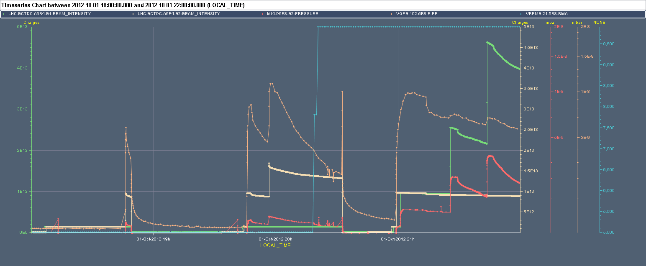
MKI8
Hit (new) interlock on interconnect pressure after 1 or 2 72 bunch injection. No significant decrease unless losses. No effect of solenoid.
Hit interlock on MKID pressure when injecting B1 (444 bunches)
I_{B1} I_{B2}
VGPB.192.5R8.R (interconn. to Q5)
MKID (tank) Solenoid curr. [A]
12
12+72
12
12+2x72
12+72+144+216
12+2x72

Slide 4
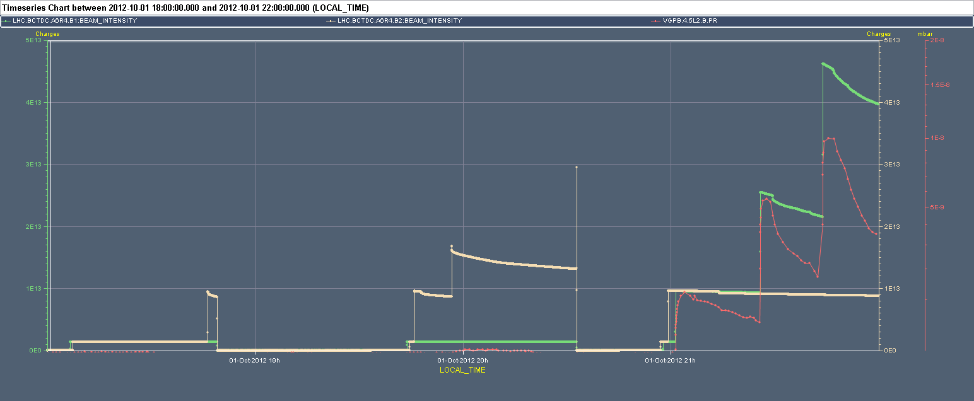
MKI2
Hit interlock on interconnect pressure after with 444 bunches on B1. Recently added interlock
I_{B1} I_{B2} VGPB.4.5L2.B (interconnect)
12
12+72
12
12+2x72
12+72+144+216
12+2x72

Slide 5
ADT setting-up (W. Höfle, G. Kozian, D. Valuch)
Beam transfer function was measured for all beams and planes. Only minor corrections of the one turn delay were needed. The damper is ready for 25ns operation.
Tested the new filter coefficients for enhanced frequency response (flat up to 20MHz)
Flat frequency response means almost ideal bunch-by-bunch damper, the signal edges are fast and bunches should not see each other through the impulse response.
We believe the system works properly with enhanced frequency response, tested at injection and with circulating beam It needs to be thoroughly tested through a complete cycle

Slide 6
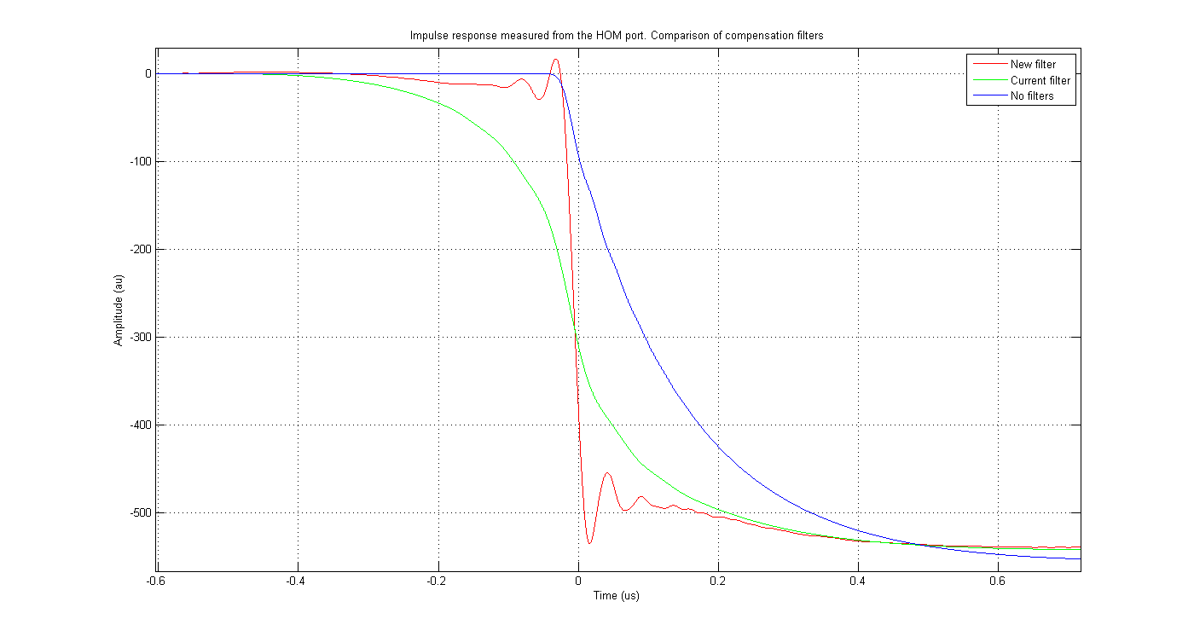
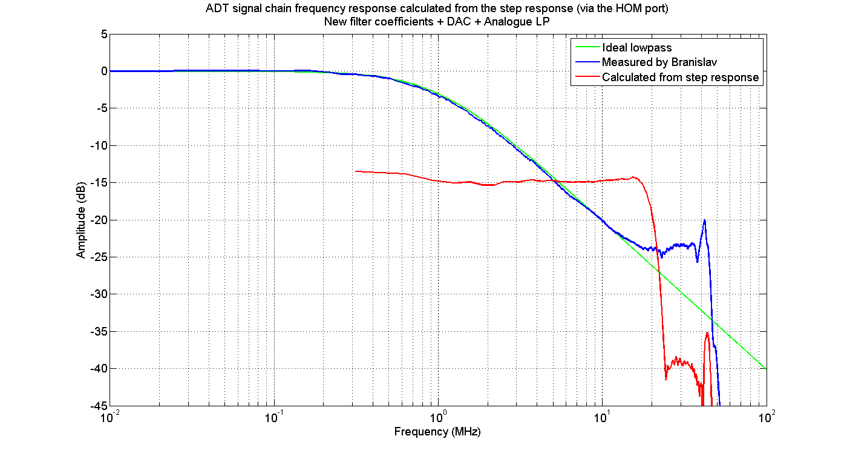
Damper setting-up

Slide 7
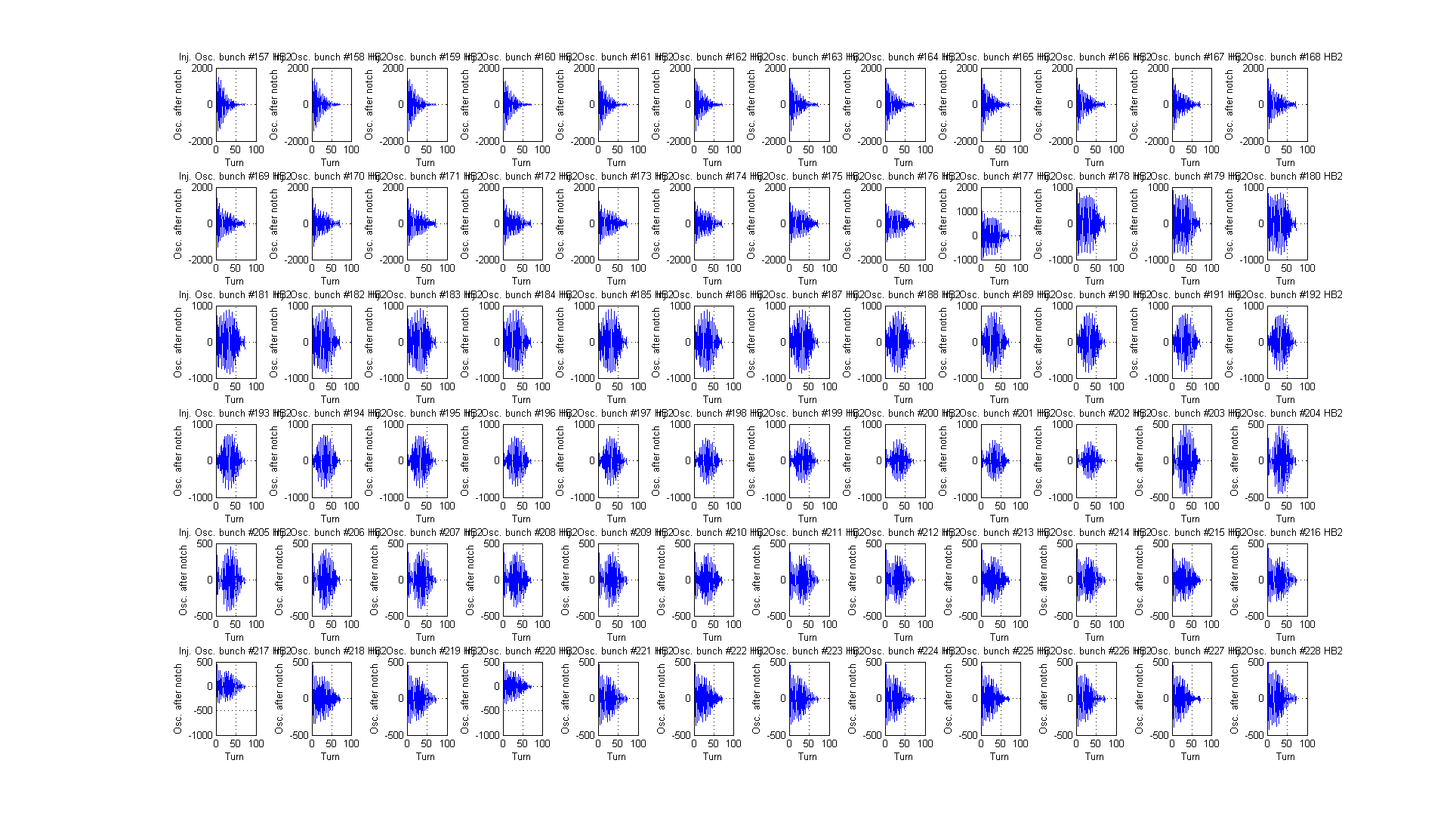
Damper
D. Valuch
Behaviour of some bunches (20-50) to be understood

Slide 8
Many thanks to the injectors for the quick setting-up of the 25 ns beam on Q20 (to be fine tuned): H. Bartosik, S. Cettour-Cave, Y. Papaphilippou
Damper team: W. Höfle, G. Kozian, D. Valuch
Injection team: W. Bartmann, C. Bracco, G. Vanbavinckhove

Slide 9
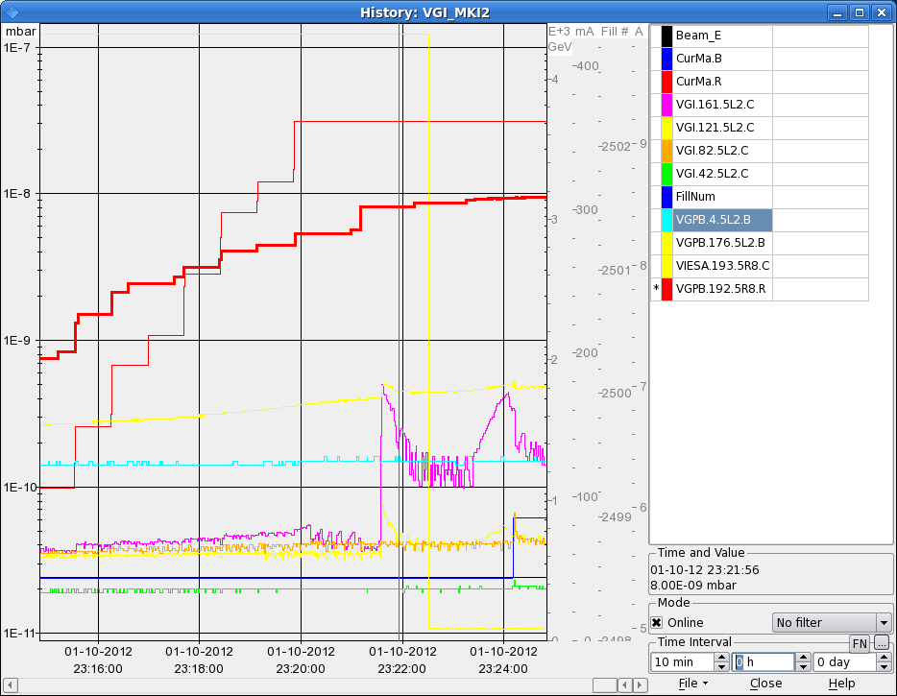
Back to 50 ns
Pressure rise at interconnect MKI8 preventing injection of last train of 144 bunches. Ramp with 1230 bunches per beam

Slide 10
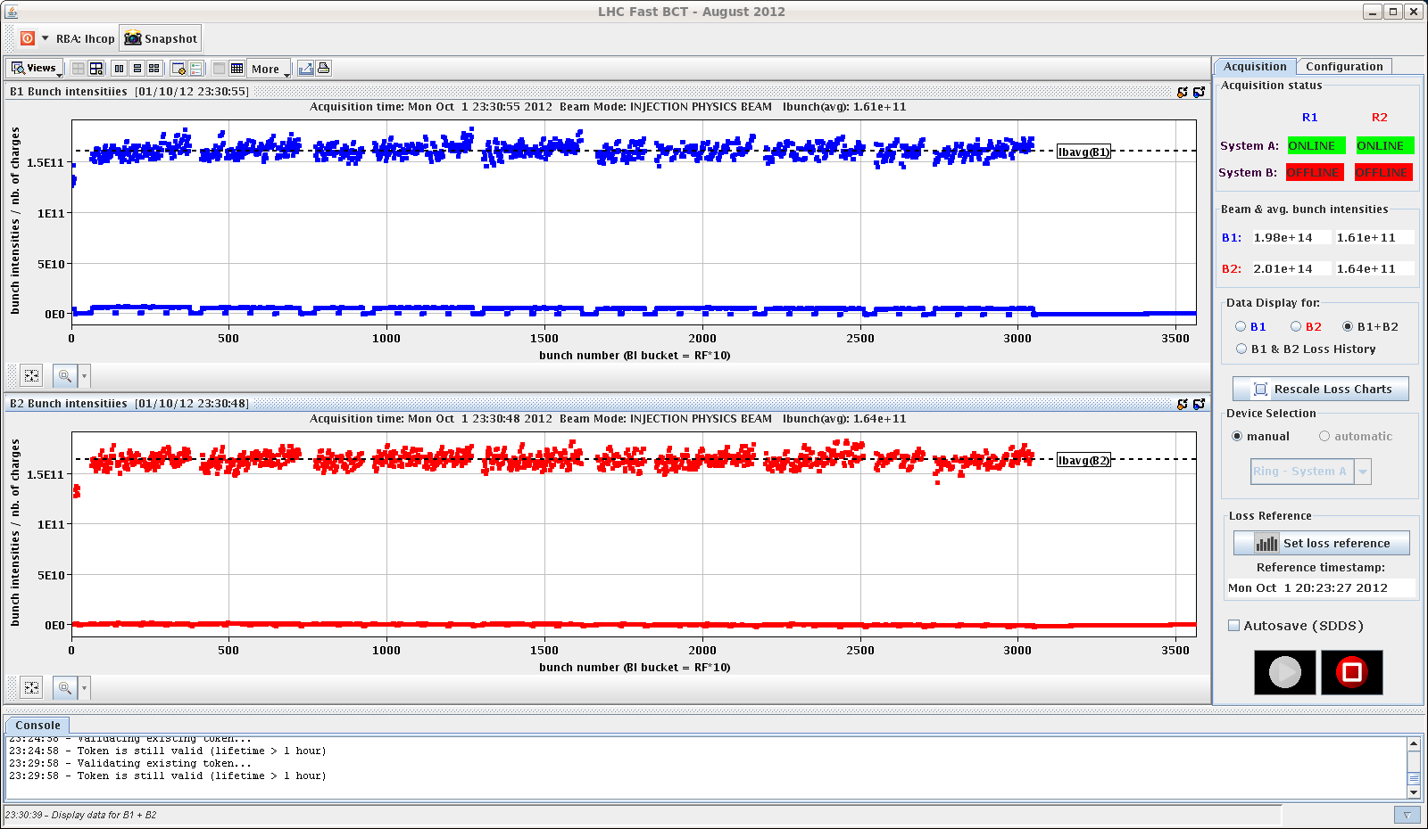

Slide 11
Stable beam #3121
Fill #3121
Good luminosities in spite of the reduced number of bunches, thanks to higher intensity (1.62x1011 at injection) and small emittances (Q20)
00:38 STABLE BEAMS
CMS solenoid up just in time!
Problem with BRAN for IP8

Slide 12
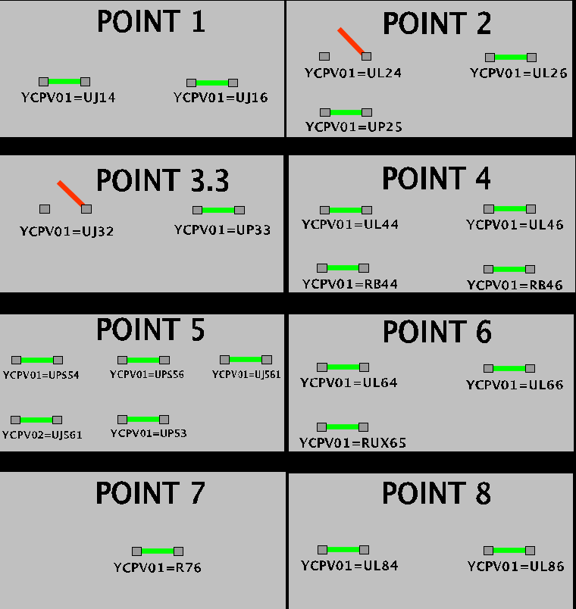
Pending
17:36 Ventilation doors YCPV01-UJ32 and YCPV01-UL24 are seen open. We mask the interlocks in SIS for now. We later found that this is fake signal due to an update in progress on the LACS at P6.
After further analysis by GS/ASE it was confirmed for sure that these two doors are indeed OPEN. Status information was blocked since 24th September.
Door YCPV01-UL24 should be closed at the next opportunity, ie after the next rampdown and before setting the magnets to injection level.
Door YCPV01-UJ32 should be closed at the next opportunity of access to sector 23.

Slide 13
Pending
Access for:
TOTEM (1 hour)
ATLAS (1 hour)
BSRT (2 hour)
Scope for Diamond detector in point 8 (1/2hour)

