Slide 1
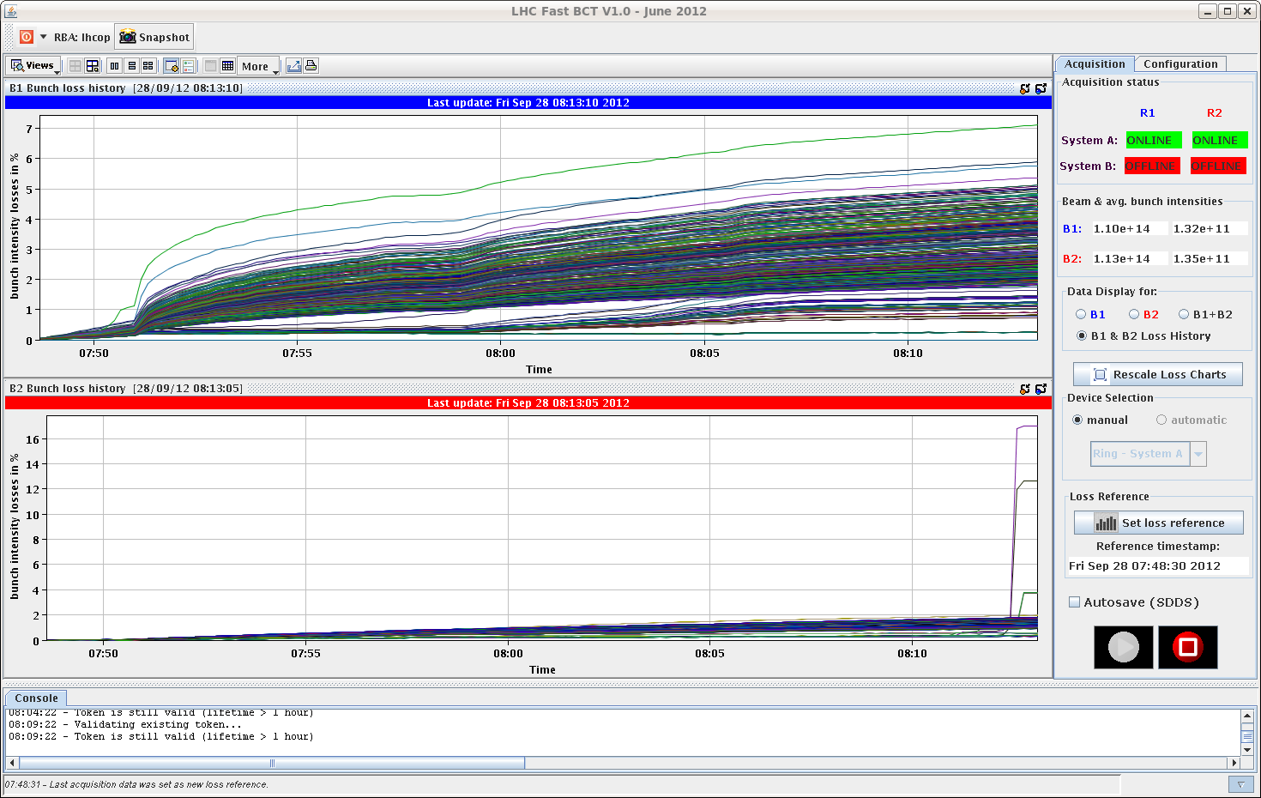
Friday morning
08:00 Stable beams with 840b.
Nice smooth cycle.
08:15 Losing on non-colliding (and no LR) bunches when trimming down the octupoles.
Had to back off in octupole current to stabilize.
Sign that we should avoid bunches without head-on in IR1/5 in the filling schemes.

Slide 2
Friday continued
09:40 Beam dump, trip of RCBXH3.R1.
No faults, reset and go.
10:20 Lost cryo in S78 due to DFB levels.
Unfortunate error while reconnecting the distribution between heat shields. An interlock was left unmasked, and an interlock triggered, closing valves on the 4.5K distribution line.
In the context of decoupling S78 and S81.
Some accesses (LHCb, CMS) during cryo recovery.
Collimator T sensor on TCSG_4R6_B1_TTRU with strange reading disabled (1 out of 4).
15:30 Cryo S78 is back.

Slide 3
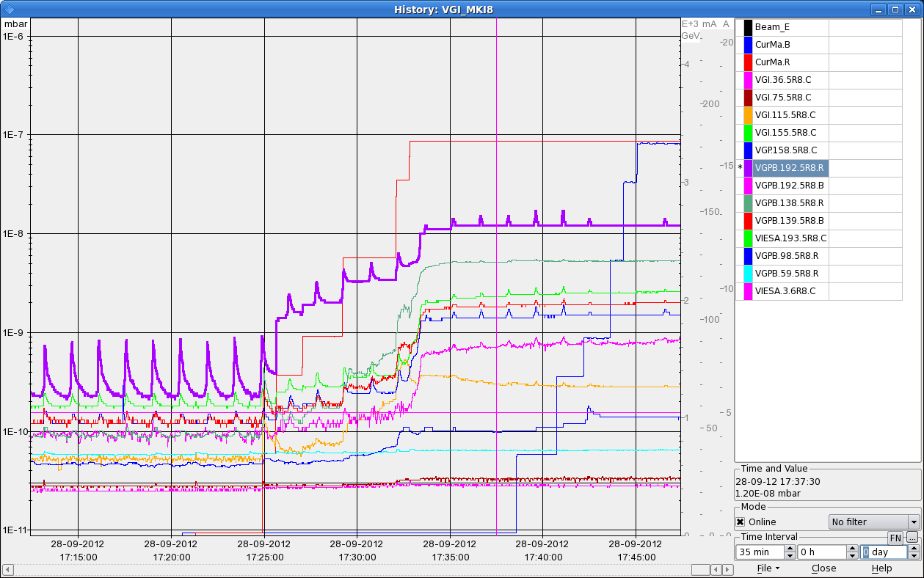
Friday afternoon
17:00 Filling with standard schema, 1.4E11 p/b, as far as vacuum allows.
Had to stop at 726 bunches, vacuum in interconnection > 1E-8.

Slide 4
Friday afternoon
18:40 Stable beams, fill 3109, L ~3E33 cm-2s-1, 726b.
Smooth, a few poor quality batches made it through (we had a some issues with PS bunch length) – reflected in losses.
21:40 Start of ATLAS VdM scans.
23:10 Beam dump – lost cryo sector 78 due to communication with vacuum.

Slide 5
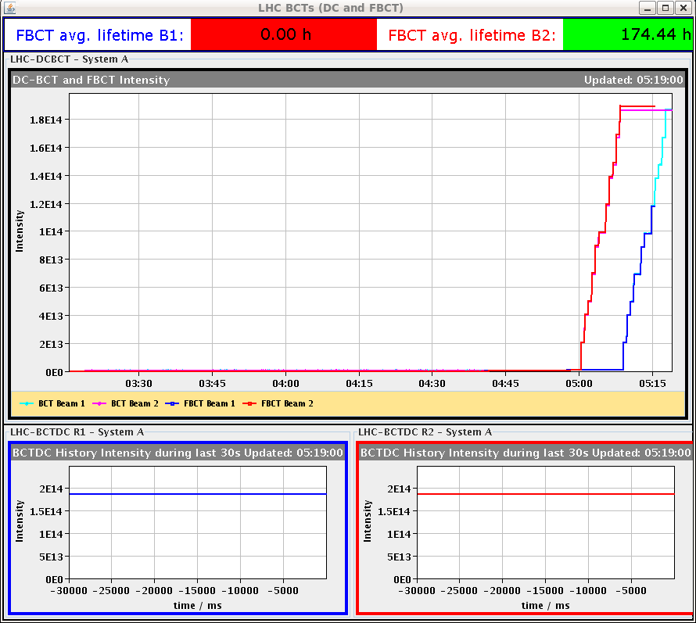
Evening
00:00++ Access LHCb. Followed by CMS. Then vacuum for PLC restart.
00:50 No more logging of some systems (LHC BI) – server hardware failure.
03:30 End of access. Pre-cycle.
04:30 Injection – 1374 bunches @ 1.4E11 !!

Slide 6
Morning
05:00 Server for logging repaired.
05:40 Lost BCT information.
06:30 Stable beams fill 3110, L ~ 5.3E33 cm-2s-1.
Lumi optimization by hand, as FBCT down (should not be like that…).
LHCb leveling does not work as no Xing plane scan done → manual forcing by Richard.
07:10 Beam dump – electrical glitch affecting S78 and S81. Apparently related to the UPS.

