Slide 1
Overview Saturday
10:00 Q20 injection test.
Problems with the SPS orbit at 450 GeV.
B1 MKI faulty.
12:00 Stop of Q20, revert back to Q26.
Access for RF and injection kicker. Precycle.
14:30 Injection.
15:30 Quick ½ hour access for ATLAS, safety alarm.
16:00 Steering lines, reconfigure RF.
18:10 Filling for physics, 10% reduced intensity.
19:50 Stable beams fill 3067, L ~6.3E33 cm-2s-1.
Both ATLAS and CMS a bit off, some troubles to find LHCb.
Changes incorporated.

Slide 2
Overview Saturday
Around 22:50 orbit jump when SPS switched off the TLs (compensator problem). In the upwards direction for LHCB lumi.
01:00 One ADT module lost (H1B2).One amplifier is disabled until TS3.

Slide 3
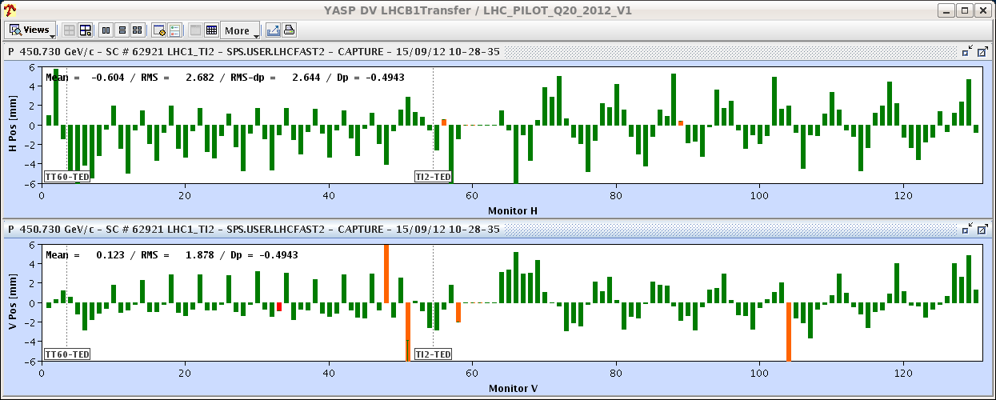
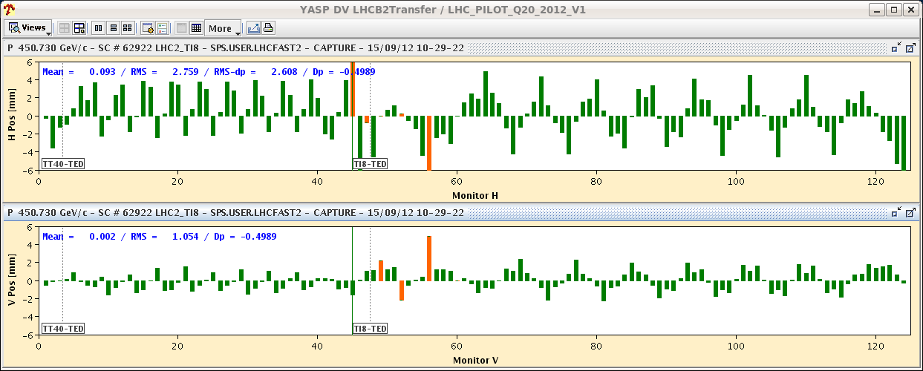
Q20
Bad trajectory, source in the SPS. Seems the SPS orbit at 450 GeV has changed on Q20.
Extraction to be revisited…

Slide 4
RF
Klystron line 2B1: modulator anode and filament cable swapped, which reduces the load on the suspected faulty HV cable from 25A to a few mA.
We will see if this provides a workable temporary solution.
In the last moment before start the ramp, it was realized that the RF voltage partition had not been reverted.
Fixed by Themis. But this required to dump and refill.

Slide 5
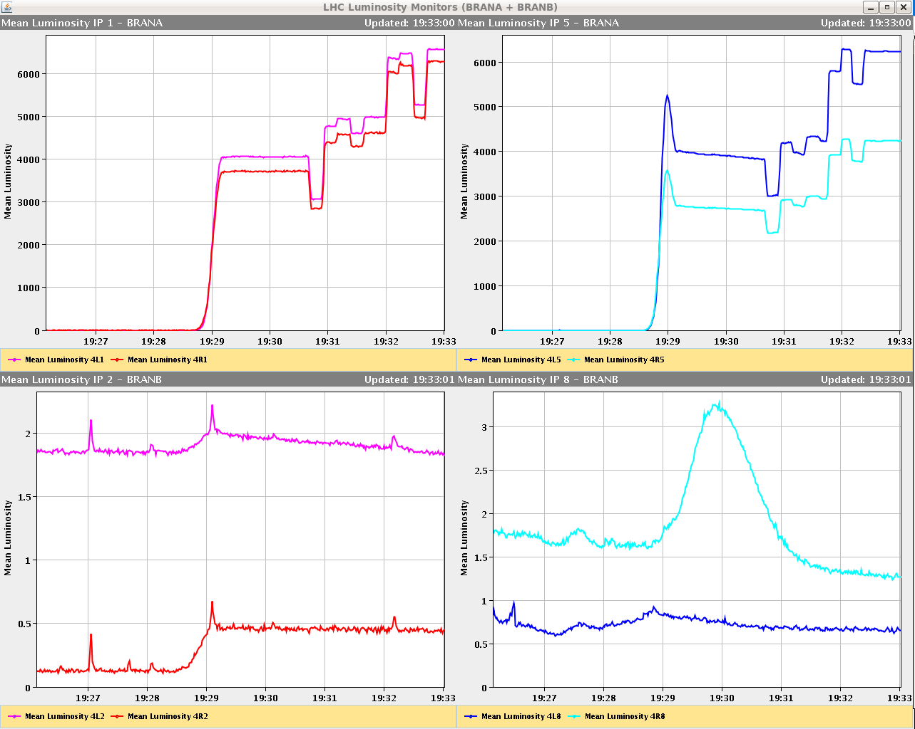
Collisions
CMS and ATLAS a bit off…
ALICE again limited to ~0.5E30 cm-2s-1.
Initial ‘Luminosity’ signal in LHCb very low. Not possible to exceed 2E30 cm-2s-1.
It seems that we were optimising on beam-gas?
After ~1 hour of scanning overlap was found (off in both Xing & Sep).
During the test of the morning, the scans were OK. Needs more analysis – but the settings were indeed unusual…

Slide 6
Plan
If RF holds – physics.
Else:
Q20 (daytime).
Optics in ramp (evening).
2 step collision BP iteration 3 (any time).
If physics and fill is lost late Sunday night/Monday morning (not worth a refill), insert this test.
Beams dumped Monday at 06:00

