Slide 1
Sat 01/09 – Sun 02/09
08:03 Operator dump Fill 3018. 173 pb⁻¹ in 13 hours
09:00-10:00 Cycle IT.R1. OK from PO piquet to continue.
11:35 STABLE BEAMS #3019. Initial lumi ~6.7x10³³ cm⁻²s⁻¹
17:10 Trip of RQT13.R7B1 (QPS - likely SEU). ~92 pb-1 in 5.6 h
In parallel TCTVA.4R5.B2 problem.
21:13 After several attempts to reset the QPS controller for RQT13.R7B1 remotely, access for QPS board replacement
22:17 access finished. Precycling.
01:23 STABLE BEAMS #3020. Initial luminosity 6.9x10³³ cm⁻²s⁻¹
06:17 RQTL7.L7B2 trip (QPS – requiring QPS reset – SEU?). 87 pb⁻¹ in ~5 h.
07:13 Filling

Slide 2
Fill 3019
Improvement in the H-emittance delivered by the injectors (V – measurements performed yesterday in the horizontal plane were saturated) although still some tails
31/8 01/09
E. Bravin
Gaussian fit – Gaussian fit (core up to 1.7 σ)

Slide 3
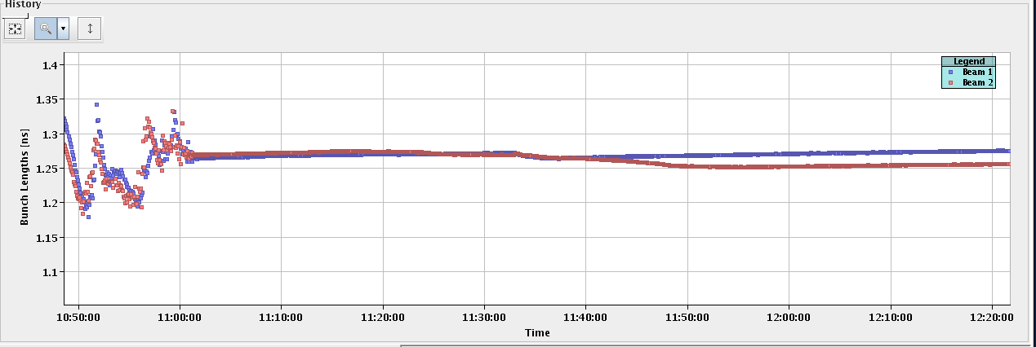
Fill 3019
Clean ramp and squeeze
Losses in collision mostly on B2. Improved by increasing Q_{H}. Corresponding reduction of bunch length (normally observed for B1)

Slide 4
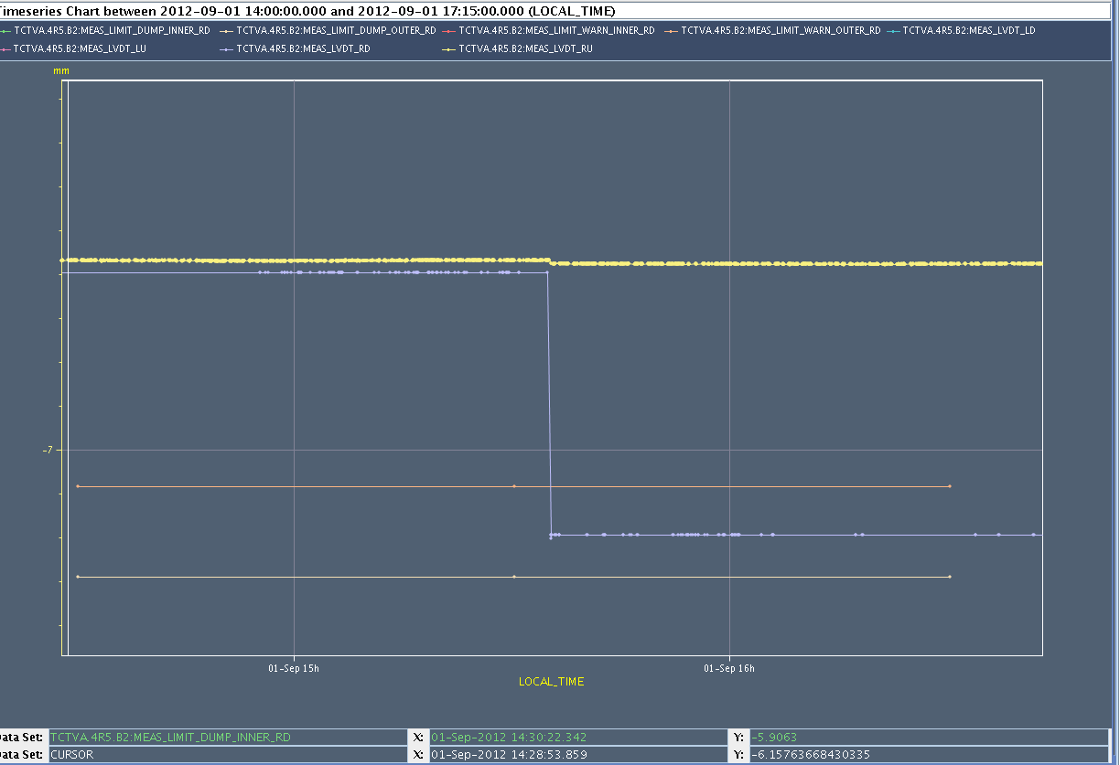
TCTVA.4.R5B2
TCTVA.4R5.B2 giving position error after sending injection settings. CMS saw the same collimator moved by 1mm while in STABLE beams.
After discussion with STI piquet, S. Redaelli, A. Masi: collimator moved by -0.6 mm at 15:35 but remained within tolerances. This is why the beam was not dumped.
Warning appeared on the collimator display but was not noticed
Only Right Downstream motor moved ➔ likely SEU. A power glitch would have likely determined a movement of all motors.
LVDT-Right Upstream
LVDT-Right Downstream
Outer Warning level – RD
Outer Dump level – RD

Slide 5
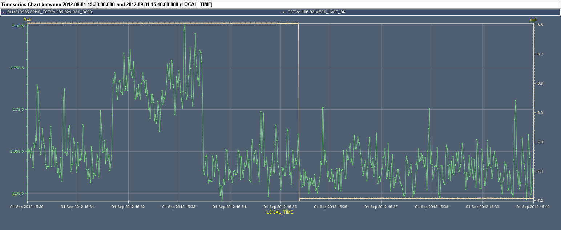
TCTVA.4.R5B2
No visible losses when moving collimator in point 5
Tested collimator with several cycles during QPS intervention ➔ no problem observed. No intervention on the driver.

Slide 6
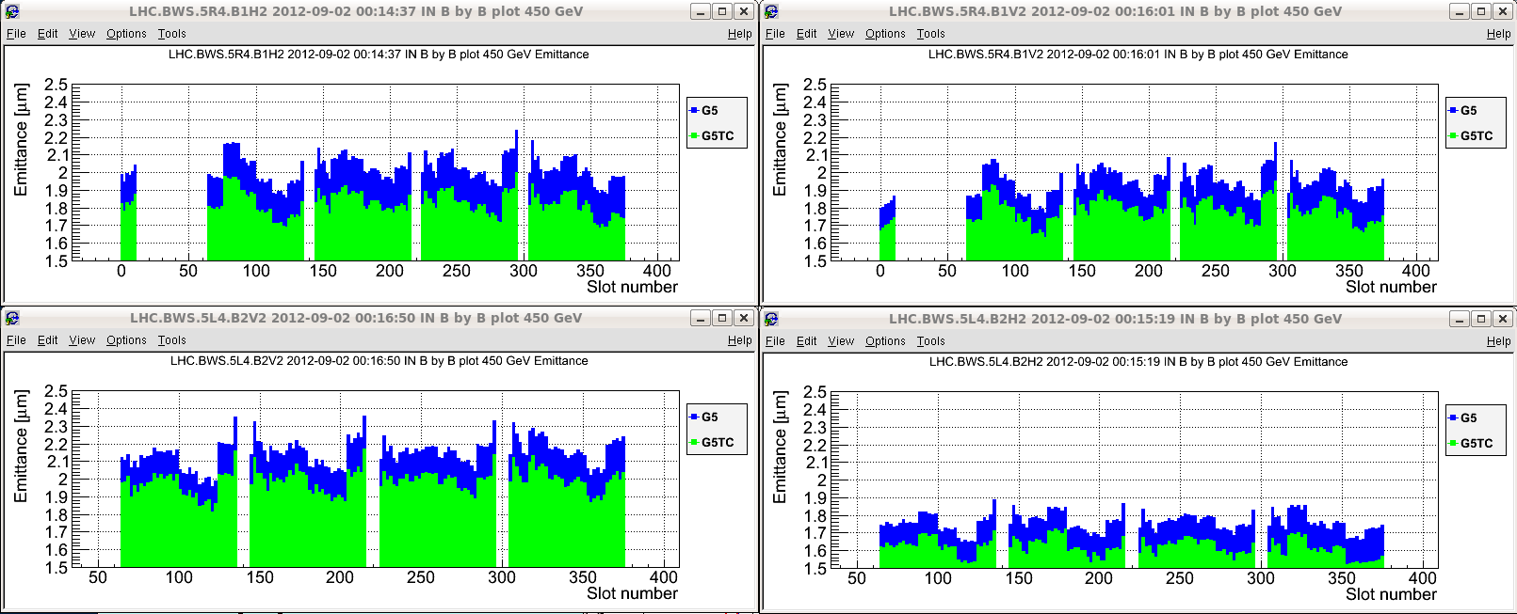
Fill #3020
Slightly higher intensity (1.65x10¹¹ p/b at inection) but emittances on the higher side as compared to best
Higher losses on the squeeze (~5%) as compared to previous fill (~2-3 %) equally on all bunches
H-B1
V-B1
V-B2
H-B2

Slide 7
Abort gap cleaning
Regularly performed in stable beams every ~1/2 hour
Daniel Valuch contacted to implement different settings for cleaning and monitoring ➔ presently away back and Tuesday. He will prepare the necessary modifications

Slide 8
Pending
SPS EDF intervention
Monday morning ~9 h for about two hours with pilot beams during that time
triplet octupole correct circuit tests & polarity
skew sextupole polarity
On the waiting list
Totem in at end of fill
RF batch-by-batch blow-up

