Slide 1
LHC Status Wed Morning 23-Aug
Bernhard Holzer, Joerg Wenninger

Slide 2
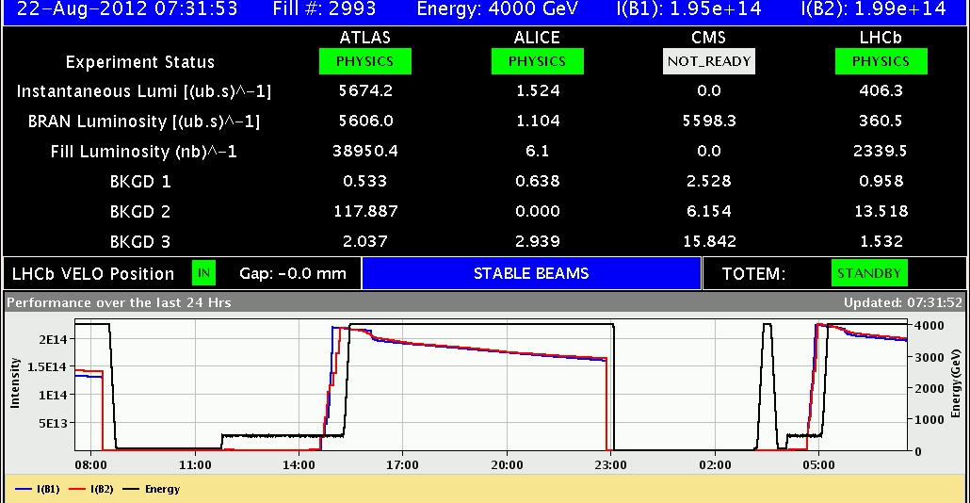
Wed Morning / Late
since 5:47h stable beams
CMS solenoid off
17:51h beam dump, QPS trigger Q4.L1
...” 50 Hz noise on beam 1”. Cryo loss of matching section
during ramp down : RD2.R2 tripped ... reason unclear

Slide 3
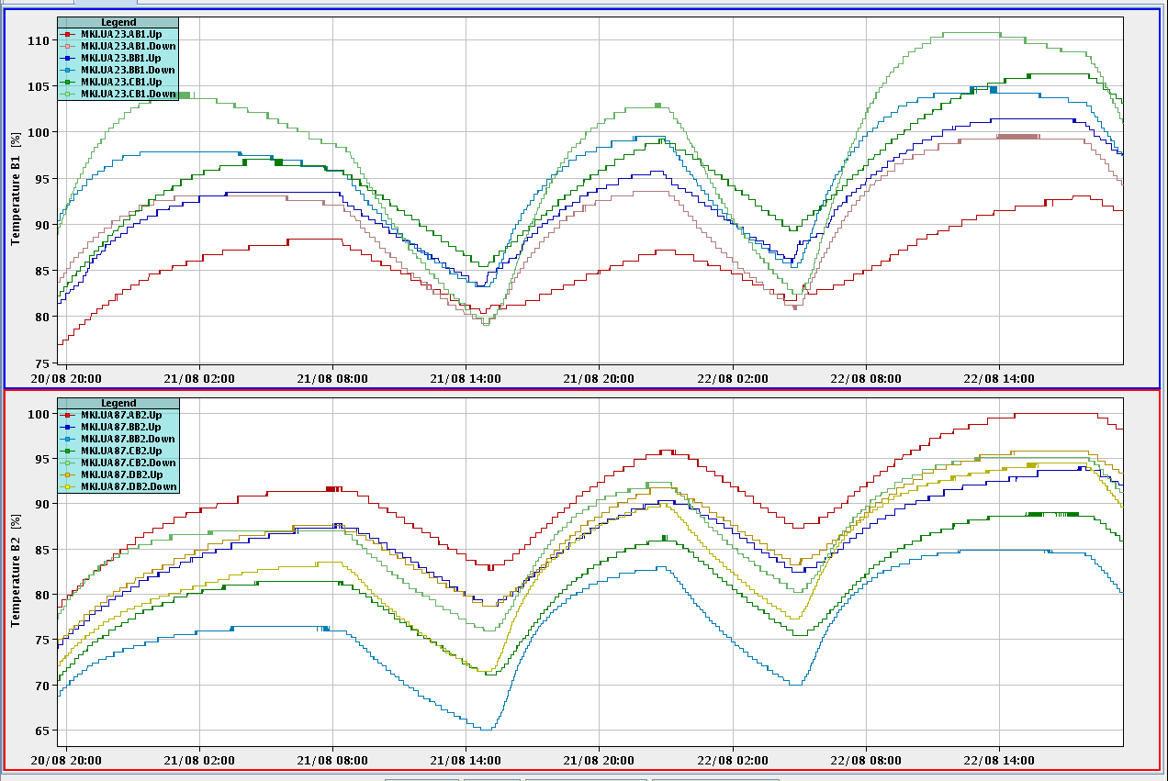
Wed Late
Kicker Temperatures after a some long runs:
110%
MKI c B1
≈ 1.5 h waiting time

Slide 4
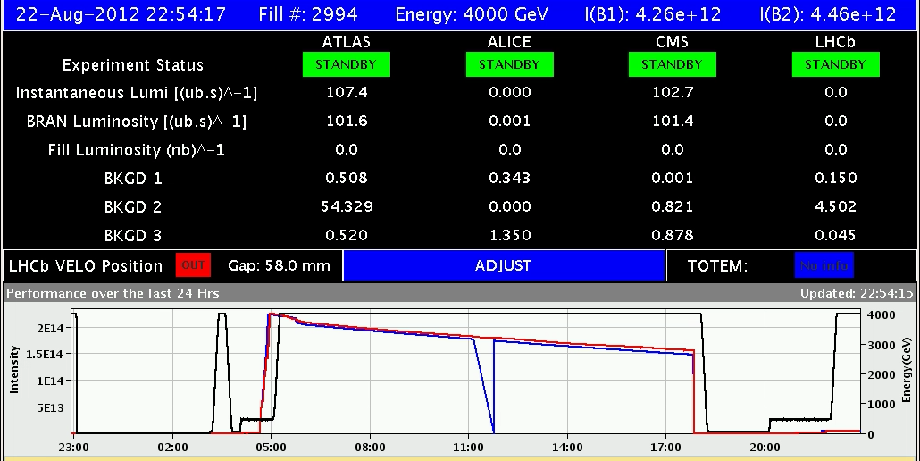
Wed Late
21:27h injection physics beam for H9 test
emittance after injection
21:57h start ramp
22:50h luminosity
22:54h CMS solenoid back in business.

Slide 5
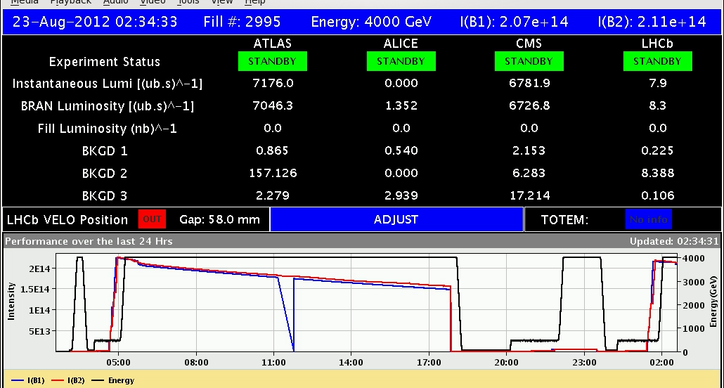
Wed Night
23:30h beam dump
prepare for standard fill
01:18h injection for physics
02:35h stable beams
L₀=7.2*10³³ (ATLAS)
Emittances B1H = 1.6 B1V = 1.45
B2H = 1.65 B2V = 1.78

Slide 6
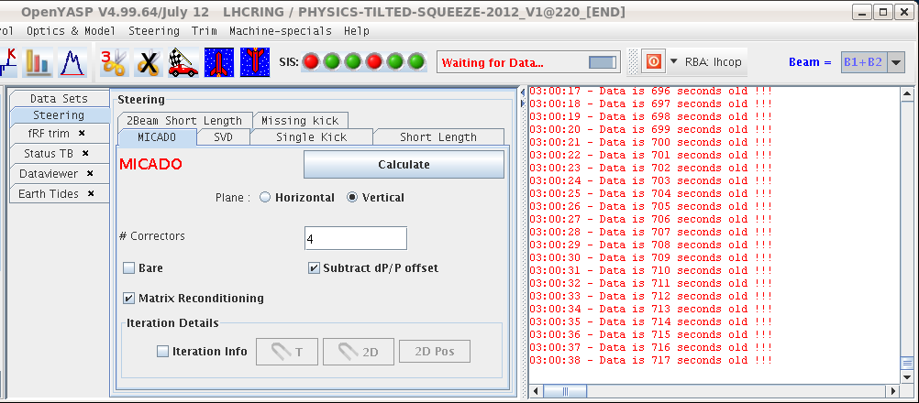
Wed Night
02:58h beam dump: OFB controller down.
SIS did not receive data for more than 10 min then triggered the dump.
expert(s) called
04:37h problem solved
server cs-ccr-ofc had to be restarted
(orbit feedback server)
05:00h LHC ready for injection ... but no beam from injectors:
LINAC 2 vacuum problem

