Slide 1
LHC Status Tue Morning 22-Aug
Bernhard Holzer, Joerg Wenninger

Slide 2
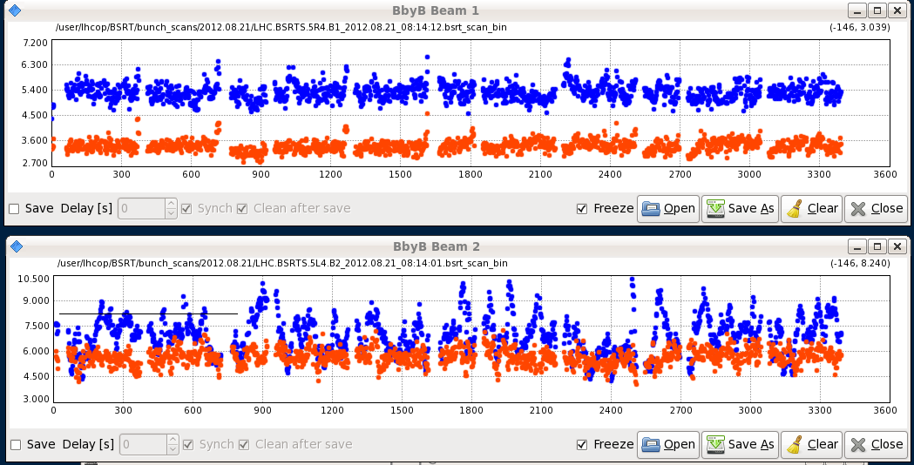
Tue Morning
08:24h beam dump:
Access needed for LHCb water leak
emittances at fill end ...
access for ATLAS / CMS / RP ... in the shadow
11:20h LHC closed, restart
11:51h injection probe beam

Slide 3
Tue Morning
12:07h beam dump: SIS problem,
“See glitches on SIS, on squeeze factors, currents and states of PCs in different sectors etc etc.”
Also the squeeze factor interlock came back - it'd have dumped, had we had beam.Example of exceptions:12:43:26 - 2012-08-21 12:43:25,706 [JapcExecutor-thread-11] ERROR JapcDispatcherImpl +==> Exception occured for parameter id [RPHGA.RR13.RQ8.L1B1_DATA] name [RPHGA.RR13.RQ8.L1B1/SUB_51]asynchronous operation on RPHGA.RR13.RQ8.L1B1/SUB_51@ failedcern.japc.ParameterException: Lost-Updates: Server overloaded and not able to handle all new updates ==> it will loose updates.
at cern.japc.ext.cmwrda.DataTranslator.createParameterException(DataTranslator.java:275)
at cern.japc.ext.cmwrda.RDAReplyHandler.handleError(RDAReplyHandler.java:115)
at cern.cmw.rda.client.ReplyAdapter.handleException(ReplyAdapter.java:103)
at cern.cmw.rda.client.ServerConnection.dispatchLostUpdates(ServerConnection.jav
a:2566)
at cern.cmw.rda.client.ServerConnection.handleReply(ServerConnection.java:2349)
at cern.cmw.corba.rda.ReplyHandlerPOA._invoke(ReplyHandlerPOA.java:45)
at org.jacorb.poa.RequestProcessor.invokeOperation(RequestProcessor.java:297)
at org.jacorb.poa.RequestProcessor.process(RequestProcessor.java:591)
at org.jacorb.poa.RequestProcessor.run(RequestProcessor.java:734)Caused by: cern.cmw.LostUpdates: Lost-Updates: Server overloaded and not able to handle all new updates ==> it will loose updates.
at cern.cmw.rda.client.ServerConnection.dispatchLostUpdates(ServerConnection.java:2562) ... 5 more
my translation: programs running in parasitically were blocking the operation servers
some users caused delays and data packet losses.
-> users identified, processes stopped, SIS reset by the experts ... and ok

Slide 4
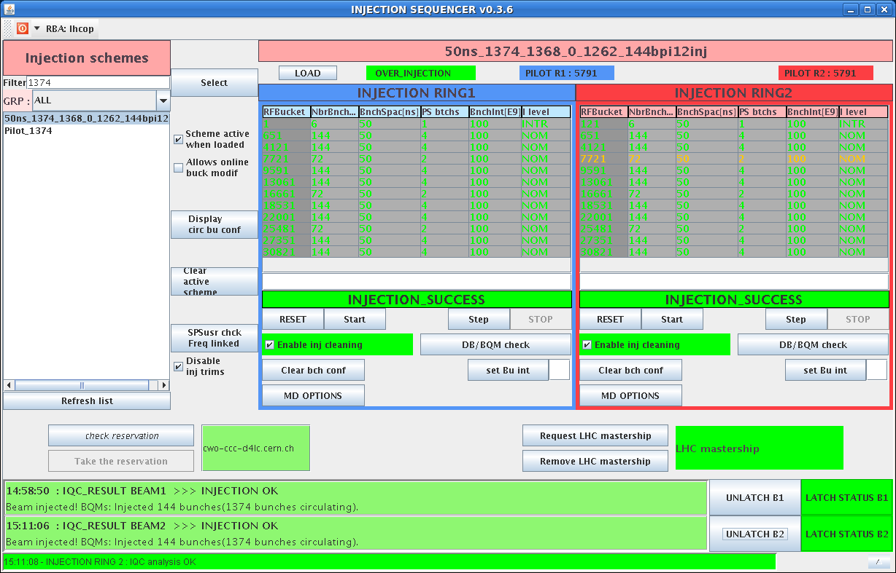
Tue Morning
14:14h injection physics beam
... CMS solenoid ramping down ... UPS problem
nice clean injection
15:16h ramp, squeeze, adjust without (?) problems
Emittances
B2H = 1.86 B2V = 1.97
B1H = 1.94 B1V = 1.76

Slide 5
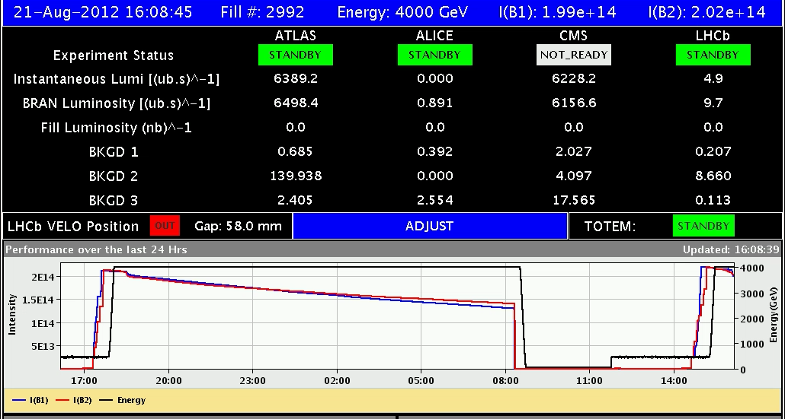
Tue Late
15:35h OFSU crashed before launching the squeeze.
Need to fetch optics and re-calculate it.
16:10h luminosity optimisation:
again beams offset in ATLAS, initial lumi: 2*10^33
lifetime down to 0.5h, considerable intensity losses
recovering after decent tuning of luminosity

Slide 6
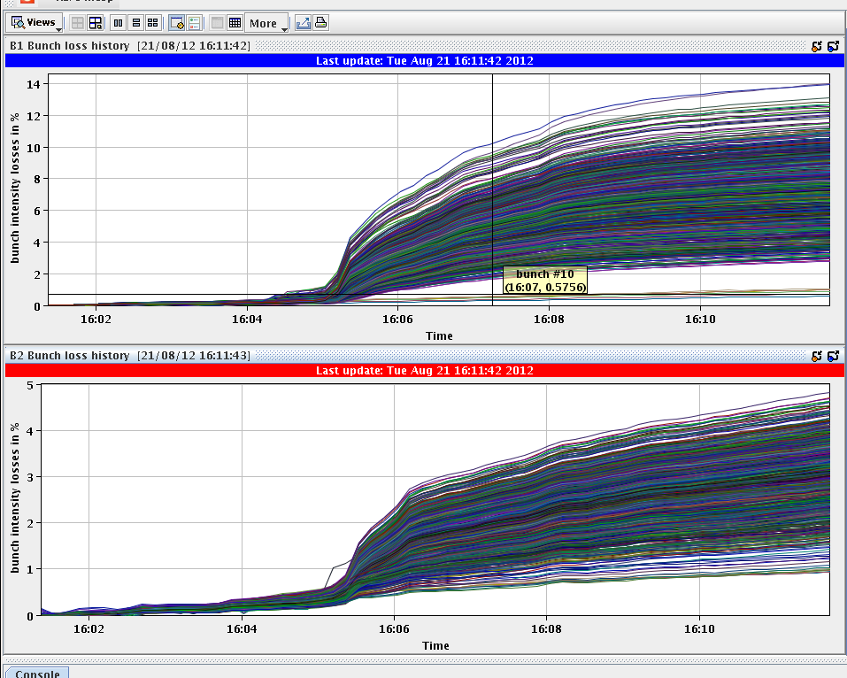
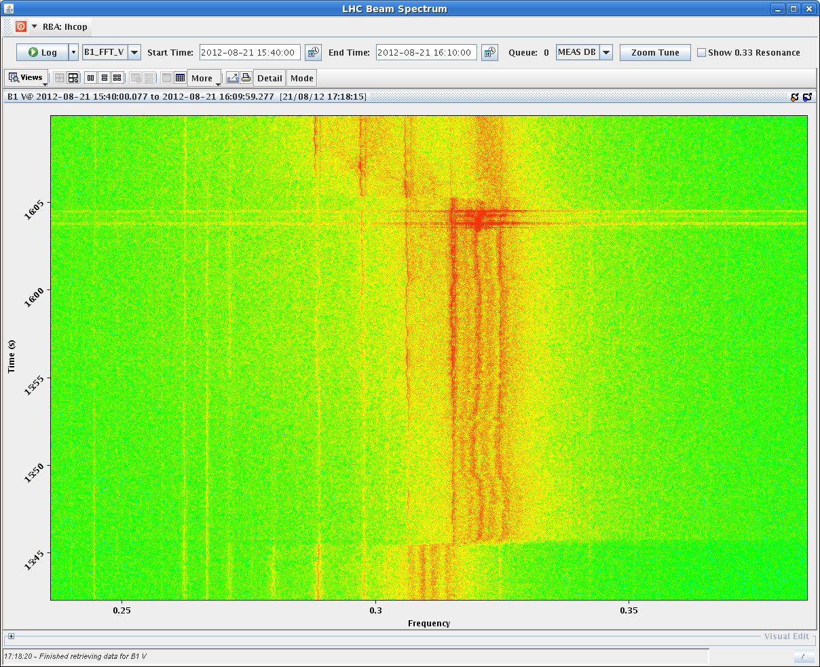
Tue Late
luminosity optimisation:
not the easiest part this time
cured by: head on in ATLAS, reducing chroma (trim of -3 H and -5 V),
octupoles at -1.7, slight global orbit correction
beam losses
tunes
lifetime
bunch intensities

Slide 7
Tue Late
22:52h beam dump due to thunderstorm
lost sector 12 ... et al
first bilan:
* lost sector 12, 23, 34, 45 ,67 and 81,
lost RD34LR7 and RD1LR5
* trip of ALICE and LHCb dipole
* lost 2 RF modules M2B1 and M2B2
* several collimators not going to parking

Slide 8
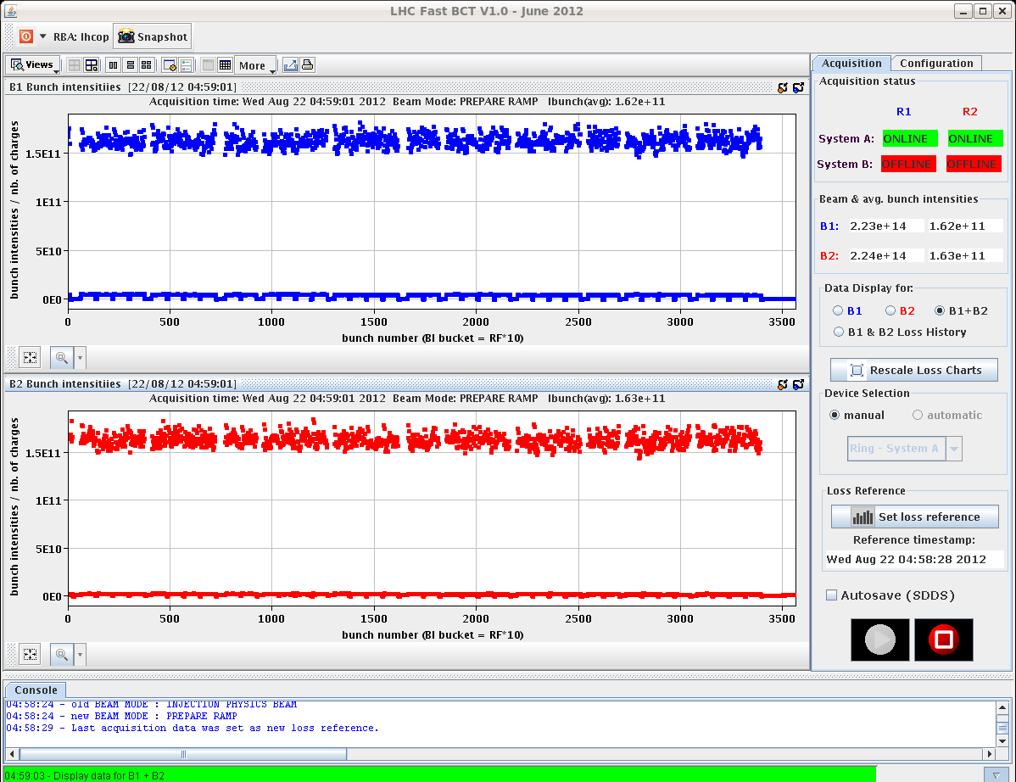
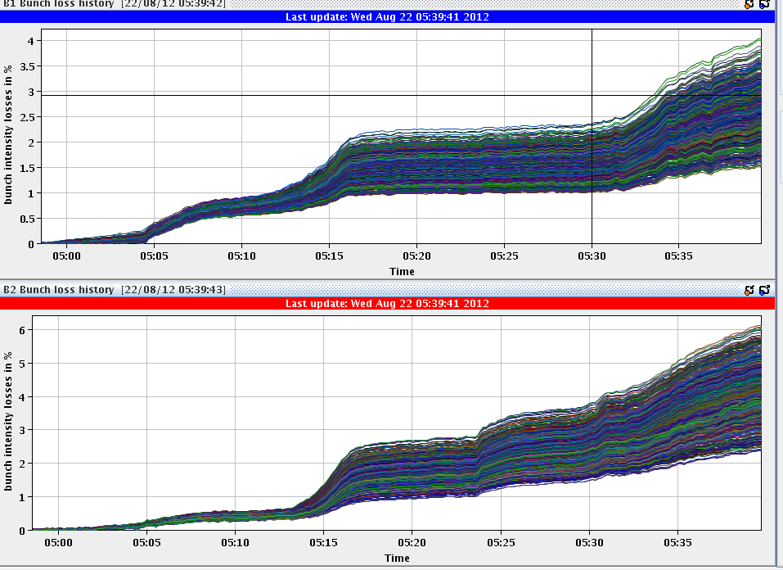
Tue Night
04:07h injection probes
04:28h injection physics
05:03h ramp, squeeze, adjust, lumi
4 %
4 %

Slide 9
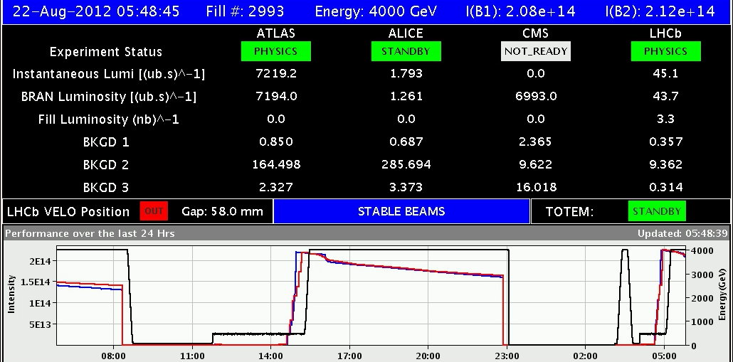
Tue Night
04:07h Luminosity

