Slide 1
Saturday
09:30 Stable beams fill 3002, L ~7.2E33 cm-2s-1.
22:12 Beam dumped, trip of Q4.L1 (#3), 178 pb-1.
MKI temperature not too bad.
Q4.L1 trip looks like previous ones.
00:00 Injecting.
High losses on fast RS for B2 (> 30%) 72b.
RF phase noise warnings, but spectrum OK.
01:50 Stable beams fill 3003, L ~7.3E33 cm-2s-1.
02:30 Beam dumped, B1 vac. valves closed in IR7.
03:00 Piquet reopened valves, spike above 2E-6.

Slide 2
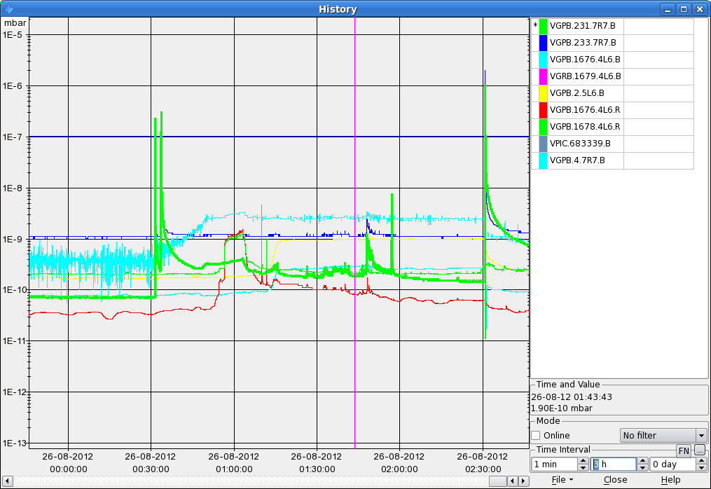

Slide 3
Sunday
04:30 MKI’s ready for injection.
RCBV24.B2R6 tripped again during ramp down (see Friday).
Again noticeable fast ring losses at injection (IR7) for B2 72b injections.
Again RF phase noise warnings (4B1), but spectrum OK.
06:30 Dump during the squeeze, ROF.A56B2 trip (PIC).
07:30 Filling again.
Again RF phase noise warnings (4B1), but spectrum OK.

