Slide 1
TDI8 alignment check (Chiara, Wolfgang)
06:00-09:00 TDI8 alignment verification
Angular alignment:
tilt both jaws to +/-1, +/-0.5 and 0 mrad and perform full beam scraping
defines beam centre and jaw angles
Measurement to check retraction:
blow up beam to nominal TCP setting
open both TCP jaws by 0.1 sig and blow up beam again
record when losses move from TCP to TDI

Slide 2
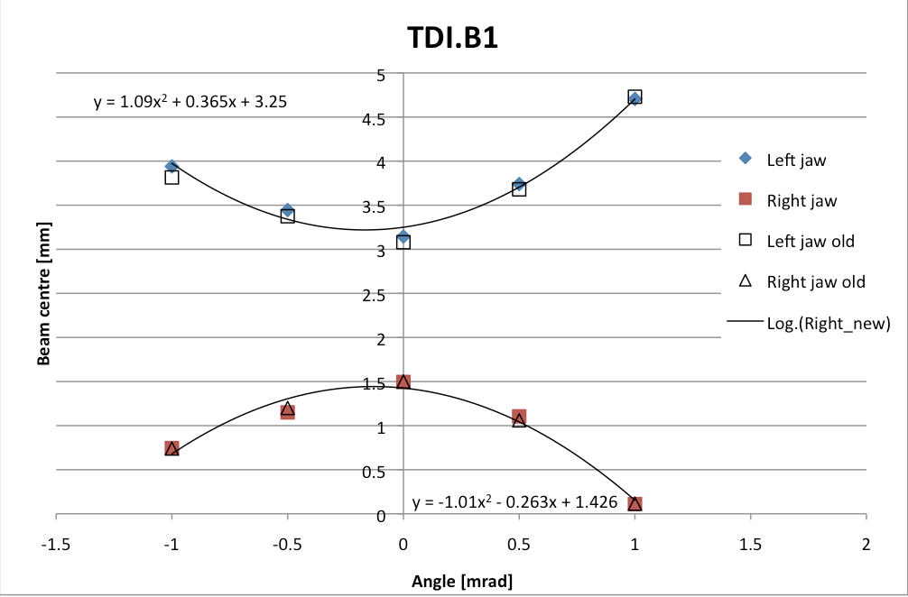
TDI8 alignment check (Chiara, Wolfgang)
Angular alignment:
No change as compared to last measurement's changes by 10 urad for the lower jaw
we keep the same positions and angles as before
Retraction measurement:
Lower TDI.P8 jaw at 6.8 (6.6 previous) σ exactly at nominal setting, OK Upper jaw at 6.4 (6.4) σ, closer to the beam and therefore OK

Slide 3
Wed 15/8
09:00-10:49 Fill with 78 bunches for verification of the full cycle and collision optimization.
10:49–11:39 STABLE BEAMS #2974. 78 bunches. 0.8 pb⁻¹ in 0.8 h. OP dump after lumi optimization.
16:00-16:31 STABLE BEAMS#2975. 480 bunches 4 pb⁻¹ in 0.5 h. Trip of RQTL9.R7B1. QPS trigger (SEU?)

Slide 4
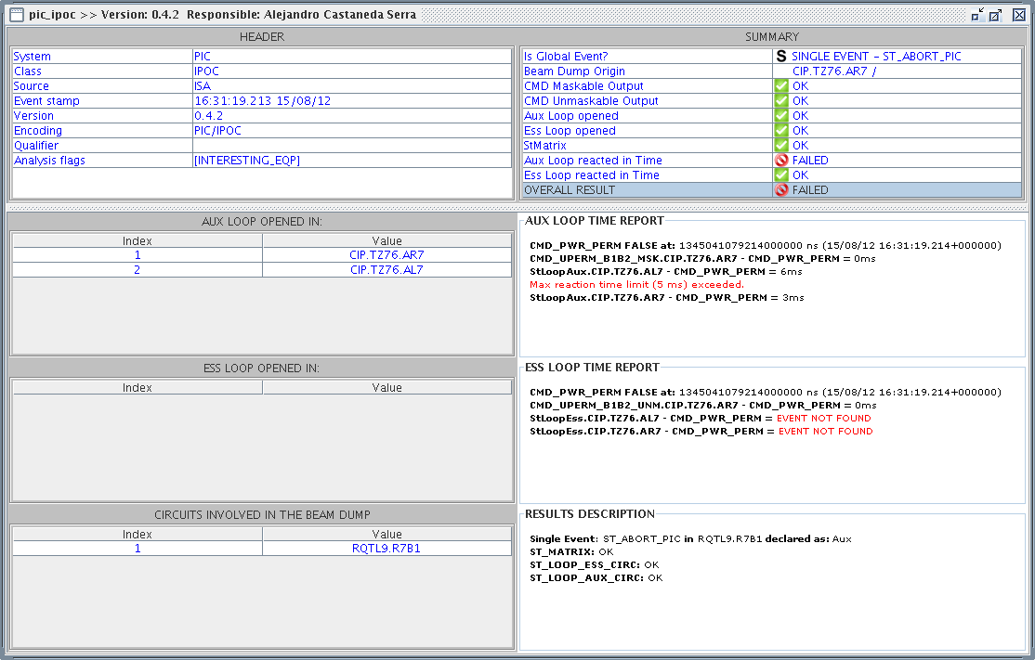
PM fill 2975

Slide 5
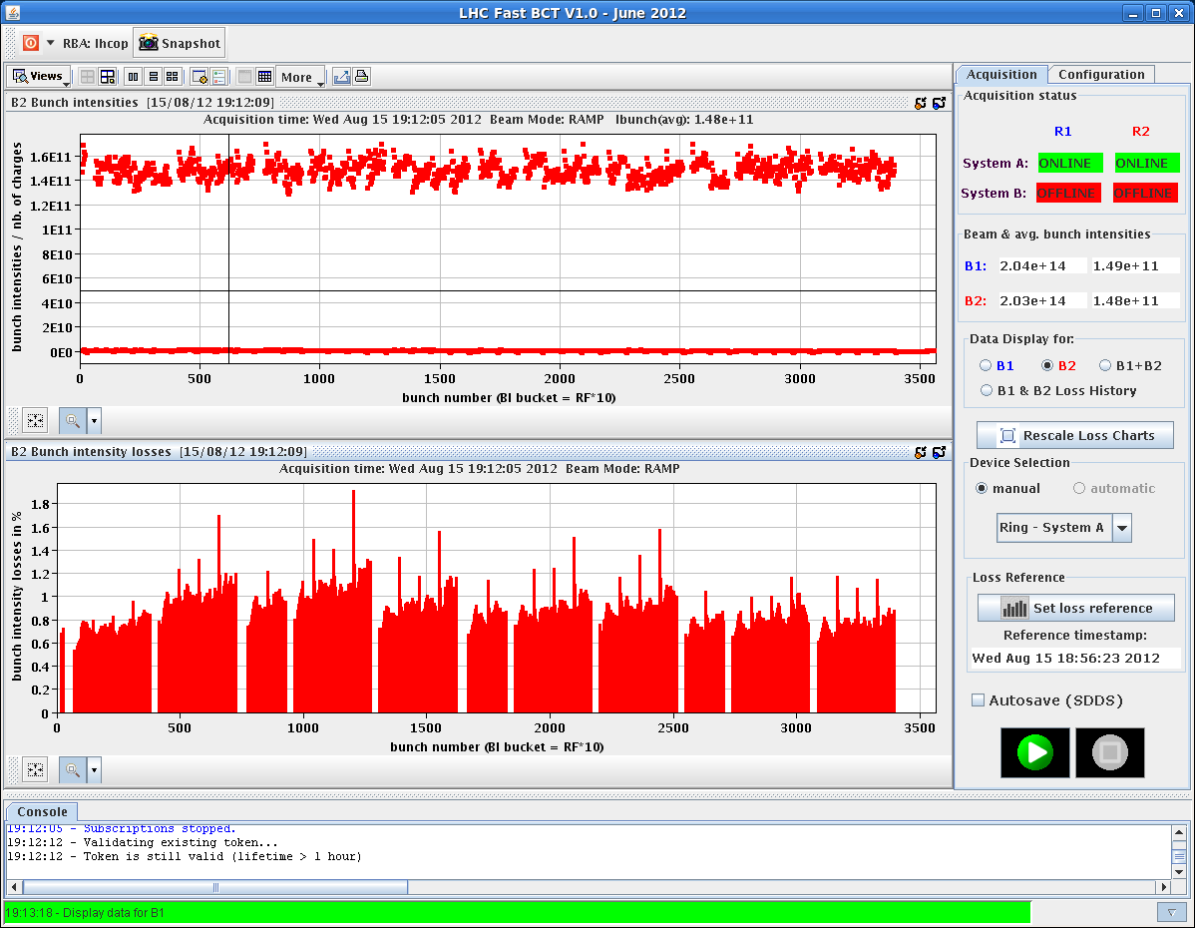
Fill 2976
Had to wait sometime at injection for injectors to check beam quality. First train of 144 bunches circulating for some time
Usual lifetime dips at the end of the ramp and β*<2m. ~3% loss for B2 through the cycle
SPS injection kicker timing to be adjusted ➔ Done over night

Slide 6
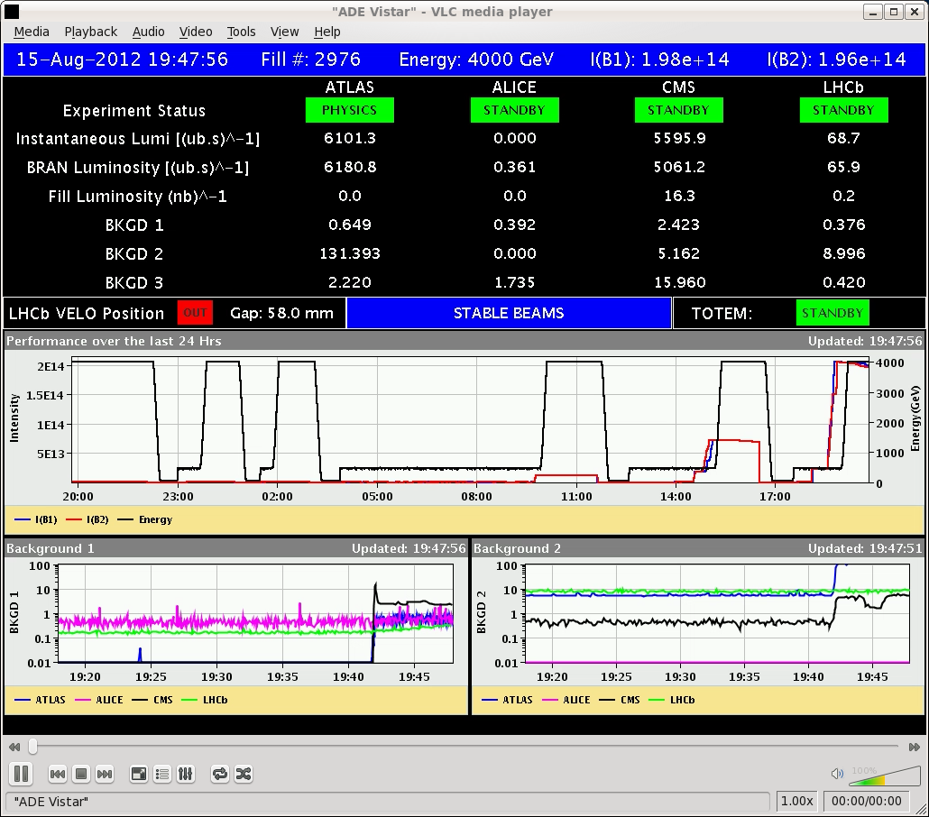
Back in business…..
19:47 STABLE BEAMS#2976. 1374 bunches. L~6x10³³ cm⁻²s⁻¹ and 1.44x10¹¹ p/b
Reduction of octupole currents down to 200 A and chromaticity down to 5 (H) / 7 (V). No significant improvement in lifetime.
07:07 End of fill #2976. ~150 pb⁻¹ in 11.3 hours. OP dump.

Slide 7
Plan
Refill for physics. 1.55x1011 p/b at injection.
Intervention on 18 kV cable in the SPS this morning
Tomorrow morning long (6 hours) intervention on PS 40 MHz cavity (power amplifier). Try to be in physics by that time.

Slide 8
Pending
Oscilloscope for diamond detector (during working hours, in UA87 for ~30 min). C. Zamantas
Moving of the spare MKD generator from gallery to the surface. N. Magnin.

