Slide 1
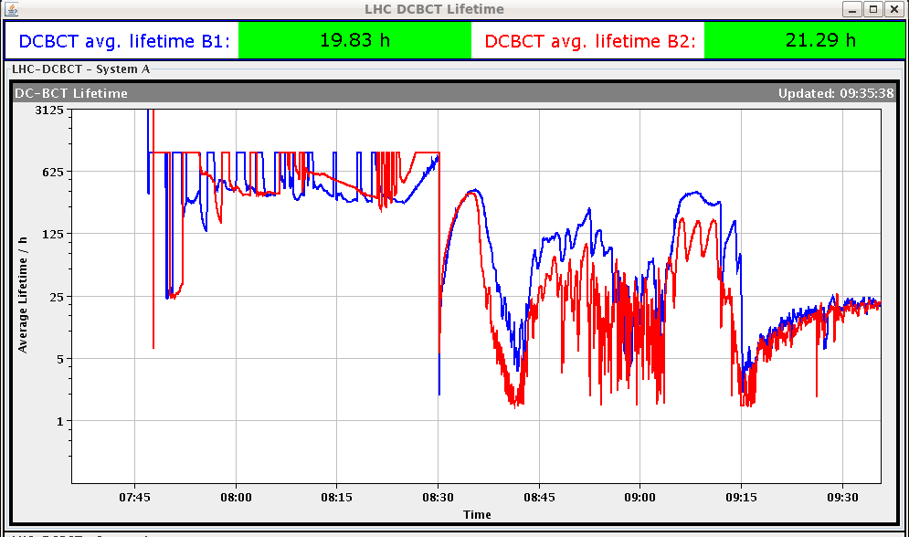
Friday 3.8. - Morning
7:30 injection for fill 2908
Average bunch intensity 1.53E11
Still rather large emittances, especially B2
Losses at the end of the ramp in IP7 (up to 32% of BLM threshold); ~6% of B2 lost during the ramp
Losses during squeeze (around 1.5m and at the end of the squeeze), up to 36% of BLM threshold
9:17 stable beams
Initial L ~6.0E33 cm-2s-1
~10 hours in stable beams
Integrated lumi: ~134 pb-1

Slide 2
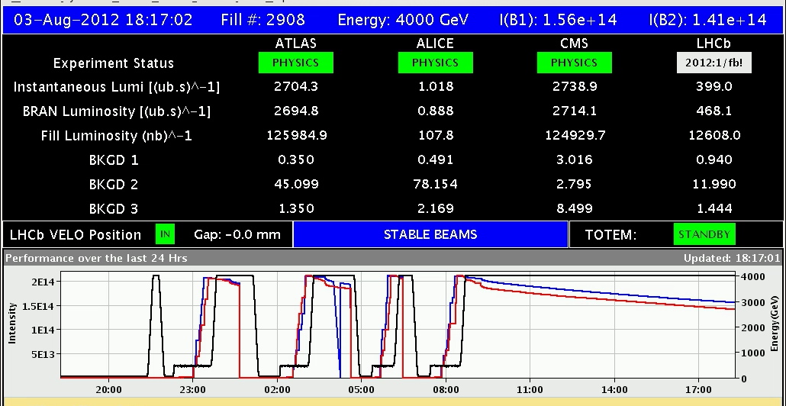
LHCb reached 1 fb-1 in 2012

Slide 3
Evening
19:12 dump after PC trip: RCBXV1.R5
→ access to replace a power converter sub-module in UJ56
Changes for the next fill:
Add empty LHC cycle in PS and PSB before the active LHC cycles
Switch off chirping B2 H after 2 TeV (and switch feed-back off if it locks on a spurious line)
21:35 intervention on RCBXV1.R5 power module finished
21:45 RD.34.LR3 tripping repeatedly while going to STANDBY
23:11 piquet re-set the fault, start pre-cycling
23:54 start injecting
0:45 dump during filling: ALICE dipole tripped (piquet checking)
1:30 ALICE dipole re-set, injecting again

Slide 4
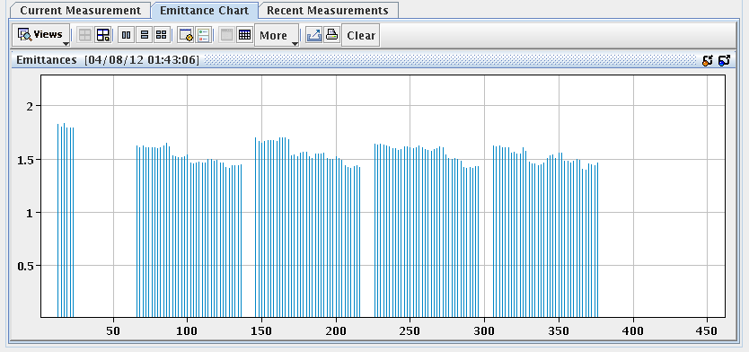
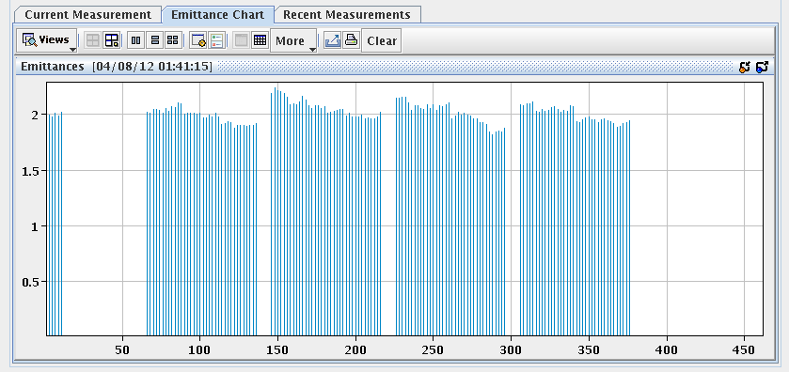
Night
Emittance of the 4 PS batches look rather similar now
1:56 dump during filling: LBDS self-trigger (MKD B2 kicker in fault)
Access needed: AUE reset by piquet
4:00 pre-cycle
4:41 SPS main power converters down (earth fault)
5:11 CMS detector partly down
5:50 SPS back and CMS ready for injection – re-injecting for fill 2911

Slide 5
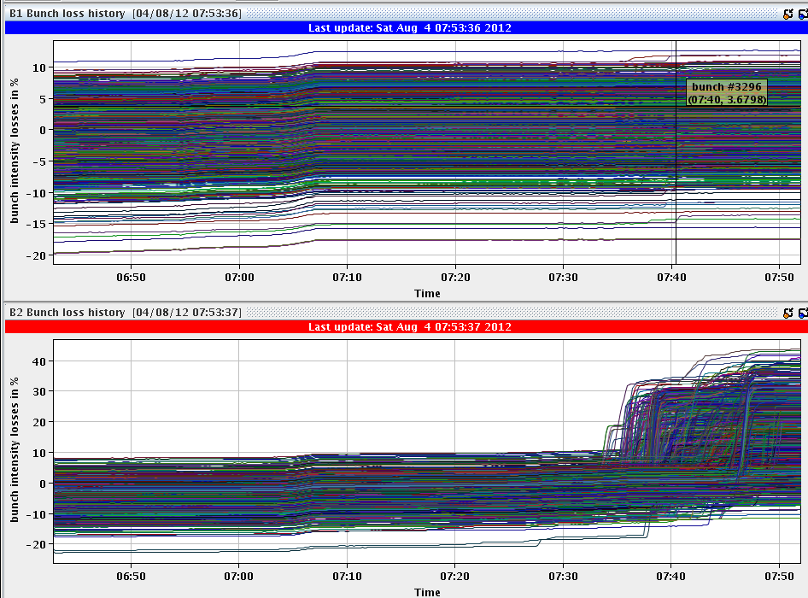
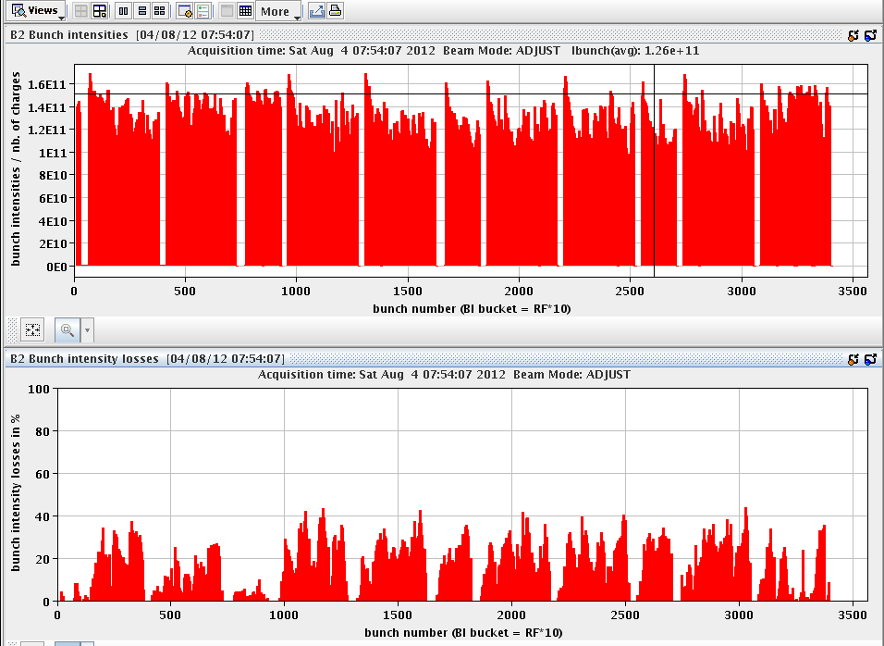
Morning
Fill 2911: Average bunch intensity 1.53E11
Prepare ramp: The incorporation and regeneration tasks take very long time
Losses during ramp down again to 2-2.5%
B2 losses during squeeze

Slide 6
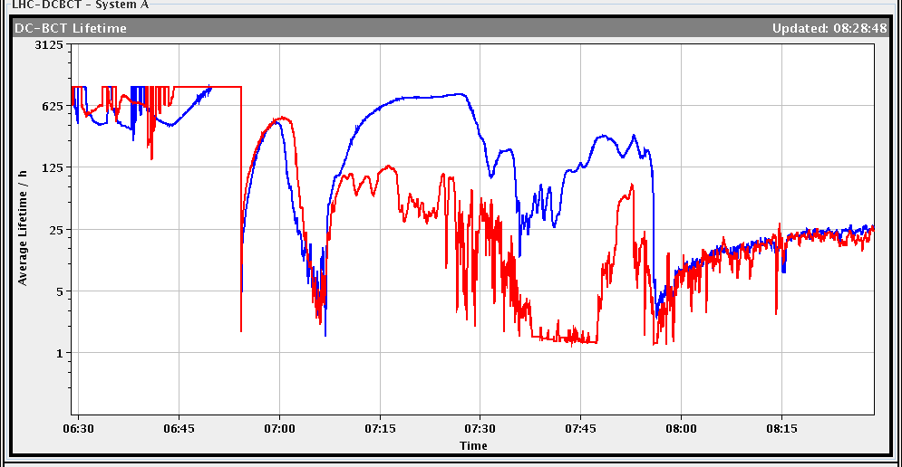
Recovery of life-time by shift crew!
life time very bad for both beams at the end of squeeze. (50% loss level on BLM TCTH point 5).
7h38:52: Before going in collisions (had another 50% loss level!), we sent a trim of +3 units chroma both planes both beams (in step of 1 unit). life time stabilized but still very low.
7h39:53 We then sent again + 1 unit only beam 2 and removed it (seem to be worse).
7h40:32 We then send a trim of +0.003 on tune beam 2 H (steps of 0.001): very little improvement on life time. We tried a trim of +0.001 on tune beam 2 V.
7h48:03 Add +2 more units to chroma beam 2 both planes: finally life time recovered.
Finally removed the tune trim on beam 2 V.

Slide 7
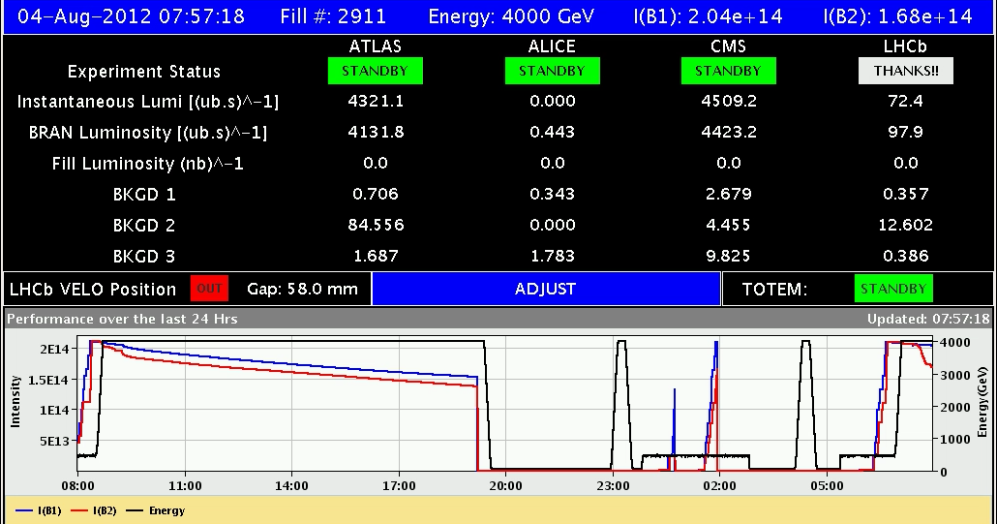
Morning
7:59 stable beams fills 2911

Slide 8
PS emittance – slides from R. Steernberg

Slide 9
PS emittance – slides from R. Steernberg

Slide 10
PS emittance – slides from R. Steernberg
Emittance H [mm mrad]
Emittance V [mm mrad]

Slide 11
PS emittance – slides from R. Steernberg
Emittance H [mm mrad]
Emittance V [mm mrad]

Slide 12
PS emittance – slides from R. Steernberg

