Slide 1
Chromaticity can make a difference…

Slide 2
Sat 4/8
After the losses observed during the ramp increased chromaticity by 5 units in the second half of the ramp and throughout the rest of the cycle as proposed by Elias and Alexey in case of instabilities until we do not manage to reduce significantly the transverse damper gain
In the mean time PSB working on beam quality: improvement of the transverse emittance by 10 % measured at PSB output

Slide 3
12:43 Injectors ready ➔ decided to dump and refill with fresh beams and new settings in the LHC.
End of fill #2911 (61 pb⁻¹ in 4.8 h).
Filling slowed down by frequent losses at injection in the SPS (under investigation)

Slide 4
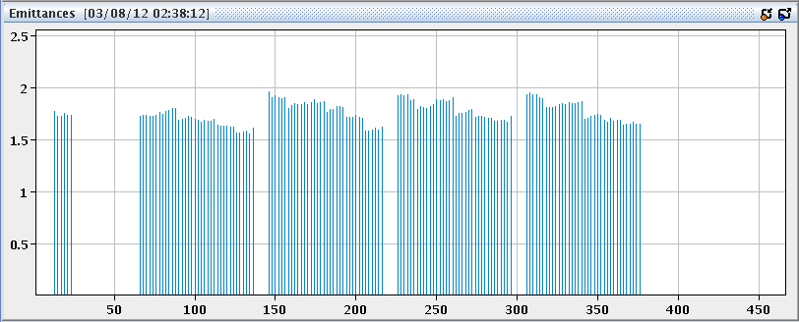
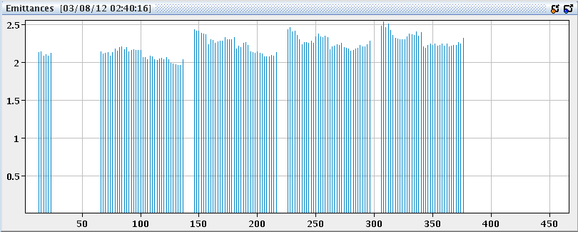
Beam quality
B2H
B2V
On average some improvement although with some differences inside the trains. No difference between PS trains (still running with dummy LHC cycle in PSB PS)

Slide 5
Very clean ramp and squeeze.
Lifetime dip when going in collision
15:28 STABLE BEAMS #2912. Initial luminosity 6.4x10³³ cm⁻² s⁻¹
Ramp
Squeeze
Adjust

Slide 6
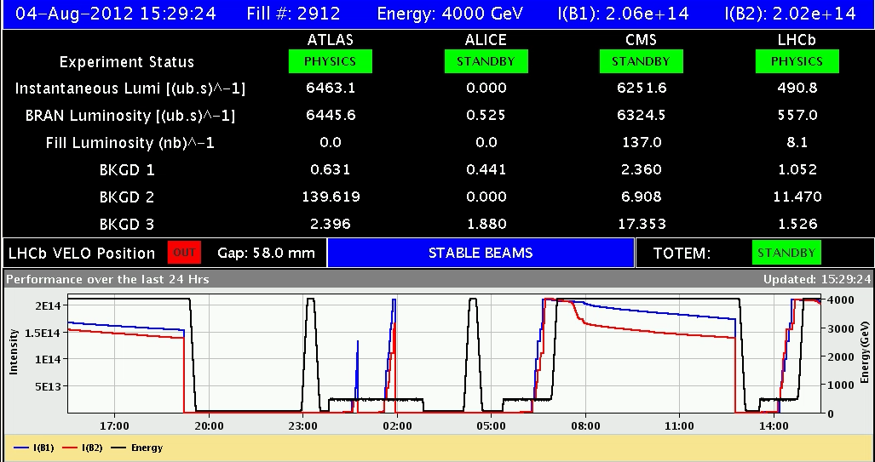
LHCb exceeding 4x10³² cm⁻²s⁻¹ when optimizing in the crossing plane. Incorporated additional separation in the levelling plane to avoid that next time

Slide 7
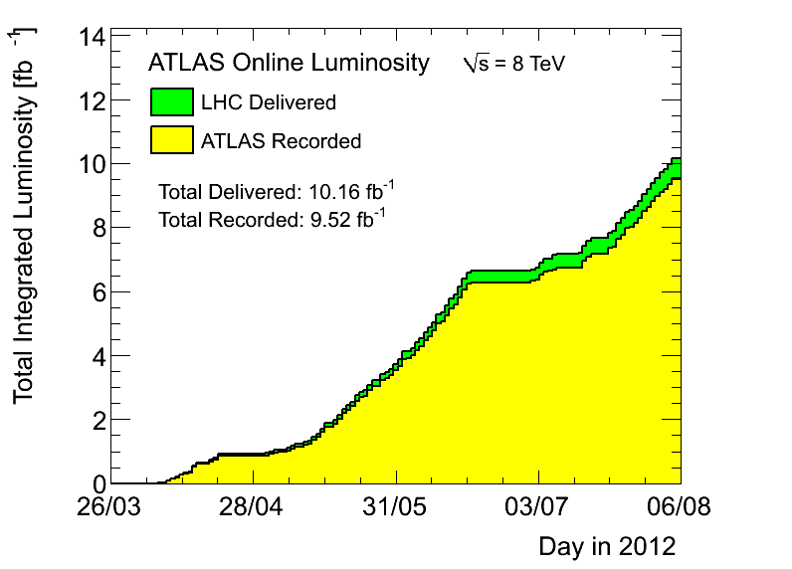
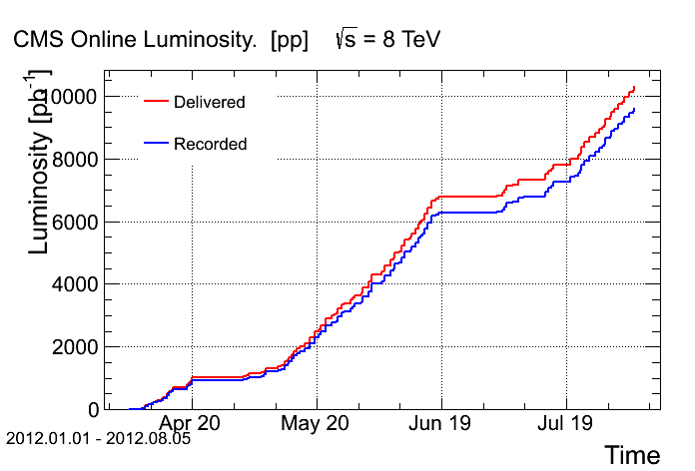
Delivered 10 fb⁻¹

Slide 8
23:12 FMCM trigger (RD1 in 5). Electrical perturbation because of the thunderstorms
23:44 trip of RQF.A45 during pre-cycle (QPS) followed by trips in 5 other sectors. 120 pb⁻¹ in 7.6 hours
01:34 ready for powering after intervention of the power piquet (remote resets)
In the mean time the SPS is also down because of the thunderstorms
03:47 SPS ready – filling. Emittances as in previous filling
Good ramp and squeeze (we had reduced gain of the damper)
05:17 cold compressor lost. Before ramping down go through the adjust process ➔ Beam dump due to BLM in point 7

Slide 9
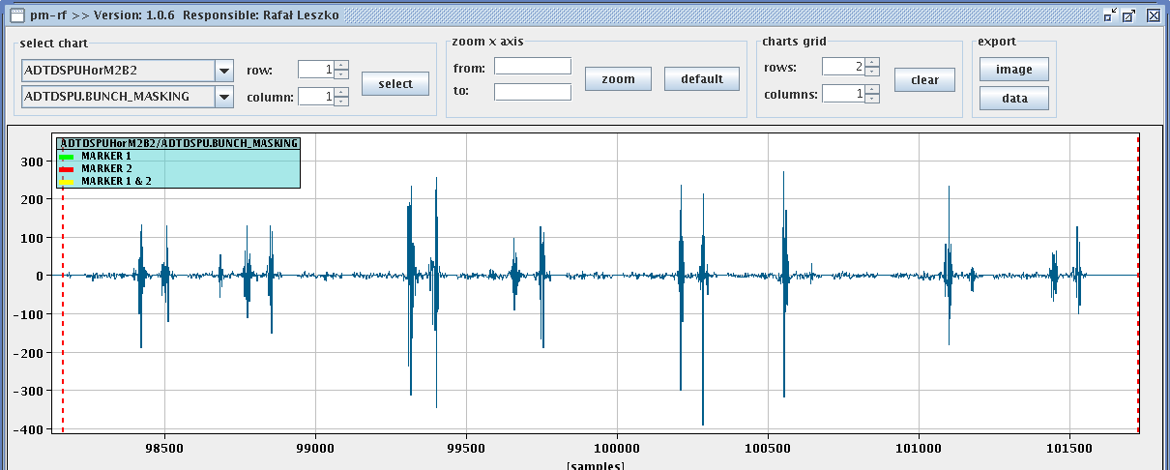
Fast beam instability B2H on some of the bunches in the first step of the reduction of the separation in point 1 and 5. Signature of loss of Landau damping due to relative sign of octupoles

Slide 10
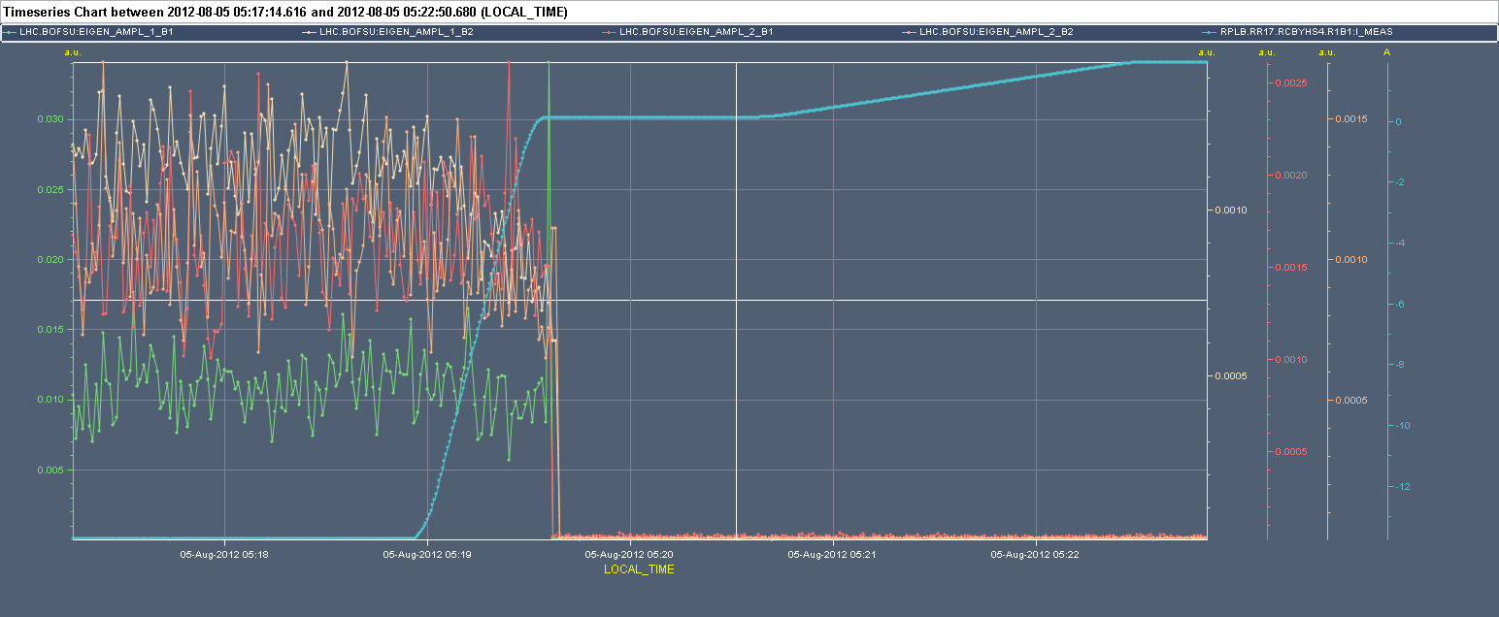

Slide 11
Plans
Recovery expected by the end of the afternoon
Fill for physics

Slide 12
Pending
Change CTRV cards on TSU FECs for LBDS ➔ N. Magnin (2 h)
Moving of the spare MKD generator from gallery to the surface

