Slide 2
Fill 2896
Some difficulties filling: poor beam quality from injectors and trigger BPM LSS6
Poor lifetime during squeeze and when going in collision (< 1 h).
Fast tune scan did not improve significantly
11:16 stable beams fill L_{peak} ~6.0x10³³ cm⁻²s⁻¹
11:27 dump by trip of RQTL7.R7B1. Likely SEU. Due to higher losses?
10 min in stable beams L_{int}: ~3 pb⁻¹

Slide 3
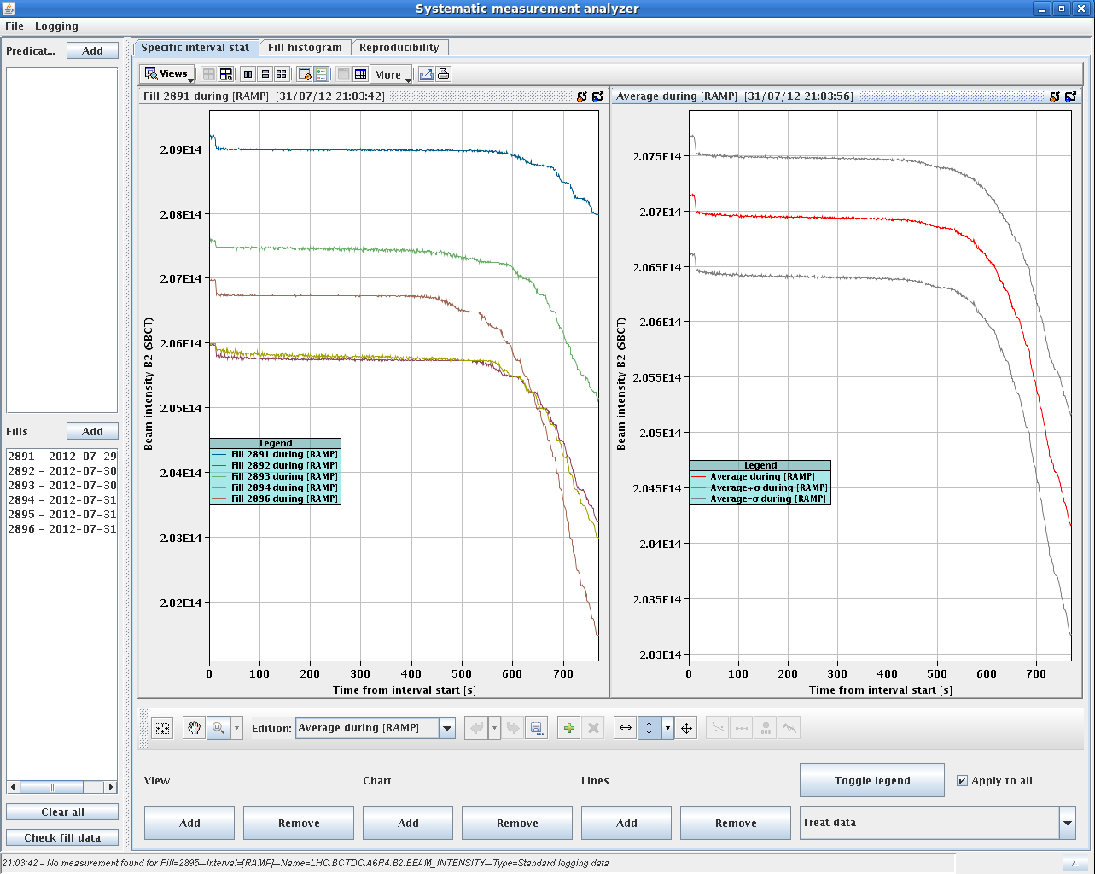
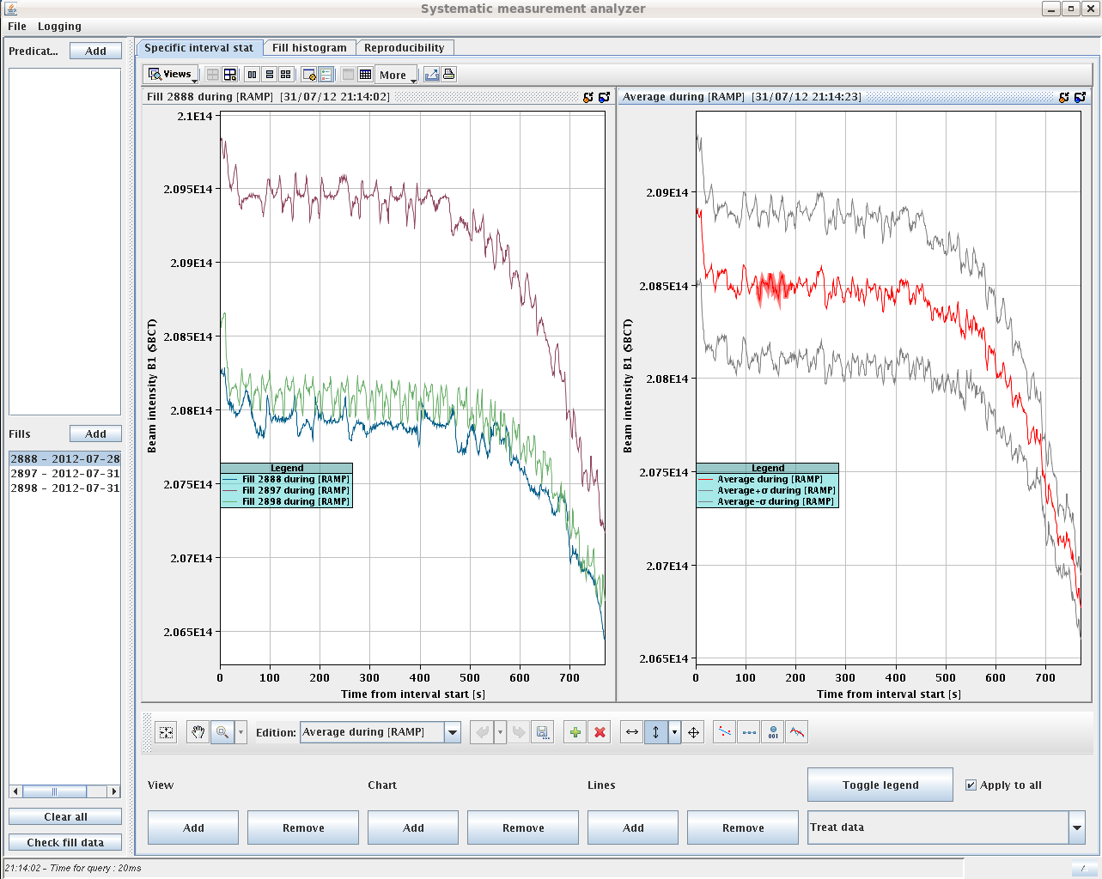
Q_{H}=0.28 vs. 0.282
0.282
1.5%
0.28
1%

Slide 4
Fill #2897
No significant difference in performance between ramp with Q_{H}=0.28 and 0.282. Go for simpler procedure.
Delays to inject due to:
BLMs (sanity check not working), SPS access requiring patrol, PS
Cleaner ramp and squeeze
Instability (faster) when going in collision
B1H

Slide 5
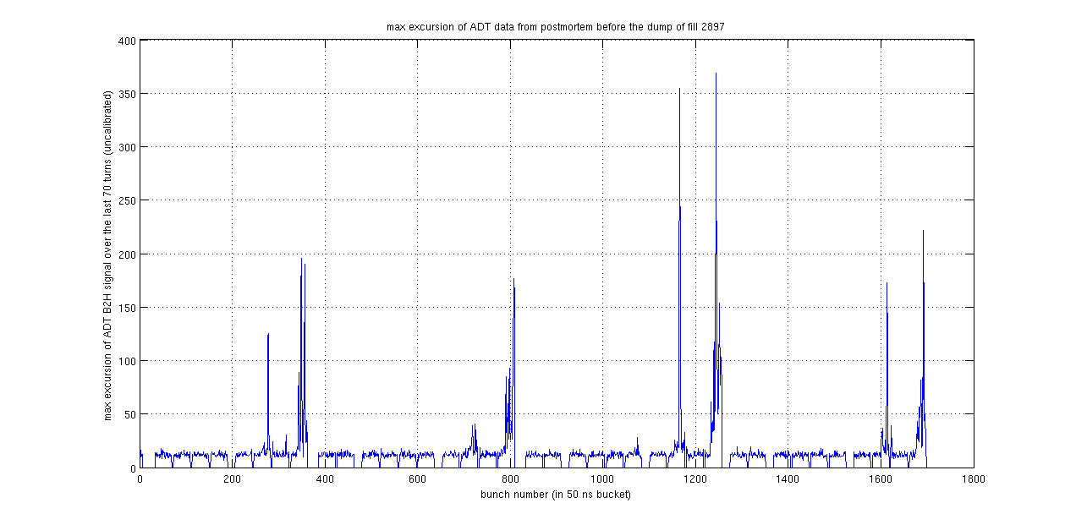
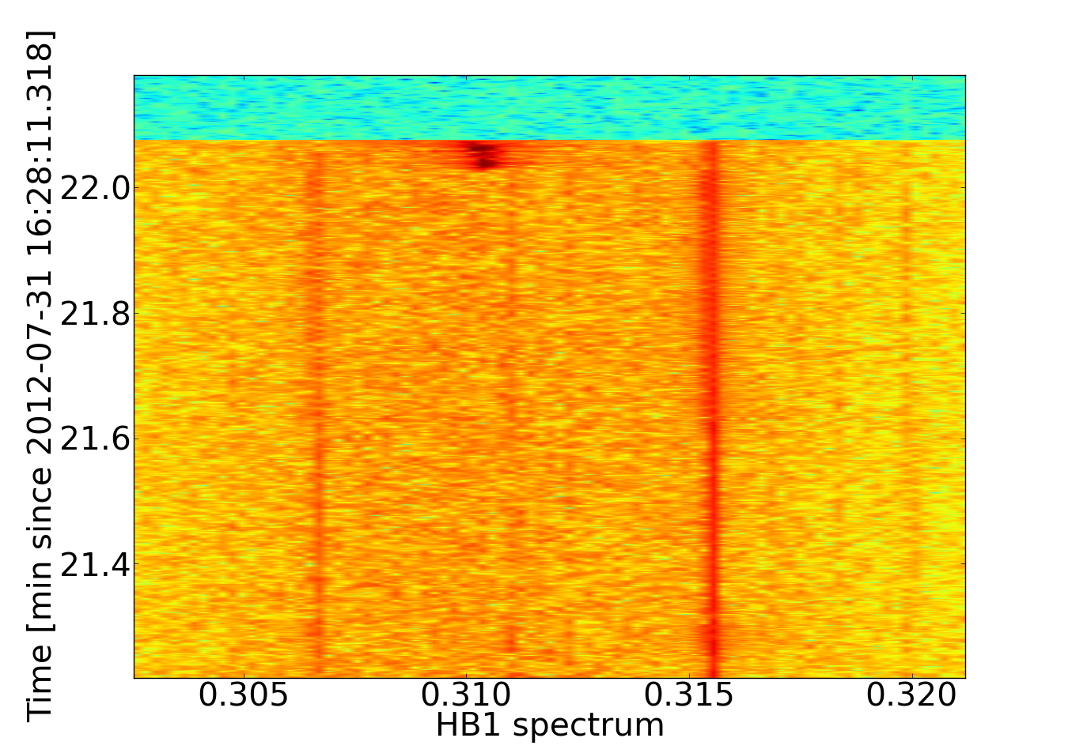
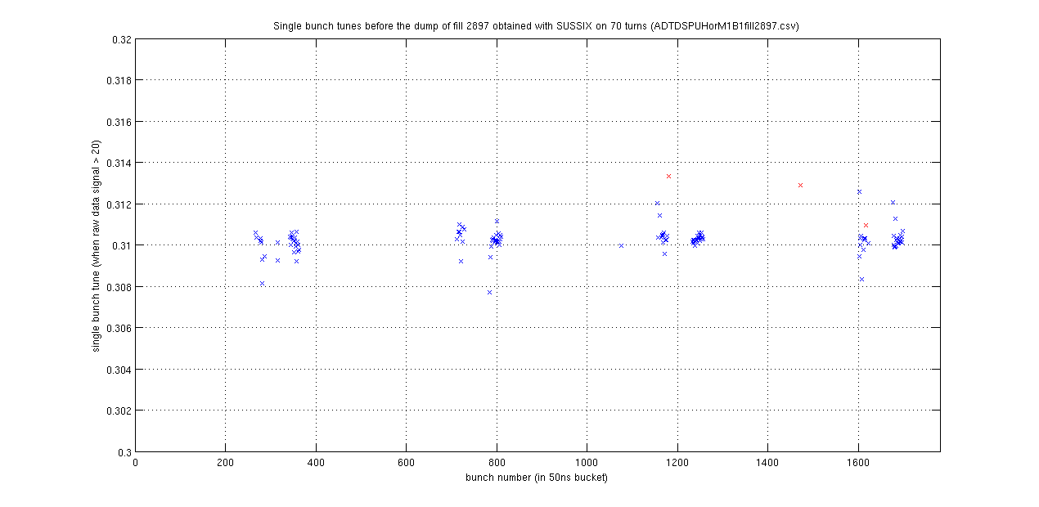
Fill #2897
B. Salvant
T. Pieloni

Slide 6
Chromaticity measurement (Sunday)
Q’_{H}-B1
Q’_{V}-B1
Energy
Q’_{H}-B2
Q’_{V}-B2
β*
Chromaticity corrected to~2 units (as planned) based on measurement last Sunday assuming B1=B2

Slide 7
Fill #2898
19:20 Stable beams fill 2898. Initial luminosity~6.0x10³³ cm⁻²s⁻¹
Produced ~160 pb⁻¹ so far
To be noted: lower bunch length for B1 in the last two fills. Statistical fluctuations according to RF (?)

Slide 8
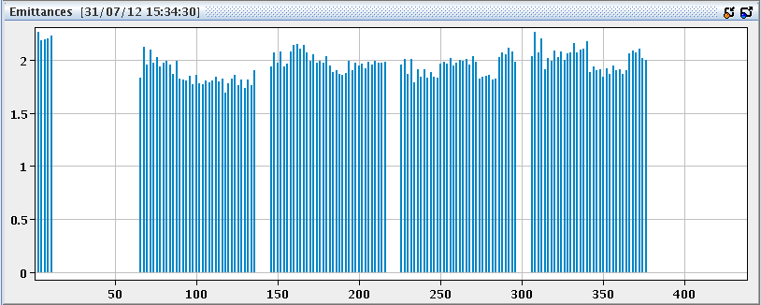
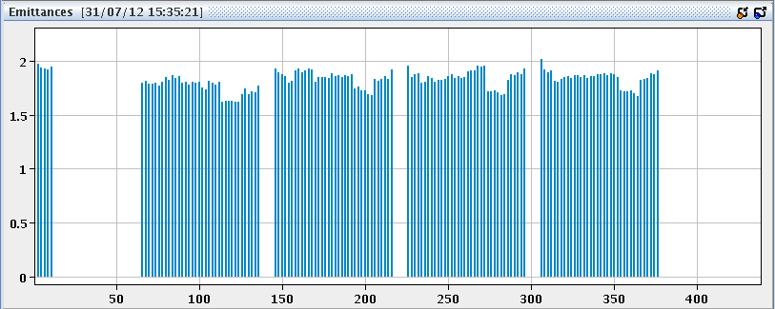
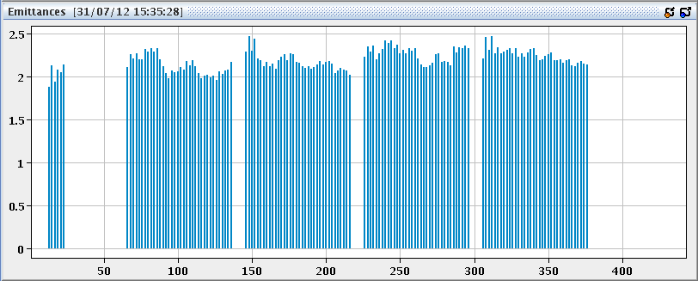
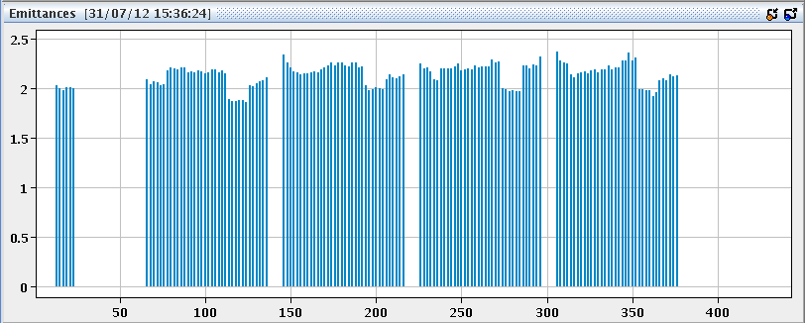
Injectors
Emittances still on the high side and poor bunch to bunch reproducibility

Slide 9
Plans
End of fill study for octupole polarity inversion (1-2 hours)
Test for tune measurement from damper signal (1 hour)
Fill for physics

Slide 10
Pending
Change CTRV cards on TSU FECs for LBDS ➔ N. Magnin (2 h)
PAD PM18 ➔ T. Riesco (3 h + patrol)

Slide 11
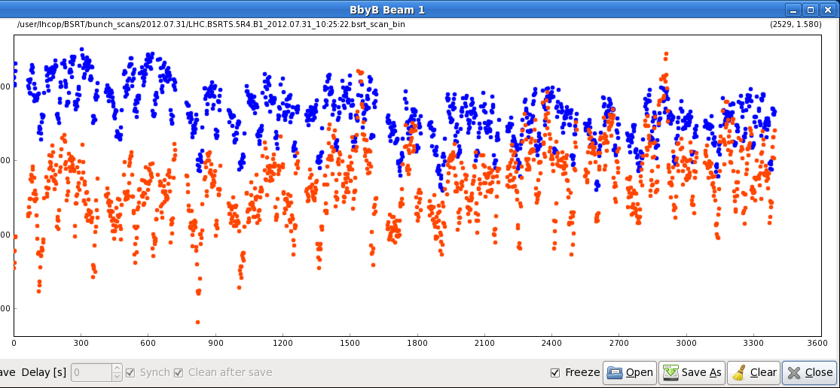
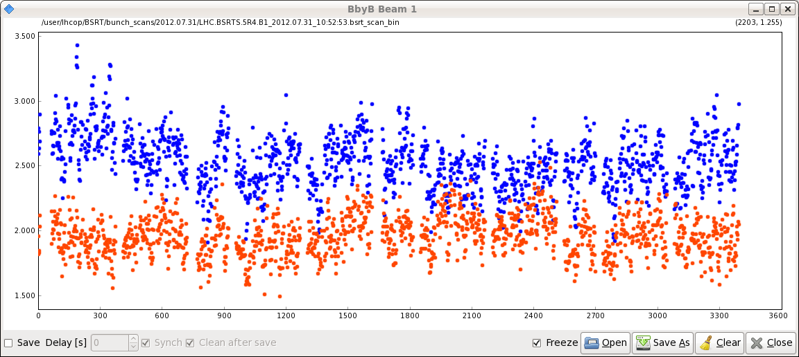
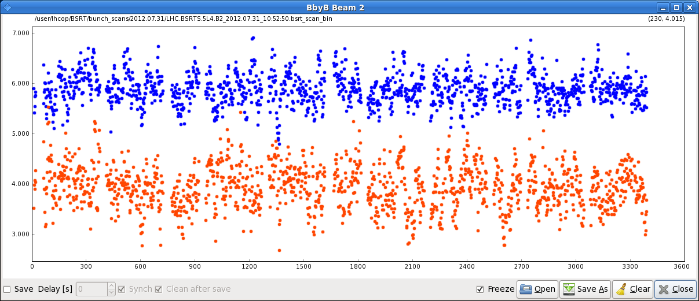

Slide 12
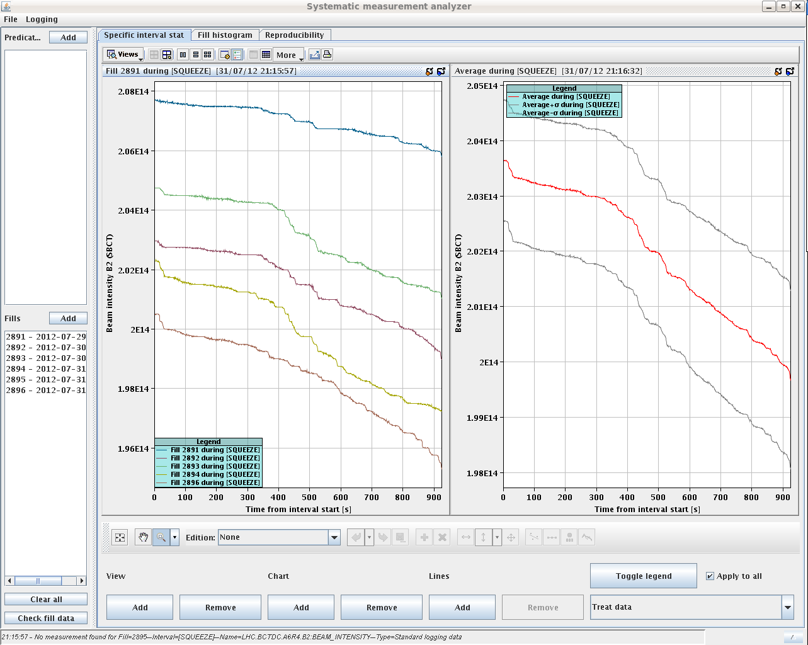
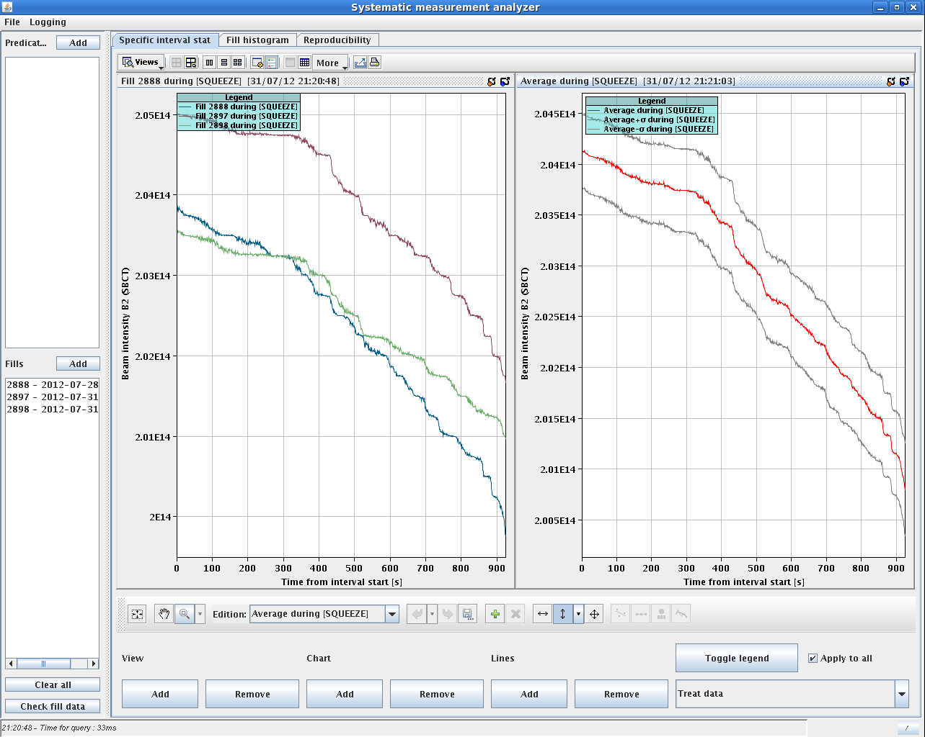
Q_{H}=0.28 vs. 0.282
0.282
2 %
0.28
1.7%

