Slide 1
Tuesday 24th July - morning
10:15 Operator dump of fill 2873
Initial luminosity: 5.83e33 cm-2s-1
12 hours stable beams
151 pb-1 delivered
Initial bunch current: 1.34e11 ppb at start stable beams
Emittance from luminosity: 2.18 micron
11:00 ACSModuleM2B1 :: Klystron 3 vac2 vacuum activity-> Vacuum pump 2 power supply current >100uA. Vacuum power supply or klystron vacuum problem.
Short access required
12:40 Injecting probes etc.
Some injection line steering required

Slide 2
Tuesday 24th July - morning
ADT gain calibration at 450 GeV (see over)
Programmed bunch length after blow-up increased from 1.2 to 1.25 ns (Themis) – had been drifting low (see over)
16:15 Injecting for physics
17:45 Stable beams fill 2875
Initial luminosity 5.72e33 cm⁻²s⁻¹
Initial bunch current: 1.39e11 ppb at start stable beams
Emittance from luminosity: 2.35 micron
Still in… 160 pb⁻¹ so far

Slide 3
Summary of the ADT Gain renormalisation
The electronic gain programmed for ADT is calculated as a function of the normalized gain programmed by the user, momentum and a calibration constant.
A normalised gain of 0.05 shall correspond to a damping time of 40 turns (tau=2/Normalised_Gain). It was checked if this was the case. The center bunch of a train of 36 bunches was taken as a reference (at 450 GeV, with data from injection oscillations).
The calibration constants which were used in the system until today date from 2010. As the tetrodes in the power amplifiers are ageing and being replaced, and the Beam Position Readings change with the beam intensity settings variations have occurred since.
Wolfgang Hofle, Daniel Valuch

Slide 4
Summary of the ADT Gain renormalisation
Since the last technical stop in June 2012 all power systems are populated with new tubes and back to nominal power gain.
From the measurements we have programmed new calibration factors today:
HB1 old 9213 new 10000
VB1 old 8804 new 9199
HB2 old 11466 new 7942
VB2 old 6197 new 5167
The effective gain of the Horizontal Beam 2 system was therefore lowered by 31% and it should be now consistent again with the "normalized gain" knob.
Wolfgang Hofle, Daniel Valuch

Slide 5
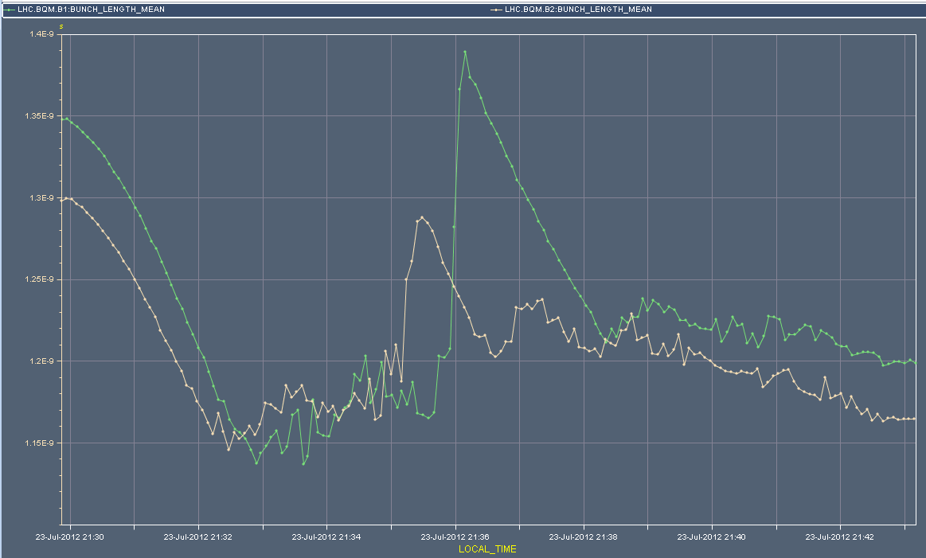
Bunch length #2873

Slide 6
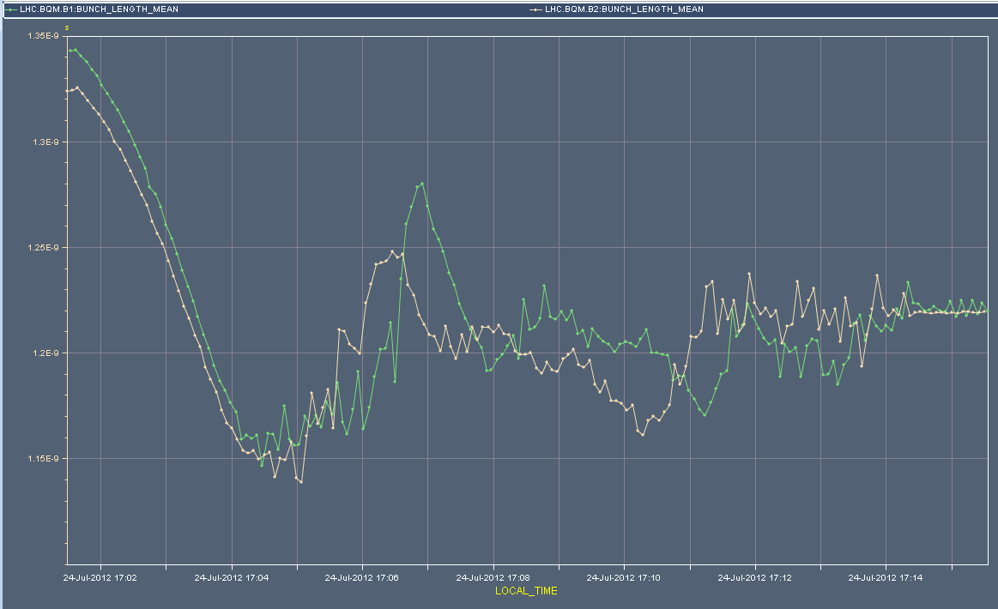
Bunch length #2875

Slide 7
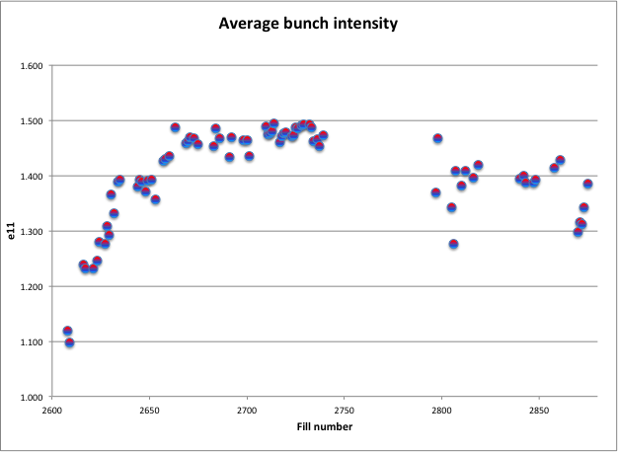
Average bunch intensity

Slide 8
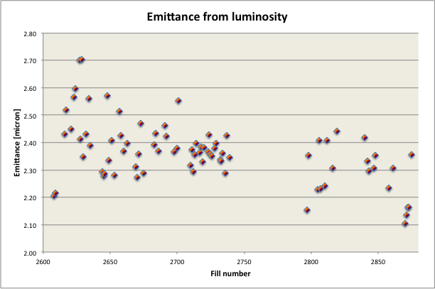
Emittance

Slide 9
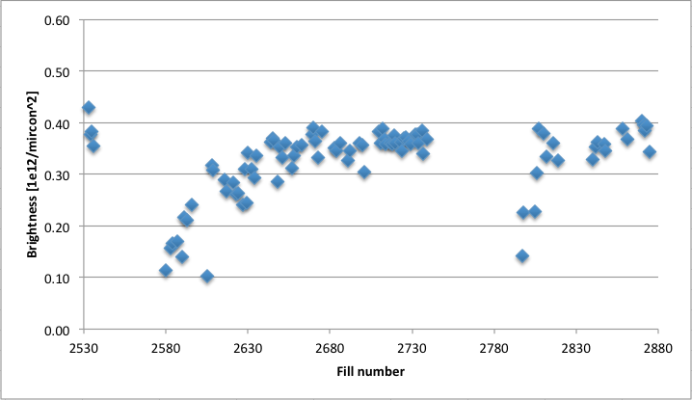
Brightness

Slide 10
Incoming
09:00 Dump beams
Morning: switch LHCb polarity
to positive (negative crossing angle “good”)
one test ramp to check collisions
14:00 Access (2 to 3 hours)
US85 – EL/cyrogenics – UPS verification/reset
UW85 – reset of electrical card (demin. water)
RE32 – reset of demin. water station
SVC switch on – point 6 – power converters off (tripped this night)
Vacuum (Gael Girardot):
Solenoid power supply MKI2
Interlock cable point 8

Slide 11
Incoming Friday
Test fill(s) with h=9 PS beams, 32 bunches/batch, nominal bunch intensity, low emittance

