Slide 1
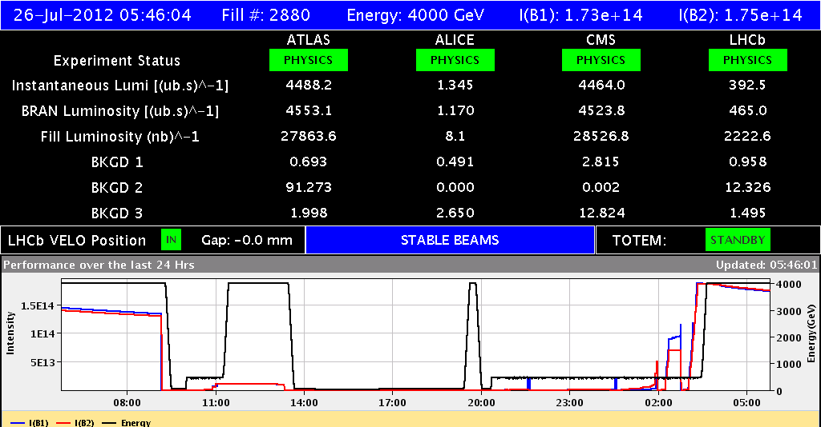
LHC Status Thu Morning 26-July
Bernhard Holzer, Mike Lamont

Slide 2
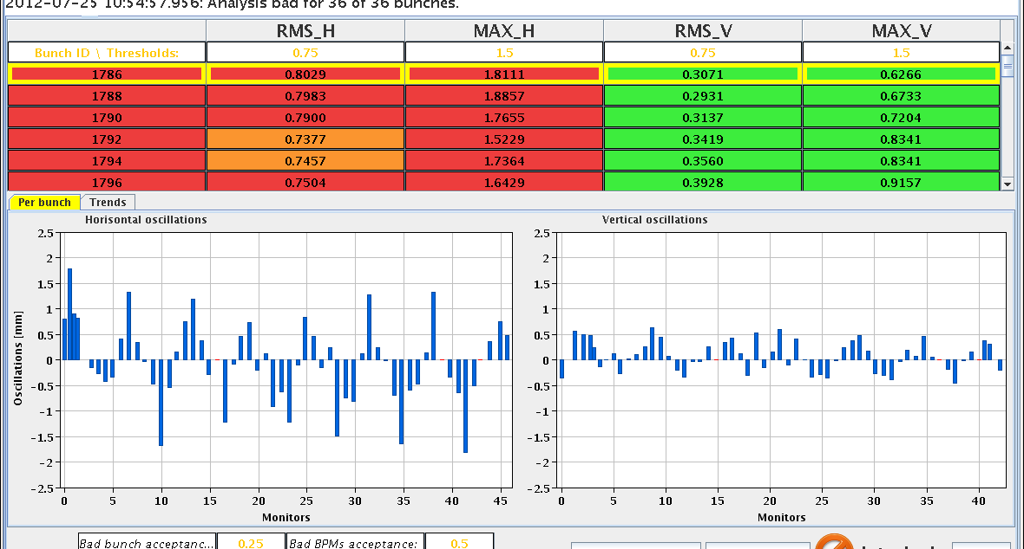
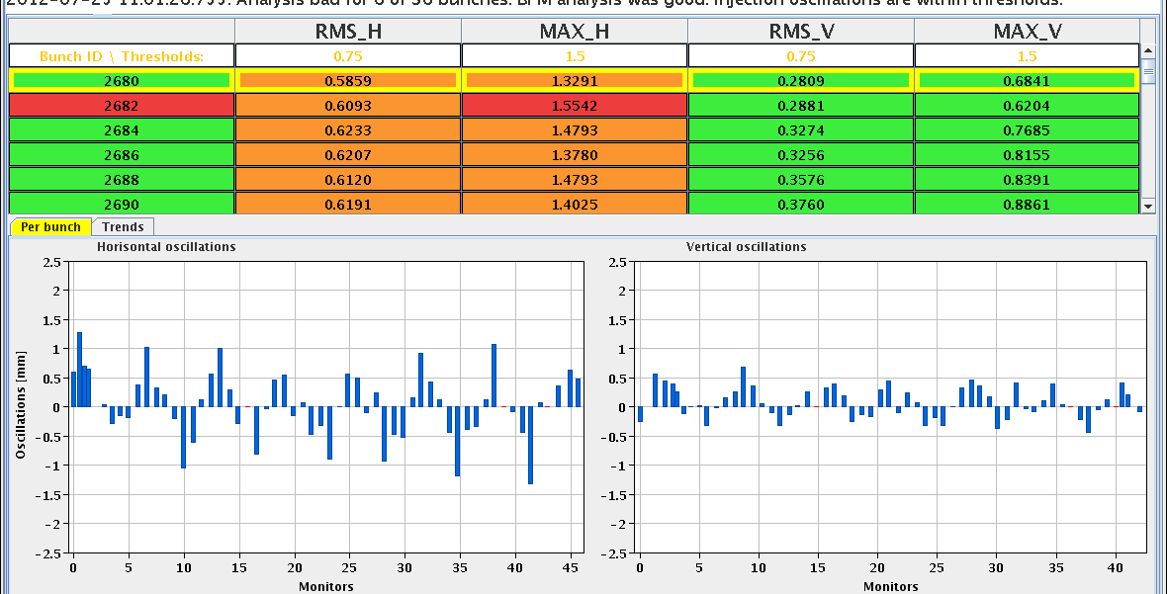
Wed Morning
09:10h beam dump ... after a nice long run
pre-cycle, preparing for LHCb polarity switch
10:35h injection probe beam
injection “physics beam” .. again with some minor (?) problems

Slide 3
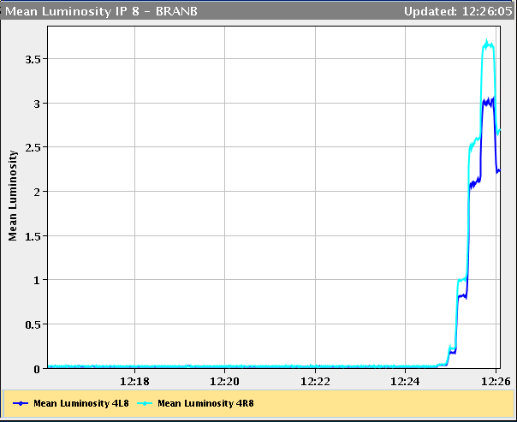
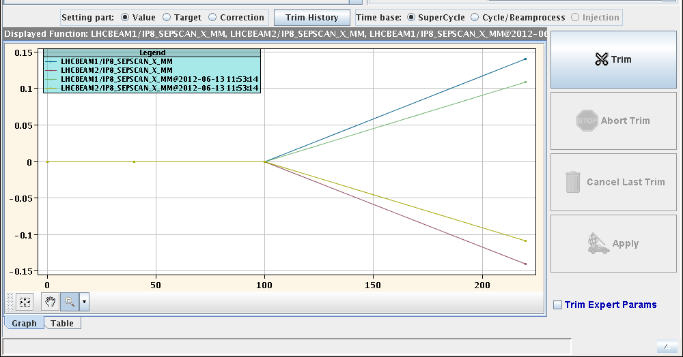
Wed Morning
11:07h ramp / squeeze / adjust
& luminosity optimisation for LHCb positive
... looks like routine
coil functions for the diagonal separation /
leveling now / before
13:20h beam dump
preparing for access 2 vacuum pumps
cms viiiips
el. filter re-activated .....

Slide 4
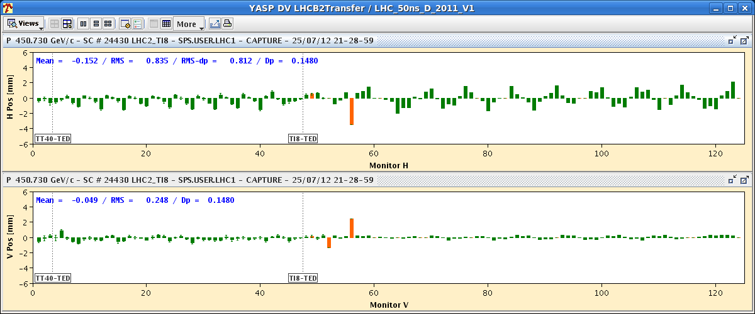
Wed Late
16:32h pre-cycle,
trip of RQ10.R8 ... “inverter_over_current”
19:21h pre-cycle, ... back to physics
20:24h injection probe beam
21:11h injection for physics
not without problems:
21:40-23:40h no beam from SPS
latch on injection oscillation for beam 2
beam dump on orbit excursion interlock

Slide 5
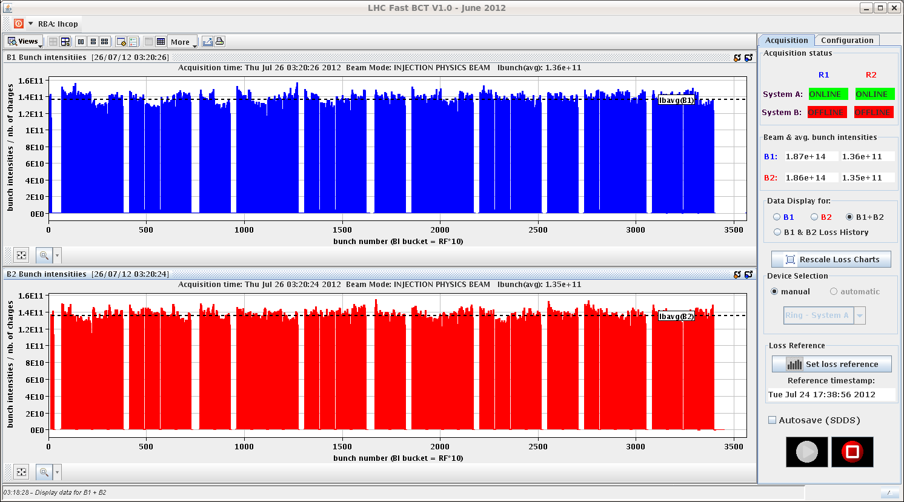
Wed Night
00:23h still / again large injection oscillations (TL)
... related to problem on SPS-ADT ?
-> Daniel Valuch
02:10h injection for physics
B1 injection randomly latches

Slide 6
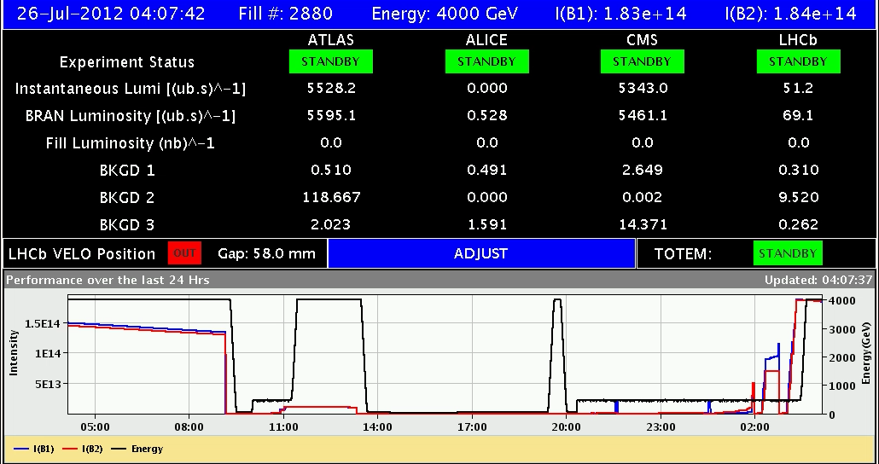
Wed Night
03:26h ramp / squeeze / adjust
04:07h stable beams

