Slide 1
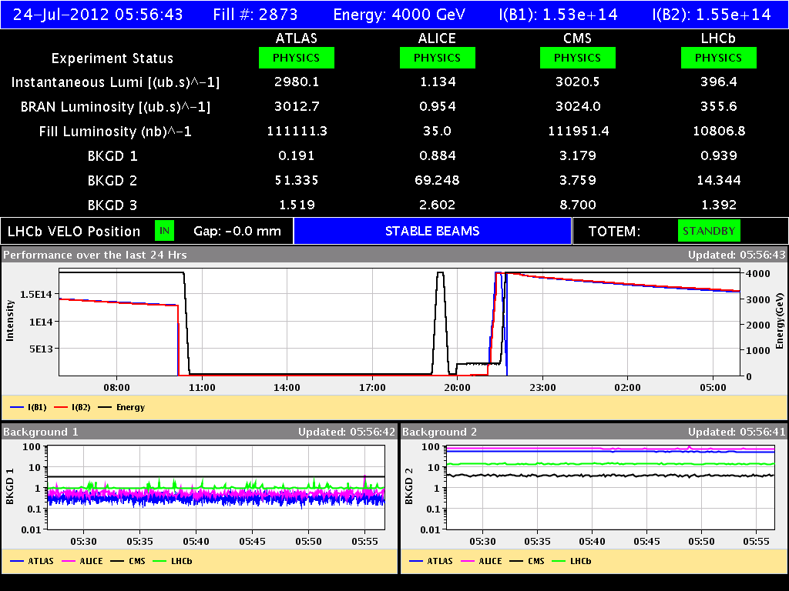
LHC Status Tue Morning 24-July
Bernhard Holzer, Mike Lamont

Slide 2
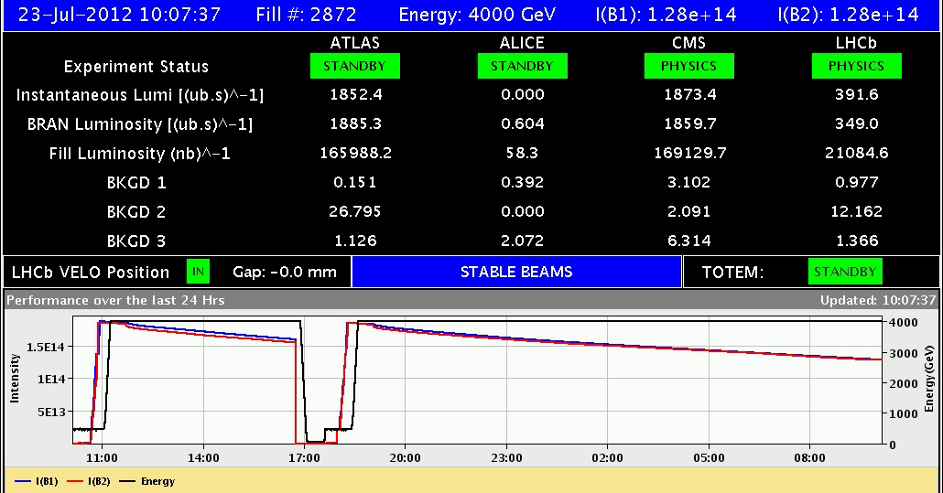
Mon Morning
10:10h beam dump ... after a nice long run
Access for ATLAS
Vacuum point 2 (switch back two pumps)
... & CMS

Slide 3
Mo Morning /Late
11:15h Firebrigade acces for a fire alarm in point 2 (UW25)
-> electrical problem at a water cooling pump
-> exchange
12:00h all other access finished
... LHCb ?
18:40h restart
20:20h injection probe beam
20:40h injection for physics
... “Steering problem in Transferline for B1H IQC latched on TL oscillation.
The oscillation at the beginning of TL seems
to be too big, two BPMs are out of threshold for 5 bunches (out of 6).”

Slide 4
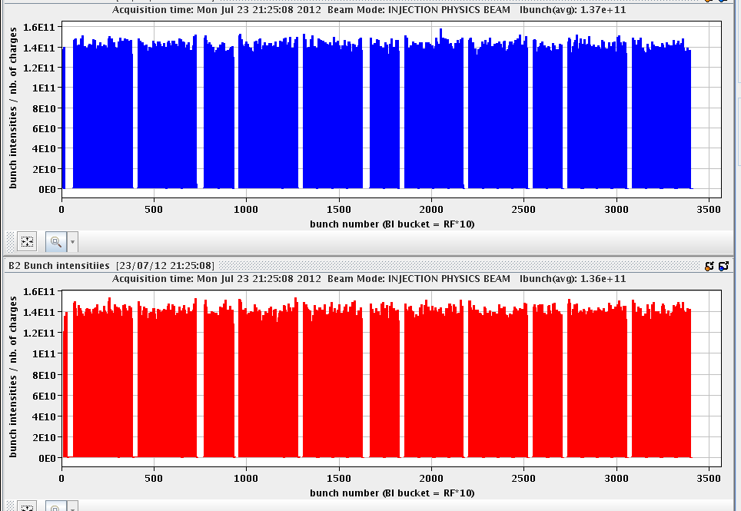
Mon Late
emittances: B1H = 1.66 B1V = 1.57
B2H = 1.40 B2V = 1.16
21:30h ramp, squeeze , adjust,
no problems ;-)

Slide 5
Mon Night
baby sitting
(in a double sense)

Slide 6
Plan:
internal (!) bsbs meeting (beam stability brain storming)
check carefully the Q / Q’ during adjust / squeeze
check separation & x-angles in all IPs
LHCb polarity flip
push single bunch intensity
?? in one go ??

