Slide 1
Floating MD week 28 summary
Ralph Assmann, Giulia Papotti, Frank Zimmermann

Slide 2
48h floating MD
MON 09/7
16:00 Beam Dump physics fill (need to come from high energy)
17:00 Q20 set up
21:00 High pile-up (~100): standard optics & 2b of 3e11 (Q20); collisions IR1&5 ; noise excitation, transverse offset etc
TUE 10/7
07:00 Beam dump, revert to Q26 injection
08:00 25ns injection tests
13:00 Ramp down and cycle
14:00 ATS MD: Pre-squeeze and very low beta ATS (0.1 m)
WED 11/7
03:00 Dump & ramp down
04:00 Beta* leveling test up to 36b OR Week AFTER
16:00 End of floating MD

Slide 3
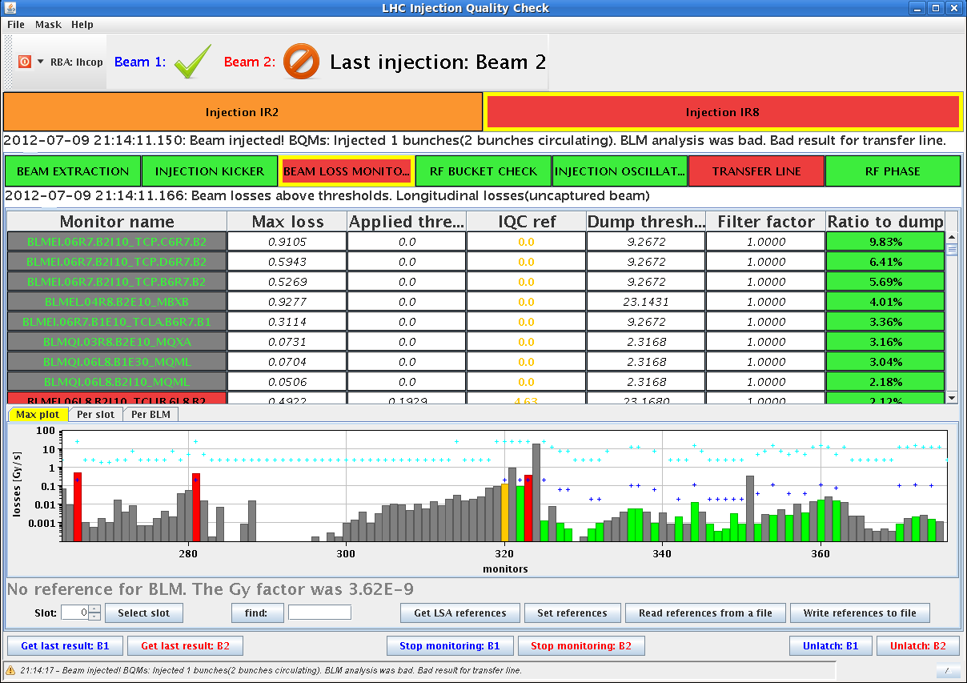
Q20 setup
started 1h40’ late, then waited for SPS beam setup
TL corrected
no other studies due to lack of time
3 - 3.3e11 ppb in 2 - 2.4 um
waited 30’ with single bunches at injection for IBS measurements

Slide 4
High pile-up MD
4 fills, 3 (short) stable beams
beams were quite touchy, had several issues with losses and emittance blow-up
possibly emittance growth enhanced by chirp
observed instabilities
increased chroma (Q’ = 5) and blow-up target to 1.4ns for fills 2-3-4
managed b2 very well ramped up and squeezed
emittance before collision about 2.2 um, losses <5% through cycle
some small activity on BBQ b2v
pile-up
48/45 (ATLAS/CMS) with first fill
70/65 in fourth fill
no time for systematic studies
parallel separation, levelling, noise excitation, …

Slide 5
25 ns injection tests
Injection of 25 ns bunch trains worked extremely well
very small losses coming both from the TL collimators and debunched beam
kept Q’ = 15
steered with 12 b only in h
maximum losses at 3% from dump thresholds, mainly at the TDI and TCLIs (satellites?)
72 b injection clean
(3% as for 12 b), good trajectories and injection oscillations
144 b injection
6-7% losses, injection oscillations and trajectories still fine
216 b for B1 only (MKI8D weakness)
losses 11%, a small oscillation in h TL
288 b injected and stored for the first time
very bad lifetime, injection losses at 12%, emittance 3.3 um

Slide 6
25ns e-cloud observations
beam 1, (12+12+) 72 b, Q’ = ~15 in both planes
no instability after injection but bad lifetime and emittance growth of bunches at the end of the batch
same behavior for beam 2, however slightly better lifetime
continued with injection of 144 bunches in both rings
signs of instabilities at injection (mostly in H), bad lifetime and clear signature of ecloud driven losses
again beam 2 slightly better than beam 1
then injection of 216 and 288 bunches for beam 1 only
similar behaviour as with 144 bunches
Q’ = 3-5 for beam 2
injection of 72 b fine, although already signs of instability
behaviour of freshly injected 72 b better than the first injections
beams dumped after injection of 144 b on beam 2
after around 700 turns, stronger oscillations in h

Slide 7
ATS MD
2 cycles
first one, beam lost at flat top during dispersion measurement
second cycle was a success
many measurements taken at beta* = 40 cm, 20 cm and 10 cm
only beam 2 at 10 cm, beam1 lost from 20 to 10 cm (bad Q trim)
beam 2 had very bad life time towards the end of the squeeze, down to 2-3h
no IT corrector and beta_max up to 20 km
optics results will follow

Slide 8
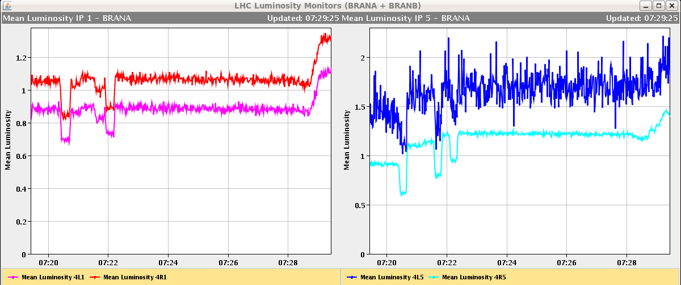
beta* levelling MD
ongoing
first fill with 2 indiv/ring for cycle/settings verification
arriving at 2 m - very good, both move up !
next: fill with 36 b trains for beam-beam effects

