Slide 1
Saturday14th July & night
06:58 Stable beams fill #2842
18:30 Operator Dump, Int. Lumi 147 pb-1
21:17 Stable beams, fill #2843, initial lumi 5.9/5.6e33 cm-2s-1
05:04 RQTL11.L1B2 trip. Beams dumped. Int. Lumi 113 pb-1
06:39 Ramp fill #2844
07:13 Dump in adjust, Loss of CM for AML7 tripped S67
08:30 Cryo conditions recovered, access for ODH in UJ33
08:50 ODH done, closing machine

Slide 2
Fill #2842
Stable into physics, but many BLM warnings (42 % IP7) during the squeeze at 2 m, but much better than on earlier fills
Reduced octupole knob at top energy from 3.9 to 3.7.
Lowish lumi at the start, but also lowish bunch intensities.
Operator dump and finally integrated some real lumi

Slide 3
Fill #2843
Some small changes – which might have an effect:
SPS some stronger scraping in the H-plane and relax a bit on the V-plane scraping
Octupole knob from 3.7 to 3.6, current now to 415 A in the squeeze
Dropped QH increase during collision beam process from 5e-3 to 3e-3 based on BBQ measurements
Still lowish bunch intensities of 1.44e11resulting in low initial lumi’s: 5.9/5.6e33 cm-2s-1
Only BLM warning from UFO at 1 TeV
83 % on TCDQM.4L6.B2, ouf!
Turnaround of 2h45min!

Slide 4
Fill #2843 Fill#2844
Fill #2843
01:37 After Lumi optimisation CMS lumi increased significantly and equalled ATLAS lumi
05:04 RQTL11.L1B2 trip. Int lumi 113 pb-1
PC looks good again after reset.
Fill #2844
In squeeze at 2 m losses in IR7, B1 & B2, up to 39 %
07:13 Lost because of cryo controls problem. Seems ok after reset of controls crate. Cryo Maintain back at 08:30
Started request access for ODH in UJ33

Slide 5
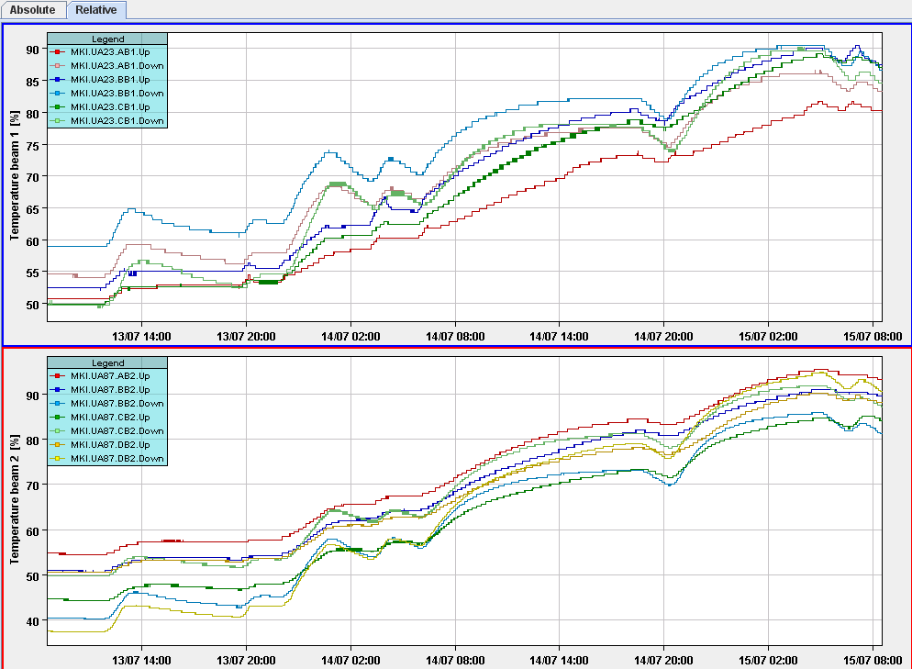
Injection kicker temperatures
Integrated performance indicator reaching 90 % of injection interlock temperature

Slide 6
The Plan
Back to ‘standard’ physics production
Slowly increase bunch intensities if things go well
Mo/Tue
Van der Meer scans injection optics
For next week
Additional BP for going into collision 1/2/5 and 8 separately
Octupole polarity change postponed for the moment

