Slide 1
Saturday
7ish – refill for RP set-up
9:15 Going for Roman pot alignment. Stefano is coming.
12:10 TOTEM: Alignment of horizontal RPs B2 finished, short period of data taking
13:10 loss maps
13:20 beams dump during off-momentum loss map
14:10 Access for ATLAS (CMS in as well)
muon chamber TGC and safety detector system (sniffer)
15:10 Access finished
16:00 Injecting for physics
17:35 Stable beams fill 2816
Initial luminosity 5.9 e33 cm-2s-1
~1.43e11 ppb at start of fill

Slide 2
Sunday morning
02:55 ATLAS toroid back up to nominal current
05:27 Fill 2816 lost to Electrical perturbation visible on several power converters. FMCM triggered first for RD1.LR5.
144 pb-1 in 11 hours 51 minutes of stable beams
06:16 filling again
06:53 Thunderstorm. All sectors apart from sector 12 trip.
Access required for QPS – Q9.L6 – can’t reset QPS (remote power cycle not possible)
RF, collimators look OK

Slide 3
2816
Losses at start of squeeze and going into collision were at the 30-40% level, but there was no noticeable instabilities.
Note that we used the I_measure values on RQTF.A12B2 as an indicator of the B2_H tune setting

Slide 4
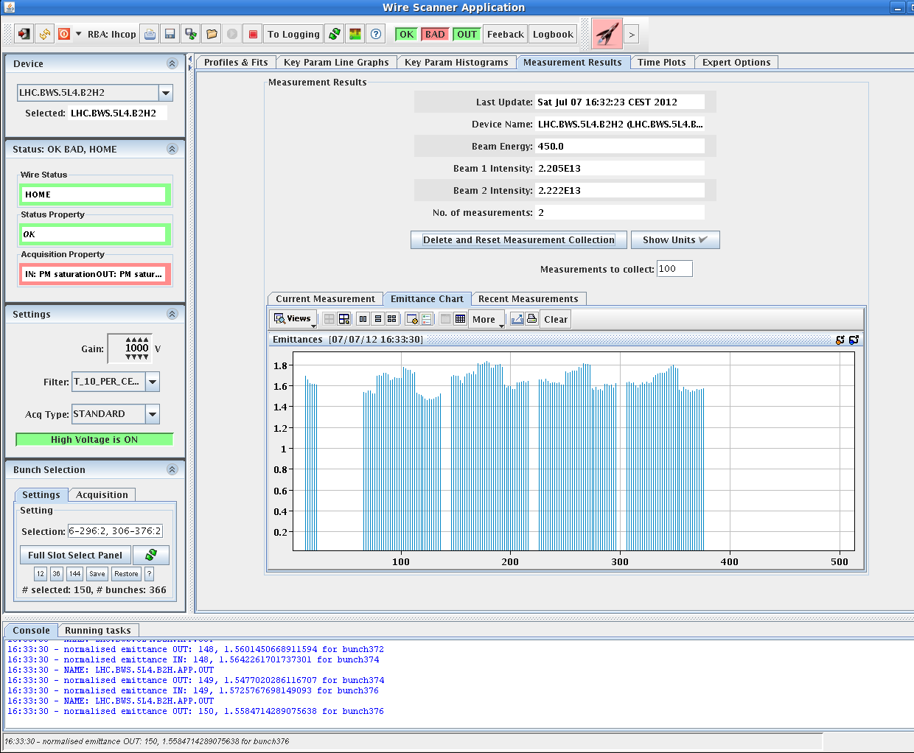
vertical emittance for some PSB rings was noticably larger

