Slide 1
Last 24 hours
RQ4.L1
Lost going into collision
Test ramp
Storm
Lost going into collision but different
RB45 trip

Slide 2
Thursday morning
10:52 Lost fill 2807 to trip of RQ4.L1 due to a SEU on internal QPS communication board
10hrs 43 min and gave ~145pb⁻¹ to both ATLAS and CMS
Short access for: - QPS in Pt1 to reset QPS cards od RQ4.L1 - ALICE, for intervention on their T0 detector - ADT at pt 4 to replace a broken attenuator on module H1B1 - Cryo at pt 6 for valve regulation - CMS for equipment validation
The repair of the leaky pipe on the pt 2 warm compressor was done without incident, and was transparent to OP (and without loss of cryo maintain)

Slide 3
Thursday afternoon
14:30 injection
16:09 Fill 2808 lost going into collision
Usual pattern
Losses 110 s into collision BP – see later
17:00 Injecting probes for test ramp & squeeze for chromaticity measurement
19:05 injecting for physics – slightly reduced bunch currents

Slide 4
Thursday evening
21:10 Stable beams Fill 2810
21:15 Beams lost just after going into stable beams
Lost sector 12 – thunderstorm
some time before we could close the switches for the RB.A12
Precycle
Midnight – injection again
01:30 Beam lost going into collisions (fill 2811)
Bit different this time
Losses in IP7 a few seconds from the end of the collision BP

Slide 5
Early Thursday morning
02:20 Injecting again
03:30 Stable beams fill 2812
03:55 RB.A45 tripped
QPS current loop is open and seems that the current (normally 50 mA) is 0. To be confirmed.
Piquet RICHARD, MOMPO in action
09:10 QPS problem fixed
Leading into 24 hours of 90 m later this morning after precycle

Slide 6
Two problems
Tune control
Losses in squeeze
Lifetime dips going into collisions
Losses going into collisions

Slide 7
Tune
Tune feedback in ramp
Problems keeping it on
Some variability in final tune
Exacerbated by strong 100 Hz lines making it difficult to actuall measure the tune
Relying on play back in squeeze and collision beam process
Some variability in final tune
Know that we have tune dependent lifetime dip going into collisions – increasing tune helps

Slide 8
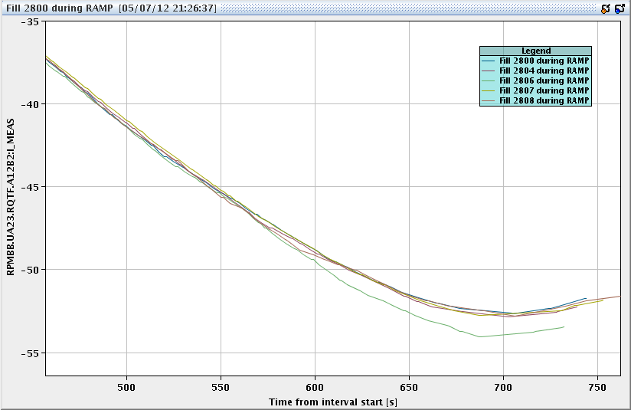
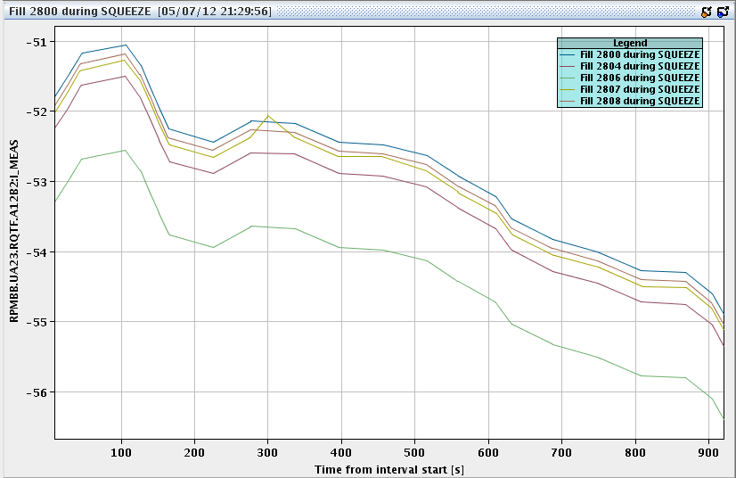
QTF current in ramp and squeeze
Losses fill 2806

Slide 9
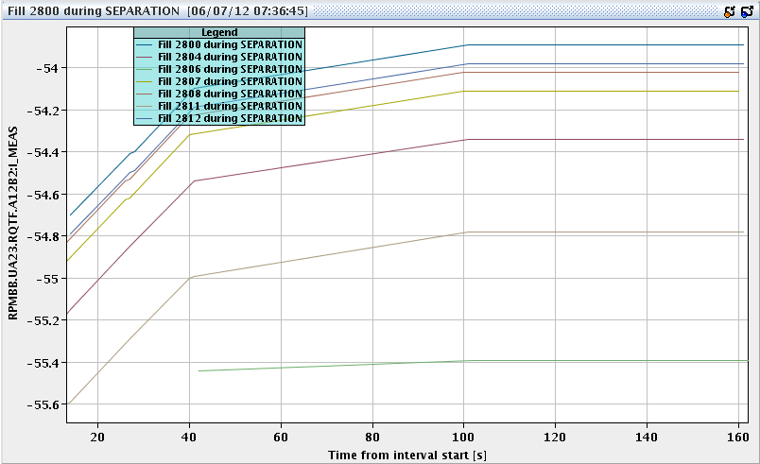
Tune – collision beam process
Fill 2811 – lost on losses
Fill 2806 – heavy losses
Proposal – seq task – check currents – manual trim of tune if required

Slide 10
Collision beam process
At present:
Phase 1 (0 – 40 second): reduce separation in 1,2,5,8
Phase 2(40 – 100 second): increase vertical crossing angle in 8
Phase 3(100 – 210 second): reduce horizontal crossing angle in 8; and adjust tilted crossing plane in 8; and bring 1,2, 5 into collisions.
Problem 2: Systematic losses at around 110 s

Slide 11
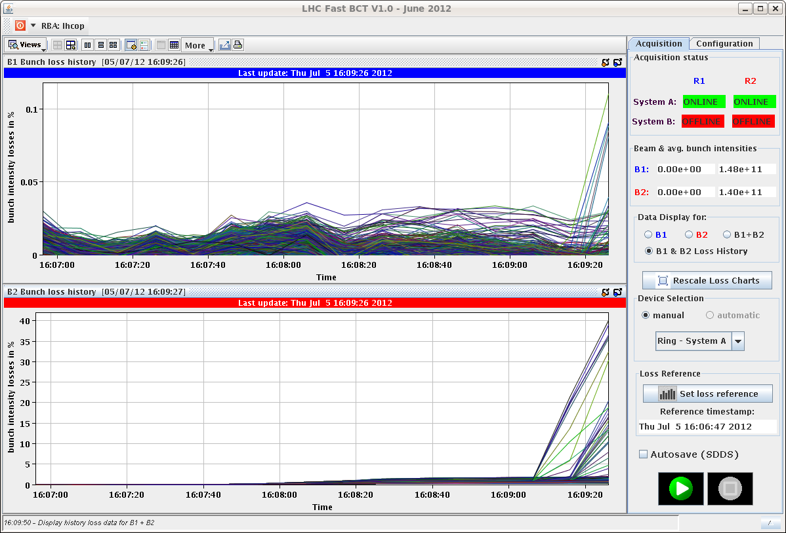
Losses going into collisions

Slide 12
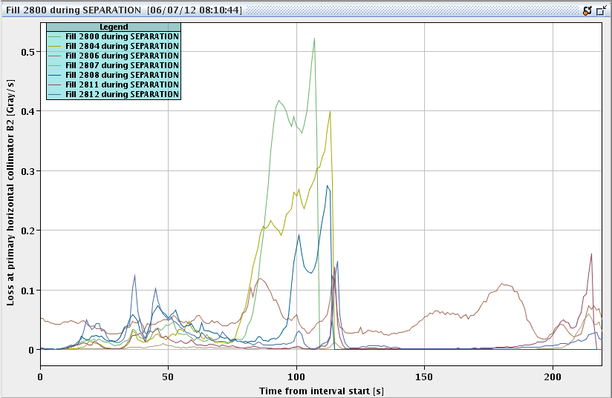
Losses in collision BP

Slide 13
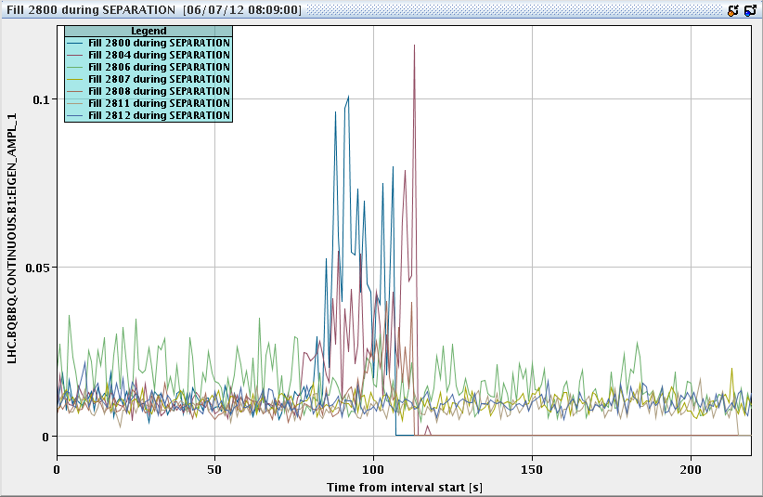
BBQ amplitude B1 – collision BP

Slide 14
Collision beam process
Proposal
Split out collisions into two separate beam processes
BP1: Collide in 1,2,5
Have opportunity to optimize, bring on full bb Landau damping
BP2: Tilt crossing in 8 and optimize
Stable beams
Prepare settings and sequences for after floating MD next week

Slide 15
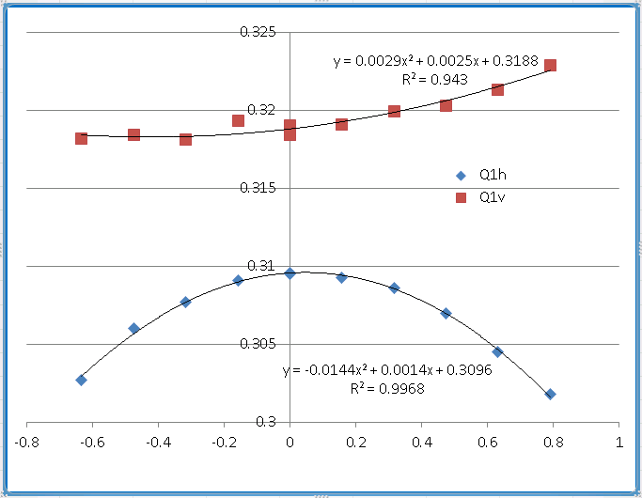
Chromaticity B1
Ghislain, Guy, Mike

Slide 16
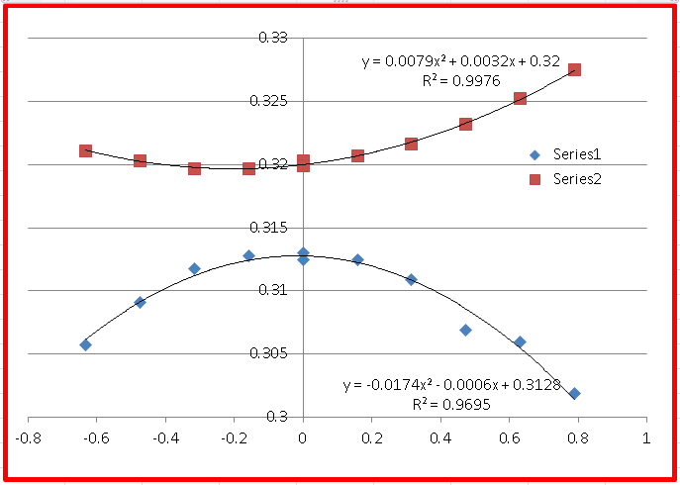
Chromaticity B2

