Slide 1
Summary week 27
Mike Lamont, Jorg Wenninger

Slide 2
Brief overview of the weekend
Saturday morning: third 90m setup fill finishing at 13:30 with loss maps.
TOTEM and ALFA run at 6 sigma after alignment.
Access for ATLAS safety system.
16:00 Filling for physics.
17:30 Stable beams fill 2816, L ~ 5.9E33 cm-2s-1.
05:00 Sunday: Beam lost due to thunderstorms.
06:15 Filling again.
06:45 Lost 7 sectors: electrical perturbation, thunderstorm.
08:30 Access for QPS – Q9.L6.
11:30 Problems on LBDS B2.
Communication lost between PLC and hardware for some kickers of LBDS beam 2.

Slide 3
Brief overview of the weekend
13:30 Access for LBDS.
15:00 Filling.
17:00 Beam dumped at end of squeeze. Slow losses on Q4.L6 (from B2).
Refilling.
19:40 Stable beams fill 2819, L ~ 5.8E33 cm-2s-1.
20:45 Beam dumped, RF B2 – cryo problem Pt4 / R4.
Valves on line C (main supply) closed at 20:20.
Access for cryo in Pt4.
Block of ice constricting compressed air supply for valve.
02:00 Cryo recovery starting.
Possibly need to recondition RF cavities.

Slide 4
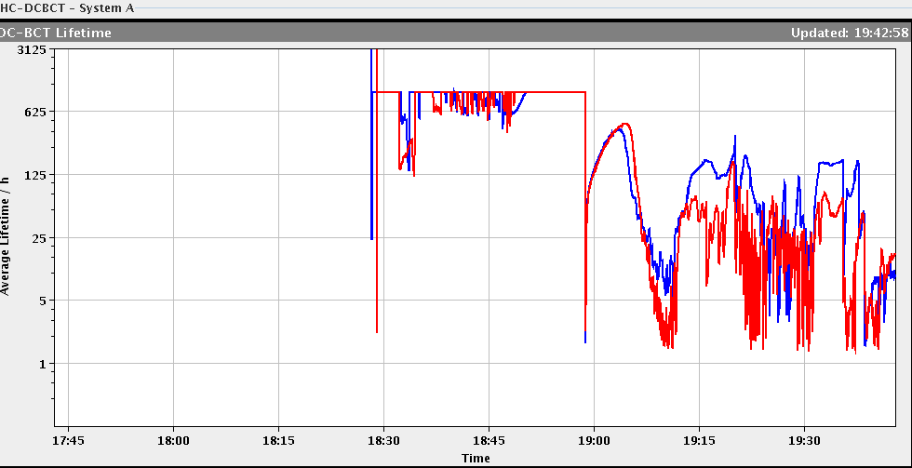
Fill 2819 – Sunday afternoon
Losses on B2 look similar to what was observed after TS1 – but this time we have higher BLM thresholds.
Squeeze
Collide

Slide 5
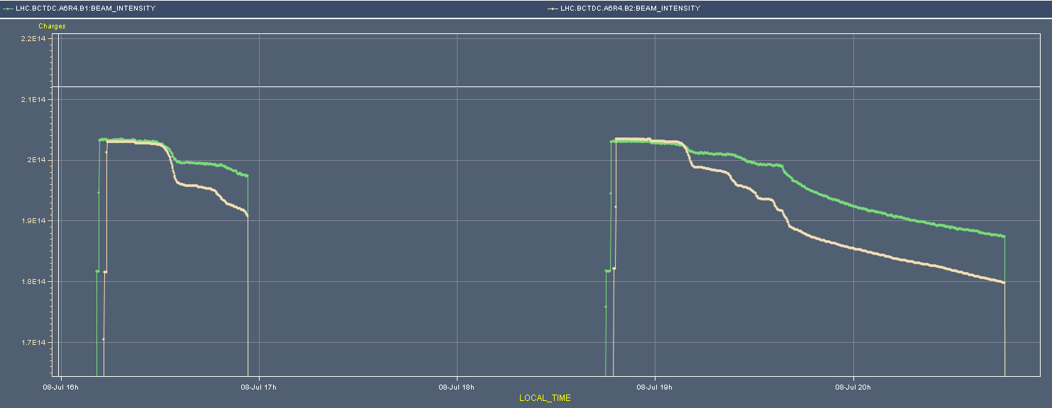
Squeeze losses - Sunday
Large losses in last 2 fills during squeeze – B2.
Squeeze
Squeeze
6%

Slide 6
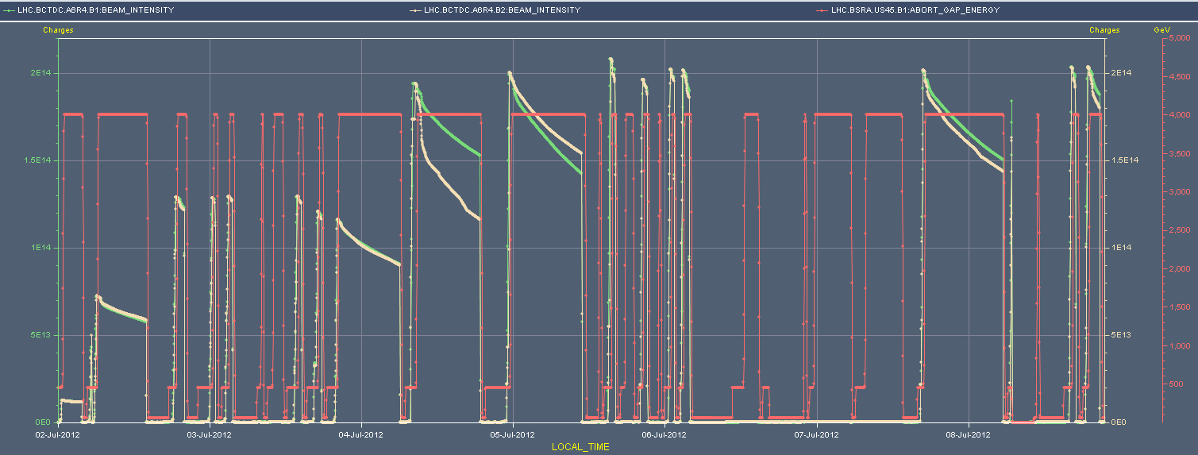
Week overview
Intensity ramp up & 90 m setup.
Tricky recovery – 5 fills lost going into collision or at end of squeeze.
Intensity limited ~10% below pre-TS2 values at 1.45E11 ppb/
Intensities and energy
1380b
480b
852b
840b
90 m
×
×
×
×
×
×
×

Slide 7
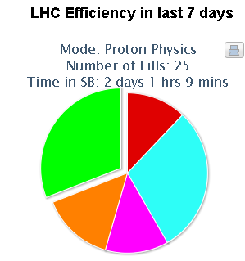
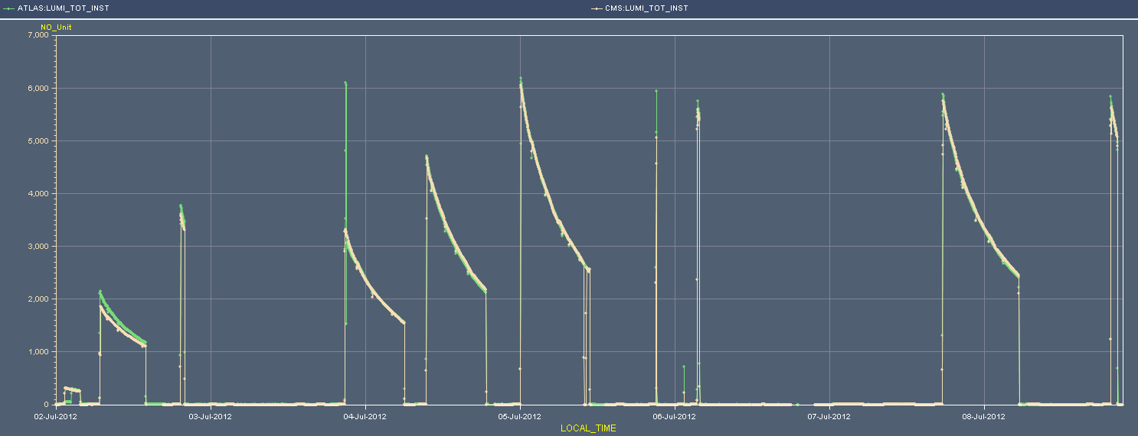
Overview of lumi production
Max. initial L : 6x10³³ cm⁻²s⁻¹
31%
Luminosity
1374b
6E33 cm-2-s1
840/852b
90m

Slide 8
Fills of the week
Fill | Day | L (h) | Nb | Int L (pb-1) | Dump
2797 | Mo | 7:02 | 480 | 36 | OP
2798 | Mo | 0:37 | 852 | 8 | MKI2 UFO
2805 | Tu | 9:11 | 840 | 60 | OP
2806 | We | 9:16 | 1374 | 103 | OP
2807 | We | 10:40 | 1374 | 145 | QPS on Q5.L1
2810 | Th | 0:03 | 1374 | 1 | Thunderstorm, FMCM trigger
2812 | Fr | 0:24 | 1374 | 8 | QPS on RB.A45
2816 | Sa | 11:50 | 1374 | 156 | Thunderstorm, FMCM trigger
2819 | Su | 1:10 | 1374 | 22 | RF B2, cryo issue Pt4
Integrated luminosity 539 pb⁻¹

Slide 9
Fills lost on beam losses
Fill | Nb | Phase | Comment
2800 | 852 | Adjust | B2 losses up to 40% on some bunches.
2803 | 852 | Adjust | B2 losses up to 25% on some bunches.
2804 | 852 | Adjust | B2 losses up to 25% on some bunches.
2808 | 1374 | Adjust | B2 losses up to 40% on some bunches.
2818 | 1374 | Squeeze | B2 losses at end of squeeze. Rather large(r) losses in R & S on B2.
Dumps on IR7 (MQW) of IR6 (Q4) BLMs.
Last fill: losses in ramp and squeeze look suspiciously similar to the issue we had after TS1. To be checked.

Slide 10
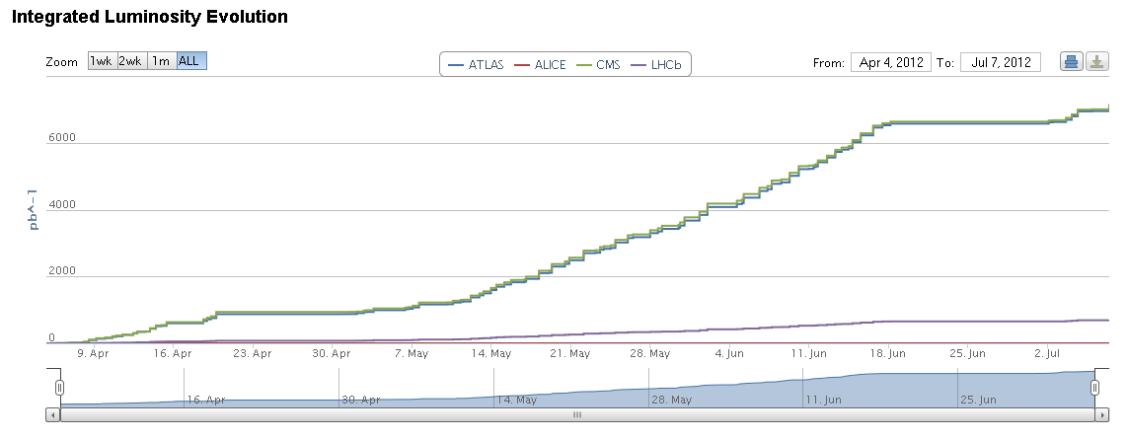
Integrated luminosity

Slide 11
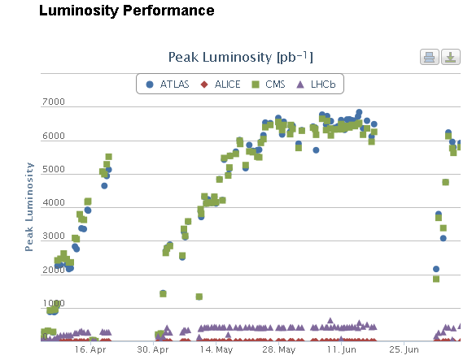
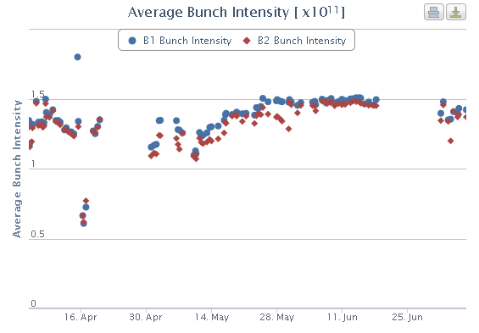
Performance evolution
Recovery much better than last TS, but missing 10% wrt pre-TS performance.
Emittance in collision ~ OK.

Slide 12
Downtimes
Day | Length | Cause
Mo | 3.5 h | EE switch RCS.A23.B1
Tu | 2 h | ATLAS turbine (torroid)
Th | 4 h | QPS Q4.L1, ALICE, ADT
Fr | 7 h | nQPS RB.45
Fr | 6 h | Water leak → ATLAS safety system and vacuum crate
Sa | 2 h | (Water leak →) ATLAS safety system
Su | 2 h | QPS Q9.L6
Su | 4 h | LBDS B2
Su | > 12 h | Cryo Pt4
To note: Friday morning a warm cryo compressor in Pt2 (1 our of 2) was repaired – oil leak – transparent to operation.

Slide 13
Lost fills - collisions
Frequent problem in past week: large beam losses on B2 when going into collision - during the LHCb Xing manipulation phase.
4 fills were lost, 3 with 852 bunches, 1 with 1374 bunches.
One fill (2806) had heavy losses at end of squeeze on B2 – managed to collide and this stabilized the beams.
Losses are not associated with particular beam-beam family.
Dropped bunch intensity by 5-10%.
Q’ measured during test cycles – seems to be OK.
Losses on B2 correlated to horizontal tune on B2 – but not always.
QFB has frequently problems with B2H – noise.
Re-optimize Q measurement for more accuracy and less bandwidth?

Slide 14
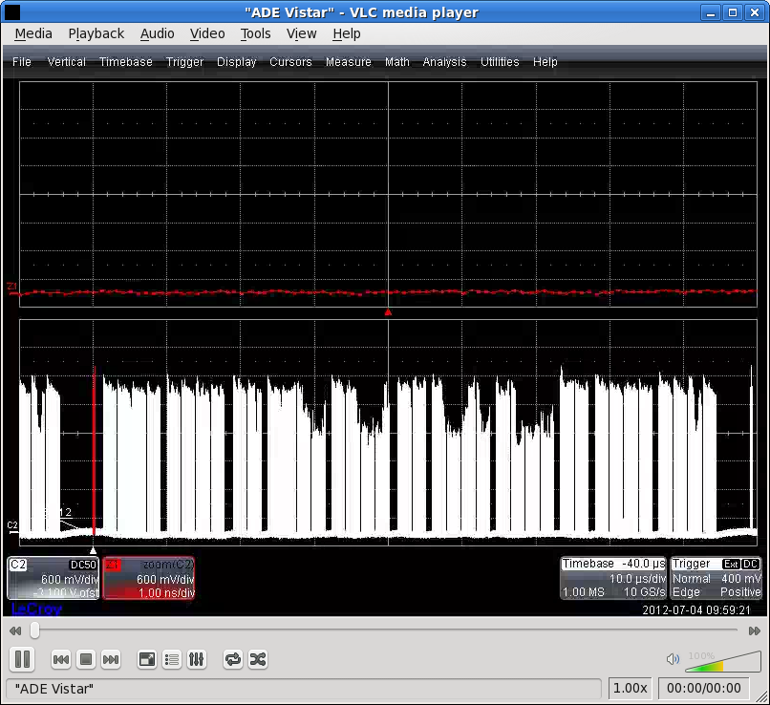
Pattern of losses of B2 in collision fill 2806
Developed in the squeeze, getting worse and worse…
Stabilized finally when colliding…

Slide 15
Emittances on B1 for fill 2806
All OK on flat top, blown-up after the squeeze in H.
Mirrors the losses on B2 bunches (wrt IR/5 collisions)
B1
B2

Slide 16
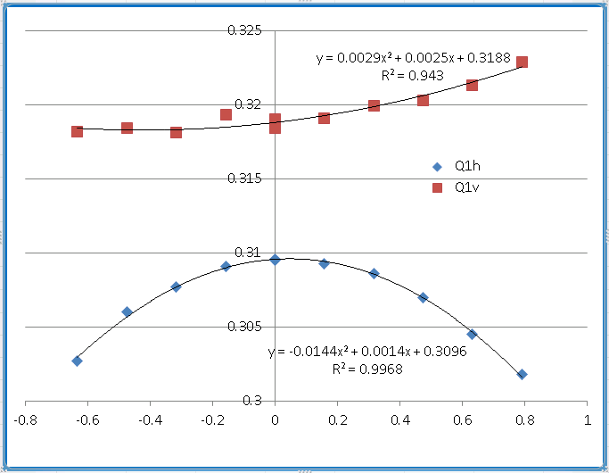
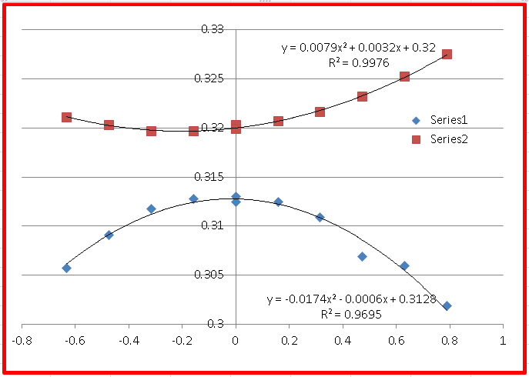
Chromaticity
Very non-linear – octupoles !
Reverted to good old method : trim fRF, measure tune etc
Q’ from fRF modulation not always consistent with manual measurement…
V
H

Slide 17
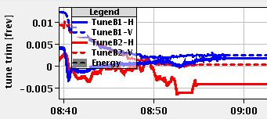
Real-time trims of QFB
Frequently difficulties with B2H in ramp
0.005
90 m fill

Slide 18
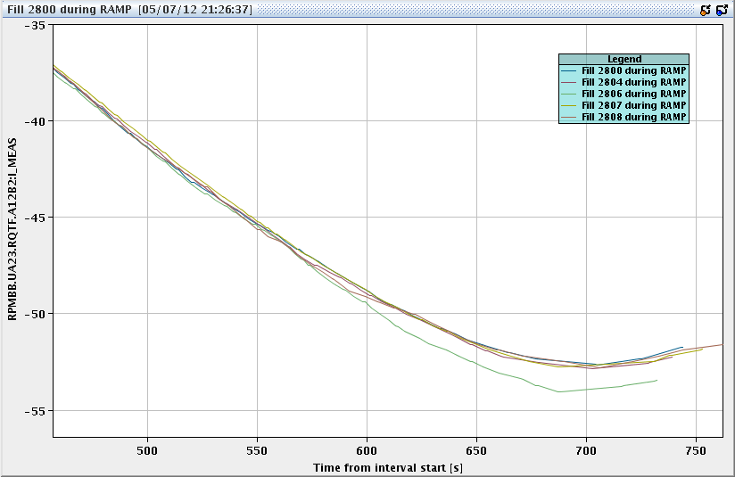
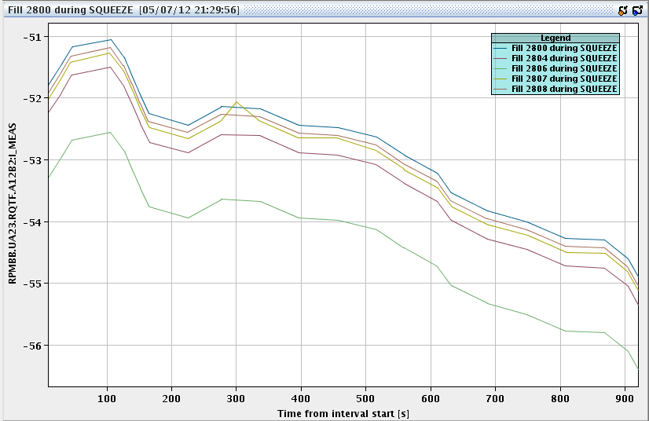
QTF current in ramp and squeeze
Ramp
Losses fill 2806
Check QTF.B2 current at start and end of squeeze to avoid problems.
Start: -51.5 A – OK, -53 A – bad
End: -55.2 A – OK, -55.7 A – bad
Squeeze

Slide 19
Change way to go into collision?
Now – steps to go into collisions:
0-40 s: collapse separation.
40-100 s: ramp up IR8 vertical crossing bump.
100-220 s: ramp down IR8 horizontal crossing bump, apply lumi scan corrections.
This week we frequently had problems in the second step. No way of diagnosing by stopping.
Proposal - add new distinct BP:
Collapse separation and apply lumi scan corrections for IR1, 2 & 5 to collide head-on → BB tune spread.
Move on to present schema, leaving only the IR8 manipulations (separation, vertical crossing, horizontal crossing).

Slide 20
Change way to go into collision?
The challenge of the proposal: we have to remain in collision in IR1 and IR5 during the LHCb crossing bump manipulations.
Looks feasible since we maintain ~30 um stability of the orbit at the TCP during that phase, << 1 sigma.
Main commissioning work consists in correcting the orbit leakage by feed-forward + new collimator functions.
2-4 cycles before high intensity can be used (> 480 b).
Endpoint remains the same !!
Settings well advanced (collimation to do).
Food for thought…

Slide 21
Beam to TDI
Wednesday evening, 2 B1 injections on 6 bunches went straight to the TDI in Pt2.
Beam not synchronous with the MKI pulse.
Problem was traced to the SPS RF for 50 ns beam user was on local reference instead of LHC reference.
Not caught by BQM as its reference is also switched.
(My) understanding was that BQM was always using LHC reference during actual LHC filling.
Protection added within injection sequencer (checks reference).
Protection to be added in LHC SIS – soon.
Some small technical issues.

Slide 22
90 m setup
Started Friday 12:00, ended Saturday 13:20.
Lost ~7 hours due to water leak in Pt1 drowning crates in US15 (ATLAS safety system and vacuum).
3 fills:
No 1: lost colliding B2 bunches when going into collision. Some luminosity visible in both IR1 and IR5.
No 2: lost on beam losses due to error in RP manipulation.
No 3: successful – RP run at ~ 6 sigma, loss maps (betatron and off-momentum -)

Slide 23
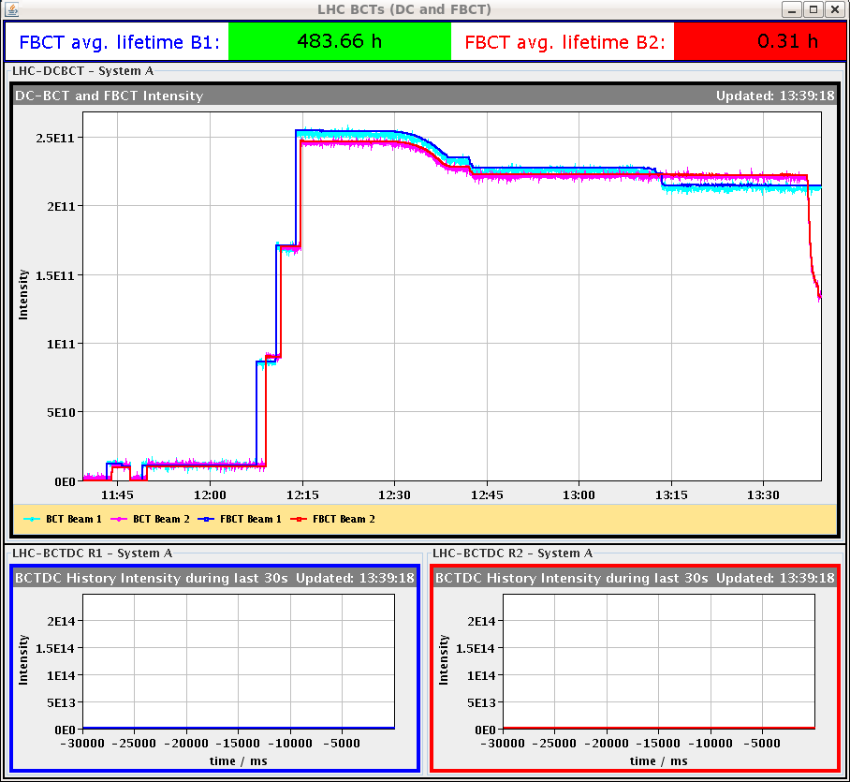
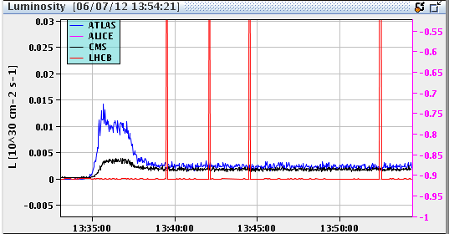
Luminosity and losses first 90 m fill
B2 instability after ~2 minutes in collision
Luminosity in IR1/5
Octupoles 200 A
Damper ON, gains ~factor 2 (H) and 4 (V) lower than for 50 ns

Slide 24
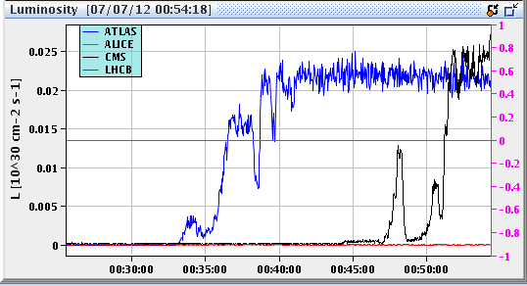
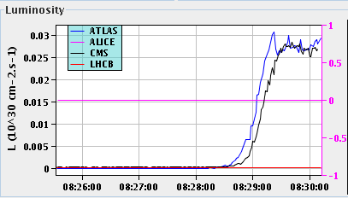
Colliding at 90 m
Second fill : octupoles at 300 A, collide first in IR1, optimize to get tune spread, then collide IR5.
Third fill : with lumi scan corrections.
Fill 1
Fill 2
Fill 3

Slide 25
90 m : next steps this week
Setup: missing some validation – 2 cycles
Betatron loss map at 90 m, separated beams,
Off-momentum + and asynch. dump test in collision.
Physics run with 80-150 bunches
Must define asap the bunch separation and filling scheme.
ALFA requires separation >= 650 ns. Can be done in the SPS, but implies injecting 4 bunches at a time (and not up to 16 with 525 ns or multiples).
Leave ADT gain lower in squeeze, increase (V) in physics?
SIS orbit interlocks settings to update.

Slide 26
Plans for the week
Cryo recovery afternoon – early evening.
Mo 16:00 – Wed 16:00 : floating MD
Wed 16:00 to Thu 16:00 ++ : 90 m
Then back to physics.
New collision BP??
Next week Mo – We : 48 hours of VdM scans.
4 TeV un-squeezed.
Requires setup of un-squeezed collisions (Xing angles etc to be defined), TCT setup, validations.

Slide 27
Floating MD for 48h
MON 09/7
16:00 Beam Dump physics fill (need to come from high energy)
17:00 Q20 set up
21:00 High pile-up (~100): standard optics & 2b of 3e11 (Q20); collisions IR1&5 ; noise excitation, transverse offset etc
TUE 10/7
07:00 Beam dump, revert to Q26 injection
08:00 25ns injection tests
13:00 Ramp down and cycle
14:00 ATS MD: Pre-squeeze and very low beta ATS (0.1 m)
WED 11/7
03:00 Dump & ramp down
04:00 Beta* leveling test up to 36b OR Week AFTER
16:00 End of floating MD.

Slide 28
MD settings
Hyper-cycles for floating MD:
25 ns MD : 4TeV_10Aps_0.6m_25ns
Collimator settings at injection to be finished: settings for TCTs L2 and digital signatures on thresholds !!
ATS : ATS_4TeV_2012
Squeeze in collisions (b* level): 4TeV_10Aps_0.6m_BSTAR_LEVEL
For Q20 / high pileup : standard settings
!! Revert all changes !!

