Slide 1
MD Report 24 June 2012
Machine coordinators: Barbara Holzer, Mike Lamont
MD Coordinators: Ralph Assmann, Giulia Papotti, Frank Zimmermann
MD#2 News & Plan 23 June 2012

Slide 2
MD#2 News & Plan Tue – Wed (19. – 20.6.)
Day | Time | MD | EiC | MP
Tue | 06:00 | 450 GeV → 4 TeV: Ramp for chromaticity (done later) |  | A
 | 08:00 | Ramp down
 | 10:00 | 450 GeV: Large Piwinski Angle MD + precycle 2 bunches 2.4e11 – started with 3:30 h delay |  | A
 | 18:00 | 450 GeV → 4 TeV: Octupole instability threshold Single full physics beams Ramp for chromaticity + octupole effect |  | C
Wed | 02:00 | Ramp down
 | 04:00 | 450 GeV → 4 TeV: Longitudinal dynamics studies– |  | B
 | 10:00 | Ramp down
 | 12:00 | 450 GeV → 4 TeV: Beta* leveling 2 nominal bunches |  | C
 | 20:00 | Ramp down
 | 22:00 | 450 GeV → 4 TeV: Long-range beam-beam with high bunch intensity 84b 50 ns 1.7e11 |  | C
Giulia
Alick
Ghislain
Giulia
Mirko
Alick
Ghislain

Slide 3
MD#2 New & Plan Thu – Fri (21. – 22.6.)
Day | Time | MD | EiC | MP
Thu | 06:00 | Ramp down
 | 08:00 | 450 GeV → 4 TeV: High beta* (1) |  | A
 | 16:00 | Ramp down
 | 18:00 | 450 GeV: MKI UFO studies |  | C
Fri | 04:00 | 450 GeV → 4 TeV: Scraping, diffusion and Repopulation Study and fast losses (with ADT) |  | C+C
 | 12:00 | Ramp down
 | 14:00 | 450 GeV: Injection and Q20 optics |  | A
 | 22:00 | 450 GeV: RF cavity phase modulation for 25ns |  | B
Ghislain
Mirko
Alick
Ghislain
Verena
Mirko

Slide 4
MD#2 News & Plan Sat – Mon (23. – 25.6.)
Day | Time | MD | EiC | MP
Sat | 06:00 | 450 GeV → 4 TeV: High beta* (2) |  | A
 | 14:00 | Ramp down
 | 16:00 | 450 GeV: Transverse Damper studies – cancelled → instability studies (octupoles, ADT, Q’)
 | 22:00 | Ramp down
Sun | 00:00 | 450 GeV → 4 TeV: Collimation (impedance, nominal settings) |  | C
 | 06:00 | Ramp down
 | 08:00 | 450 GeV: Beam Instrumentation (BSRT, BGI, wire scan, BPM nonlinearities) |  | A/B/C
 | 16:00 | 450 GeV → 4 TeV: Test ramp for emittance calibration |  | B/C
 | 20:00 | Ramp down
 | 22:00 | 450 GeV: Dynamic Aperture MD |  | D
Mon | 06:00 | Technical Stop
Alick
Enrico
Mirko
Alick
Enrico
Mirko
Alick

Slide 5
H. Burkhardt, J. Wenninger,
A. Mcpherson, E. Bravin,
D. Jacquet, S. Cavalier,
T. Baer, E. Maclean et al
High beta* (2)
switching to dedicated Hypercycle HighBeta_4TeV_2012, implied recycling before injection. RQTL11L2.b2 went faulty during the recycling delaying the MD start
unsqueezed to 90m and then to 500m without stops and without beam losses
completed 500m optics measurements, confirming good correction
further un-squeezed in steps of 100m and reached beta*=1000m in IP1&5 on first attempt without any significant beam losses
complete set of measurements of yet uncorrected 1000 m optics
refilled for higher intensity; injected, ramped and un-squeezed in the short remaining time two nominal bunches per beam to 90 m; MD ended at 15:00 after major beam loss (by mistake OFB left on) in preparing collisions at 90m

Slide 6
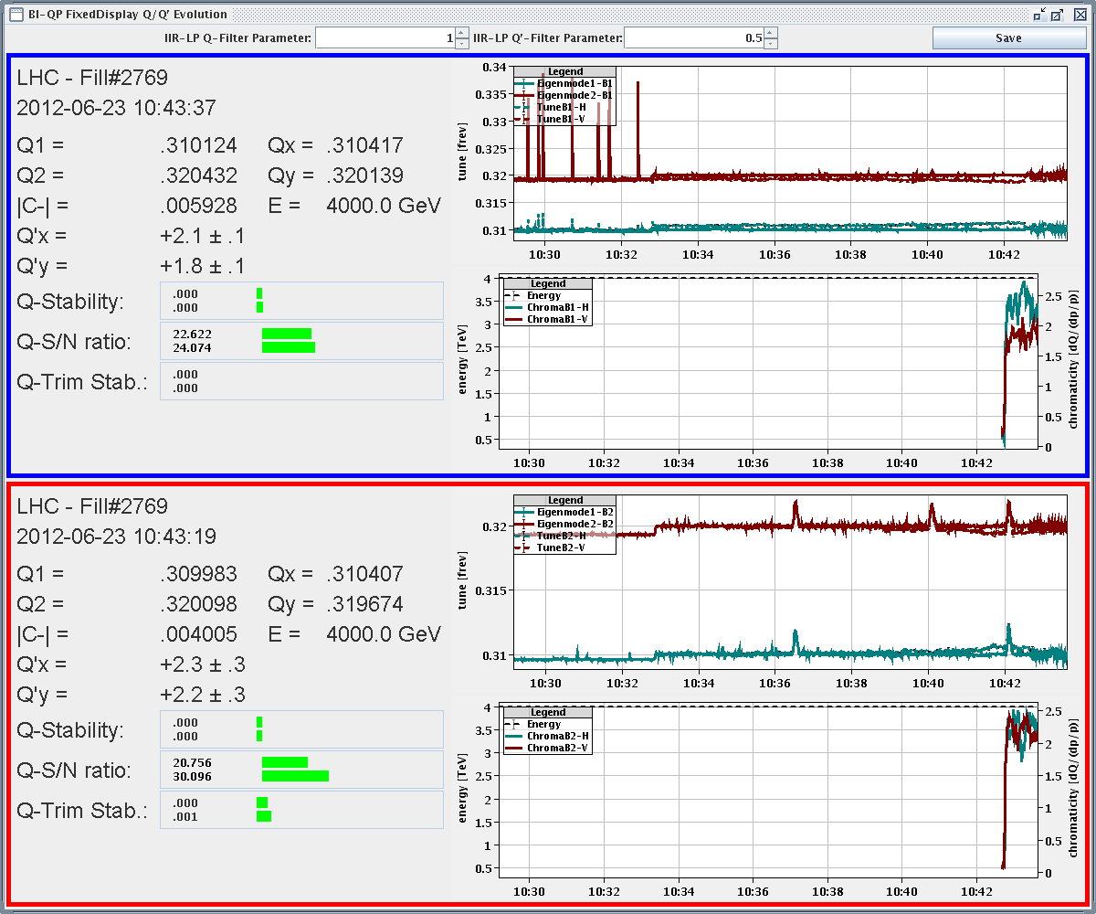
Q/κ/Q’ at β*=800 m

Slide 7
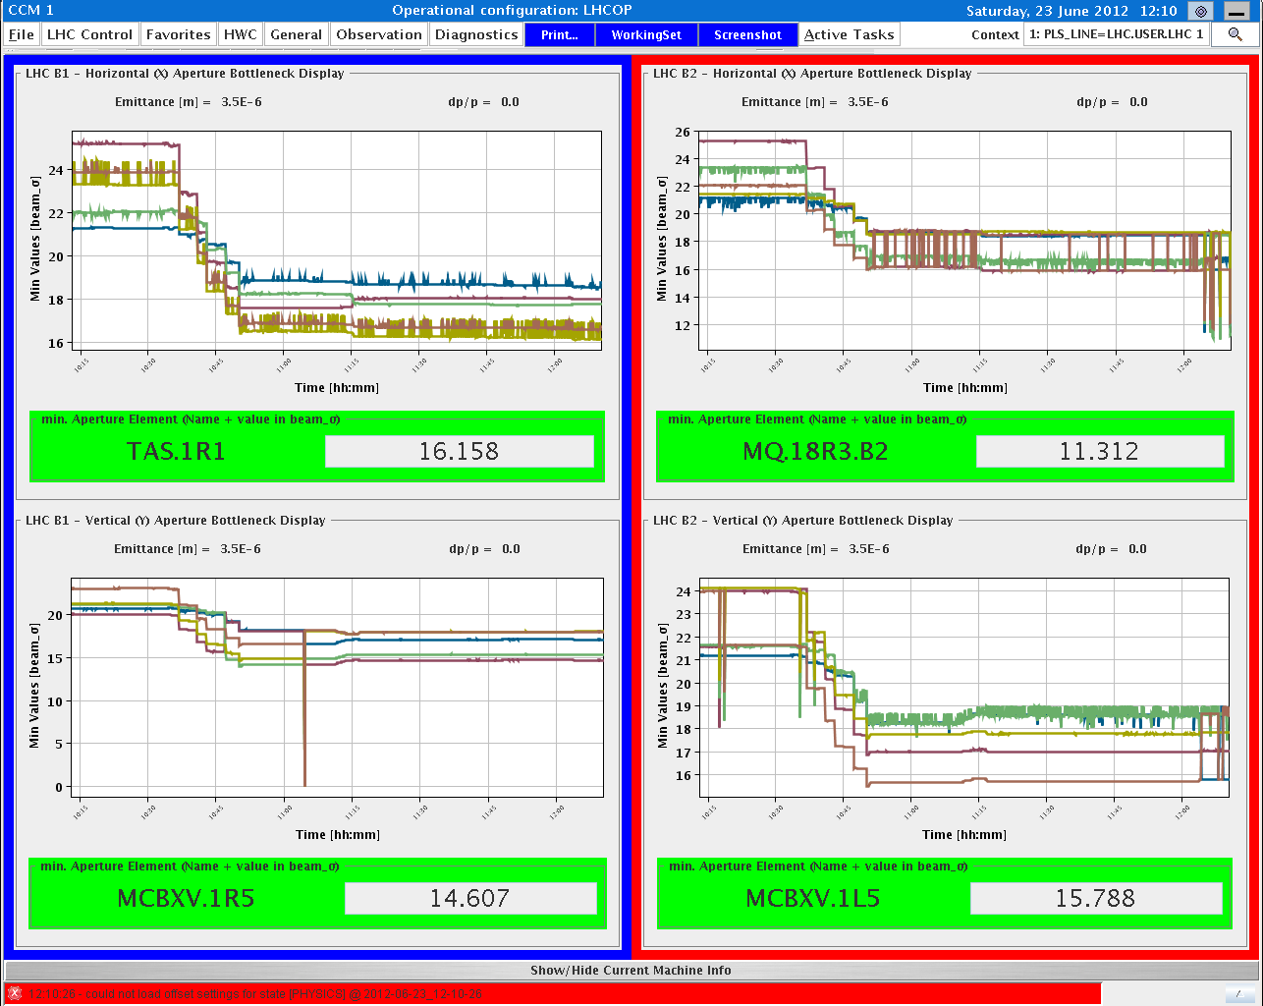
aperture bottlenecks at β*=1000 m

Slide 8
beta*=500 & 1000 m optics
on-momentum measurements for B1 at 500 m, with global correction implemented (horizontal plane had not yet measured due to malfunction of AC dipole in high-beta MD 1); B1 global correction seems to have worked well
next optics measurements were performed at beta*=1km; the 500m corrections had been removed for these measurements; on and off (+-50Hz)-momentum measurements for both beams

Slide 9
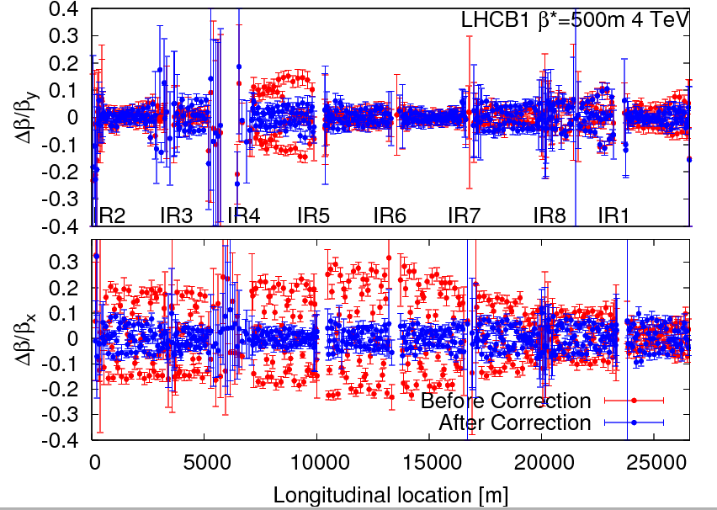

Slide 10
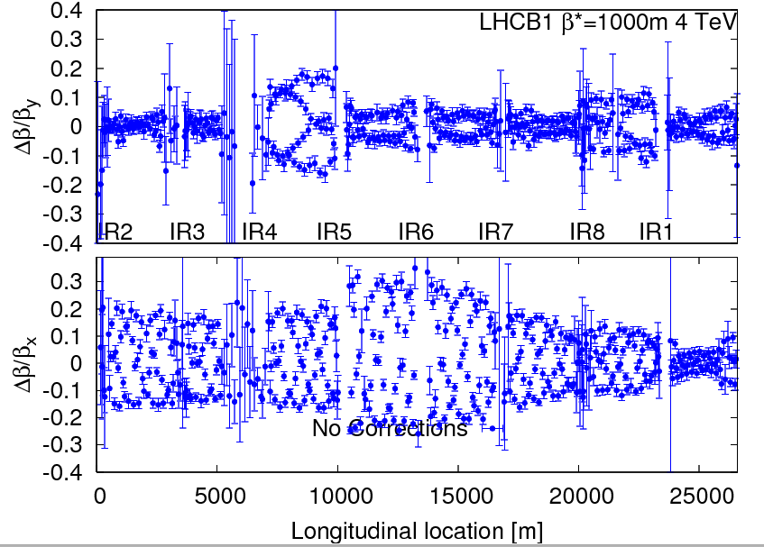

Slide 11
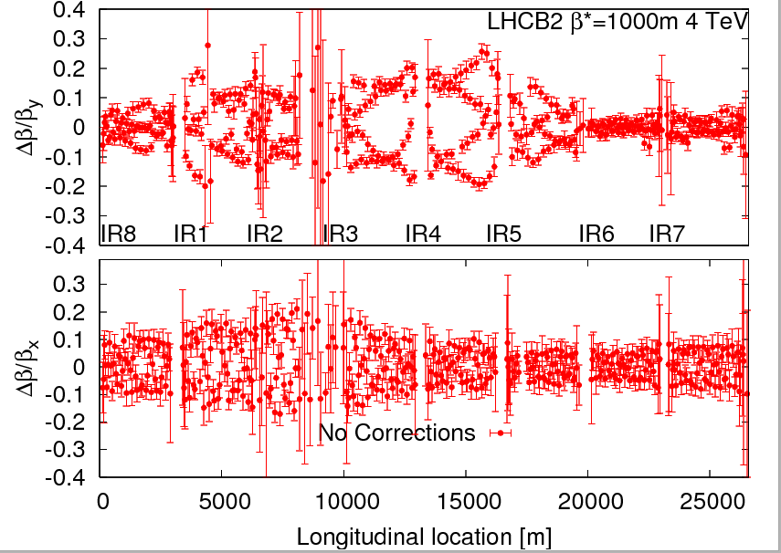

Slide 12
octupole MD II - after the squeeze
6 studies:
Q'x,y = + 5, ADT as in physics: decreased octupole current down to 0; at 0 the beam became unstable in Vplane (still stable at ~ 20 A in the D octupoles). Increased octupoles to save beam (also Q'x,y +2).
Ioct = 450 A, ADT as in physics: decreased Q'x,y from + 7 to - 10 by steps of 1 unit. The beam was always stable. Then we moved in 1 step to Q'x,y = + 10 and the beam was still stable.
Q'x,y = - 5, ADT as in physics: decreased the octupole current down to ~ 220 A , when the beam became unstable in Vplane. Just after the instability, increased again the octupole current to save beam.
Q'x,y = + 2, ADT as in physics: we decreased the octupole current down to ~60 A, when the beam became unstable in Hplane. Just after the instability, increased again octupole current to save beam.
Q'x,y = + 2, Ioct = 450 A: decreased the ADT gain by steps of 20% (each time of the previous value) and after having reached the limit of the lower value, switched ADT off. The beam was stable. BBQ signal in H increased ~ linearly ~ 3 times above the noise level.
Q'x,y = + 2, ADT switched off: decreased the octupole current by 1 step to ~ 400 A and the beam was unstable in Vplane and finally dumped.
A. Burov, M. Pojer, Y., G. Trad, Y. Le Borgne, T. Pieloni, E. Metral

Slide 13
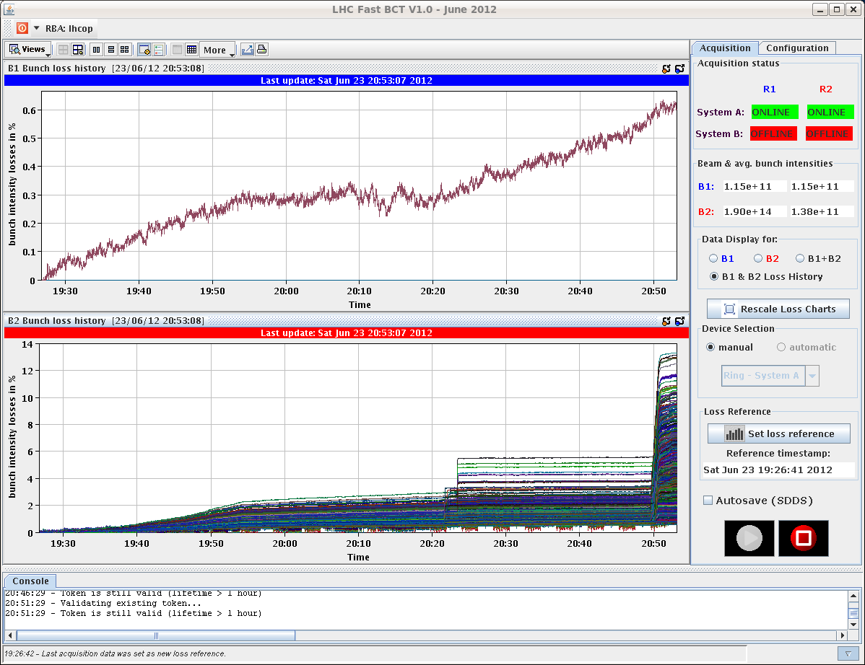
octupole MD II - losses during study 4

Slide 14
octupole MD II - BSRT emittance during study 5

Slide 15
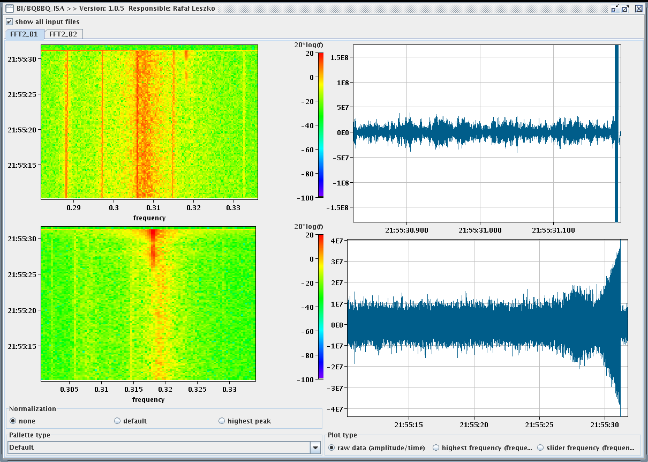
octupole MD II - beam loss & dump in study 6

Slide 16
octupole MD II - after the squeeze
preliminary conclusions:
with a single (50 ns bunch spacing) beam, with ~ 1.5E11 p/b, the beam seems to be deeply inside the stable area in terms of octupoles' current, chromaticity and ADT gain
the transverse emittances seemed to be larger than in physics (factor ~ 2 in H), which has to be looked at in detail.
all these studies were done with the same beam which suffered several instabilities, which can have some influence on the following ones.
A. Burov, M. Pojer, Y., G. Trad, Y. Le Borgne, T. Pieloni, E. Metral

Slide 17
collimation (impedance, nominal settings)
squeezed and separated beam, 3 nominal bunches
established nominal 7 TeV collimator settings in IR6& IR7 w/o problem
hierarchy worse than nominal settings especially for beam 1
beam-based alignment of 7-8 B1 collimators, 80 micron shifts, hierarchy improved
impedance: movement of primary and secondary collimators in IR7 with and w/o ADT
vertical signals clean; horizontal signals jumping between two peaks (even w/o ADT)
transverse tune shift of all IR7 secondary collimators from 5.1 to 9 sigma: 5e-4 ; tune shift from 3 primary from 4.3 to 6.3 sigma barely visible
octupoles decreased in large steps, Q’=+2, both beams lost at ~80 A (instability started at 200-300 A)
analysis of ADT signals & synchronous phase shift to be done offline

Slide 18
beam instrumentation
450 GeV, BSRT, BGI, wire scan, BPM nonlinearities,…

