Slide 1
Monday 11th June
08:10 Beam dumped in the ramp by OP. OFB did not start its function and kept the injection orbit.
08:50 Switch LHCb polarity to negative
09:28 Change of RBAC rules for OFSU and test afterwards.
10:51 Start test ramp with 24 bunches - Optimised IP1 collision values incorporated
14:34 Fill #2743 Stable Beams.
17:01 Dump due to trip of ROD.A81B1 (RR13) , followed by ROF.A81B1 and RSF1.A81B1, looks like a SEU. Int. lumi around 46 pb-1.
20:03 Fill #2724 Stable Beams
21:17 Dump due to electrical perturbation, triggered first FMCM on RD1.LR1 and heaters discharge on RQ10.R4. Int. lumi around 26 pb-1.
Waiting for quench heater to cool down - access for ALICE.
23:55 Access and pre-cycle finished
00:30 to 02:12 CMS electrical problem – access – could not fix
02:54 injecting for physics – dumped, access system wrong manipulation
Patrol and pre-cycle
05:18 No beam from injectors – PS RF beam controller problem
08:00 Probe beam back again….

Slide 2
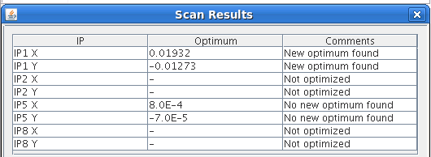
LHCb polarity change to negative
Test ramp with 2 x 24 bunches
Check head-on collisions for LHCb, ATLAS and CMS
LHCb reproduced previous settings for negative polarity
For V: (180 um + 6um) /2 - 100 um = 7 um. Will not change the function
For H: (160um +37 um)/2 - 42 um = 58 um. Incorporated in IP8_SEPSCAN_X_MM
ATLAS changes incorporated
CMS no changes

Slide 3
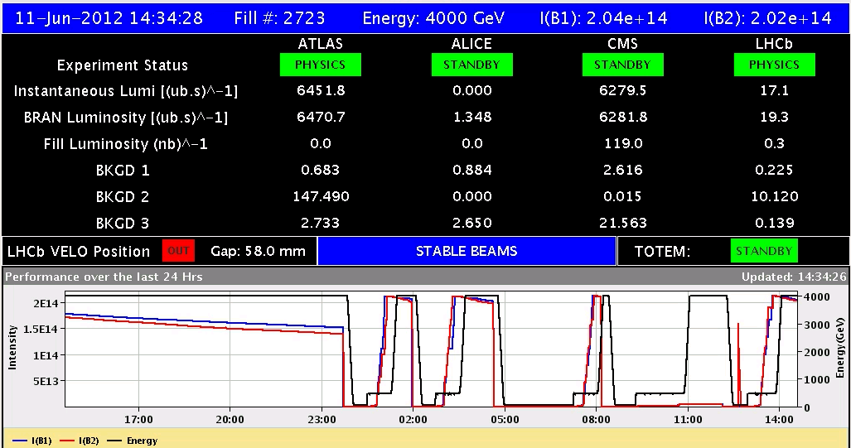
Fill #2723
Clean injection, BLM losses squeeze and adjust < 40 %
Initial lumi’s OK
No loss individual bunches
17:01 Dump due to trip of ROD.A81B1 (RR13) , followed by ROF.A81B1 and RSF1.A81B1, looks like an SEU. Integrated. lumi around 46 pb-1.

Slide 4
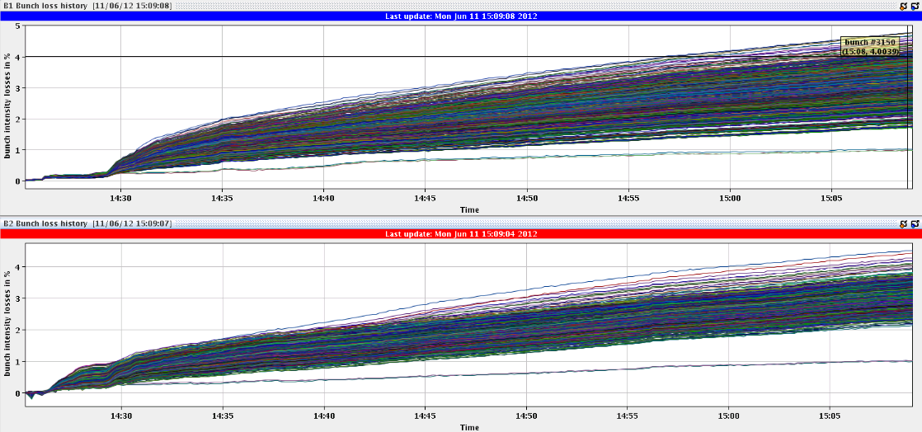
No loss individual bunches

Slide 5
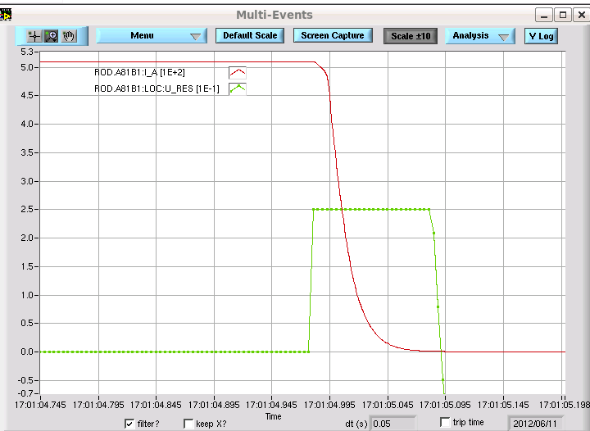
SEU?
The U_res of ROD.A81.B1jumps and saturates all of a sudden.

Slide 6
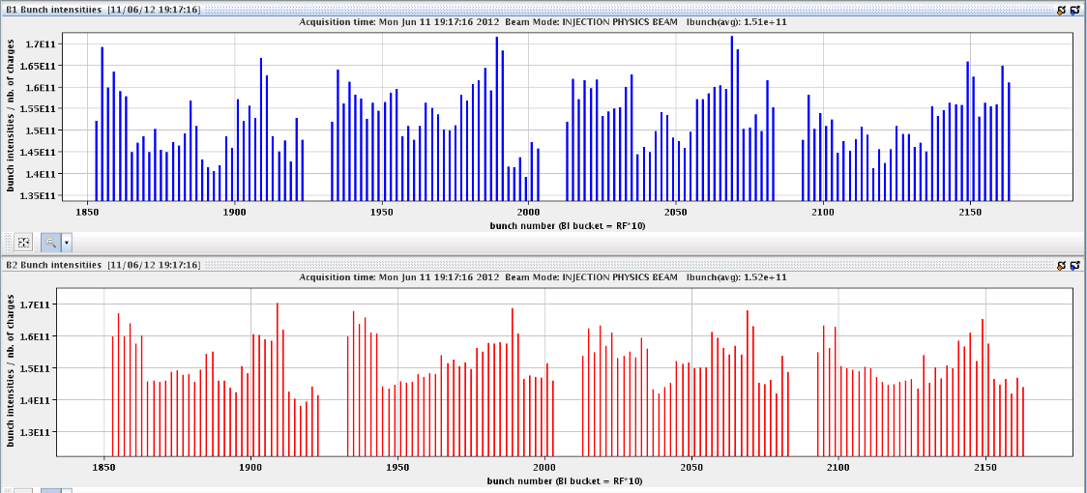
Fill #2724
Filling not smooth due to various BQM interlocks in SPS (bunch length, bunch peak, satellites, pattern)
Large spread bunch intensities
Initial lumi’s a bit lower, only just above 6e33 cm-2s-1
21:17 Electrical perturbation triggered first FMCM on RD1.LR1 and heaters discharge on RQ10.R4
Dump resistor 3 at 150C for RB.45

Slide 7
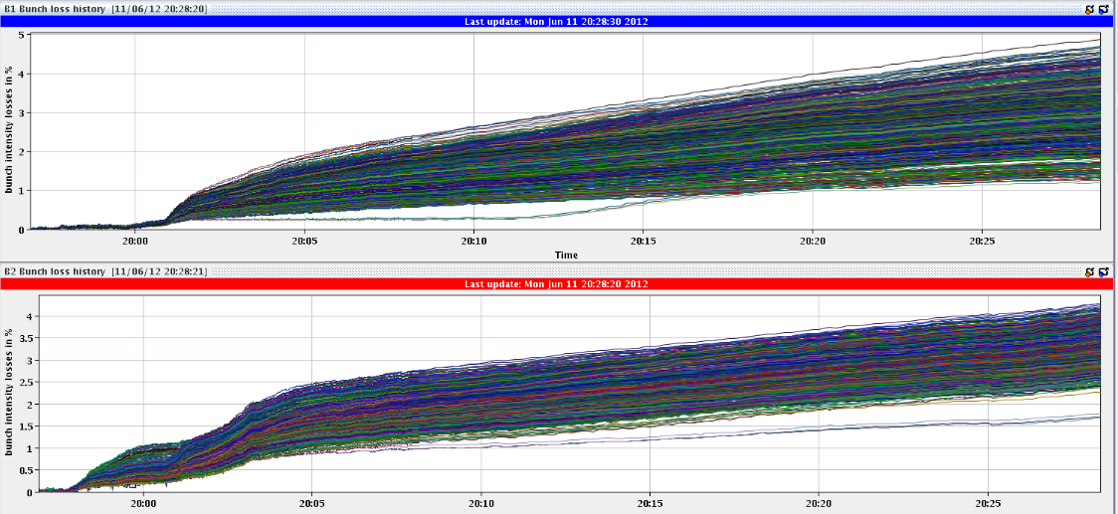
‘Special bunches’, some losses
The B1-bunches which collide only in IP8 (0,2,4) experience a gentle loss increase at about 20:11, while the equivalent bunches of B2 (24, 26 and 28) don't show any change of their loss-slope

Slide 8
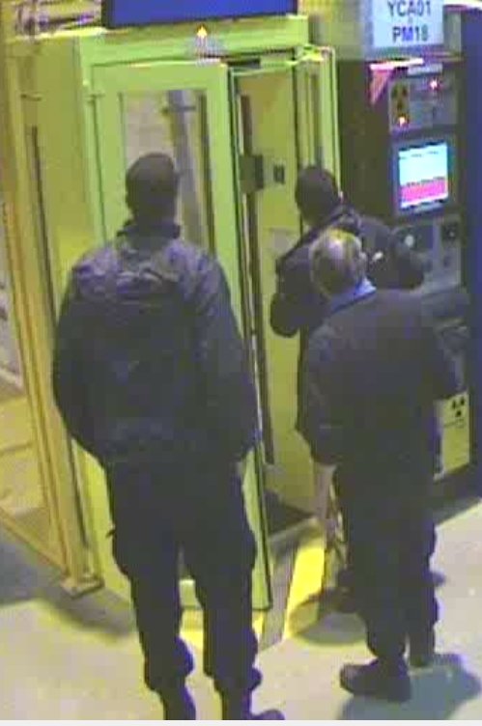
Fill #2725
Dumped during injection for physics
Beam dump caused by a wrong manipulation of the access door. CSR forced the PAD in PM18 to add a missing "plombage" on the internal handle.
This caused the loss of beams and of S12 and S81 as foreseen.
Security guard team opened the PAD, using their key. Apparently there was a "plombage" missing on the inside of the PAD, and they wanted to repair it!!! They tell us that CSA told them he had called the CCC and it was ok to touch the PAD. We did not know anything about the intervention.
Forcing a door at 03:02 in the morning…

Slide 9
The Lists
Done:
SPS Q20 extraction tests to TI2/8 downstream TED.
Outstanding
Impact of TETRA on hump / beam.
30 mins at injection with probe bunches.
Access:
CMS electrical problem Muon chambers
ALICE access
nQPS sector 78 (power cycle needed afterwards)
TCLIB.6R2.B1 electronics and LVDT sensor.
MAD PM15: motors of inner doors not working (at least 4 hours).
RQTL11.R7B2 temp DFBAN spikes (~3 to 5 hours).
BI in Pt4 (3-4 hours, working hours).
MKA test in Pt4 (1-2 hours) in preparation for MD
LBDS TSU surveillance check
Pulse MKD/MKB in local in preparation for TS2
TOTEM vacuum gauge (3 hours).
MCBV18.L4B1 and RCO.A12.B1 to be repaired.

