Slide 1
LHC Status Thu Morning 7-June
Bernhard Holzer, Joerg Wenninger
Status:

Slide 2
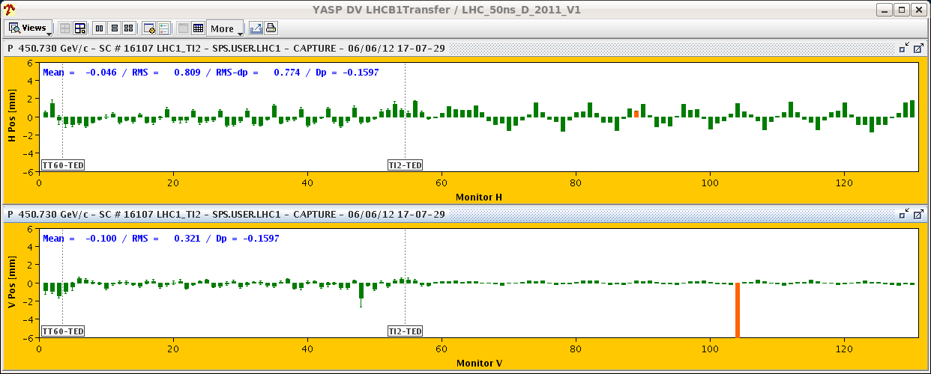
Wed Morning
05:07h beam dump, water flow fault on converter RQ10.R1
09:18h start precycle (EDF during precycle ... once again)
10:00h injection probe beam
12:49h problem with cavity in PSB, beam quality not acceptable for injection
16:29h injection probe beam
16:56h injection physics beam
some optimisation done
17:25h beam dump: power converter fault RBCV18.L4.B1
de-activated (and masked)
?? COD status in YASP ??

Slide 3
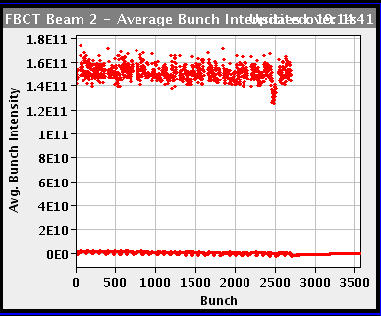
Wed Late
18:46h injection for physics not perfect but ok
20:04h stable beams
for Mike ...

Slide 4
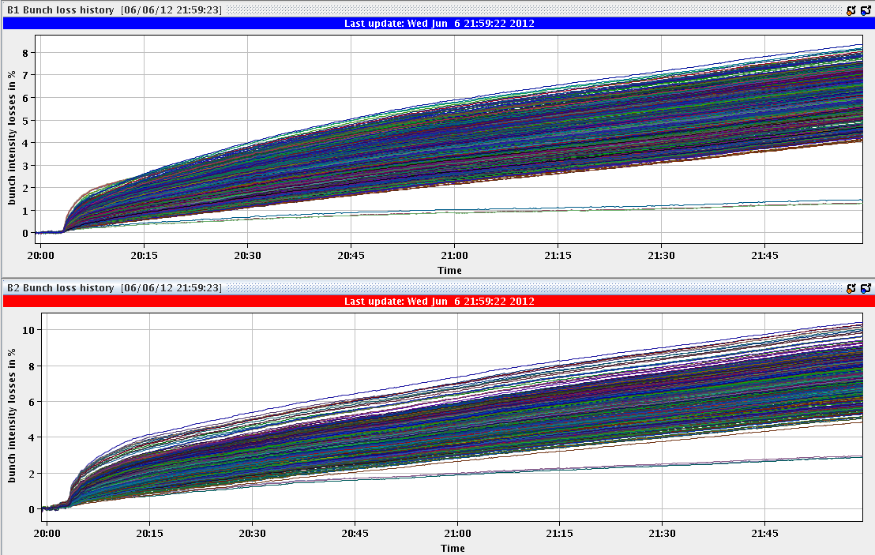
Wed Late / Night
bunch losses during
squeeze / adjust / stable beams ...
8 %
10 %
03:31h Fast emittance scan after 7 hours of stable beams ...
an easygoing luminosity fill

Slide 5
Thu Morning
delivered luminosity in present fill:

Slide 6
Thu Morning
Plan:
TCSG alignment verification in point 6 (B2) (1 hour)
Physics
Scan up to 3 sigma (CMS). Propose to do that with reduced damper gain at the end of the fill.
✔
✔
✔
✔

