Slide 1
Thursday 24.5. morning
7:20 – 12:30 faults of BLM sanity check, RQX.L8 QPS trip and iris scanner in UJ47. Access:
Pt 8 for ELQA on RQX.L8 (The voltage tap on the current lead has been lost triggering the QPS)
ALICE, CMS
Pt 1 for TCL: recurring problem with TCL.5R1.B1 should be solved. Replaced the conditioning electronic card for the resolver
Pt 2 for QPS (RQ9.L2)
Pt 4 for vacuum
Pt 4 BI (head-tail monitor)
14:40 BPM interlock test: Injected 1 indiv per beam (+ pilot) and start scraping

Slide 2
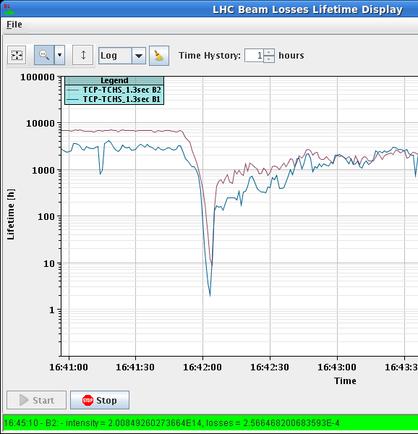
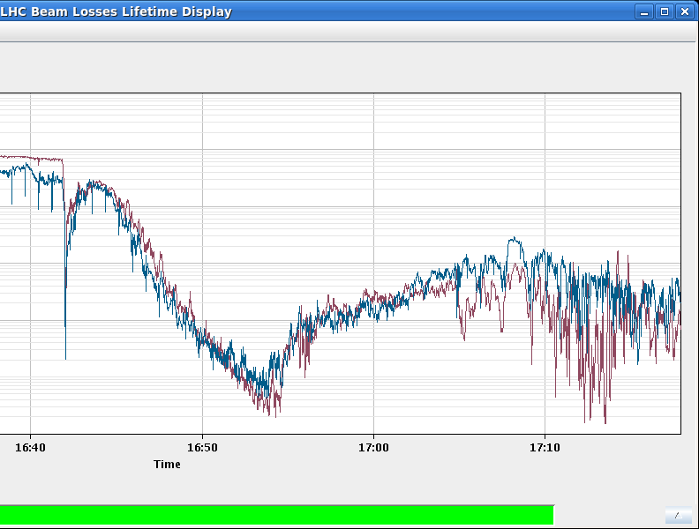
Thursday afternoon
Fill 2660 with the new filling scheme
17:34 stable beams
no more ‘private’ bunches for IP8
1.48e11 average bunch intensity
Longitudinal losses B1 at the start of ramp
losses on B2 between 2m and 1m (about 2e12 protons)
Peak lumi: 6.1 10³³ cm⁻²s⁻¹
Integrated lumi 24.5 pb-1 in 1:14h
18:47 beam dump: SIS BLM HV interlock for P7 triggered due to communication problems between BLM CPUs and CMW. Concentrator was not receiving anymore data sent by the CPUs. All processes were running on the crates. Christos did soft-reboot all CPUs.
Access for Atlas gas leak

Slide 3
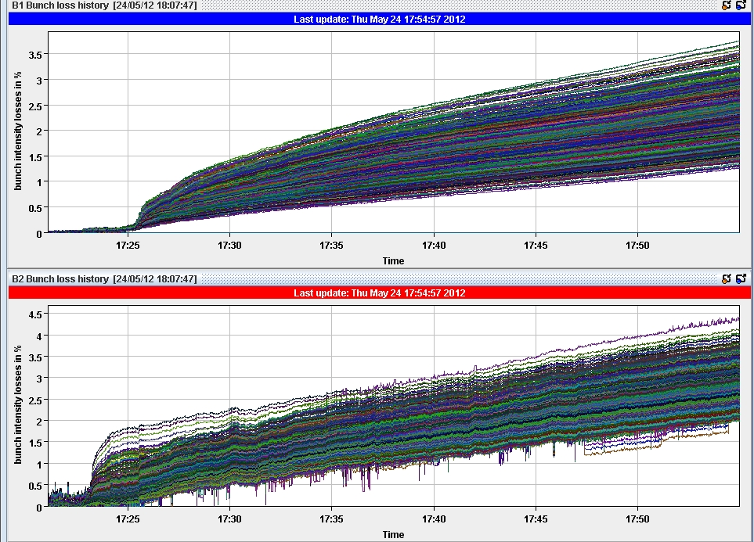
Fill 2660
Bunch losses since start of ADJUST mode

Slide 4
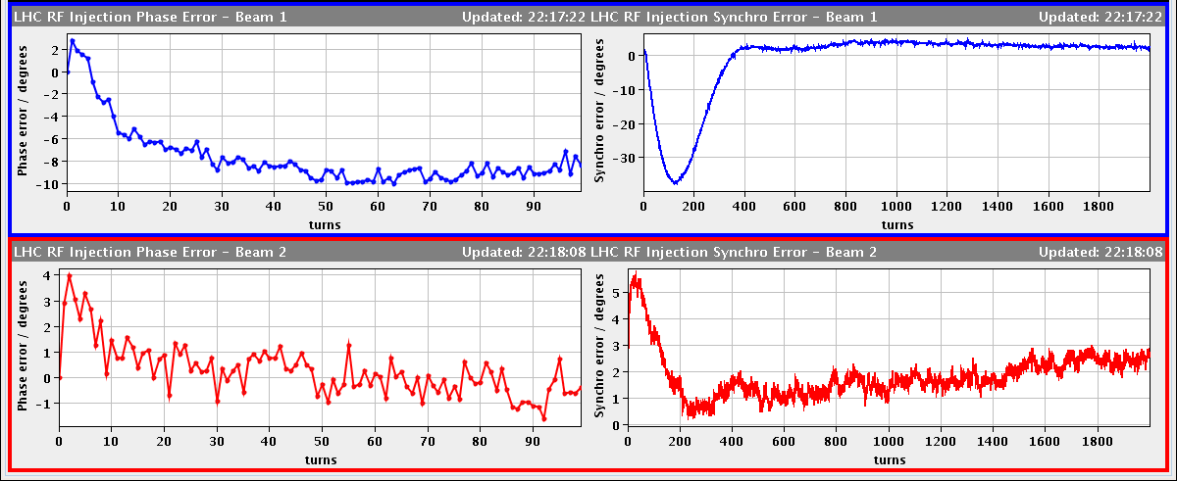
Fill 2662
21:40 injection probes
1.55e11 average bunch intensity
Adjusted the RF synchro error by de-centering quite a lot the orbit (+24Hz) to try to optimize the capture
Had to adjust TI2 H to get rid of the injection oscillation with the off center orbit
Beam losses at injection up to 55%
Left AGC until just before sending ramp start event.
Could start the ramp without chirp.
Capture losses down to 39% and fewer protons in the abort gap
'set to reference position' BSRT b2, to get the image back on screen

Slide 5
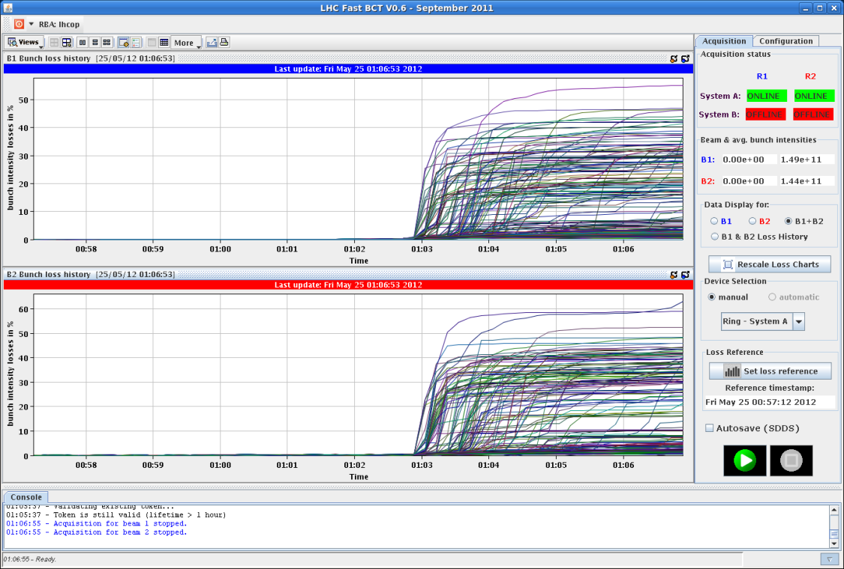
Fill 2662
1:06 beam dump in ‘adjust’ before starting to optimize: IR6 BPMs trigger, many bunches had lost half the intensity (~down to 5e10 ppb)
30-40% losses from lumi, but then got losses in IP7 up to 83% dump threshold before the dump by the IR6 BPMs.
Loss pattern seems unrelated with beam-beam effects, all losses are at the end of the trains, could be ecloud for example.
Note that we never started optimizing as we were waiting for the losses to calm down. Which they were, the intensity lifetime was recovering when we got the IR6 BPM dump.

Slide 6
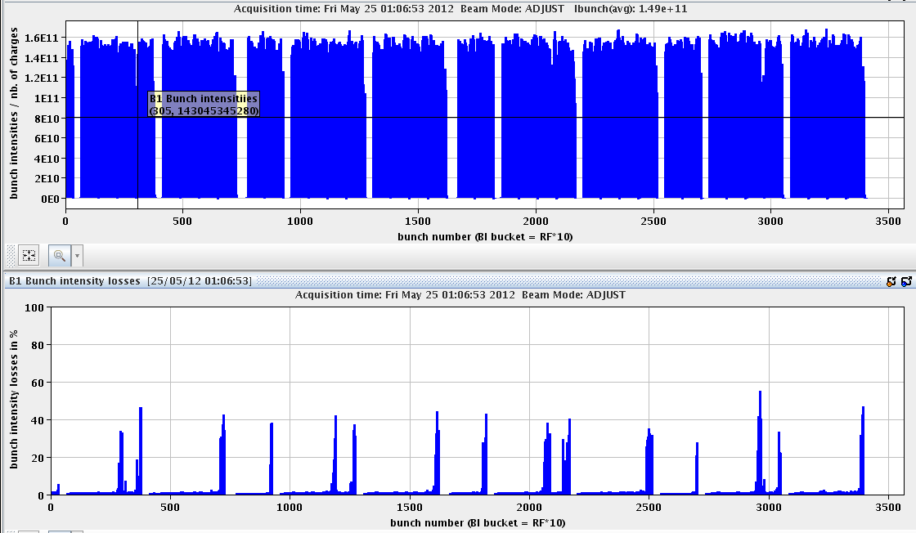
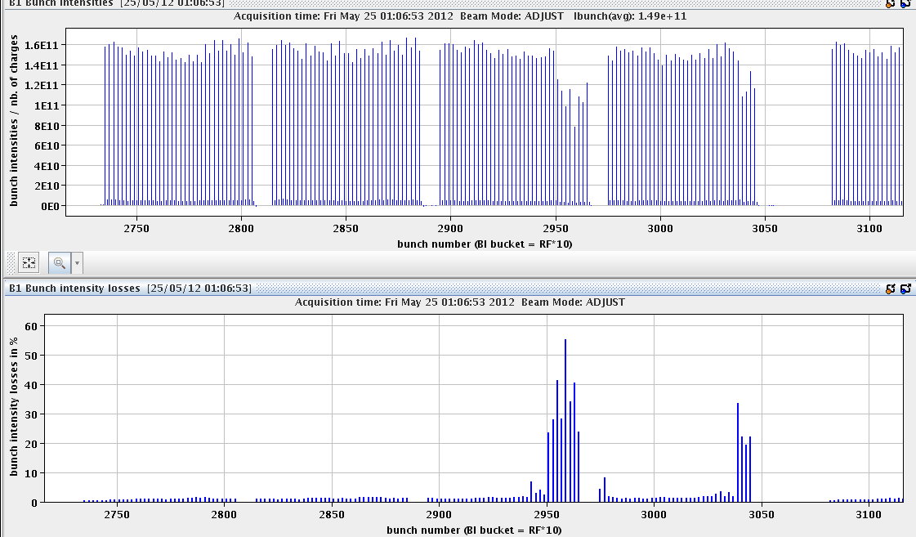
Fill 2662
B1 and B2 similar loss patter

Slide 7
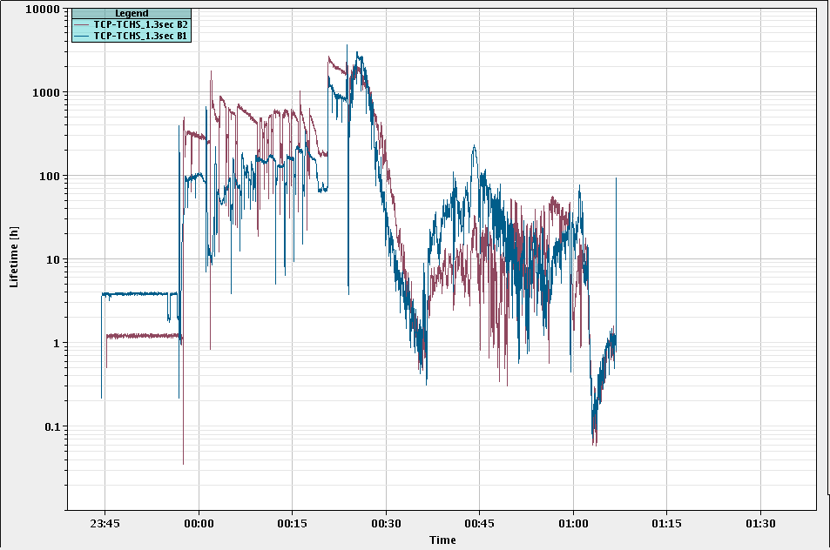
Fill 2662 Lifetimes

Slide 8
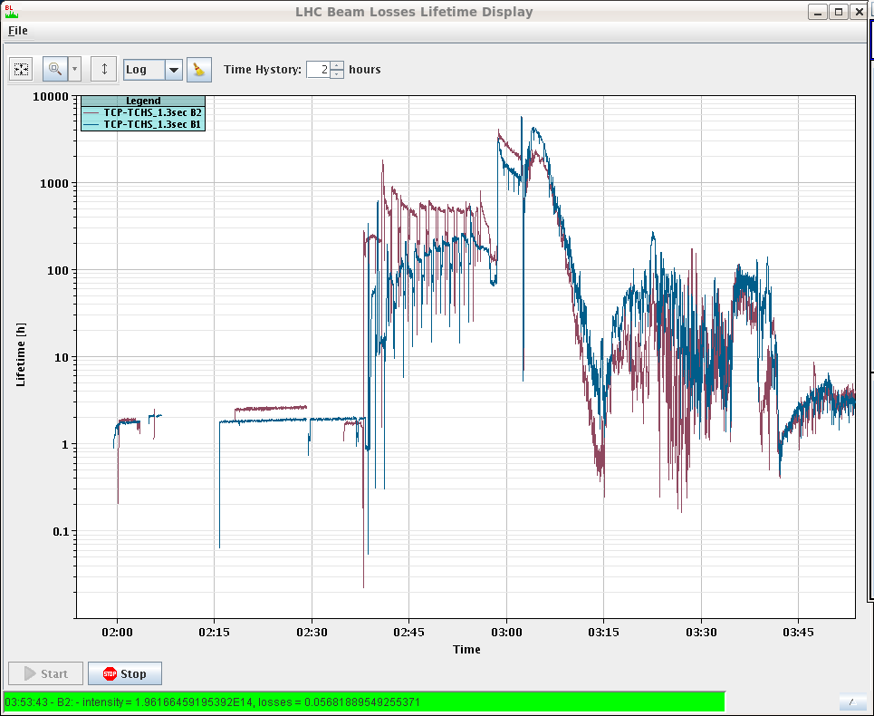
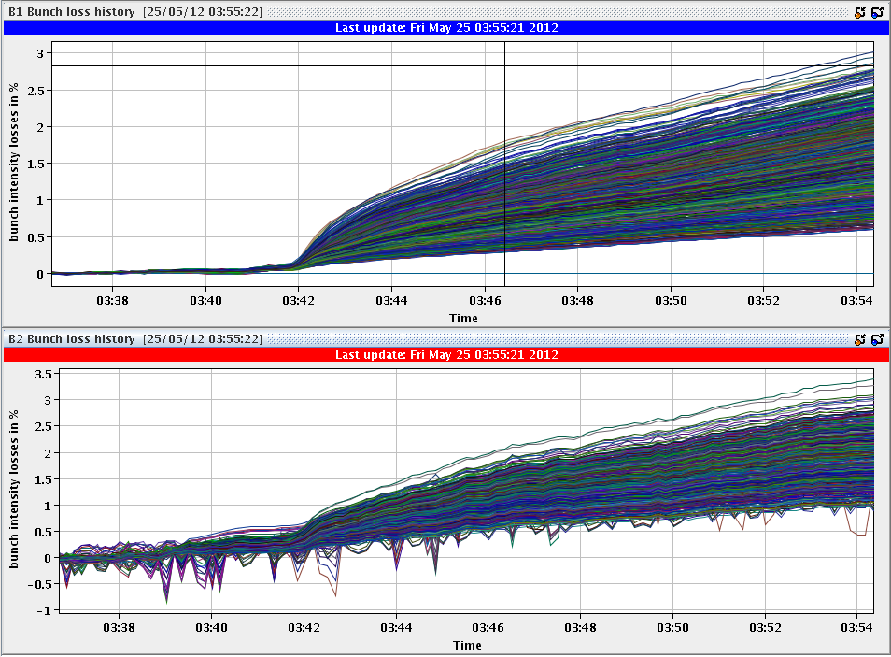
Fill 2663
1.51e11 average bunch intensity
RF injection synchro error similar to last fill
Less injection losses
left AGC on until ramp start event
Capture losses at start of ramp 31% of thresholds (no other BLM warnings until lumi losses 44%)
3:44 stable beams
15 minutes into collisions

Slide 9
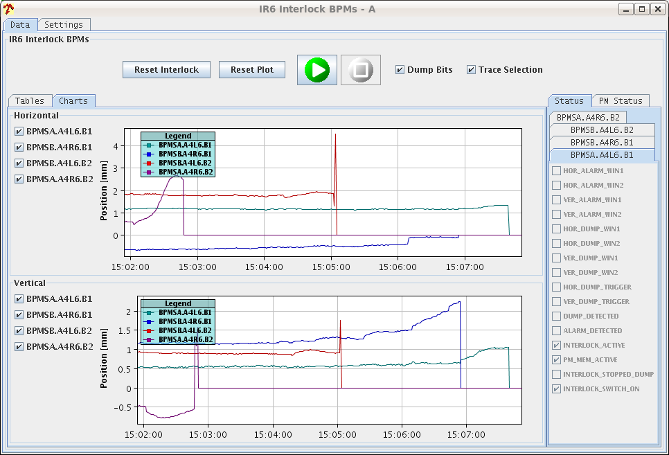
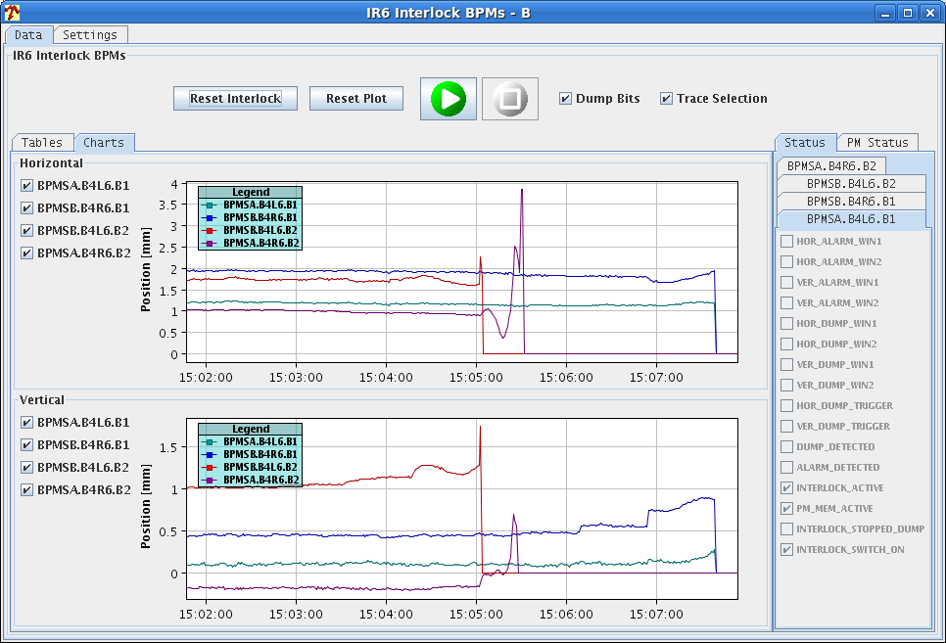
Interlock BPM Scraping Tests (Rhodri)
B1
2.3e10
B2
1.1e10
B1
2.3e10
B2
2.2e10
B2
6.2e10
B1
3.6e10
B2
2.2e10
Beam1 - everything looks fine, with limit at 3.6e10
Beam2 - attenuation levels for both BPMSA in 6R seem to be incorrect
One triggers too early (6e10 - level observed for dump Wed night)
One triggers too late (1.1e10 - i.e. can trigger on probes at injection)
Attenuation seems to have been increased on the wrong channel
either a mix-up in fibre-optic or cable distribution
Access needed to adjust attenuation & 1 hour with beam for re-verification

Slide 10
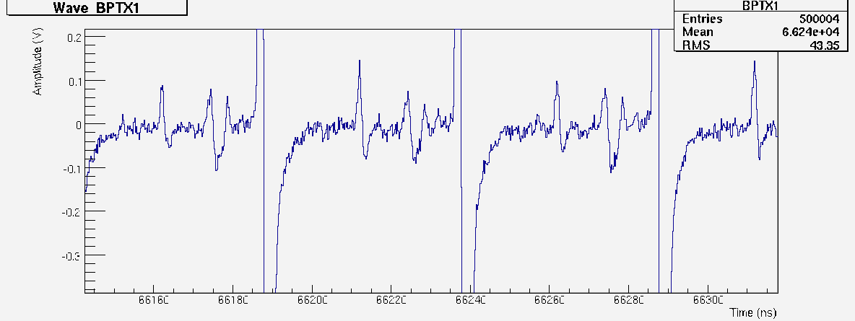
Fill 2568: 25ns-Satellites in Beam1
In fill 2568, we could clearly see 25ns-satellite bunches in beam 1 with the ATLAS-BPTX system:
from injection
in some batches up to the 5% of the main bunches
beam 2 is compatible with noise
main bunches (clipped)
25ns satellites
~5% of main
bunch
Cable reflection of the main bunches (ignore)

Slide 11
Satellite bunches seen by LDM
LDM bucket histograms for the last batch of B1 at 00:03 and 5:00. In the second fill during the night the satellites near the main bunch are a bit higher 1.6% vs. 0.76% before

Slide 12
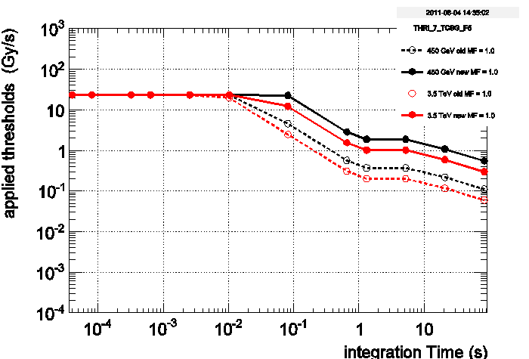
Increase BLM thresholds temporarily?
Longitudinal losses B1 at the start of the ramp up to 83% of BLM thresholds in IP3.
A detailed analysis and threshold change campaign should be done for IP3 – the same way as it is currently being worked on for IP7.
In the meantime:
Change the monitor factor from 0.1 to 0.2:
BLMQI.07R3.B2E30_MQ
Increase long running sum thresholds by a factor of 5 by moving to a different family:
BLMEI.05L3.B1I10_TCSG.5L3.B1
BLMEI.04R3.B1I10_TCSG.4R3.B1
This way TCLA will limit losses on B1 to approximately 3 times higher than during fill 2660:
BLMEI.05R3.B1I10_TCLA.A5R3.B1

Slide 13
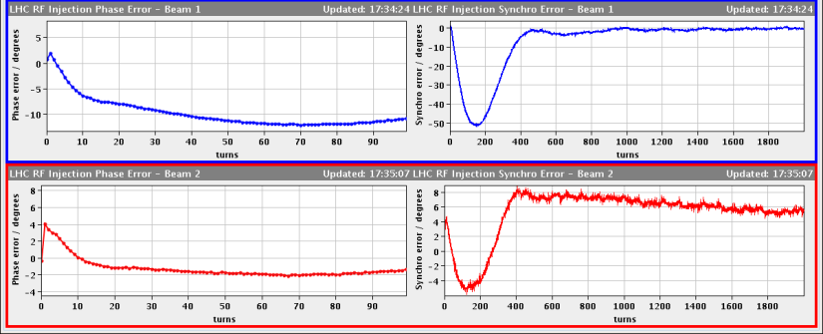
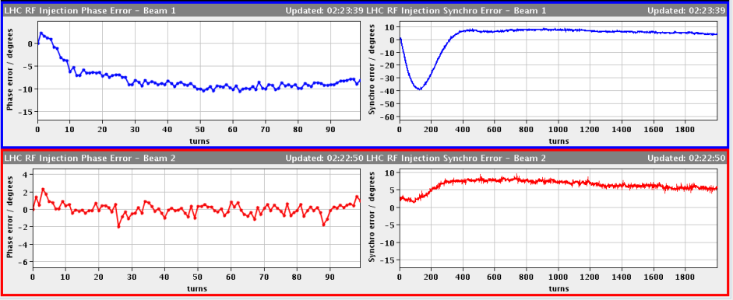
Capture Losses (Philippe)
Tolerance on max bunch length (SPS bqm) was relaxed:
From 1.65 ns (May 15), to 1.8 ns (May 17) and 1.85 ns (May 23)
Reason: increase of SPS longitudinal emittance with increasing bunch intensity (which was expected)
Fill 2657 (with the relaxed settings)
B1 energy error 1.2E-4 Dp/p, 14% of the 8.6E-4 bucket half height
BLM IP3 up to 49% of threshold
Fill 2658 (same relaxed settings)
Energy match B1 was improved before filling
0.5E-4 Dp/p, 6 % offset
BLM IP3 up to 35% of threshold
~doubling of abort gap population at the end of filling (before start ramp). Common to both rings.

Slide 14
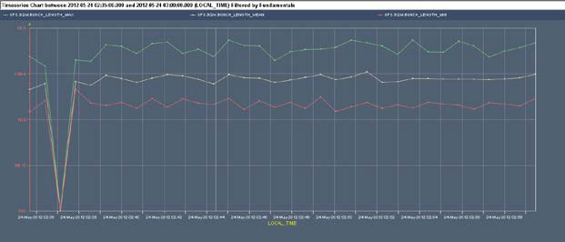
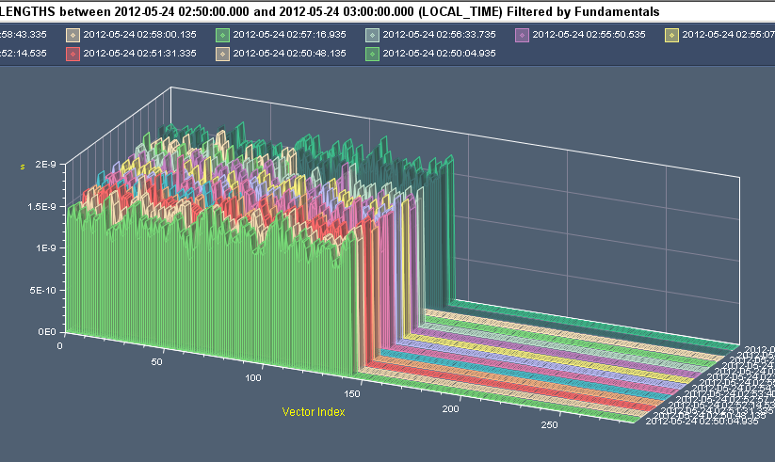
Capture losses cont. (Philippe)
Fill 2658 min, max and mean SPS bunch length
2E-9
1E-9

Slide 15
Capture Losses Conclusions (Philippe)
With the nominal (1.5 ns long) bunch we expect 0.6 % capture loss for 1E-4 Dp/p and 200 ps phase error (see LHC_RF.pdf).
The offset in energy can be further reduced by matching the two rings (calls for a fine-tuning of dipole correctors). This is not fully justified as we see similar capture losses in B1 and B2 while B2 is better matched. To be checked.
The dispersion in bunch length (and phase – not shown here) is a limitation in the SPS, related to the increased bunch intensity:
Keeping the tight max-bunch-length, there is no more injection…
Relaxing these to accept 1.85 ns long bunch result in more capture losses.
We are at the limit for capture with the nominal (1.5 ns long!) bunch. If we wish to keep working reliably at high bunch intensity (with some bunches 1.85 long and phase variation along the batch) we need a discussion including the injectors (at least SPS RF).

Slide 16
Capture Losses Options (Philippe)
Speed-up with the installation of the LHC longitudinal damper (being designed). This should damp injection errors with some (but reduced) efficiency for within batch phase variation
Spend time with AGC on after filling in pre-ramp segment. The side effect is transverse emittance growth but we could reduce that if we implement the longitudinal batch per batch blow-up at injection. I renew my demand
Improve the SPS RF: Better transient beam loading compensation of the 800 MHz is being designed. Operational end-run 2012
Relax the warning level on IP3 losses during ramp

Slide 17
Planning Ahead
Delivering luminosity…
Inverting octupole sign → No, not before next week
no IR8 “private” collisions over the week-end?
Others:
Strategy for intermittent TOTEM interlock for long weekend.
Follow up losses of uncaptured beam at start of ramp → Phillippe
Change channels of BPMS attenuators (1 hour access plus 1 hour testing afterwards)

Slide 18
Planning Ahead
Non-urgent work:
End of fill tune scan to optimize beam lifetime through tune WP.
RF: end of fill time to fine-adjust the tuners (with beam). 1-2 hours needed.
RF: Install the operational batch-per-batch blow-up… when possible. 1-2 hours at injection.
BI: Access for head-tail monitor in IR4. 1-2 hours.

Slide 19
END

Slide 22
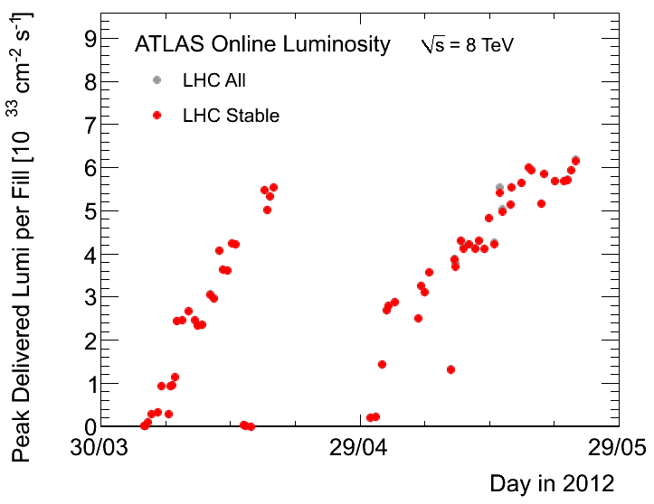
Atlas records …

