Slide 1
Sat 26.05.12
06:24 Fill 2669 stable beams, average bunch intensity 1.5e11, peak lumi: ~6.5e33 cm-2s-1.
14:37 Beams dumped by operation due to cryo problem.
Refrigeration unit (QURC) down in point 8.
Integrated lumi: 132 pb-1.
16:28 Access to US85 to reset the magnetic axle bearing of QURCB.
17:20 ALICE access (dipole and compensator had been ramped down before).
22:08 End of ALICE access.
Pressure rise in the triplet zone 7.4L1.X (no pump in the segment and triplet warming up).
Cryo recovery ongoing.

Slide 2
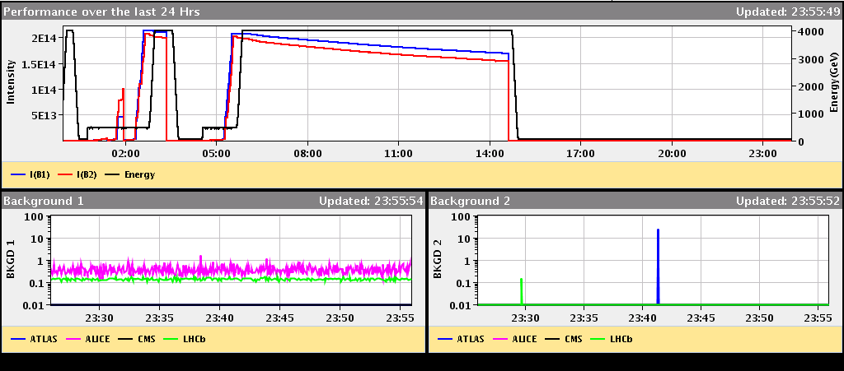
Saturday

Slide 3
Problems with Lumi Optimization
Used Optimize_All based on DIP signals. OK for IR1.
For IR5 we got hit again by the algorithm that ignores the optimum found:
While the scan takes place there is a natural decay of the luminosity but once the scan is finished the algorithm moves to the newly found optimum and checks the validity of this optimum by checking that the luminosity there is higher than at the starting point.
If the luminosity gain is very significant this is indeed the case and the algorithm stays at the optimum; if the luminosity gain is small enough and the natural decay is comparable or larger the legitimate optimum is rejected and the algorithm moves back to the starting point, thereby losing the small gain.
The algorithm should be changed to remove that last check.

Slide 4
Cryo Problem

Slide 5
Planning Ahead
Recovery from cryo fault
Access point 6 for change of cryo PLC?
Delivering luminosity…

