Slide 1
LHC Status Fri Morning 18-Mai
Bernhard Holzer, Jan Uythoven
Status yesterday morning

Slide 2
Fri Morning
... investigating IP8 situation and / or bunch losses
* separation in IP8 checked during night shift: ok
* crossing angle for the diagonal leveling checked,
based on BPM readings (at s = 22m)
hor: ≈ 0 μrad
vert. ≈100 μrad
* test run during the night: 84 bunches procedure to go into the
diagonal plane ok
* observation of losses / lifetime during the new set-up: ok

Slide 3
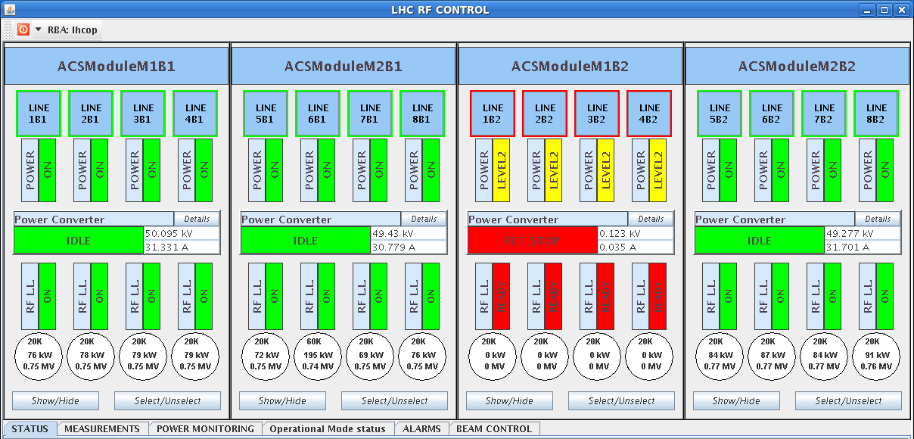
Fri Morning
07:26h beam dump, RF fault
... again
changed back the crowbar
ATLAS access in the shadow ...
Unfortunately one door is
mechanically closed but the contact is missing.
11:16h access story solved, pre-cycle, prepare injection
12:14h injection physics beam,
ramp, squeeze, adjust without problems.

Slide 4
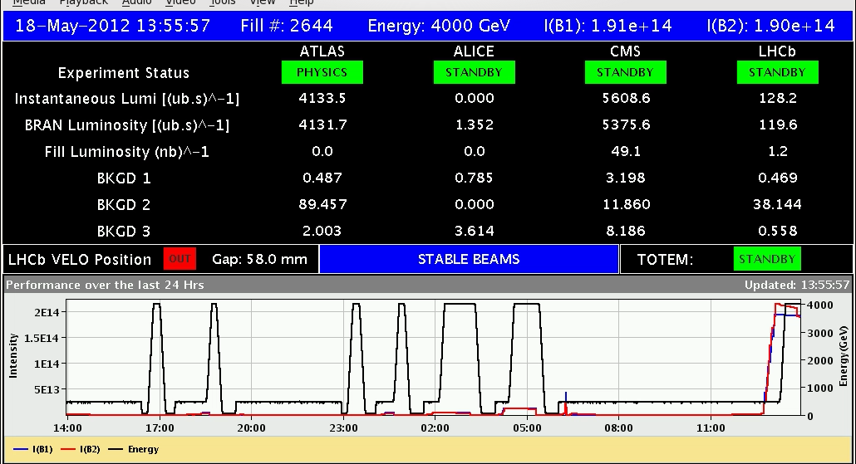
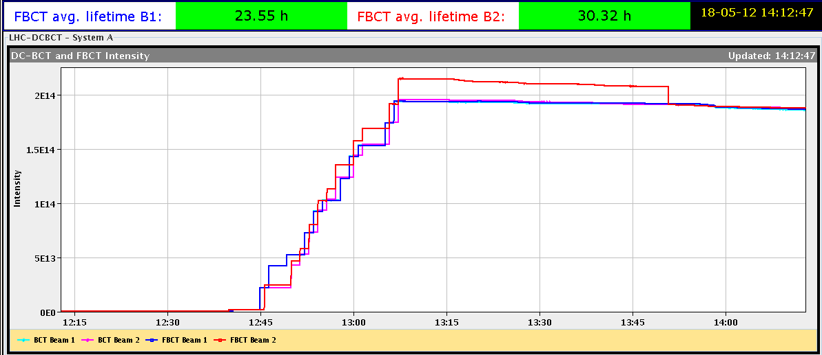
Fri Morning
13:56h stable beams
remark to confuse the experiments:
several steps to re-calibrate the beam current measurment of B2
please remember: it is just a measurement

Slide 5
Fri Morning
still: losses of single bunch intensities in the very first part of “stable beams”
careful analysis of the problem: one colleague in front of every relevant screen
* only losses in beam 1
* single bunch losses
... and only bunches affected that collide exclusively in IP8
* it happens AFTER adjust, i.e. in stable beam condition
* surprising emittance values

Slide 6
Fri Morning
emittances of beam 2: the healthy one
emittances of beam 1:
emittance measurments from BSRT monitor
nota bene: before going into collisions: everything looks ok !!
careful and preliminary conclusion:
the bunches that lost intensity are nit blown up (typical for instability)
but they are scraped !! possible in case of coherent oscillations

Slide 7
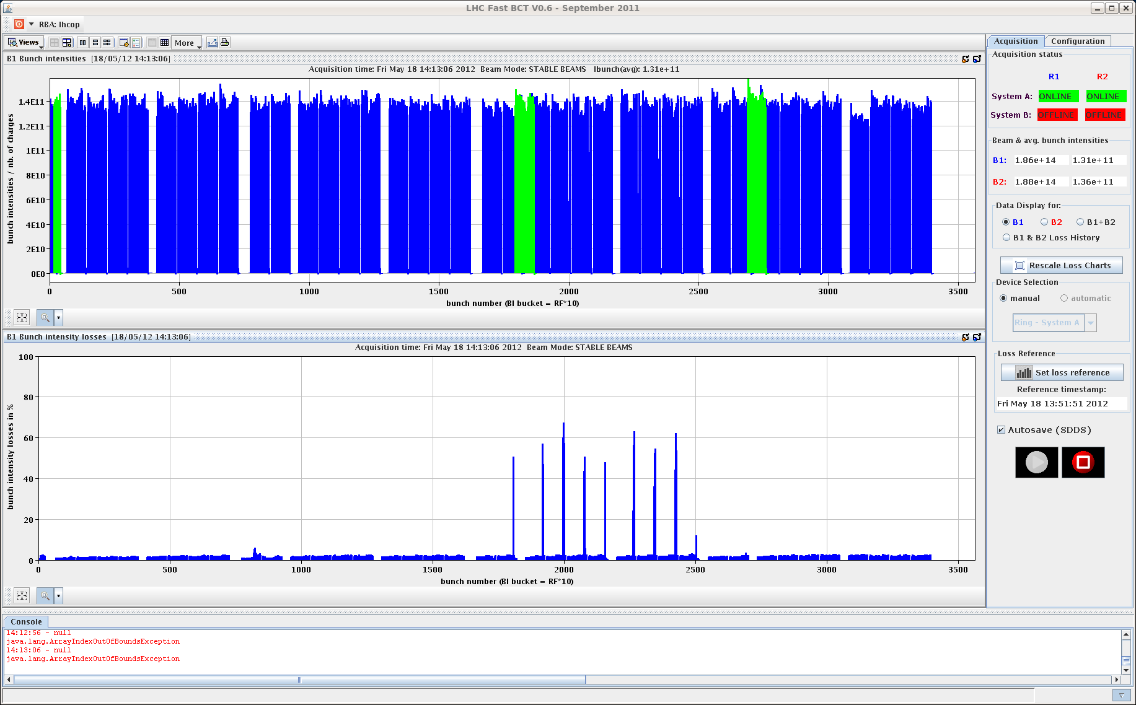
Fri Morning
losses quantitatively:
up to 60 %
but still good enough for a long fill
dump threshold due to BPM problem

Slide 8
Fri Late
all in all: a good fill
TLC optimisation ... freq shift of 5 Hz improved lifetimes,
global & local orbit correction etc

Slide 9
Fri Late / Night
19:45h
sudden drop in B1 bunch intensity for several bunches
02:05h new bunch emittance measurments ... ?

Slide 10
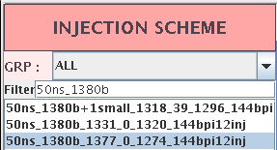
Fri Night
preparing for the next fill:
three options apply a tune shift before going into collisions
... in case the IP8 bunches only suffer
from a lack of tune shift
reduce bunch intensity to gain some margin
avoid IP8 collisions
avoid collisions in IP8 only
go back to LHCb positive
Created a new filling scheme to remove most of the bunches that collide in IP8 only

Slide 11
Fri Night
04:39h beam dump:
Interlocked BPM's fired on low-intensity/bunch count.
05:41h collimator problem
unable to load collimator energy thresholds at point 7.
Plan: lumi with new filling scheme

