Slide 1
Thursday 17th May
01:11 Fill #2633 dump in squeeze arc circulator load channel Ad1B
03:16 Fill #2644 Stable beams, lumi 5.2e33 cm-2s-1
04:38 Dumped by interlock on BPMS, loosing intensity on some bunches
06:48 Fill #2635 Stable beams, initial lumi 5.5e33 cm-2s-1
11:57 Dumped by interlock on BPMS, again one bunch b2 going unstable.
12:34 Error on the module H2B2 of the ADT.
14:15 Injecting beam for test ramp to find LHCb head on collisions
15:13 Injector chain down: POPS in PS
17:47 POPS back
18:30 Start ramp with 24 bunches per beam
18:38 Dump in ramp at 2.5 TeV due to SIS interlock. Not clear why.
RING_B2_PERMIT to false for a couple of seconds, without latching it.
19:32 Injecting probe
19:35 Collimator - BIS interlock in TI2, same as last days. Try to unblock.
22:09 Start access in TI2 to fix collimator - BIS problem.
loose connector on collimator crate side
22:56 Cycling the machine

Slide 2
Thursday to Friday night
00:40 On ramp RF Module M1B2: crowbar fired
01:53 Inject
02:38 Adjust beam process to optimise collision point in LHCb
03:09 Dump by operator
04:54 Optimise collision with 2 x 84 bunches
05:18 Dump by operator
06:29 Again RF the module M1B2: crowbar fired. Preparing access

Slide 3
Fill #2635
1.4e11 per bunch
Peak Lumi (Hz/ub):
ATLAS: 5564, CMS: 5627, LHCb: 412
Delivered Lumi
ATLAS: 78 pb^-1, CMS: 79.6 pb^-1, LHCb: 7.2 pb^-1
Lost because one bunch B2 going unstable, not following any action
B2 bunch 2091 suddenly being lost. This bunch is colliding in IP1, 5 and 8.

Slide 4
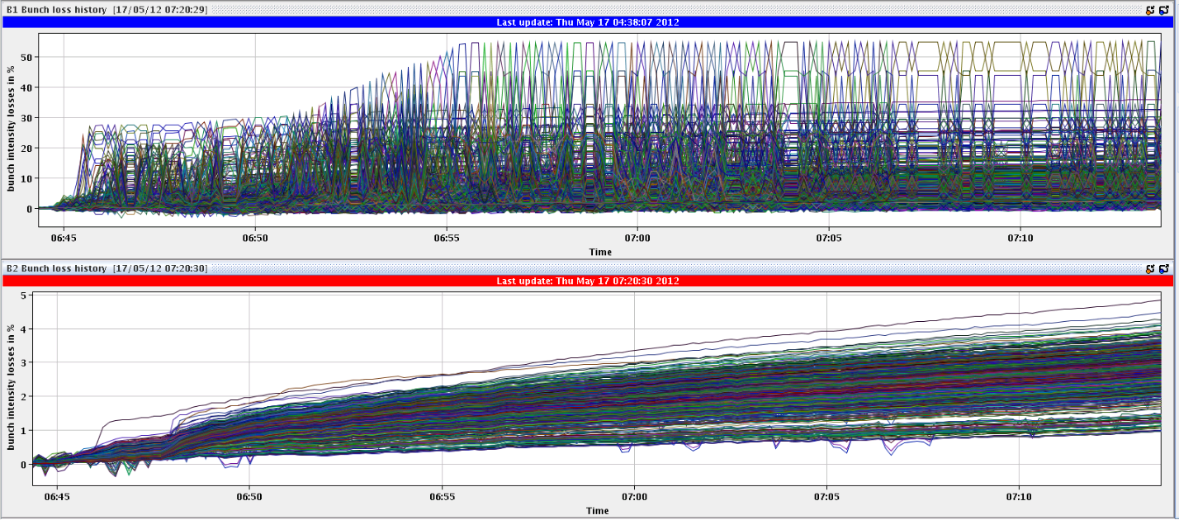
Problem since swapping LHCb polarity
Beam 1: losses of some bunches when bringing beam into collision
The bunch numbers are 2075,2077,2079, which are bunches with head-on collisions only in IP8
Beam 2: sudden loss of 1 or 2 bunches during the fill (see prev. Slide)
Adjust: blow-up and losses when beam going into collision
B1: 50 %
B2: 4 %

Slide 5
B1, Fill #2635
Bunch sitting at 6e10
BPMS IP6 will have bad readings below 4e10, so still ok for a while if following normal beam lifetime
If the single bunch B2 would not have gone unstable

Slide 6
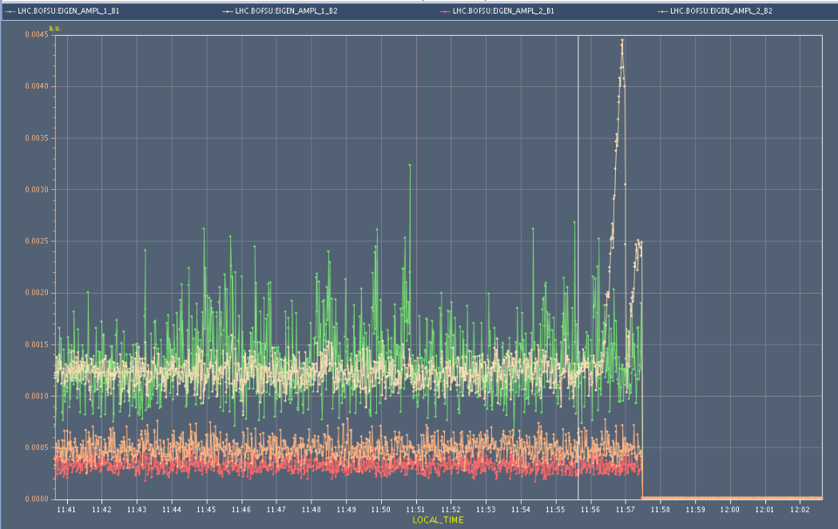
Fill 2635 going unstable
BBQ signal: B2 H was unstable and produced likely the loss
Similar instability seen for other fills lost on B2 BPMS
Fill 2632 B1 H going unstable
Fill 2634 B2 H

Slide 7
Understanding and Plan
LHCb set-up with negative polarity 2 weeks ago, right after the TS
Since then orbit trims – had to find the correct head-on collision in ATLAS and CMS
We have lost the correct head-on collision in LHCb
leading to strong parasitic beam-beam effects as separation between the two beams might be too small when going into collision
Plan is to perform test ramp with 2 x 48 bunches with collisions in IP1, 5 and 8 and find back the head on collisions with negative LHCb polarity

Slide 8
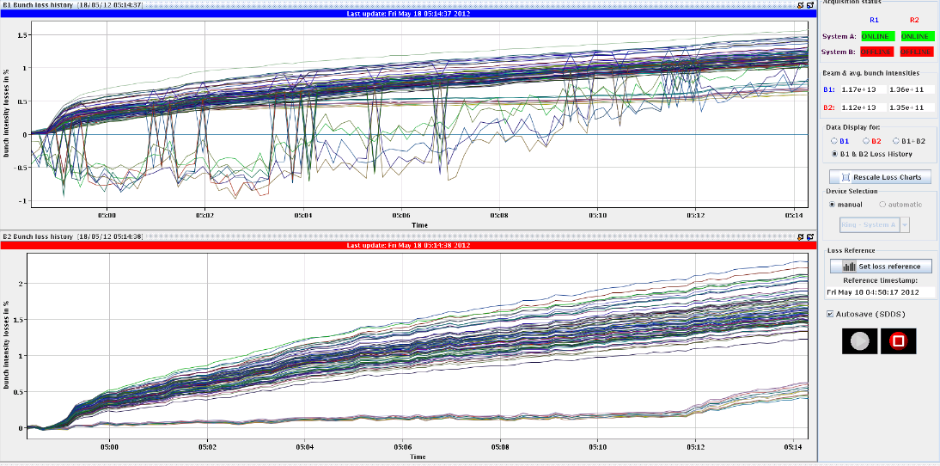
LHCb collision point
Fill with 2 x 24 bunches
It seems we go through collision during the collision BP in IP8.
To find the lumi in IP8, we moved in the crossing plane by +100 um and in the separation by +200um. Beams were separated more than expected.
Lumi scan
+29 um in crossing, +74um in separation.
Added fill with 84 bunches mainly colliding in IP8
To be sure that changes are not affecting orbit near TCT collimators
To be sure one ends up with about lumi of 50 at end of the collision process
All looks fine, so far…

Slide 9
RF (Philippe & Co.)
13:56 RF coupler control fixed.
Most likely explained the abort population during the previous fill.
Bunch-Length-Mean growth rate at injection B1.
It is (likely) related to the energy (frequency) match at injection,
Should not be harmful
During night: crowbar problem B2 back

Slide 10
Plan
Fix RF crowbar problem
Previously attributed to HV cable between power supply and klystron
Fill with 2 x 1380 bunches

