Slide 1
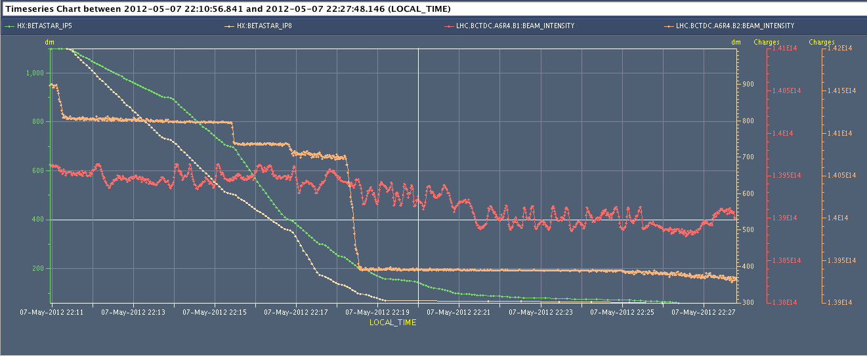
Squeeze 2596
1.3 x 10¹² in 20 s i.e. around 45 kW
Note: squeeze in Atlas, CMS, LHCb and Alice on going

Slide 2
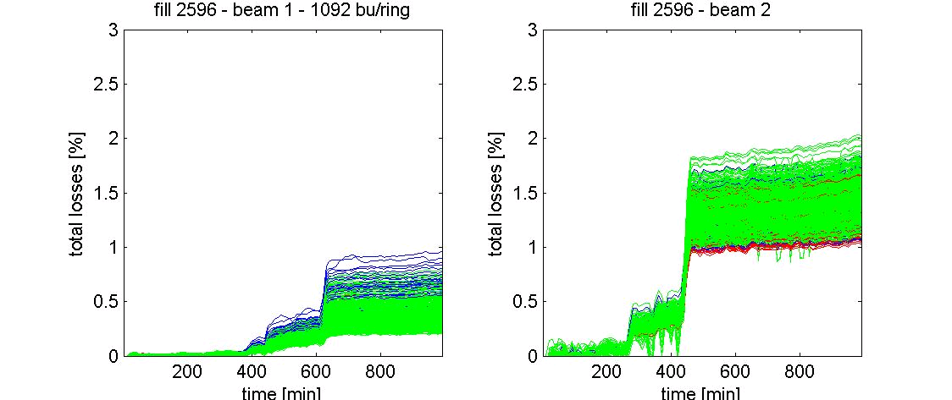
Squeeze 2596
Giulia Papotti

Slide 3
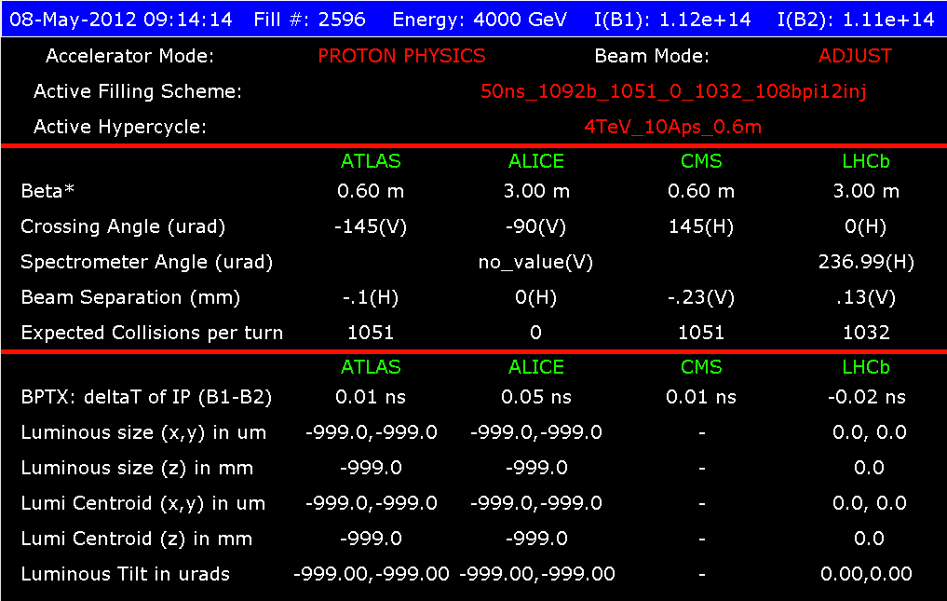
Tuesday 8th April - morning
09:15 EOF: RF (Philippe) changed the phase of R2 wrt R1 by 15 degrees (corresponds to a shift of 15 mm longitudinal displacement)

Slide 4
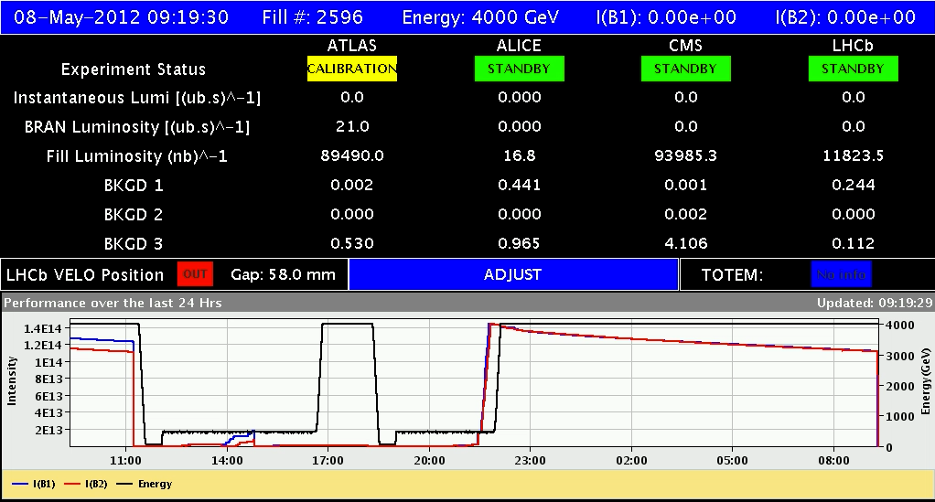
Tuesday 8th April - morning
09:19 Fill 2569 dumped ~90 pb⁻¹
Initial lumi 3.6e33 cm⁻²s⁻¹
1.27e11 ppb, emit ~2.4 - 2.5 microns

Slide 5
Tuesday 8th April - morning
To 10:30 Usual problems with TDI
After 6 or 7 cycles, we still don't manage to put the TDI.R8 in place, right jaw up is still out of limits for a few um. Changed position thresholds by 50 micorns
11:00 Beam in
FBCT-A system calibrated for probes (by D. Belohrad)
Loss at injection
11:40 mastership back to SPS to check scraping and bunch length
12:25 injecting physics beam again – better
13:15 trip of the RQTL11.L5B1 – access required

Slide 6
Tuesday 8th April - afternoon
14:20 Access
Access to PM56 (RP & EPC) - power module was changed
E.Calvo has sent a colleague to P6 to intervene on the interlocked BPMS right of IR6 (B2) . increase the attenuation on both planes for the BPMS.BR6.B2.
LHCb in access with delegation
BLM threshold adjustment
17:35 BPMS requalification
18:40 filling for physics curtailed by PSB power supply problem R3
Emittance blow-up at 450 GeV measured with 12 b
21:00 Re-injecting

Slide 7
BLM thresholds
As discussed this morning in the rMPP concerning 4 MQYs in IP6 cell 4 and 5 position 1 after the TCSGs:
Changed the BLM monitor factor from 0.1 to 0.2 on
BLMQI.04L6.B2I10_MQY,
BLMQI.05L6.B2I10_MQY,
BLMQI.04R6.B1E10_MQY,
BLMQI.05R6.B1E10_MQY
due to leakage losses from IP7 to L6 TCSG.
Barbara Holzer

Slide 8
Tuesday evening
21:00 Filling – nice and clean
Squeeze a lot cleaner
IR 6 not showing up in BLM warnings between 2.5 & 2 m
Limited to
22:01 Beam lost at very end of collision BP
Beam goes unstable – B1 H - rise time ~2 seconds
23:15 Lost cold compressor for sector 7-8.
Access in UX85 through US85 to fix heater on interconnection box - will allow faster recovery when the compressor is back.

Slide 9
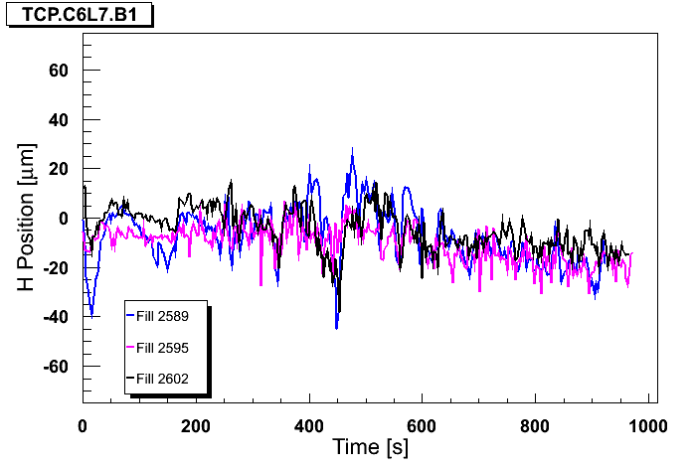
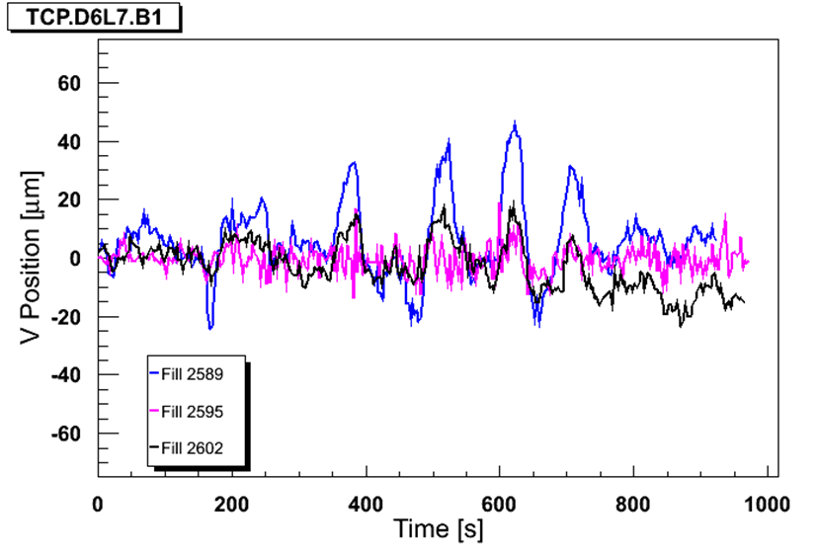
Orbit FF – squeeze – beam 1
Jorg Wenninger
Ralph Steinhagen
Sigma H at TCP ~300 microns
TCP ~5.1 sigma

Slide 10
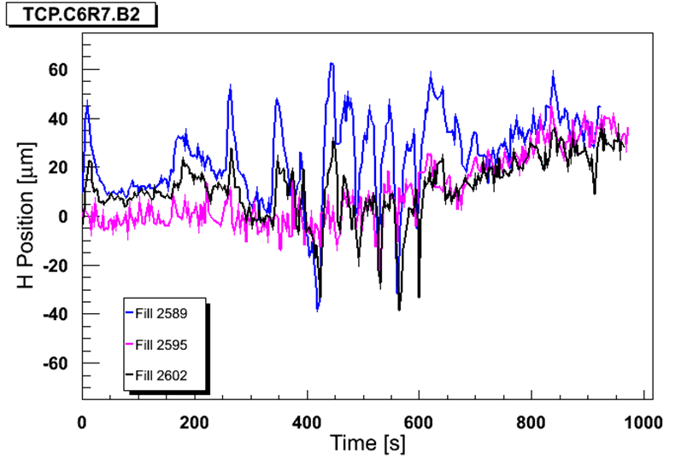
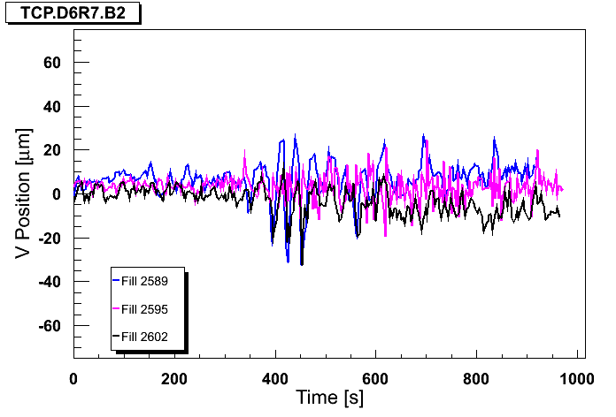
Orbit FF – squeeze – beam 2

Slide 11
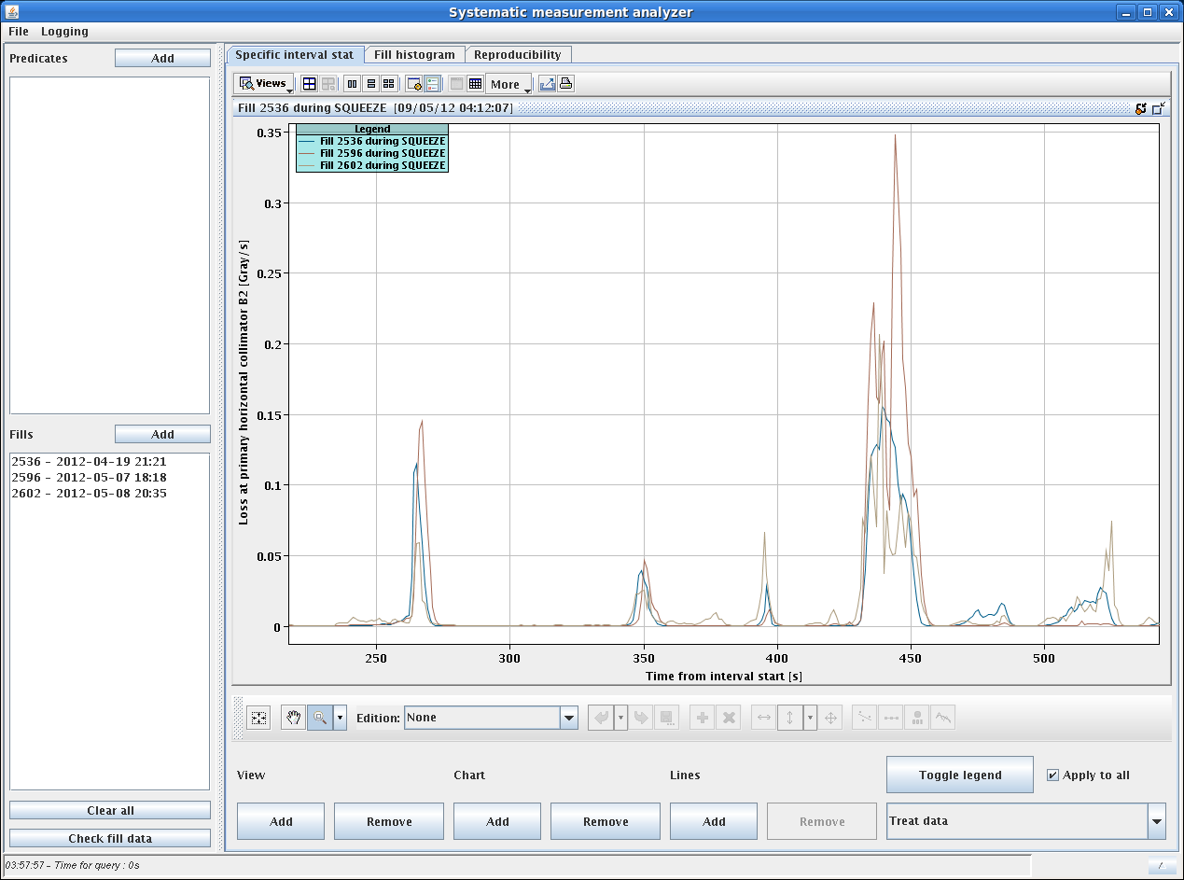
Losses in squeeze at TCP

Slide 12
Orbit FF

Slide 13
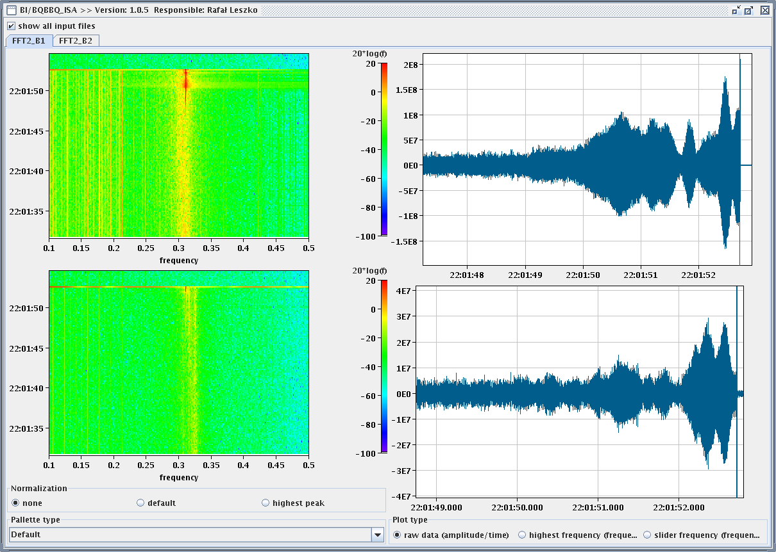
Instability – B1 H

Slide 14
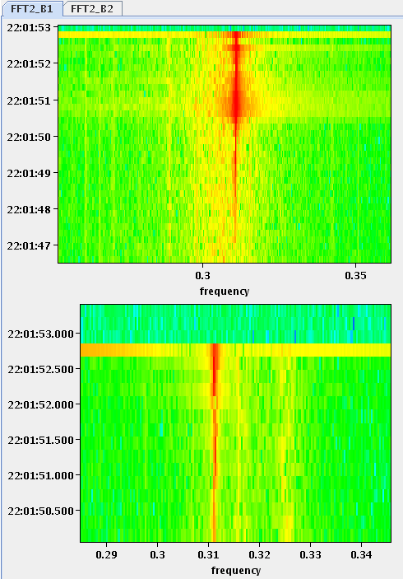
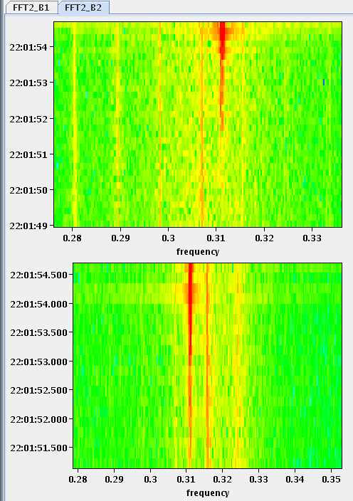
Instability

Slide 15
Recent actions v. losses
Scraping optimization SPS
Injection optimization
TDI measurement at warm to do
Transverse damper modulation off
Collimator set-up at top energy checked
BLM thresholds tweak and more general discussion started (rMPP)
OFB higher bandwidth in squeeze and feed-forwarded

Slide 16
Today
Recover from cold compressor stop ~midday
Increase TFB going into collisions (following analysis – Wolfgang Hofle)
(Increase LD octupoles)
1380

Slide 17
Misc
Both occasions while preparing the machine for injection the BLM sanity check failed 2 times.
The CMW on the OFSU server was down; Ralph restarted it and said it's an unknown already experienced cause, it will be investigated tomorrow.
One of the RB.A12 quench detector crashed during injection (we lost the QPS OK) but reset itself and went back to the right status.

