Slide 1
Saturday
Cryo recovery 78.
Optics tests in the shadow (for next MDs).
High-beta re-checked to 1km – OK , no PC trips.
ATS checked to 0.1 m – OK, no PC trips. A few PCs in 78 that participate in the ATS part of the squeeze (< 0.4 m) could not be tested, but not expected to be the critical ones.

Slide 2
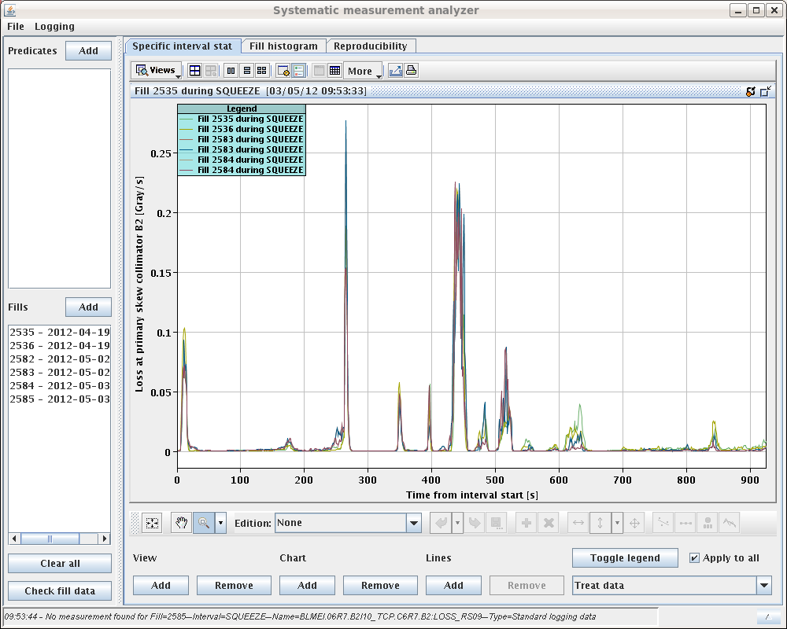
Losses in squeeze
Qualitatively similar before and after TS.
M: Losses at/close to a matched point.
I : Losses between matched points.
M
I
2.5m →2m (I/5)
I
I
M
M
I
M

Slide 3
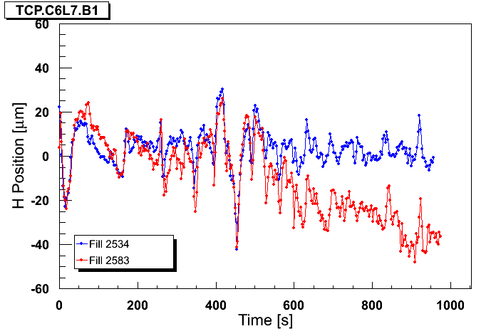
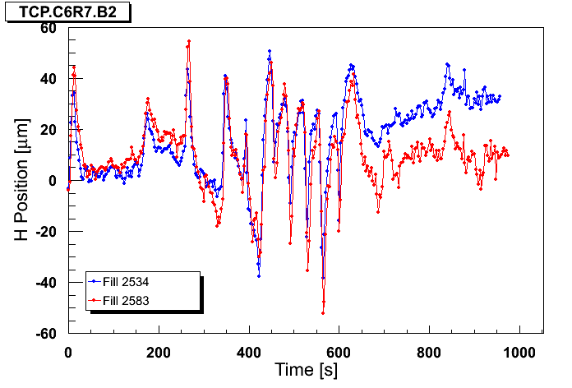
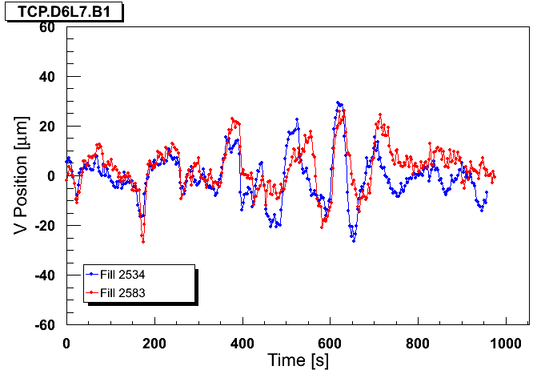
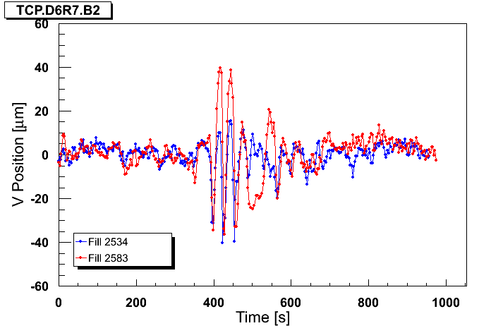
TS function cleaning
Blue : ref fill before TS1, Red : fill after TS1
B1H
B2H
B1V
B2V

Slide 4
Orbit
B2: Losses and H TCP orbit well correlated

Slide 5
Orbit
Losses and H TCP orbit better correlated

Slide 6
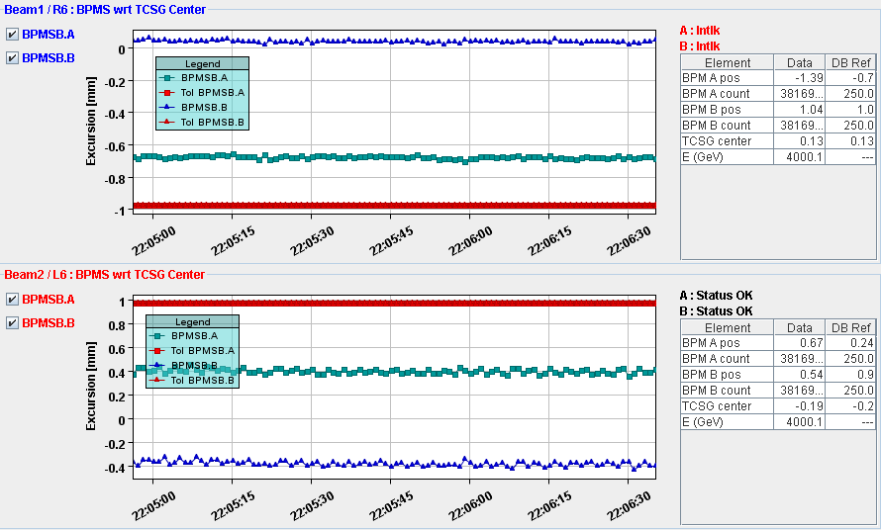
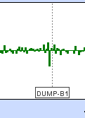
Interlock BPMs in IR6
SIS interlock TCDQ/TCSG – beam ‘worry’.
One BPM B1 has developed large offset.

Slide 7
Transient beta-beat
Transient beta-beat (from the model !!) too small to explain losses – 2% only (and not at right time).
Beta versus squeeze time for BPM close to TCP B2.
β_{x} (m)
β_{y} (m)

