Slide 1
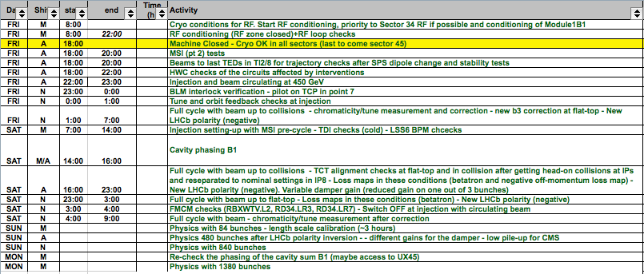
LHC Status Sat Morning 28-April
Gianluigi Arduini, Bernhard Holzer
Restart after Technical Stop:
tentative plan ... as discussed Fri Morning

Slide 2
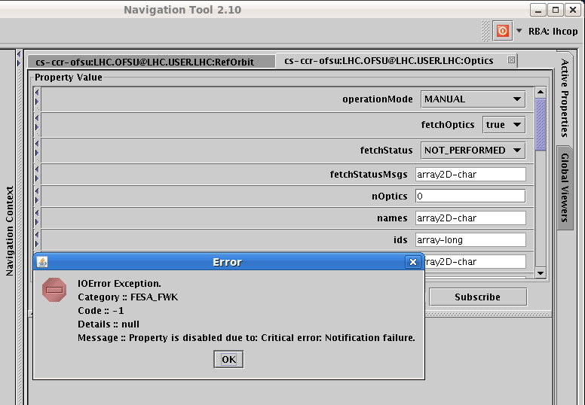
Fri Morning / Late
16:14h Error during the fetch optics again on OFSU,
had to restart the OFSULHC_M process
The OFSU server has been restarted and is working correctly for now. The problem we were experiencing with non responding 'Optics' property is by far not trivial and has to do with Real Time behaviour of OFSU Fesa server. An occasional overload of resources takes place, so that the Communication part of FESA, does not get time to service its notification/get queues.

Slide 3
Fri Late
15:53 LHCb set to “Negative”
16:00 ROF.A81.B2 back in operation
18:00 RP reported that RAMSES monitoring stations are not fully operational.
After the RAMSES system upgrade (started on wednesday),
the monitoring stations are not able to send measured values to be logged
the RP montoring devices are partially blocked and need to be manually rebooted.
18:00 Problem with ATLAS Toroid: power converter recieved an external fault.
...... The Beam Imminent Warning failed had to clear the interlock several times
22:38 Technical Stop now finished ....

Slide 4
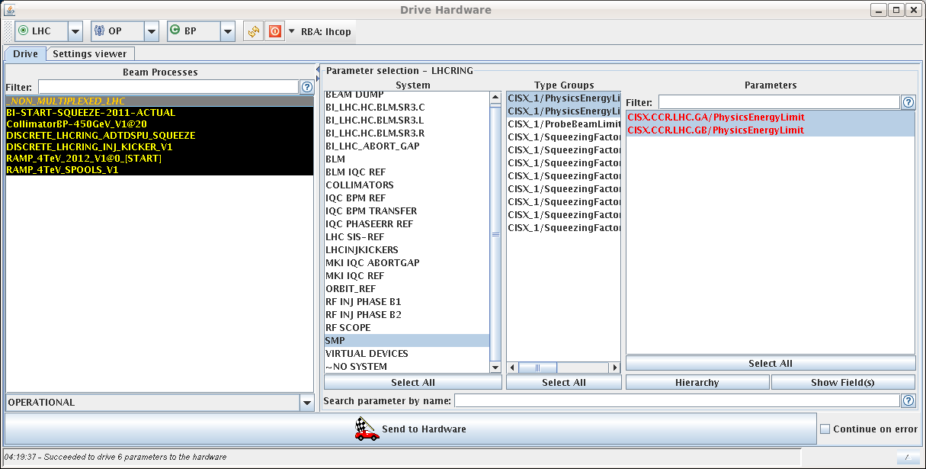
Fri Night
23:45h RBXWTV.L2 tripped (i.e. ALICE compensator)
... it seems as if the water valves on the ALICE compensator were closed.
00:35h RQX.L5 tripped during test-cycle
01:35h DIP-handshake communication problem
... solved via “Chris must have restarted something....”
02:52h problem with loading the ramp functions for the spools: all RCDs have a ref mismatch fault.
03:22h exception for RCBV28.L8B1
04:20h Error during MCS checks
with PHYSICS energy lower/upper.

Slide 5
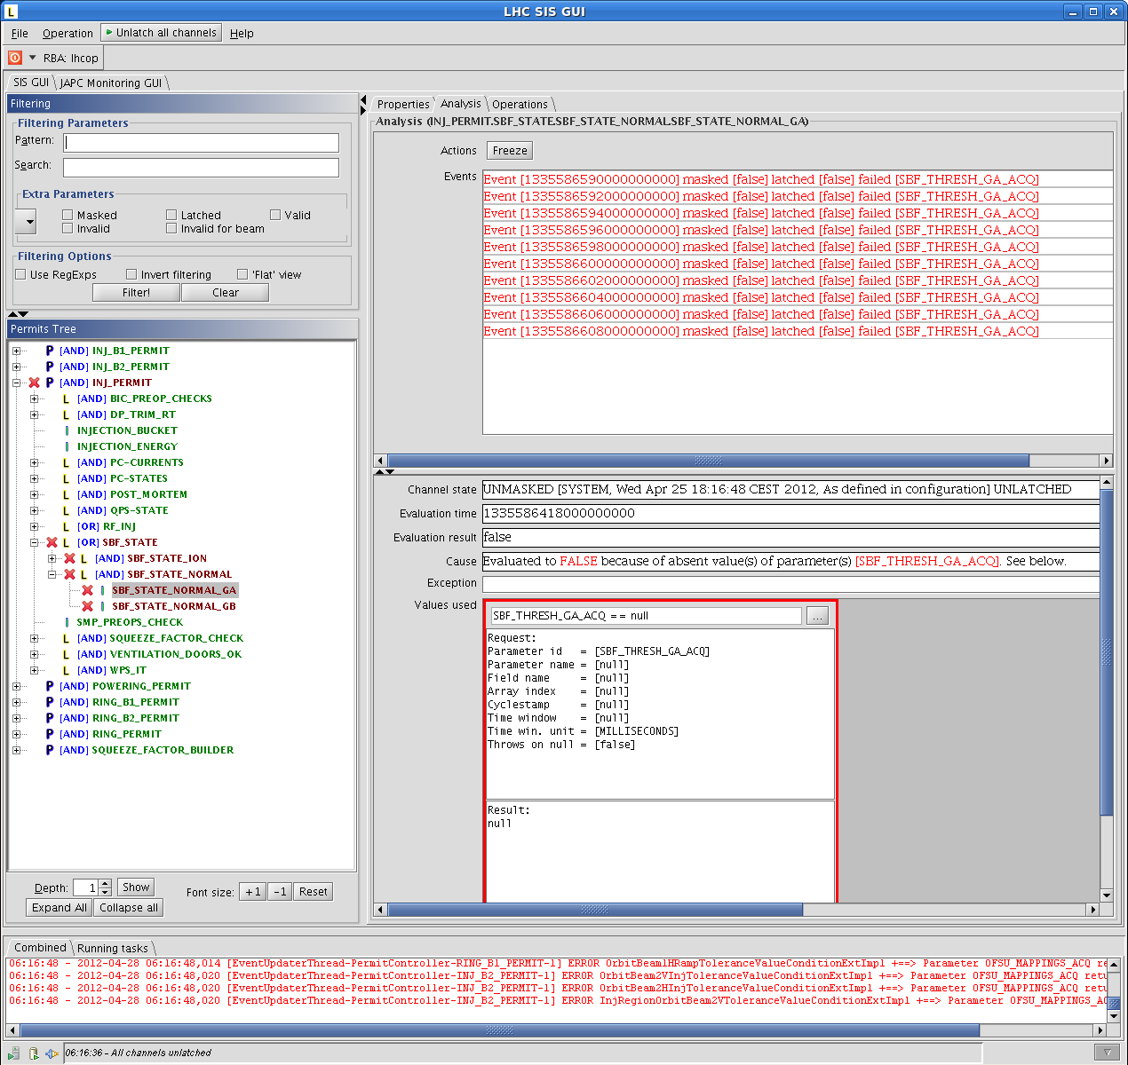
Fri Night
04:20h BLM sanity check failed with exception
06:05h We have SIS interlocks SBF_STATE_NORMAL and SBF_STATE_ION ...
Joerg has changed the comparison time window

Slide 6
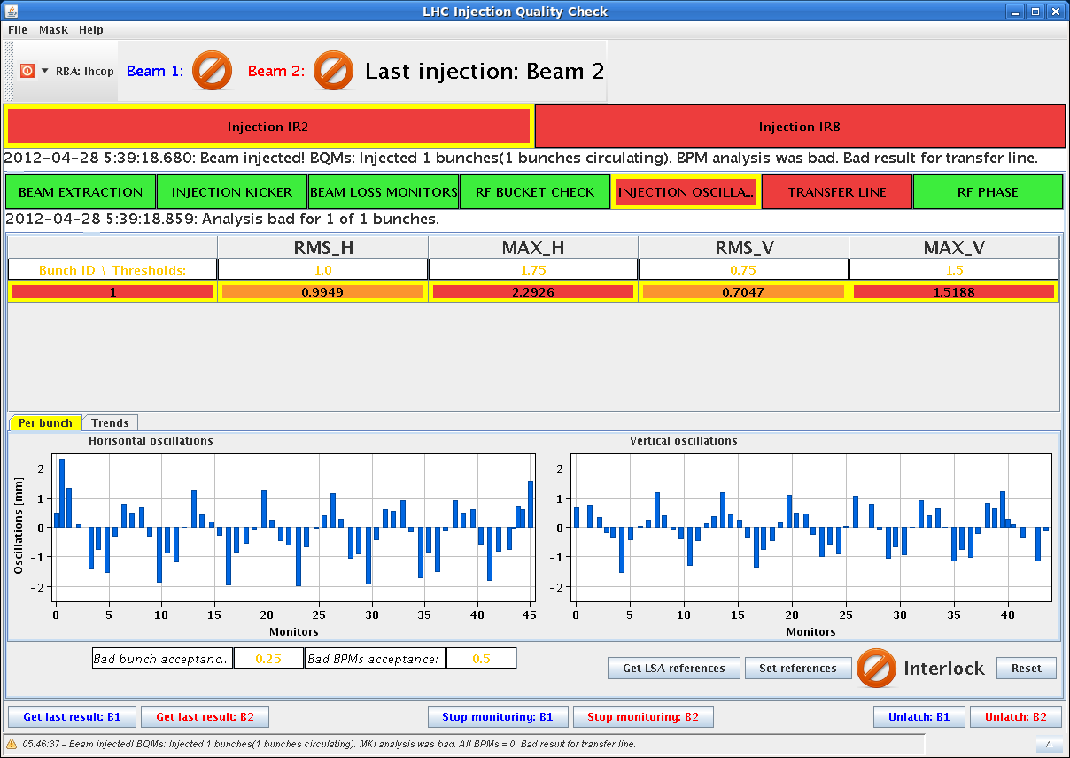
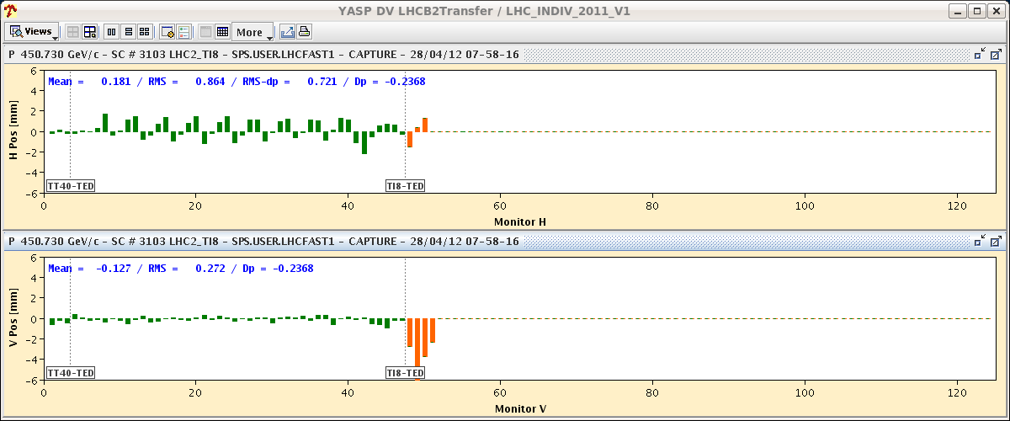
Sat Morning
05:40h FINALLY !!!
B1 probe injected
but high injection oscillations
B2 dumped right at the injection
too high injection oscillations.
Oscillation beam 2 H starting in the arc of TI 8 ...

Slide 7
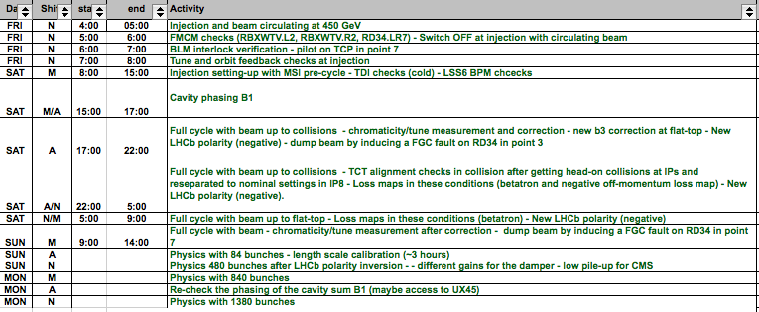
LHC Status Sat Morning 28-April
Gianluigi Arduini, Bernhard Holzer
Restart: tentative plan ... updated
basically we are here ...

