Slide 1
Tuesday 17th April
04:00 Prepare second fill for v/d Meer scans.
06:22 Stable beams, v/d Meer scans for Alice and LHCb.
13:20 End v/d Meer scans.Dump beam.
14:30 Injecting pilot, prepare for abort gap cleaning tests.
15:15 No beam from SPS
16:00 Injecting for abort gap cleaning tests at 4 TeV
19:36 AGC tests finished. Dump beams.
19:40 Ramp down and access for CMS
21:40 End of CMS access
22:00 Start injection steering
02:00 2 x 1380 bunches injected – start ramp
02:45 During collision process, vacuum spike on VGPB.219.1R8 at 1.8E-7, valves closure
04:01 Injection kicker timing problems B2, Injection pre-pulse shifted, causing BETS to inhibit beam injection. 144 bunches on TDI.

Slide 2
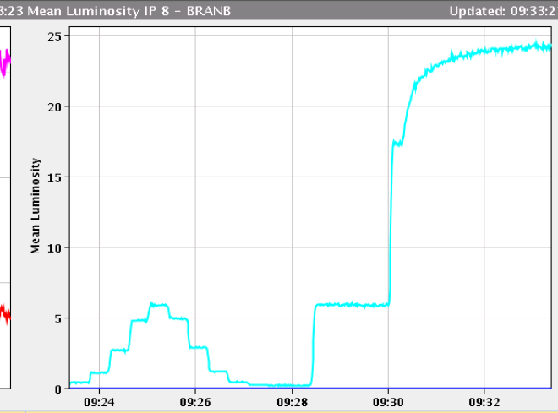
v/d Meer scans for Alice and LHCb
SMOG in LHCb
BRAN sees increased rates.
Full program of scans for LHCb
- X' scan with 31 steps - X scan, 29 steps - Y, 29x11um - Y', 29x11um "Fast" length scale calibration - X,Y, 15x11um - X, 15x11um with offset in Y by 98 um, and vice versa
Here prime stands for the tilted axis
Then we switched ON SMOG and made - X',Y' 15x11um to measure the movements in the tilted plane and check the orthogonality of X' and Y'.

Slide 3
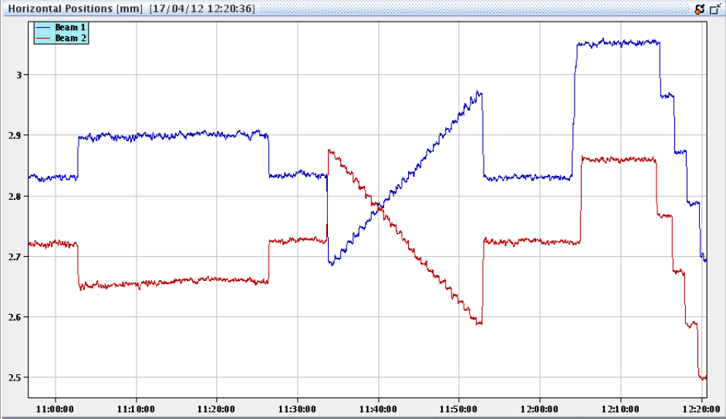
v/d Meer scans
Summary of ALICE scan: X scan Y scan Y scan with 1.5 Cap_sigma offset in X X scan with 1.5 Cap_sigma offset in Y LSC à la LHCB (1 sigma_beam separation), in X and Y Fast Y scan with -1 Cap_sigma offset in X Fast X scan with -1 Cap_sigma offset in Y

Slide 4
Abort Gap Cleaning @ 4 TeV with collisions
The cleaning is working as expected, using the new 'abort gap check interface' to switch on/off the cleaning and adapt the strength of the cleaning.
The BLM display part of the 'abort gap check' application does not seem to work
Use normal BLM fixed display for the moment
Highest loss in % of dump threshold during cleaning occurred on TCLA.B6L7.B2.
The effect on luminosity of the cleaning is found back, like last year.
Needed to use longitudinal blow-up to have significant abort gap population. Reducing the RF voltage to 5 MV was not sufficiently low
Big Sister announcement seems to work for B1, but not clear about the ‘precision’. Nothing B2.
BSRA for B1 has some channels close to bunch 1 reading high also when no population expected.
Cleaning in collision can be used with the application
- Some brush up of applications required

Slide 5
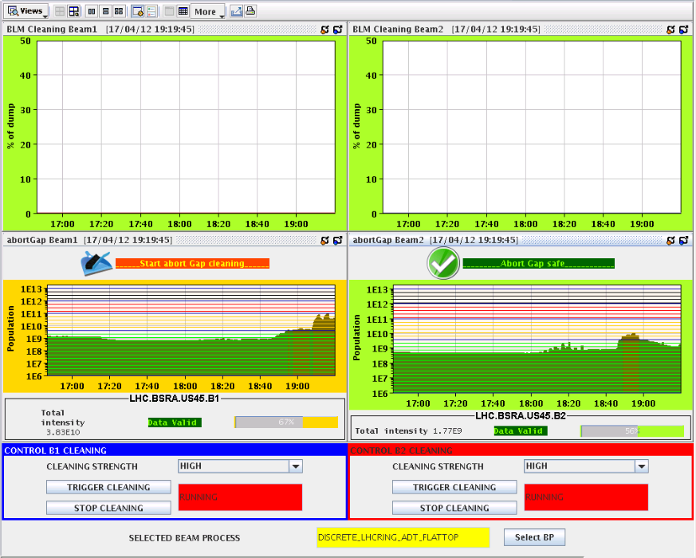
Cleaning application
BLM part stays blank

Slide 6
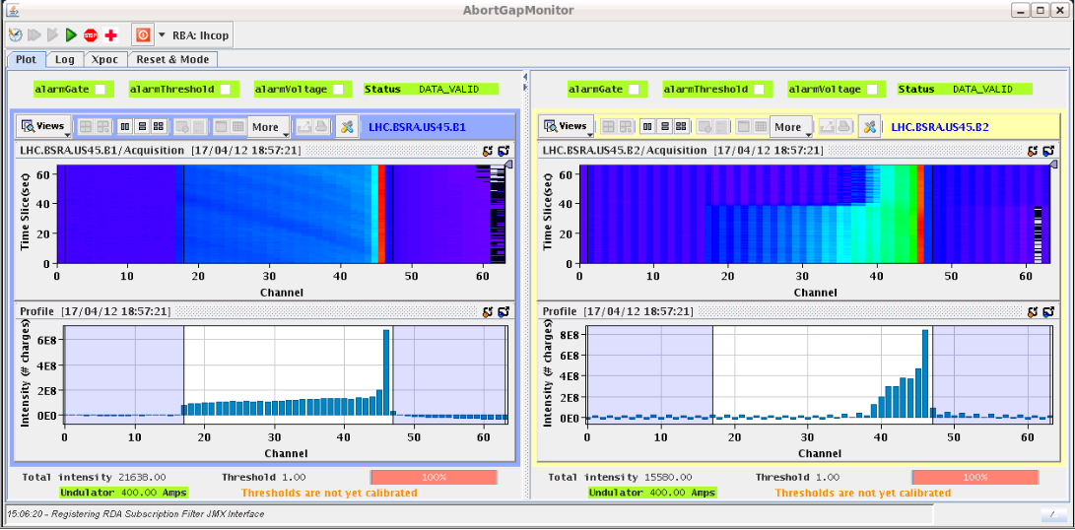
Cleaning the Abort Gap

Slide 7
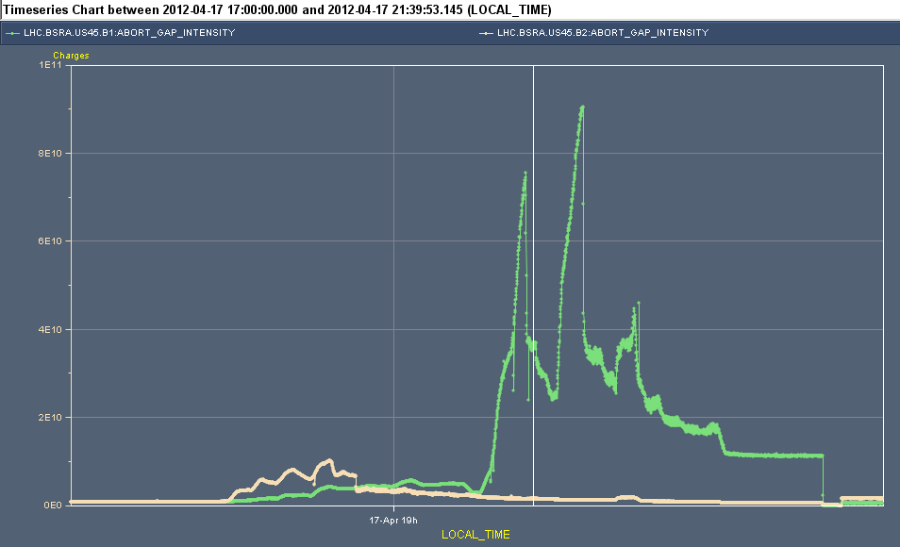
Abort gap population up to 9e10 p+ for B1

Slide 8
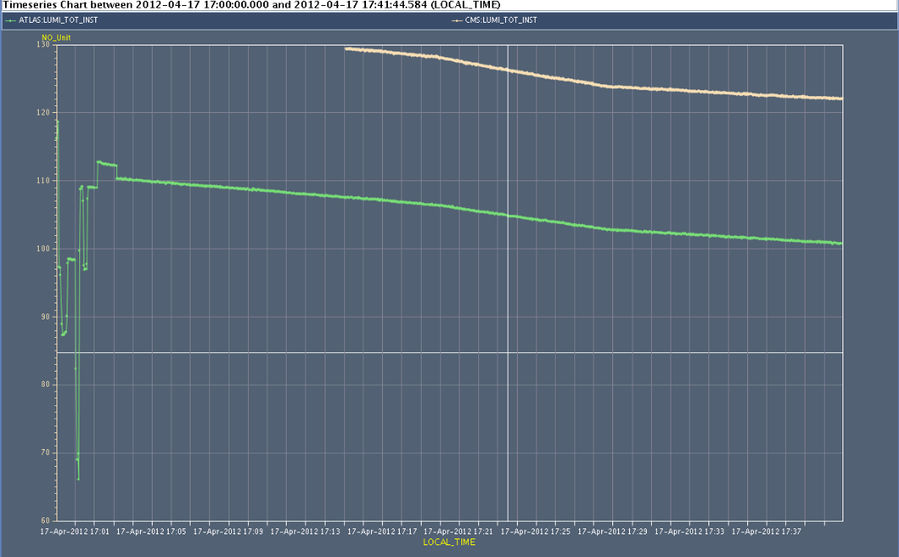
Atlas and CMS lumi’s
Effect of cleaning on luminosity
Cleaning off

Slide 9
Injection of 144 bunches
******* injection of 144 bunches *********** - Very clean injection for B2 (losses at the level 0f few %) - Problematic for B1: - big shot-to-shot trajectory and loss variation (at BPM 29004 from -500 to -1100 um) - Difficult to steer (no significant change in the sensitive region) - We did not switch off and on the MSI (trajectory during setup with 12 bunches similar to what we had during the 108 bunches injection setup) - TCDI settings to be revisited (now at 4.5 sigma in both lines)

Slide 10
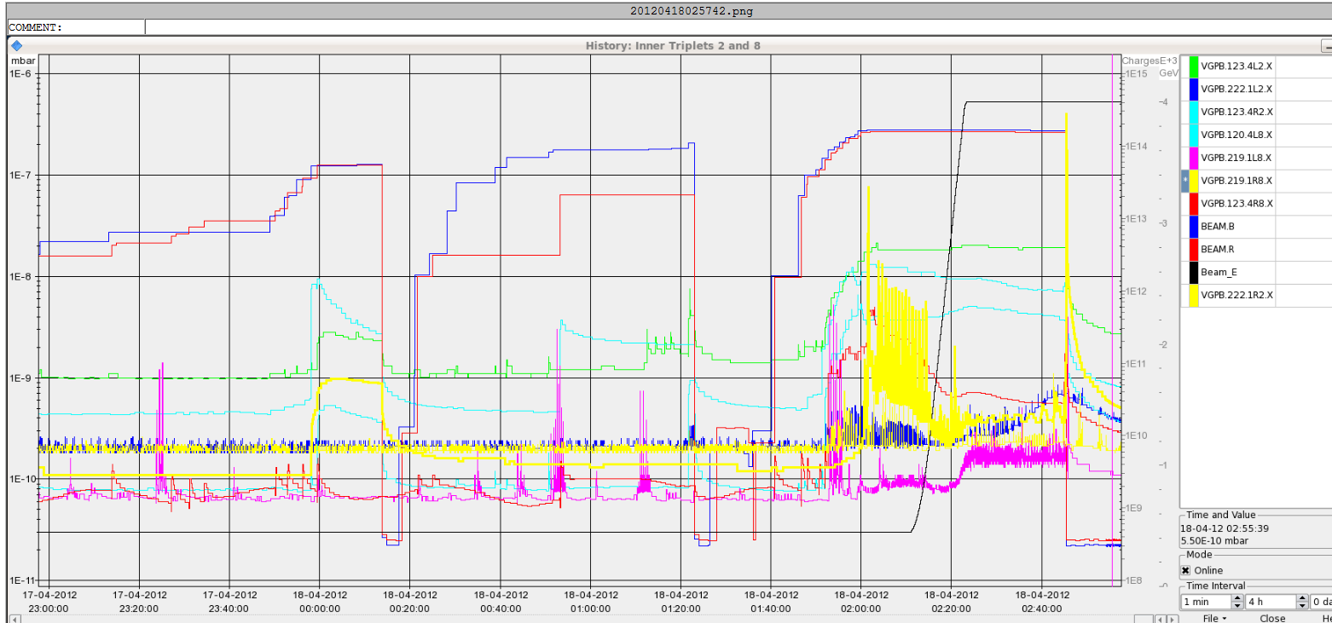
1380 bunches
In the middles of collision beam process we had a beam dump due to a vacuum spike in 1R8 that provoked valve closure
Vacuum spike VGPB.219.1R8 at 1.8E-7

Slide 11
Injection kicker problem B2
Injection kicker problems, Injection pre-pulse shifted, causing BETS to inihibit beam injection
144 bunches on the TDI
As beam to the core of TDI, not grazing, no magnet quenches
During tests the inhibition re-appeared
Being sorted out between kicker and RF specialists

Slide 12
The Plan
Wed Sort out problem injection kicker / RF pre-pulse
Wed – Thu Physics with 1380b
Fri 06:00 Start of LHC MD #1
Mon 06:00 Start of LHC technical stop

Slide 13
2012 MD#1 Draft 1
Fri
06:00 – 07:00: end of fill study (tune scan, levelling, …)
09:00 – 12:00: 450 GeV: Longitudinal impedance
12:00 – 18:00: 450 GeV → 4 TeV: ADT (incl. fast blow-up test)
20:00 – 02:00: 450 GeV: BI (FBCT and BPM’s)
Sat
04:00 – 12:00: 450 GeV → 4 TeV: Collimation
14:00 – 22:00: 450 GeV: Injection: beam loss limitations towards nominal intensity
00:00 – 08:00: 450 GeV → 4 TeV: Aperture at the triplets
Sun
10:00 – 18:00: 450 GeV: RF batch by batch blow-up
18:00 – 23:00: 450 GeV → 4 TeV: BI (emittance cross calibration with ADT blowup)
01:00 – 06:00: 450 GeV → 4 TeV: ADT (tune compatibility)

