Slide 1
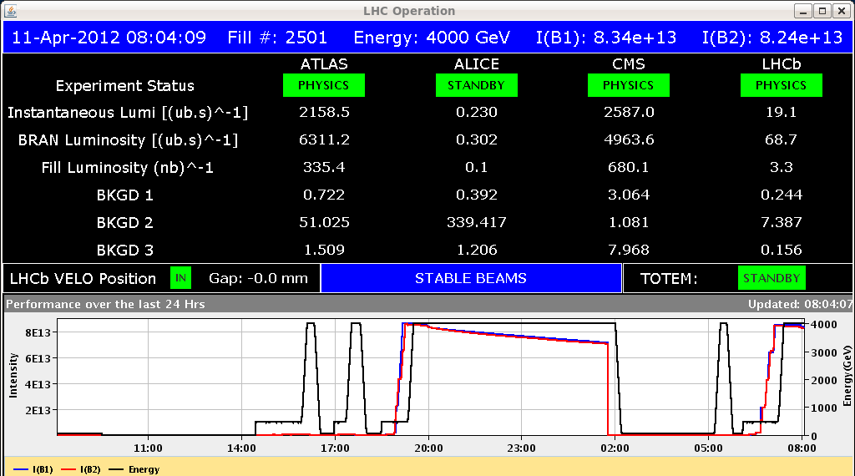
LHC Status Thu Morning 12-April
Bernhard Holzer, Mike Lamont
Reminder:
08:00h Stable beams
... at the end of squeeze, we trimmed the Qv of +0.003 for both beams
-> reduced loses during the
collision procedure

Slide 2
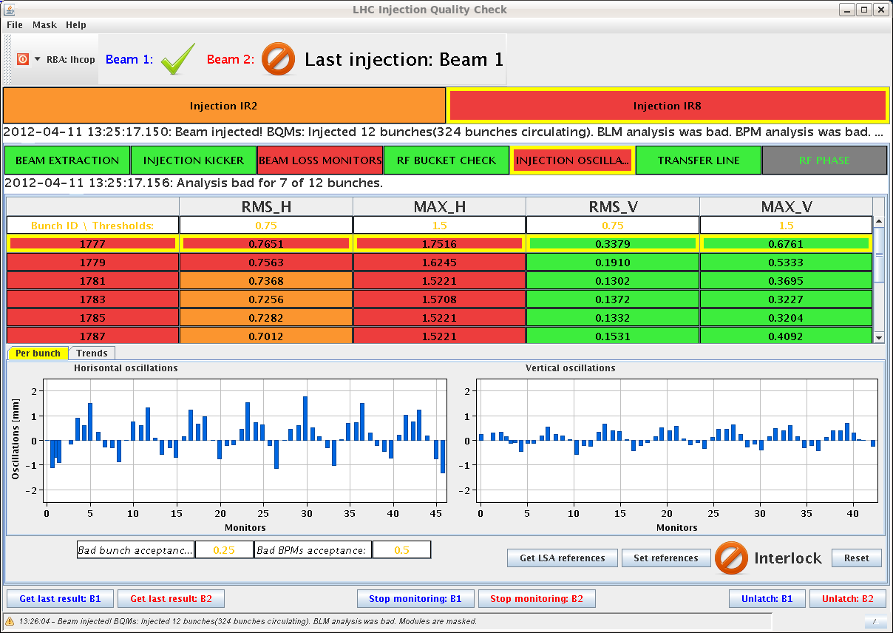
Wed Morning
10:44h Beam Dump: CMS BCM signal went over threshold due to a power supply
spike of 1 channel.
... channel masked.
12:24h Remark OFSU problem: 10s added to the restarting of the OFSU when
the process dies. Connection to the SIS tested 10 times.
13:03h Injection: IQC: bad injection oscillation.
We need to dump and steer the line

Slide 3
Wed Late
16:00h injection finished
nb=624,
Np=1.3...1.4*10¹¹
Ramp: “ too many tunes”
-> ... chirp on for B2 H at 1% level
for last part of ramp

Slide 4
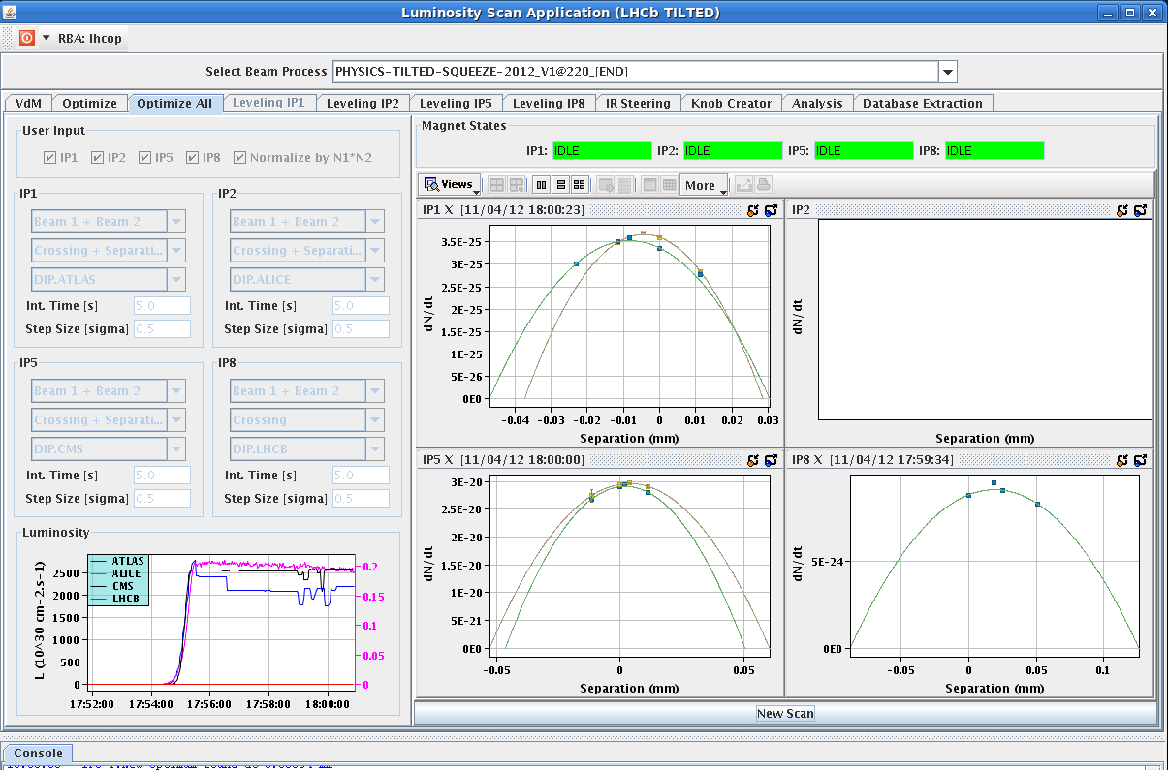
Wed Late
18:00h stable beams
CMS gymnastics:
50um separation in vert plane
Remark OFSU: It is important to check before starting the squeeze that orbit reference list is correct and completed (10 orbits!!!)

Slide 5
Remark OFSU:
Check Orbit references before squeeze
Wed Night
a new SIS interlock has been deployed which is checking that the reference orbit is not zero during the beam mode RAMP and SQUEEZE, andnot in SAFE BEAM.
two tasks have been added in the nominal sequence just after the loading of the reference orbits before the ramp and before the squeeze.
One task (CHECK ref orbit for ramp/squeeze) is reading back from OFSU the list of loaded reference and compare with the contents of the optics table.
it is followed by a pop-up window which ask the operator to perform the same check in the YASP reference orbit panel. In addition, you can check more FESA fields, as explained at the end of the email and in the logbook of Wednesday 11/04/2012 night.In case the check task failed, showing that one reference was not loaded correctly, just repeat the previous task till the check is OK

Slide 6
Remark OFSU: Check Orbit references before squeeze
3. The new SIS interlock is also dumping the beam during RAMP and SQUEEZE mode in case of crash of the OFSU (in this case, the OFSU iscoming back with the actual reference, but losing the next one to beplayed, cannot be recovered so we have to dump).
4. to avoid the crash of the OFSU (probably due to memory leak), it is now advice to restart the host OFSULHC_M on cs-ccr-ofsu during thepreparation for beam (can be done via DIAMON and a sequencer task will come soon)

Slide 7
Wed Night
02:00h Beam Dump: electrical perturbation, FMCM on RD1.LR5 triggered fisrt, then RD1.LR1 and FMCM in pt 3 and 7
03:45h LHC pre-cycled, ready for injection ...
BUT: beam dumped just after injection with extremely large excursion
looks like a injection kicker problem: PFN not charged
access needed to exchange low voltage power supply which tripped when we had the electrical perturbation this morning.
07:05h access finished, LHC pre-cycling

Slide 8
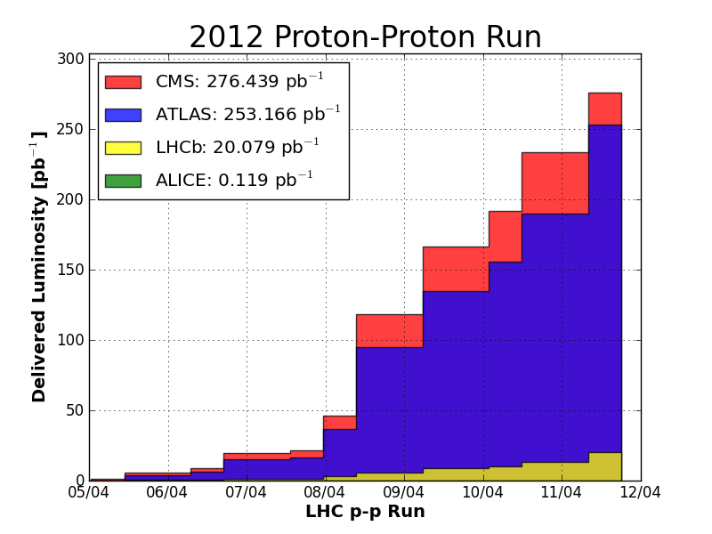
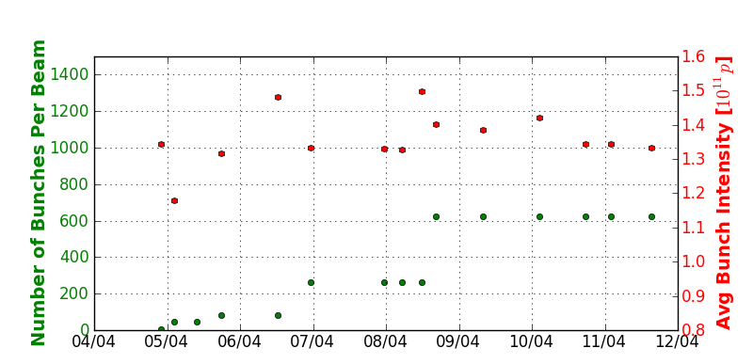
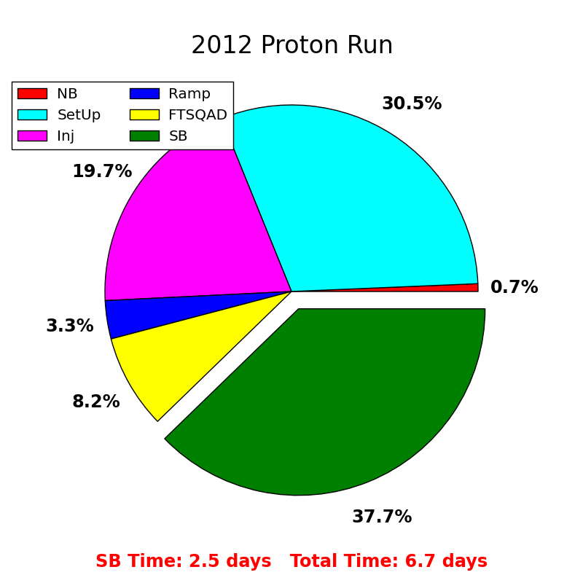
Thu Morning
Lumi-Status: (A. MPh)
on purpose:
little bit reduced bunch intensity
Plan of the day: stable beams with 840 bunches

