Slide 1
Mon 26.03.12
8:00 lost cryo compressor in p2
Problem due to noise picked up by instrumentation, cryo operator knows how to mask it if it comes back.
Accesses:
BPMD, exchange of RCVB25.R4B1, BI for the BSRT
Cable adapters were removed from BPMD cables in IR6 in order to check if the multiple triggers came from reflections generated at their level.
LBDS asynchronous beam dump test (with no beam). Kicker synchronization was OK, but asynchronous with the beam.
Orbit reference changes now in a display of YASP. During the ramp/squeeze the current target orbit is highlighted in yellow.
Tests performed on RD34.LR7, FMCM problem.
11:00 Cryo is back - access ongoing...
trying to sort out the problem with RCD.A34B2. Fixed…
13:00 Machine closed. Pre-cycle.

Slide 2
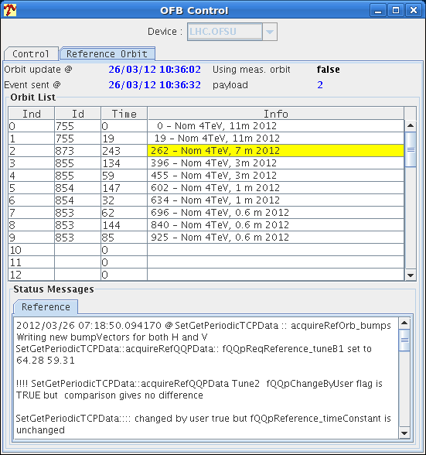
YASP Improved Display Reference Orbit

Slide 3
Mon 26.03.12
14:30 Injecting...
Problems with communication to PCs leading to beam dumps. Loss of energy interlock on SIS. Cleaning up rogue clients solves the problem.
Sequencer:
Added task to switch off the energy feedback in the ramp-down sequence
Added task to disable the RT trims at the start of the collisions sequence.
Deployed new OFC version that includes the feed-forward corrections on the energy trim bump. New functionality not yet enabled/settings remain the same as yesterday. Ralph St.
Investigating orbit- & energy-FB issue, and problem of '0' RT reference glitches on 120 A CODs.
The RT inputs of LSS/DS 120 A CODs seem to jump to exactly 0 at regular intervals. We could not find any arc corrector with this problem.
Understood and fixed: Interference between orbit and tune feedbacks.
Orbit reproducibility now OK! Ready for collimation setup.
Problems with OFSU process crashes

Slide 4
Mon/Tue 26/27.03.12
17:45 Preparing to inject nominal.
18:50 Beam went on the TDI. Erratic trigger just before injection. Called Etienne who will be looking.
LBDS: problem of checking retrigger signal
Summary of injection protection setup
Started with setup of TCDIs in TI 8:
measured center
put them to +/- 5 sigma, trimmed in values and thresholds
checked with injection of nominal and losses were OK
details in entry 8 at 00:37
validation still to be done
Checked TCLIA.4R2 (critical one after ALICE polarity flip last year)
checked only lower jaw angle with 0 and +/-1.5 mrad
found symmetric results - --> no angle to be applied
TCLI centers not checked, TCLIB to be set at 8.3 instead of 6.8 sigma

Slide 5
Mon/Tue 26/27.03.12
Setup of TDIs:
angular alignment, found angles and center for both TDIs
same angles (within meas. accuracy) as last year, applied angles
rechecked with beam based alignment (defined edge with TCP)
found sigma 0.75 for B1 and 0.76 for B2 instead of nominal 0.57 mm
trimmed in settings and thresholds for nominal sigma --> more conservative
injected nominal bunch with losses OK ( bad inj. oscillation for B2)
validation still to be done
Results for TDIs:
left jaw angle [urad] right jaw angle [urad] TDI.B1: +65 -750 TDI.B2: -170 -140
Final settings in mm for TDIs:
LU LD RU RD TDI.B1: 9.14 9.29 -1.54 0.11 TDI.B2: 6.92 7.29 -2.58 -2.27

Slide 6
Tue 27.03.12
Pre-cycle
06:41 – injection probe beam
07:40 – Ramp
08:04 – 4 TeV

Slide 7
Ahead
Tuesday
08:00 -13:00 Pilot (and later nominal) bunch through full cycle (4TeV), collimation expert to manually adjust TCT's to measured orbit shifts, test of fast 4TeV collimation alignment
14:00 - 22:00 TCDQ setup at 450 GeV
23:00 Pilot bunch through full cycle (4 TeV)
Wednesday
05:00 - 20:00 Collimation setup at 4 TeV
21:00 Injection and beam dump work (until Thu 05:00)
Commissioning measurements to be scheduled:
k-modulation with nominal bunch intensity for beta*=0.6m
additional aperture checks at 4 TeV with beta*=0.6m
Loss maps…

