Slide 1
Tuesday 20 March 2012

Slide 2
Tuesday
08:40 Beams in for K-modulation test
To be continued …
09:00 RF phase set-up & blow-up in ramp
9:30-11:30 cavity phasing
11:30 – 13:40 new blow up tests
13:40 SPS EDF intervention → keep beam at 4 TeV
Ramp and squeeze
15:30 Dumped beams. Testing stretched squeeze functions without beam (from 819 to 840 seconds)
Needs to be made longer still
16:01 Beam back in the SPS – prepare machine for injection studies
17:00 – 23:00 injection studies. No beam from PS (POPS problem) for 1h 15min.
23:00 – 7:00 optics during the squeeze
7:45 lost beam during k-modulation (trim too strong)
Test longer squeeze functions

Slide 3
RF Blow-UP tests (P. Baudrenghien)
Good results from Blow-Up tests.
Controlled blow-up beam 1, at 450 GeV, nominal intensity single bunch, target at 1.3 ns (11:50). A bit too fast…
Controlled blow-up beam 2, 450 GeV, nominal intensity single bunch, target 1.3 ns (12:05). Now OK
Controlled blow-up beam 1 (12:22) and beam 2 (12:35), 450 GeV, nominal, target = 1.5 ns. OK
These 4 tests show a nice (1-Exp[-t/tau]) response.
Ramp with pilot (13:10), target at 1.2 ns. We get 1.17 ns both beams. Looks fine. However some length oscillations in the first few minutes. Will try another ramp without modification, then reduce gain.
Follow-Up:
We have left blow-up operational
We will fine tune it using following ramps

Slide 4
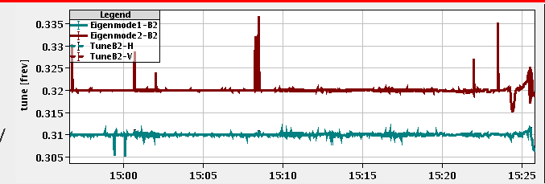
Tune feedback & diagnostics (S. Jackson, R. Steinhagen)
Tune feedback 5 times slower than 2011 proton run (bandwidth was reduced at the end of the ion run): cannot follow fast tune changes
Chirp was not active (ramps on Monday): bad signal to noise ration → solved
“Higher order correction”: Update the BQBBQLHC FESA class This fixes side-effects that were already present last year but became more important with the new 2012 acquisition settings (e.g. going from 8192->1024 turn FFTs). This synchronises/equalise the GUI and FESA based tune estimates and eliminates the 'NaN' indicator seen earlier. The 'NaN' was put in intentionally to indicate an non-conformity of the fitter that was only mitigated now.
Tune variation
squeeze from
0.8 to 0.7m

Slide 5
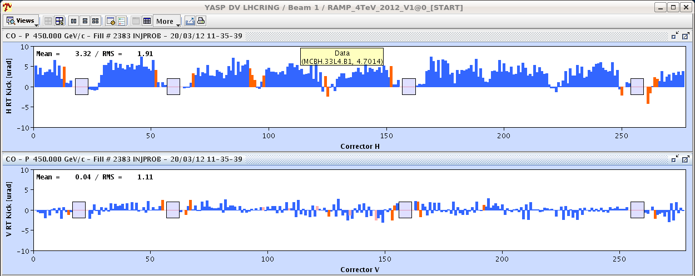
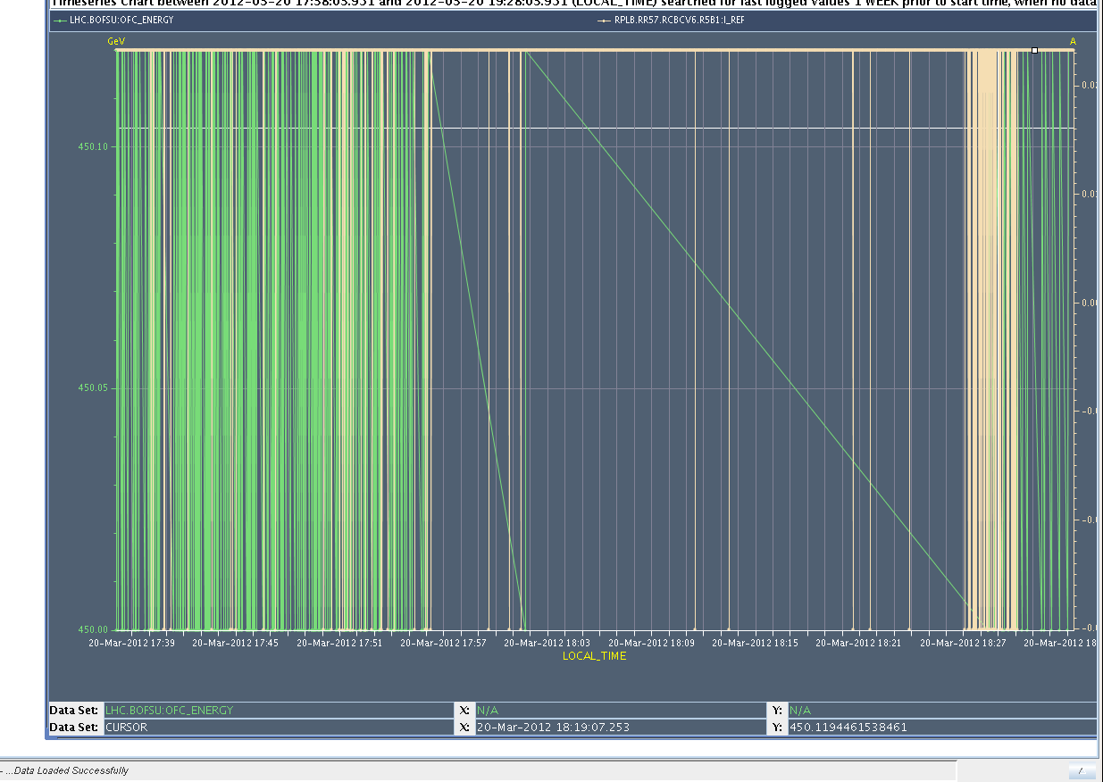
Orbit Feedback (R. Steinhagen & T. Baer)
voltage and current of some orbit correctors switch rapidly between two states, average stays constant → rate limitation on the correctors. Also: amplitude of orbit oscillation is pulsing
“Effect seems to be energy related: Between 17:56 and 18:27 the energy transmission between BBQ fesa front ends and the OFC has been disabled for the continuous systems. This visibly reduces the energy fluctuation (still energy reception from e.g. on-demand systems or schottky) and the rapid I_ref changes of the orbit correctors.
The energy is used for converting the RT kick strengths to corrector currents (also with disabled orbit feedback, in order to maintain the deflections during the ramp). → Will be looked into
Also: drift of tune from OFB RT trims (deltaQ = 0.005 in ~6 minutes) (effect known from last year) → mitigated by energy feedback (to be commissioned)

Slide 6
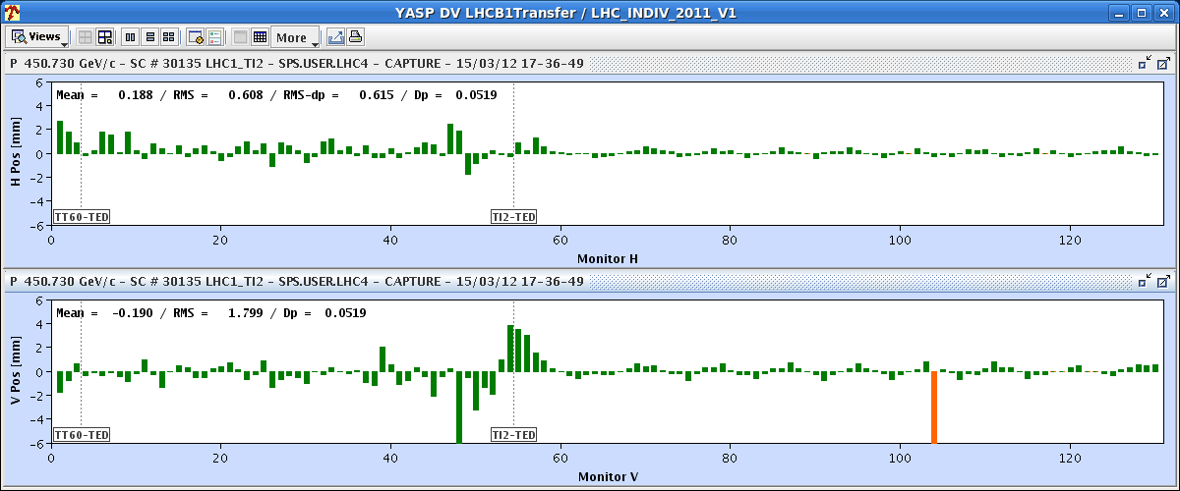
Tuesday evening – injection set-up
Aim: investigation on the origin of the vertical bump at the end of TI2 in
Scan of MKI delay and voltage: The settings of the MKI (delay and strength) were already optimized
Can not get rid of the bump without creating injection oscillations
But there is enough aperture available in the line → We can establish this year's reference with the bumps in.
No losses observed with a bump up to 18 mm (~11sigma)
Still unclear the origin of the bump (not there last year): roll angle of the MSI (vertical kick)? Realignment after layout change during TS? → To be investigated
LHC
TI2

Slide 7
Tuesday night – optics corrections during squeeze
Chromaticity, coupling, Beta-beat , dispersion measurements and corrections at 4 TeV during the squeeze.
Beta-beating down to 10-20% after local correction
Beta-beating down to 5% after global correction
Dispersion beat in horizontal reduced

Slide 8
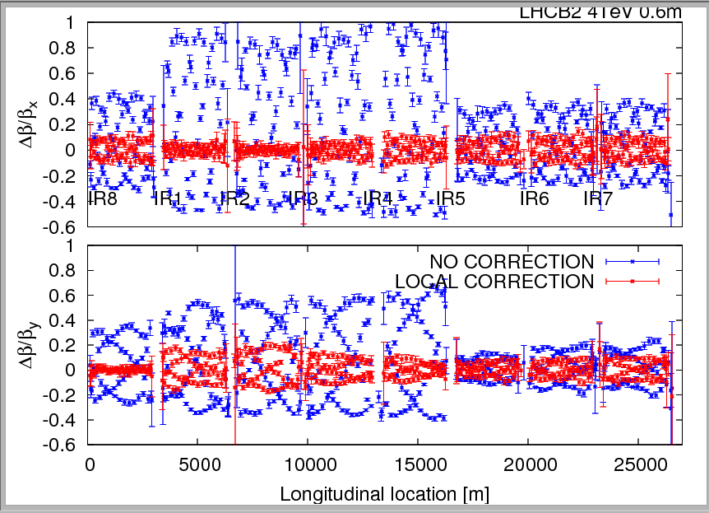
Beam 2 beta-beating at 0.6m after local correction

Slide 9
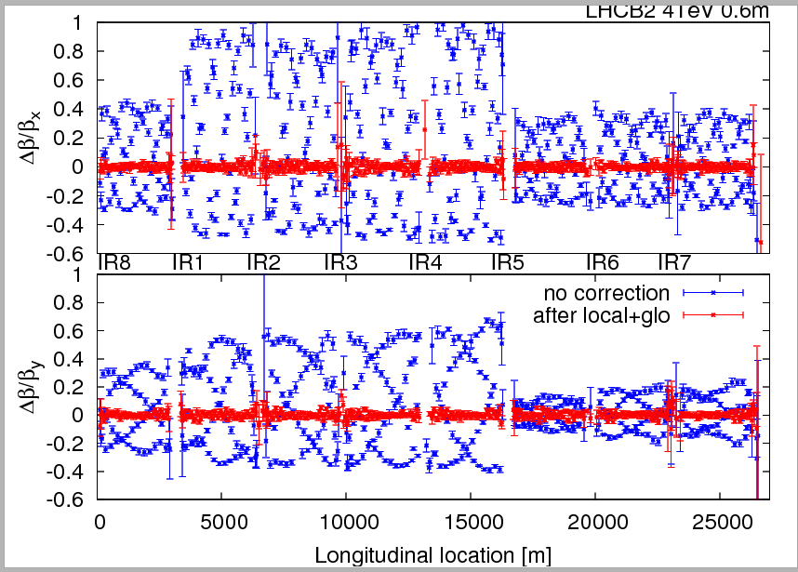
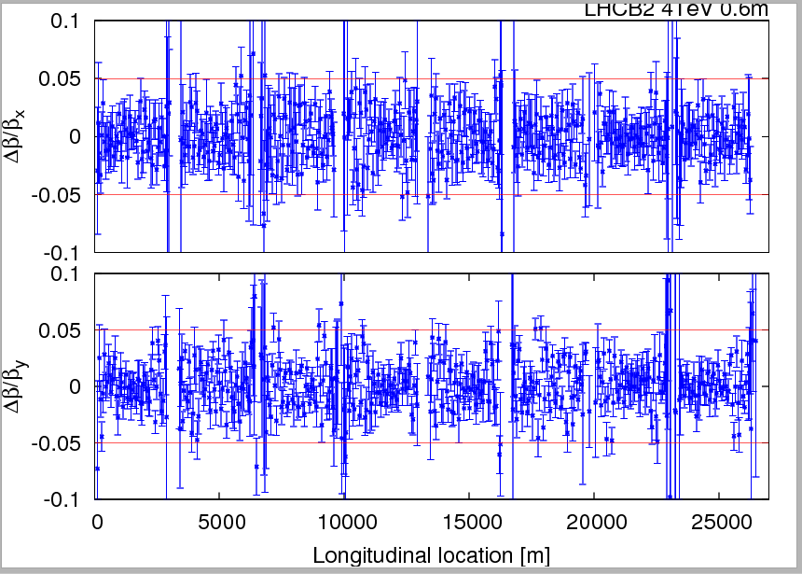
Beam 2 beta-beating at 0.6m after global correction

Slide 10
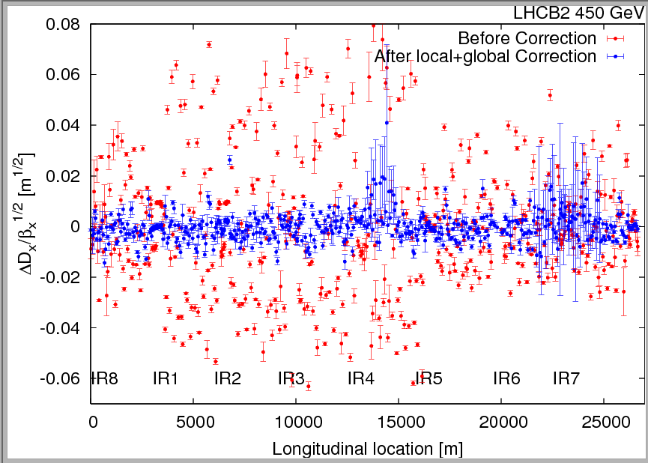
Beam 2 dispersion error (normalized) after global correction

Slide 11
Plan
Wednesday
30’ test longer squeeze functions without beam – machine stays at 4 TeV after beam dump
9:00 – 23:00 Collimation at 450 GeV
Night: Squeeze to 0.6 m corrected (longer squeeze function and correct orbit with pilot, possibly beam physics processes)
Thursday
Morning: injection line collimation setting-up + checks
5 to 10 splashes for ATLAS (Thursday or Friday)

Slide 12
Access requests
LHCb 1 hour
Atlas 2 hours
CMS 2 hours
BPMS point 6 1 hour (?)
FMCM RD34.LR7 1 hour
Suspected electrical problem on a fire detection unit in UX85. Access required at the next occasion
RF UX45 1 hour
BIS
PC piquet: RQX.R2 and UA.87
BPMSW.1L1.B1 and B2
Diamond BLM UA87
HT monitor cable extension 6R4
Collimator LVDT position sensor IP3
BCTFRA UA47
Please fill in IMPACT!

Slide 13
To be sorted out
SBF glitches: Use 1 second (or more?) moving average DCBCT data transmitted at 10Hz to the SMP system or increase SBF limit…
FGC adapting the functions when they cannot be played
TCTVA.L2 out at injection as it shadows TDI
Polarity of BPMSW.1L5.B1/2 – V plane
Squeeze length
BCTFR needs frequent reboot → solved?
BPMD (dump line BPMs) for B1 shows often many bunches in the machine (50+), even when there is only one in the machine
orbit feedback switched off in H both beams during the step to 2m. When checking the reference, found plan H at zero both beams

